Slide 1
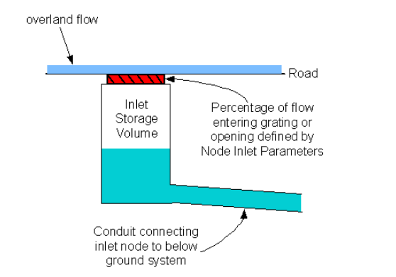
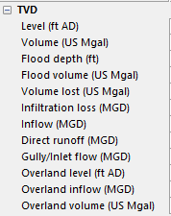
Free flow into underground pipe
Gully/Inlet Rim
According to the help,
For a manhole, flood depth = Level - Flood Level
However, for inlet nodes.
Flood depth = overland level – ground level

Slide 2
Overflow out of underground pipe
Simulated level for the node
will be above the rim
H = (level – rim) – “Flood depth”

Slide 3
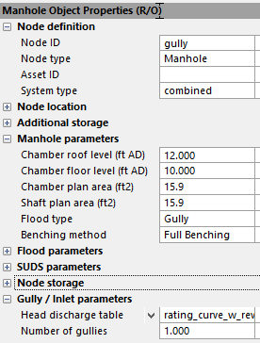
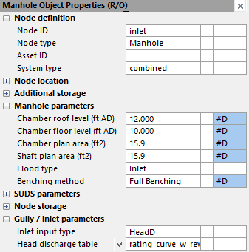
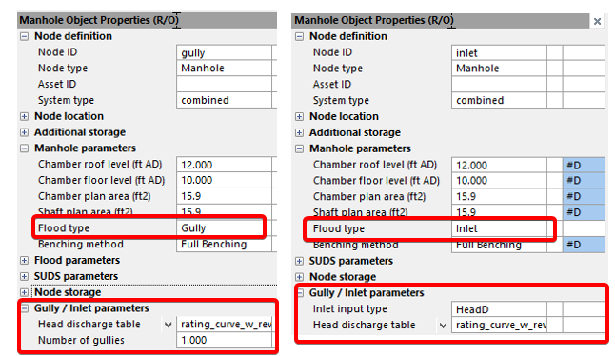

Slide 4
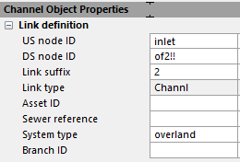
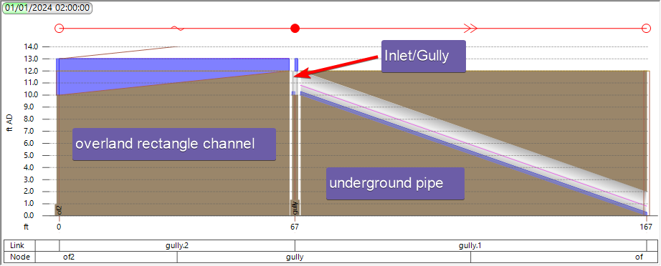

Slide 5
