Slide 1
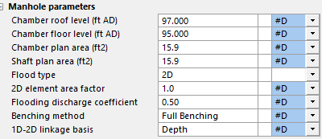
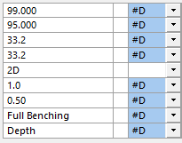
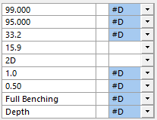
mh24
mh48
mh48_shaft16

Slide 2
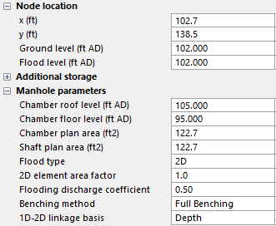
Shaft
Chamber
Default values:
Chamber diameter = pipe diameter (m) + 0.762m
Chamber roof = Pipe crown
Chamber floor = Pipe invert
Shaft area = Chamber area
Shaft
Chamber

