Slide 1
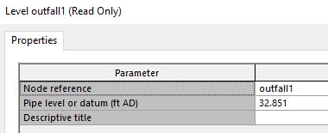
Level Depth:
1 ft (Above Datum=32.85)
Level Elevation:
33.85 ft (AD)
Pipe Invert:
32.85 ft (AD)

Slide 2
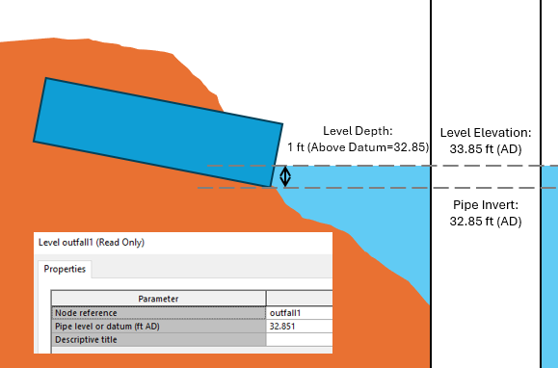

Slide 3
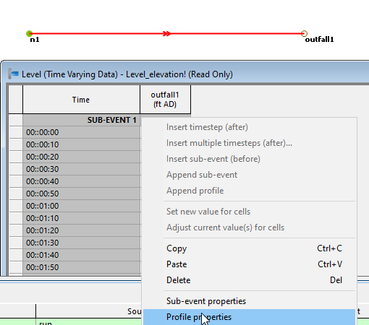
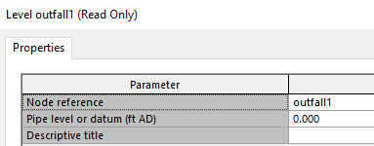

Slide 4
