Slide 1
Participation in Weak Lensing Uncertainty Challenge
(ML Course Fall 2025 Project)
Mikhail Kuvakin, Melvyn Kui
Notes:
Our project is participation in the Weak Lensing Uncertainty Challenge conducted by FAIR Universe. Although neither of us hold degree in astrophysics, it doesn’t mean that we can’t apply machine learning in this field.

Slide 2
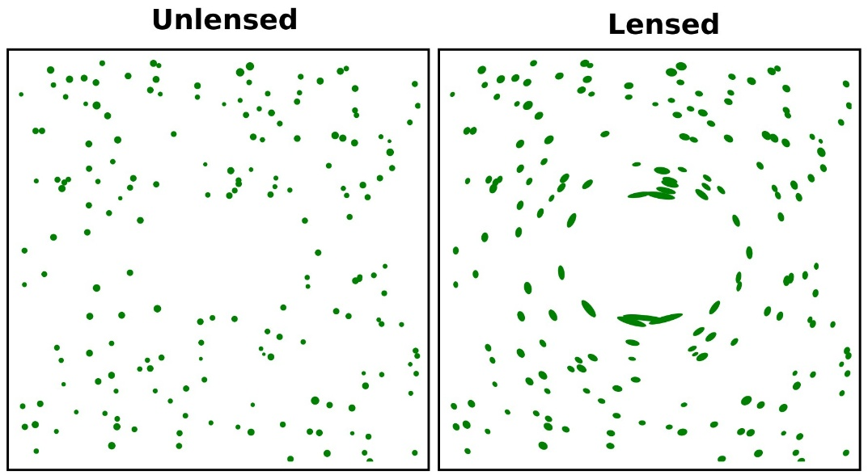
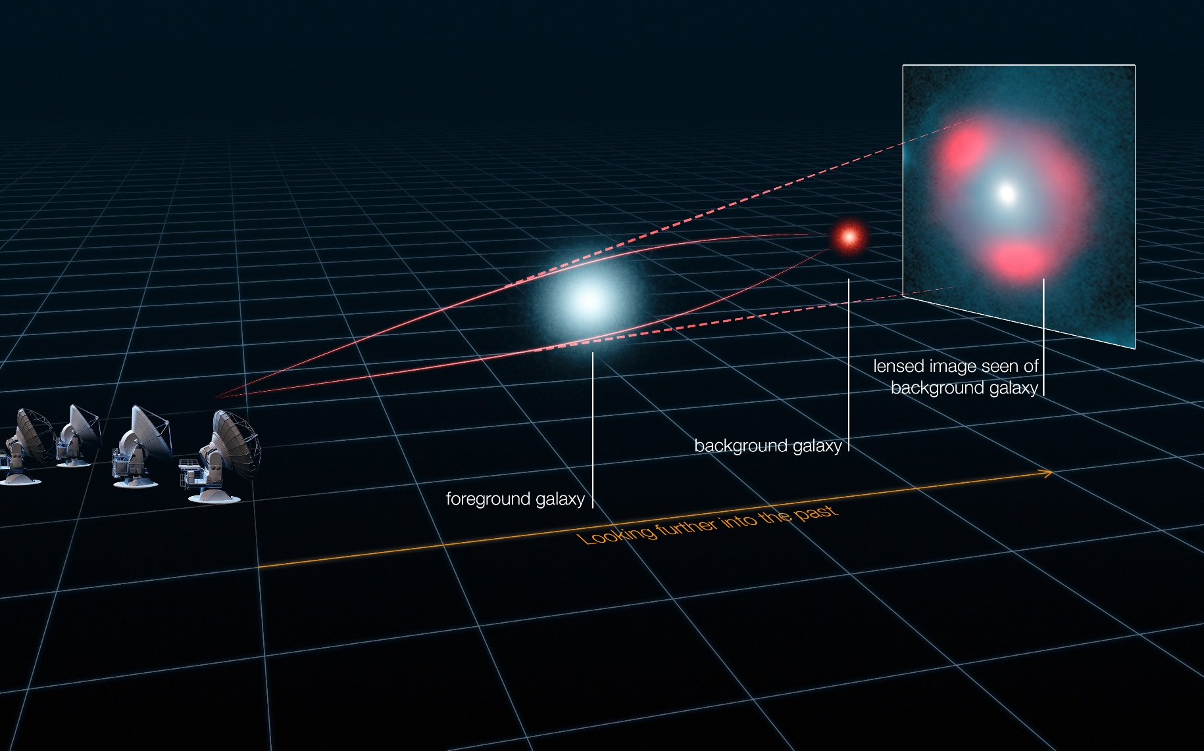
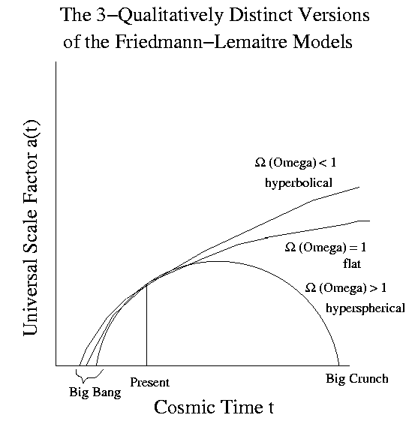
Motivation
Weak gravitational lensing:
Gravitational lensing:
Notes:
Basically gravitational lensing is a distortion of light path by massive objects, that are located between observer and an object of interest. As a result the form and position of the cosmic object are quite different for the observer (see left picture – initially red spherical object appears to an observer as a red light ring, such rings are also called Einstein rings).
Meanwhile weak gravitational lensing is the same effect but on a smaller scale, which reveals in slight distortions in the shapes of distant background galaxies (see right picture – circles appear to an observer as ellipses).
Studying these distortions allows researchers to probe how matter is distributed in the Universe and to better understand the model that governs its expansion.

Slide 3
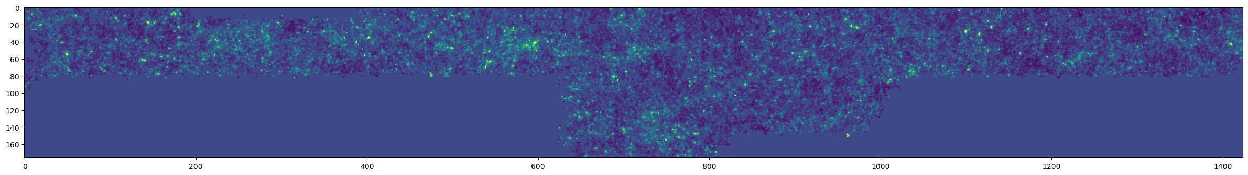
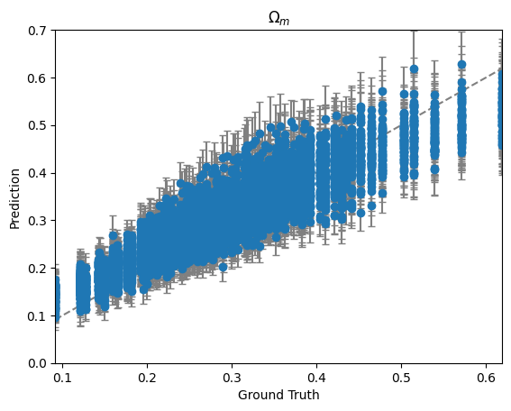
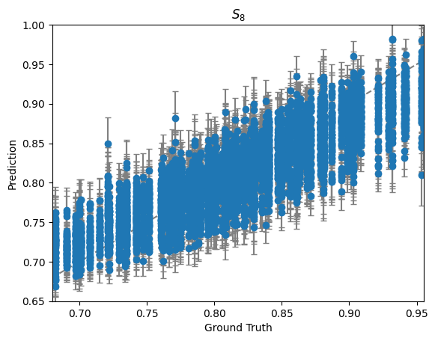
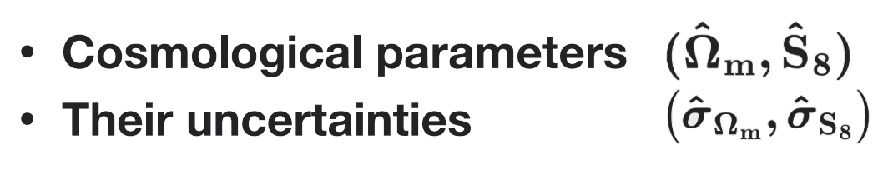
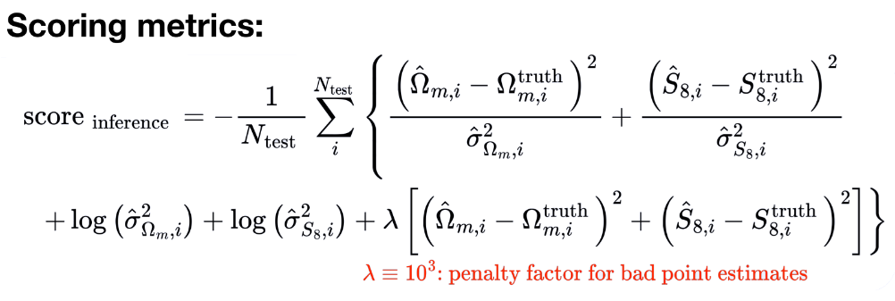
Problem
Input:
intensity map (1274×176)
Output:
Notes:
The task is to use weak-lensing map of size 1274×176 to predict two scalar cosmological parameters:
Ωm - fraction of the matter energy density in the Universe;
S8 - amplitude of matter fluctuations.
Because the maps contain noise, the model must also provide an uncertainty (one-standard-deviation) estimation for each parameter: σΩm, σS8. Charts on the right part show how the predictions usually look like.
There are 25856 sample maps available with given labels, so we can say that this is basically supervised-learning task.

Slide 4
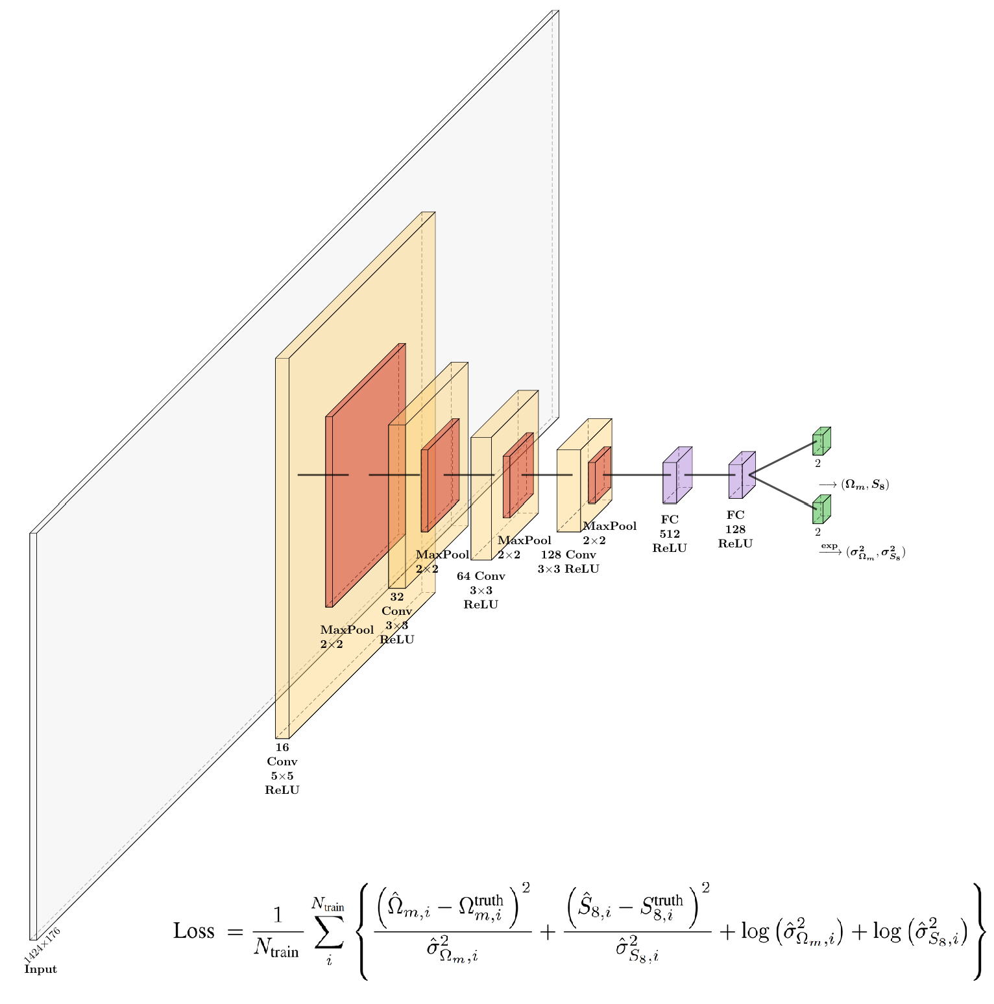
Baseline Method
Notes:
Competition organizers provide baseline (starter-kit), which employs CNN to solve this problem. The exact architecture is provided on theright part of the slide. To evaluate the results the scoring metric is used.
So basically we need to use this architecture as a reference and come up with something more suitable for this case to make the scoring metric higher (closer to 0) as a result.

Slide 5
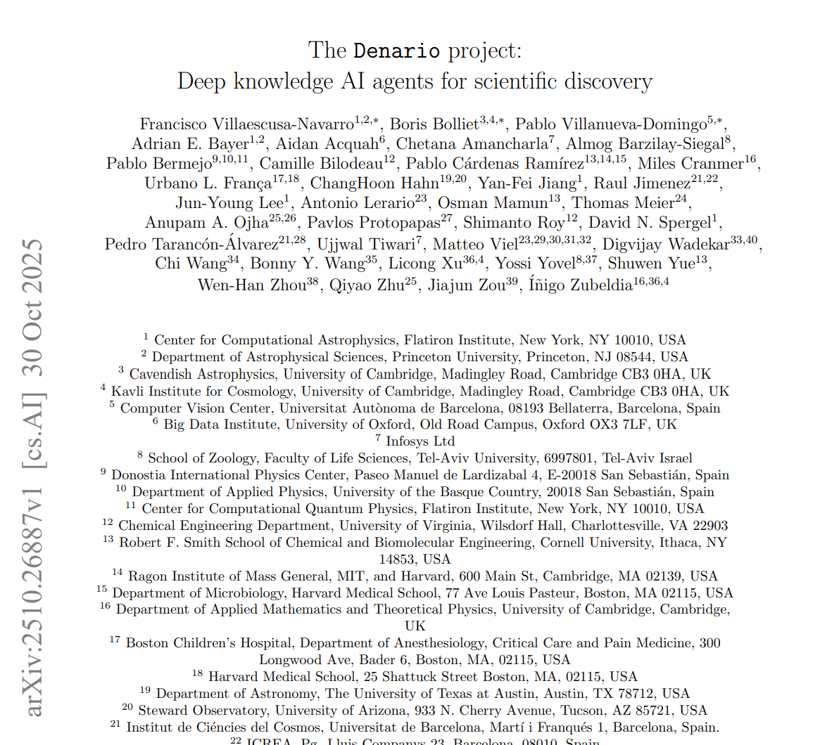
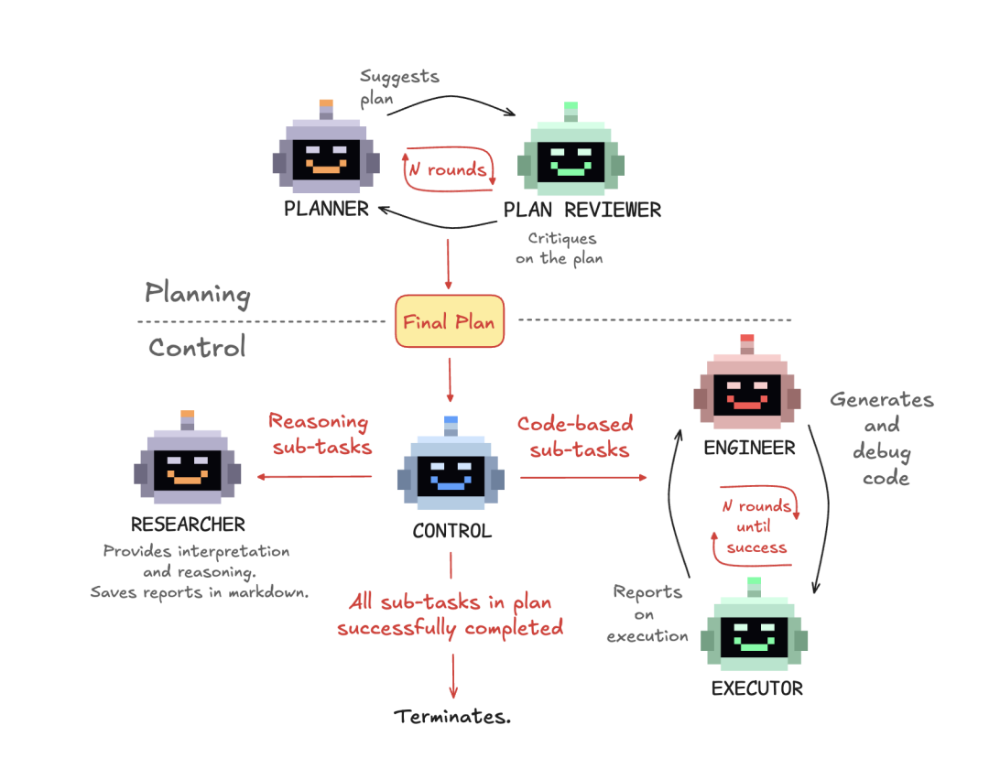
Solution by Denario
Notes:
Denario paper introduced recently after we started our project it is presented as an independant multiagentic system which serves scientific researcher
It is presented as capable of acting in fields as astrophysics so it was natural to try to compare its performance
Reason interested because aim to see its perf

Slide 6
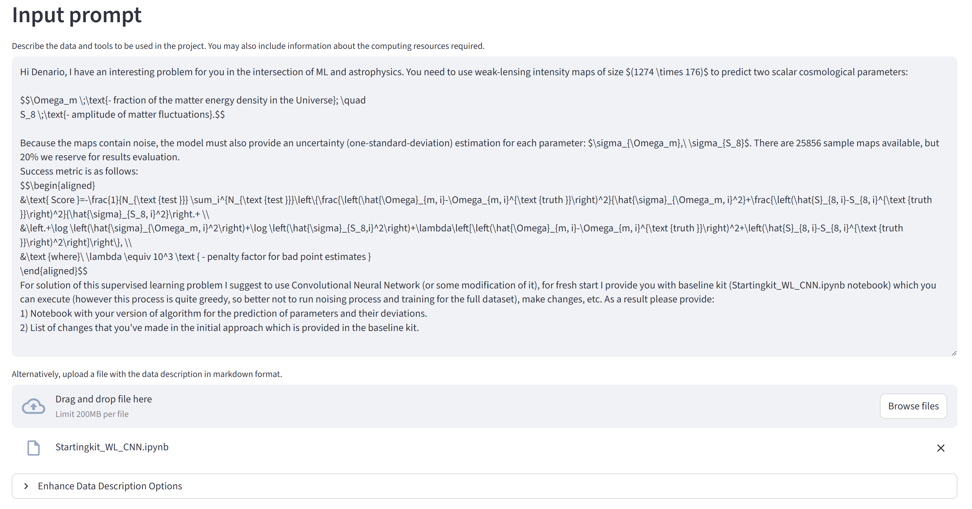
Solution by Denario
To solve our problem Denario:
Acted absolutely independently
Used multiple GPT-5 models for research and engineering
Had access to data and coding environment
Spend more that 1 hour and 4.43$ to produce the solution
Notes:
We gave Denario a prompt describing the task, the baseline model and a small sample dataset of weak lensing maps
What kinf of change it brought

Slide 7
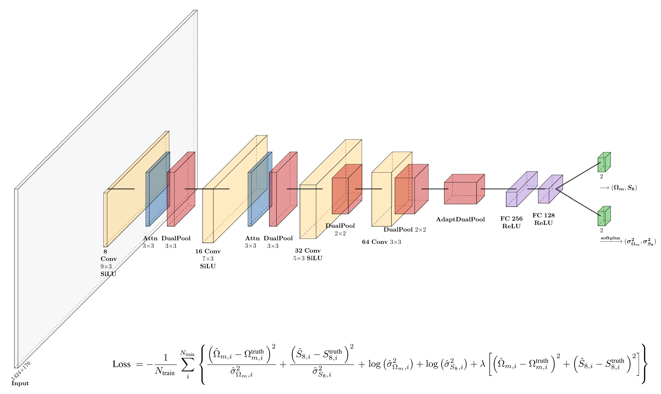
Ours Method

Slide 8
Key improvements
Parameter Reduction:
Initial model was far too large (>14M parameters for 20K samples), creating a major overfitting risk. With adaptive pooling bottleneck between convolutional part and regressor head, we compressed the feature map and slashed parameters to ~2M, dramatically improving generalization.
Anisotropic Filtering and Feature Extraction:
We designed three custom enhancements for the unique specifics of our weak-lensing maps: Rectangular Kernels to efficiently process the unusual aspect ratio; Dual Pooling to capture both sharp peaks and background texture; and a Spatial Attention module to actively focus on informative regions and suppress noise.
Activation Functions:
Updated activation functions for better training: SiLU activation in the convolutions tends to give better performance for CNNs, Softplus for uncertainty estimation provides more stable and accurate predictions for small values.
Objective Function Alignment:
Instead of using a loss that only partially resembled the final score, we reformulated it to be exactly same as our target evaluation metric, ensuring the model is trained to directly optimize for the metric we care about.

Slide 9
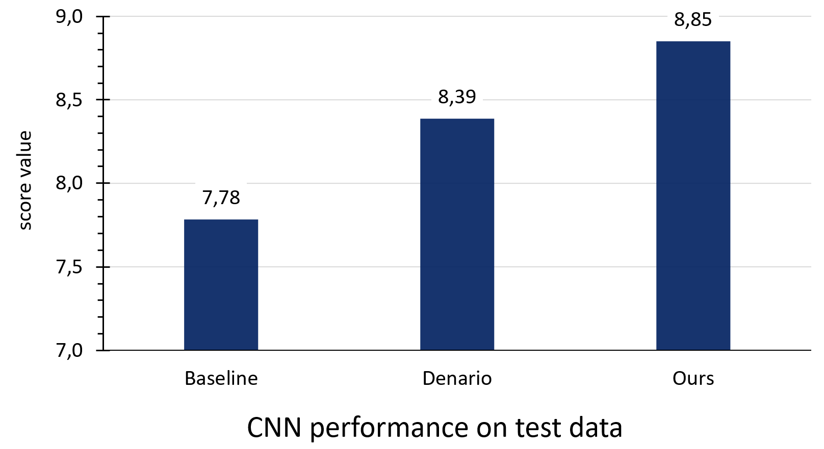
Results

Slide 10
Questions?
Weak Lensing Uncertainty Challenge: https://www.codabench.org/competitions/8934
Denario paper: arxiv.org/abs/2510.26887
Denario demo deployment: huggingface.co/spaces/astropilot-ai/Denario
Our project github: github.com/mel6502/NeurIPS-2025-Weak-Lensing-Uncertainty-Challenge

