Slide 1

E-commerce Product Recommendation System using Machine Learning

Slide 2


What is a recommendation system?
A system that creates a similarity mapping between the user and items and exploits the similarity between user/item to make recommendations.
we are building similarity-based recommendation systems using `cosine` similarity and using KNN to find similar users which are the nearest neighbor to the given user. - We will be using a new library, called `surprise`, to build the remaining models.

Slide 3

Objectives:
Personalized Recommendations: Create a system to recommend products based on customer preferences.
Increase Customer Satisfaction: Improve satisfaction with relevant and timely recommendations.
Extract Insights: Analyze review data to uncover trends and inform business strategies

Slide 4
What can it Solve ?
It can help the user to find the right product.
It can increase the user engagement. For example, there's 40% more click on the google news due to recommendation.
It helps the item providers to deliver the items to the right user. In Amazon , 35 % products get sold due to recommendation.
It helps to make the contents more personalized. In Netflix most of the rented movies are from recommendations.

Slide 5
Types of Recommenders
Popularity Based
Clustering Models Based
Content Similarity Based
Collaborative Filtering.
We will use this project to analyze our data set .

Slide 6
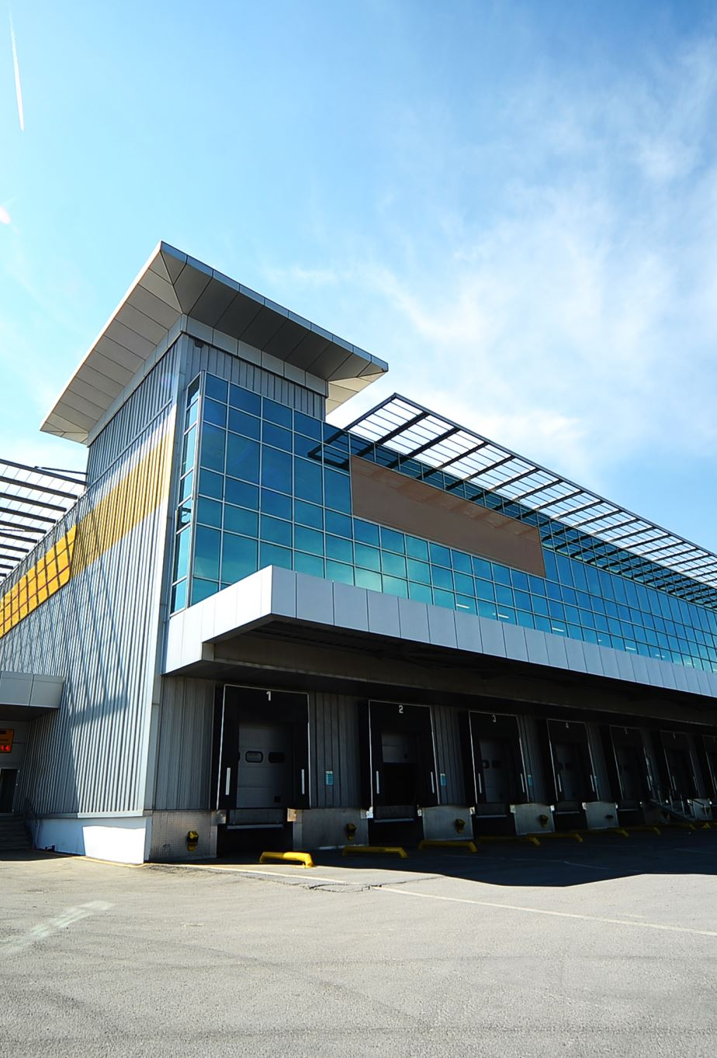
Dataset Description-Amazon

Slide 7
Amazon Electronics Dataset ​
Has 4 attributes ​
7824482 entries​
Total number of unique Users : 4201696 ​
Total number of unique Products : 476002

Slide 8
Exploratory Data Analysis

Slide 9
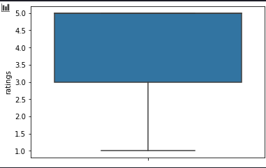
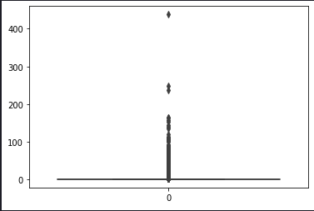
Boxplot of Ratings showing that most of the ratings lie between 3.0 and 5.0
Boxplot of per user rating count showing there are few users who rate many items but majority rate very few items

Slide 10
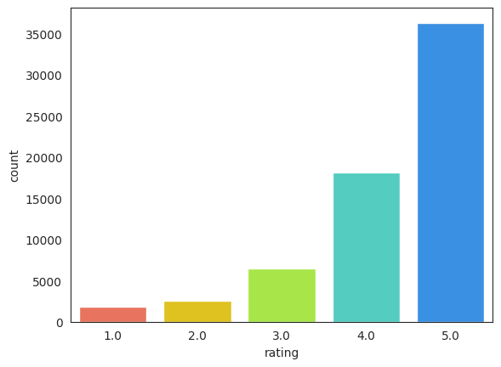
user_id
ADLVFFE4VBT8 | 295
A3OXHLG6DIBRW8 | 230
A1ODOGXEYECQQ8 | 217
A36K2N527TXXJN | 212
A25C2M3QF9G7OQ | 203
A680RUE1FDO8B | 196
A22CW0ZHY3NJH8 | 193
A1UQBFCERIP7VJ | 193
AWPODHOB4GFWL | 184
A3LGT6UZL99IW1 | 179
Checking the rating distribution
Users with the most number of ratings

Slide 11
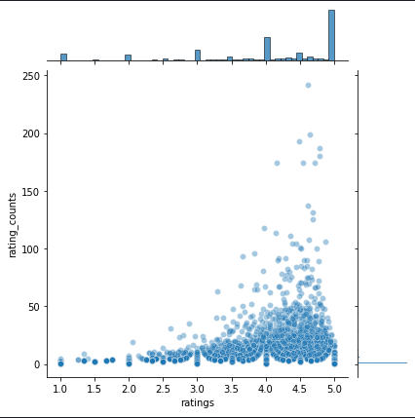
Jointplot showing that popular products ( higher ratings) tend to be rated more frequently, majority have rated products in the higher range.

Slide 12
Model Building & Evaluation

Slide 13
Building the user-user similarity-Based recommendation
Result found
RMSE: 1.0012 Precision: 0.855 Recall: 0.858 F_1 score: 0.856

Slide 14
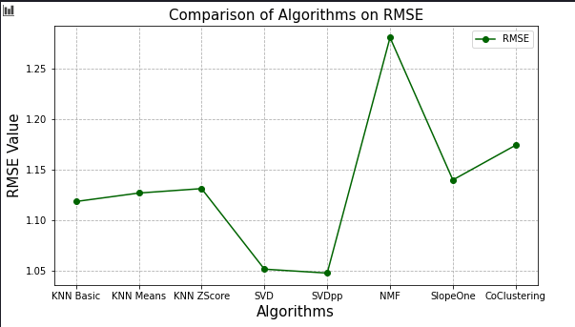
Root Mean Square Error (RMSE)
RMSE is the square root of the average of the squared differences between the predicted and actual value
Mean Absolute Error (MAE)
MAE is the average of the absolute differences between the predicted and actual values
Interpreting RMSE and MAE
Lower values of RMSE and MAE indicate better predictive performance.
RMSE penalizes larger errors more than MAE because the errors are squared before averaging. This makes RMSE more sensitive to outliers.
MAE is more robust to outliers since it considers the absolute difference
Result found
In terms of RMSE, SVD and SVDpp performs best and they both yield very close results

Slide 15

KNN and collaborative filtering

Slide 16




Some results from the model
Predicting the rating for
`userId=A34BZM6S9L7QI4`
and
`prod_id=1400501466`.
user: A3LDPF5FMB782Z item: 1400501466 r_ui = 5.00 est = 3.40 {'actual_k': 5, 'was_impossible': False}
Prediction(uid='A3LDPF5FMB782Z', iid='1400501466', r_ui=5, est=3.4, details={'actual_k': 5, 'was_impossible': False})
`['A2ZR3YTMEEIIZ4', 'A3CLWR1UUZT6TG', 'A5JLAU2ARJ0BO', ... 'A215WH6RUDUCMP', 'A38C12950IM24P', 'A2J4XMWKR8PPD0']`

Slide 17
Observations

Slide 18
The model estimated a rating of 4.24 for `userId=A34BZM6S9L7QI4` and `prod_id=1400501466`, while the actual user rating was 5. This indicates that the model slightly underestimated the user's rating. The prediction was successful (`was_impossible=False`), meaning the model was able to generate a rating estimate for this user-item interaction.
Prediction Details:
-User ID:A34BZM6S9L7QI4
- Product ID: 1400501466
- Actual Rating (r_ui):5.00
- Estimated Rating (est): 4.24
- Details:*{'was_impossible': False}

Slide 19
The model achieved an RMSE of 0.9950, indicating an average prediction error close to 1. It also attained a precision of 0.838 and a recall of 0.845, resulting in an F1 score of 0.841. This reflects a balanced performance in predicting ratings and recommending relevant items, with some room for improvement in overall accuracy.

Slide 20
In conclusion, all recommendation systems demonstrated reasonable predictive ability, but none were clearly superior to rely on exclusively.

Slide 21

Thank You!

