Slide 1
Team 6
CoverPageAddedID
logoRBCCM1
Capital Markets
0
Leveraging Machine Learning in Algorithmic Trading
Team Members:
Alan Temiryaev
Edward Foote
Melaku Melaku
Tom Banerjee

Slide 2
Overview
Executive Summary
Project Description
In this project we will be implementing a simple machine learning trading algorithm that utilizes traditional market signals to recommend Buy/Sell ratings for a particular stock
While there was some thought given to using internal financial ratios determine future price trends we eventually settled on using broader technical indicators as we felt the former would be too industry specific
The market signals we settled on were:
SMA (“Simple Moving Average”): Calculates a historical average of prices during a specific time period
The SMA can be enhanced by assigning higher weightings to more recent price action (EMA)
MACD (“Moving Average Convergence Divergence”): Evaluates the differential in two moving averages of a security’s price to recommend Buy/Sell ratings
RSI (“Relative Strength Indicator”): Measures the magnitude of recent price changes on a scale of 0 to 100
Since the signals we were modelling will be fairly generic the Team felt a well diversified enterprise with a long track record operating in a strongly regulated industry would provide the best analytical setting to judge the algorithm’s utility
To that end, the stock we decided to evaluate to test our algorithm was JP Morgan Chase & Co. (“JPM”)
“JPMorgan Chase & Co. is an American multinational investment bank and financial services holding company headquartered in New York City. JPMorgan Chase is incorporated in Delaware. As of June 30, 2021, JPMorgan Chase is the largest bank in the United States and the fifth-largest bank in the world in terms of total assets, with total assets of US$3.684 trillion. As a "Bulge Bracket" bank, it is a major provider of various investment banking and financial services. As of 2021 it is the largest lender to the fossil fuel industry in the world. It is one of America's Big Four banks, along with Bank of America, Citigroup, and Wells Fargo. JPMorgan Chase is considered to be a universal bank and a custodian bank. The J.P. Morgan brand is used by the investment banking, asset management, private banking, private wealth management, and treasury services divisions. Fiduciary activity within private banking and private wealth management is done under the aegis of JPMorgan Chase Bank, N.A.—the actual trustee. The Chase brand is used for credit card services in the United States and Canada, the bank's retail banking activities in the United States, and commercial banking.
“

Slide 3
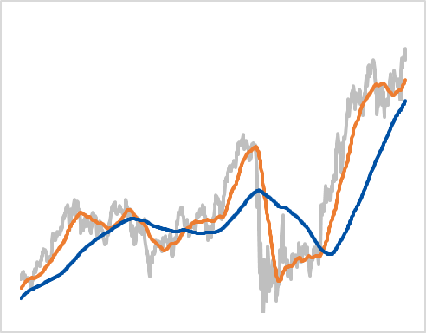
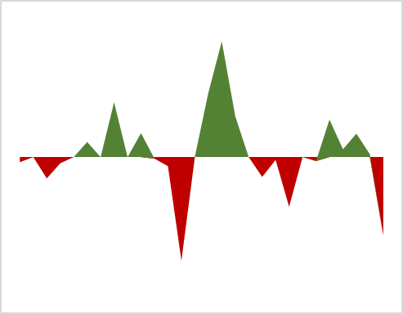
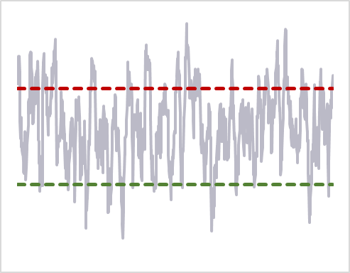
More about Signals
Technical Indicators
Simple Moving Average (“SMA”)
Moving Average Conv./Divergence (“MACD”)
Relative Strength Indicator (“RSI”)
The SMA calculates the average of a selected range of prices over a particular time period
This is meant to smooth out volatility and make it easier to view the price trend of a security
Two popular trading patterns that use SMA leverages the 50 day and 200 day moving average
When the 50 day SMA crosses below the 200 day SMA a bearish signal is triggered
Conversely when the 50 day SMA crosses above the 200 day SMA a bullish signal is triggered
The MACD leverages exponential moving average (“EMA”) and shows the relationship between a long term and short tem moving average
The EMA is a variation of the SMA which assigns higher weightings to recent price action
Specifically MACD takes the difference between the 12 period EMA and 26 Period EMA and is frequently plotted against a signal line
A positive MACD value signals bullish momentum while a negative MACD value signals bearish momentum
The RSI measures price change in relation to recent highs and lows
The RSI is calculated by averaging price gains and losses over a default time period of 14 periods and is range bound between 0 and 100
An asset is considered overbought when the RSI is above 70% and oversold when it is below 30%
Underlying Stock Price
12 Day EMA -26 Day EMA>0 indicates bullish momentum
Underlying Stock Performance
50 day SMA
200 day SMA
Buy Signal
RSI Normalized between 0 to 100
Sell Signal (RSI over 70)l
Sell Signal
12 Day EMA -26 Day EMA<0 indicates bearish momentum
Buy Signal (RSI under 30)
LONG TERM SIGNAL
SHORT TERM SIGNAL
INTERMEDIATE TERM SIGNAL

Slide 4
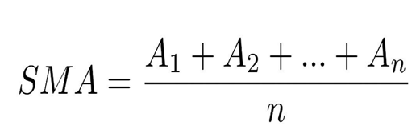
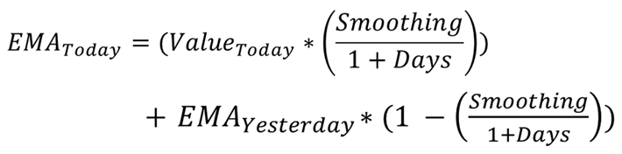
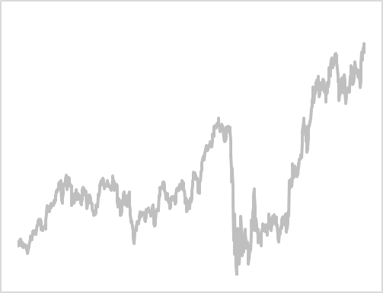
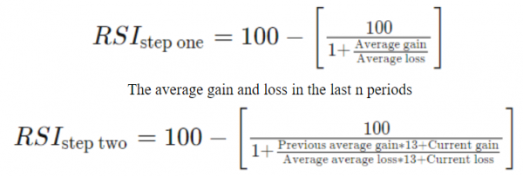
Calculations
Math behind Technical Indicators
SMA
200 Day SMA Average of last 200 days of prices
50 Day SMA Average of Last 50 Days of prices
Today
Where N is the number of periods and A is the price over each of those periods
MACD
26 Day EMA Average of last 200 days of prices
12 Day EMA EMA of Last 14 Days
Today
Smoothing corresponding to weighting. We assumed a value of 2
MACD is the difference between 12 day EMA and 26 day EMA
RSI
Historical Price Performance
Normalized RSI Plot
NORMALIZED TO:

Slide 5
Project Timeline and Considerations
Considerations
Program Outline
Testing vs Training Data
There was some discussion on how to dissemble JPM historical data into training and testing datasets
Our initial thought was to split price data from 2016 to the middle of 2018 into the training dataset and the remainder into the testing dataset
However due to the distortions associated with the pandemic we decided to split the two datasets using alternate days
Selection of Signals
In selecting signals we were split between programming financial ratios for individual tickers or broader technical indicators
While financial ratios definitely have strong predictive capability we felt these ratios are industry specific
For example ratios that are relevant for the retail sector are dramatically different from ratios that are important for the banking sector or the technology sector
Consequently we made a decision to evaluate technical signals
Training Data
Evaluate predictive capability of signals
Isolate Signals with strong predictive capability
Testing Data
Incorporate strong signals into testing data
Provide Buy/Sell recommendations
Timeline
1
2
3
Import and clean historical stock performance
Split historical Dataset into Training and Testing
Research and Finalize Trading Signals
Program Trading Signals
Incorporate Training dataset results into Testing
In Class Presenting
Incorporate Enhancements
JPM Price Performance
Datasets
Signals
Evaluation
Next Steps
5 year historical data was retrieved using Yahoo Finance
JPM historical data was split into two to evaluate accuracy of signals
MACD, SMA and RSI were chosen as signals
Signals were evaluated to determine predictive ability and results were fed into the second dataset
Allow for multiple stock tickers
Accommodate Monte Carlo simulation

Slide 6
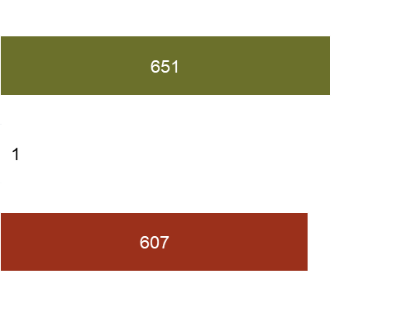
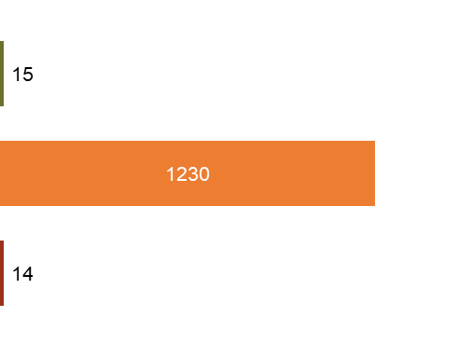
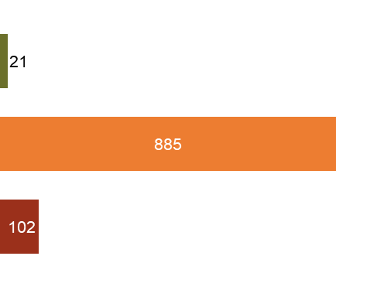
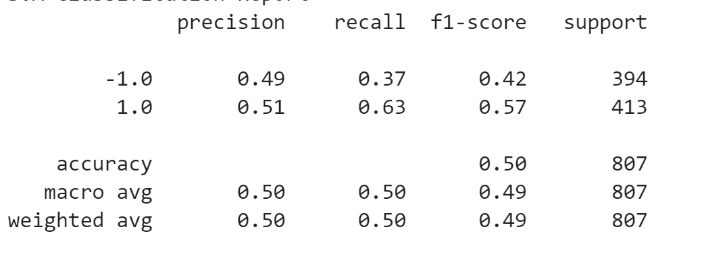
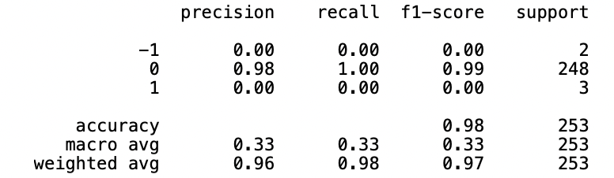
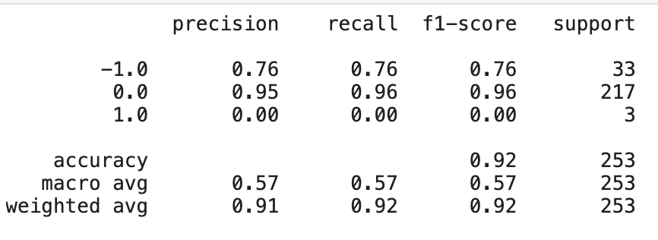
Results
Signals
SMA Signals
MCAD Signals
RSI Signals
Buy
Hold
Sell
Classification Reports
Output
Output

