Slide 1
Source Data
This is a preliminary analysis of traffic crash data made available at
https://opendata-nzta.opendata.arcgis.com/datasets/crash-analysis-system-cas-data-1.
The dataset examined here was obtained from the csv download "Crash_Analysis_System_(CAS)_data.csv"
This was used in conjunction with the field descriptions at
https://opendata-nzta.opendata.arcgis.com/pages/cas-data-field-descriptions
In addition, population counts by region from the 2018 Census were sourced from
https://www.stats.govt.nz/tools/2018-census-place-summaries.

Slide 2
Goals
Discern some basic characteristics of crash metrics in the dataset.
This suggested the folowing more specific topics
Assess whether regional crash counts are broadly proportionate to regional population.
That seemed a natural question when seeing this for the first time
Concentrated on Region, but could be more granular
Determine the dataset features that are most important in distinguishing between injury crashes and non-injury crashes.
We include region as a predictor
More granular categories cab be used

Slide 3
Methods and tools
Tools in a Jupyter Notebook in local PC
python with pandas / sklearn and other common libraries
Git for retention / versioning of code and outputs
Methods
Basic stats analysis of columns and data prep
Straightforward joins and manipulation coupled with simple visualizations
Machine Learning approach for assessing feature importances

Slide 4
Basic data stats
Tools in a Jupyter Notebook in local PC
python with pandas / sklearn and other common libraries
Git for retention / versioning of code and outputs
Methods
Basic stats analysis of columns and data prep
Straightforward joins and manipulation coupled with simple visualizations
Machine Learning approach for assessing feature importances

Slide 5
Basic column metrics

Slide 6
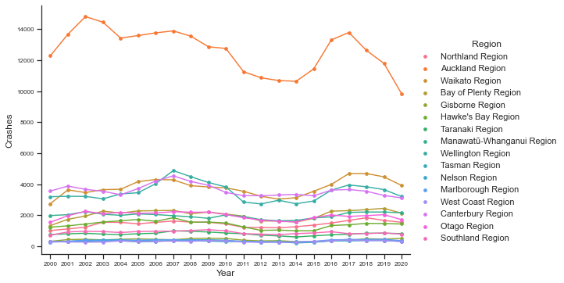
Crash counts per year by region
Not that obvious from the graph, but there was a particularly noticeable dip in 2020. Covid, at least partly?

Slide 7
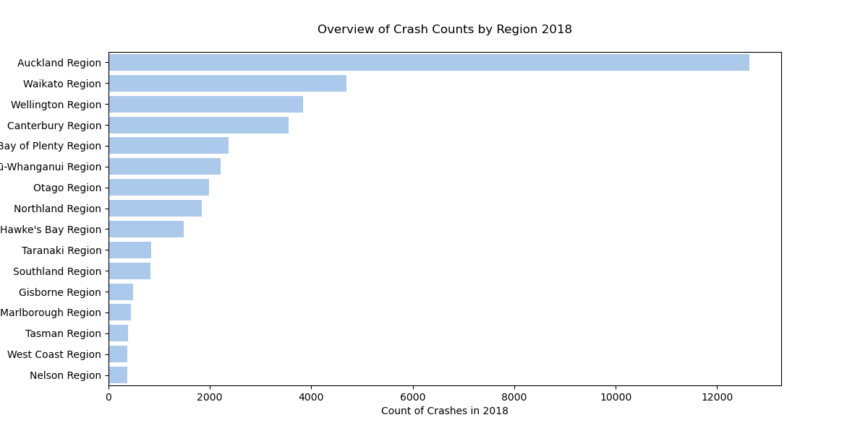
Crash counts by region 2018
Why 2018? Because we had ready population figures by region. Could repeat for all years in set.
Is crash count proportional to regional population?

Slide 8
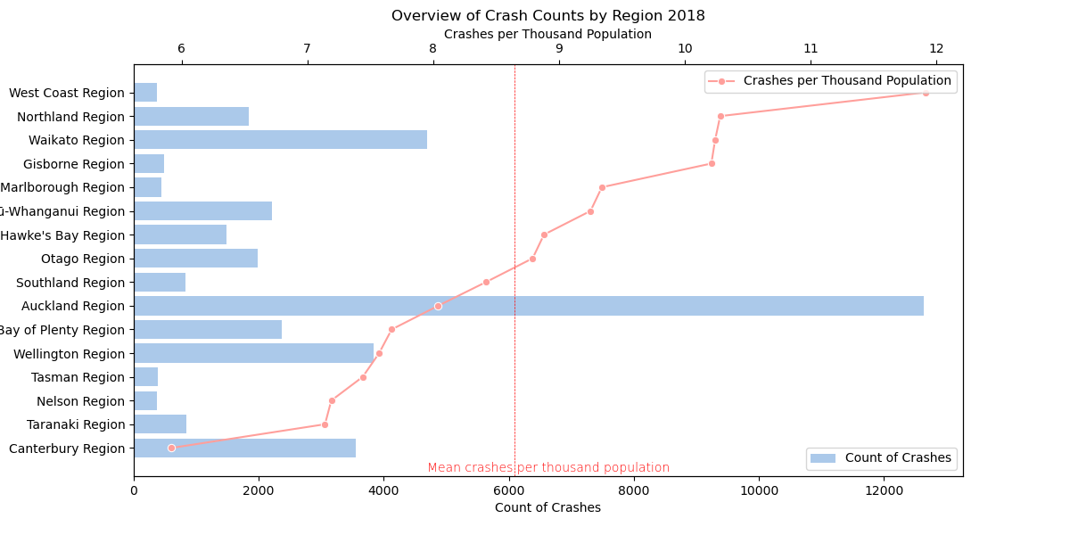
Crash counts compared to population by region 2018
This changes the picture.
Though the rates may be sensitive to small numerators / denominators

Slide 9
..continued
Speculations:
Tourists disproportionately represented in regions most dependent on tourism?
Longer average trips raise the likelihood of crashes?
Rural / urban split, either nationwide or in specific regions?
Terrain? e.g. Canterbury has a lot of flat terrain and straight roads.
Further investigation possibilities:
Analyze the frequencies of occurrence of other dataset parameters, and compare regions..
Check localized clustering. Do "black spots" dominate the statistics in certain regions?
Check down to Area Units? However, these values have not remained static over the lifetime of this dataset, and have been replaced (since 2018) by SA2s.

Slide 10
Can we find a model to relate crash variables to Crash Severity?
The purpose is to see which features, if any, are most important in determining crash severity.
Quite a few categorical variables – require one-hot-encoding.
Region is not high cardinality – AU / TA / meshblock are.
Here only Region was used as an areal feature, but this could be done, with some appropriate grouping?
Used an ML classification model.
It’s not really about prediction – it’s about determining feature importances, i.e. which of the chosen variables explain the likelihood that injuries occur.
To predict fatal crashes, or "fatal and serious" crashes would be a quite unbalanced predictive problem. Let's adopt a more balanced derived binary outcome - Minor, Serious, and Fatal crashes taken together as one outcome, and Non-Injury crashes as the other.
We are treating crashSeverity as a labelled outcome.
Some of the predictors are explicitly used to obtain the crashSeverity outcomes: "This is determined by the worst injury sustained in the crash at time of entry."
Creating a new derived 'injuryStatus' outcome as follows yields a more balanced outcome set.

Slide 11
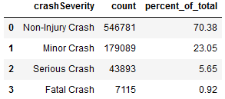

Improving balance

Slide 12
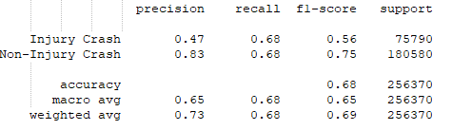
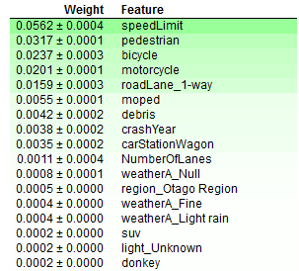
Results
Permutation feature importances
Used a Random Forest Classifier. The model is not great, but not too horrible. Could be tweaked to improve minority class precision at the expense of recall by modified undersampling / oversampling.
Plausible that many factors that determine injury are not in the dataset.
Possible extension: user single decision tree classifier and extract division rules to get more insight.

Slide 13
Production & Deployment Considerations (1)
Consider in general, since these outputs would not be productionized☺
Driving requirements
Legal / regulatory /internal to do with content
e.g. privacy, anonymization of aggregated data, licensing
Form, frequency, accuracy, timeliness of outputs
Platform architecture & support
Service Level Agreements?
Technical performance and manageability
Processes & standards

Slide 14
Production & Deployment Considerations (2)
Data
Legal / regulatory /internal to do with content
e.g. privacy, anonymization of aggregated data, licensing
Form, frequency, accuracy, timeliness of outputs
Platform architecture & support
Service Level Agreements?
Technical performance and manageability
Processes & standards

Slide 15
Production & Deployment Considerations (3)
Processes
Dependency chain management
Frequency of ingestion and output production
Archive, backup & restore
Process logging / debugging and recovery
Data & Model drift detection / updating
Model repository?
Versioning
Platform migration
CICD?

Slide 16
Production & Deployment Considerations (4)
Software
Open source / proprietary
Languages
Code reuse / patterns
Operational model
Devops?
Skillsets
External partner interactions
Statistical / scientific rigour
Reviews, checks

