Slide 1
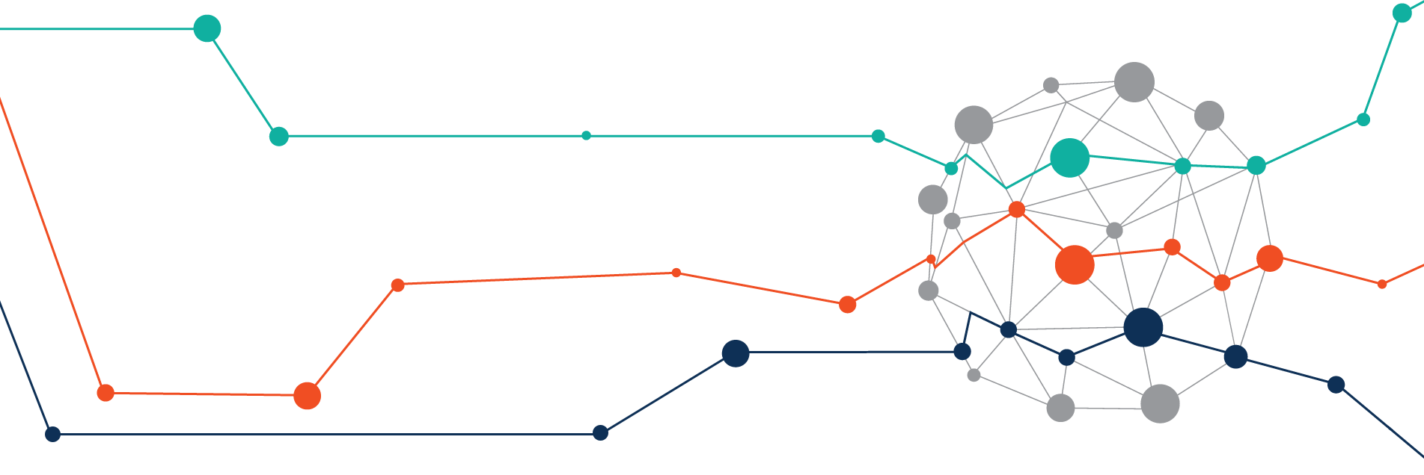
Introduction to GraphDB
The art ontology

Slide 2
Information about the KB
The knowledge base contains information about:
artists,
their works (paintings and sculptures),
museums.
There is also additional information about:
the location of each museum,
when and where the individual works were created,
the names and birthplaces of the artists.

Slide 3
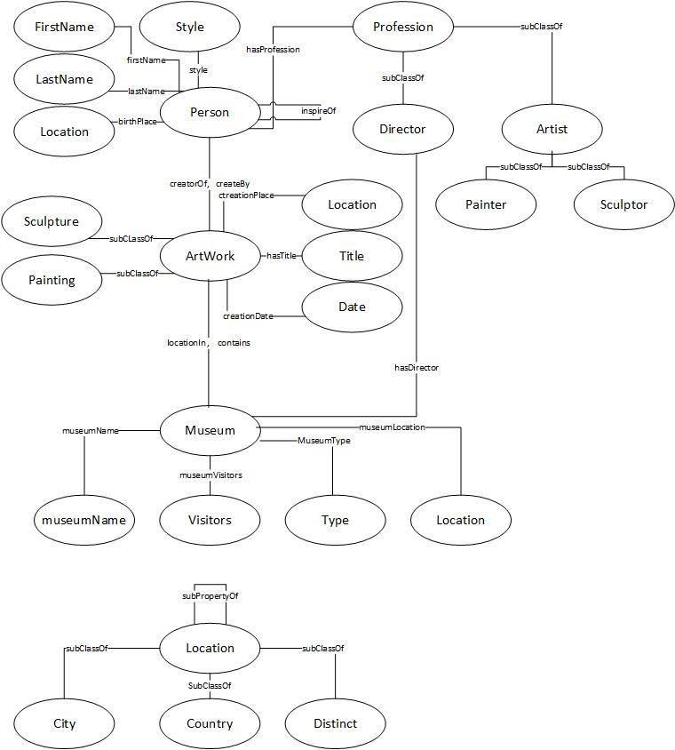

Slide 4
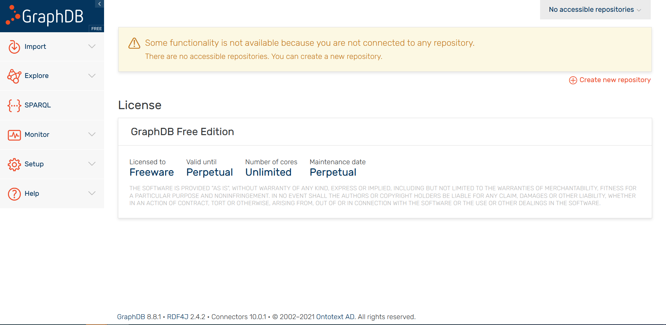
2. Creating a repository in GraphDB
For the realization of this project, we use GraphDB Free. After installation and launch of the product, its graphical view opens in the default browser.

Slide 5
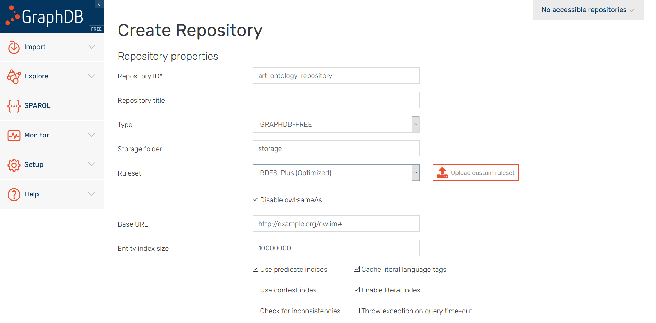
We select "Create new repository". We choose the name of the repository, select the reasoning rules to be OWL-Horst (Optimized), and click the “Create” button in the end.

Slide 6
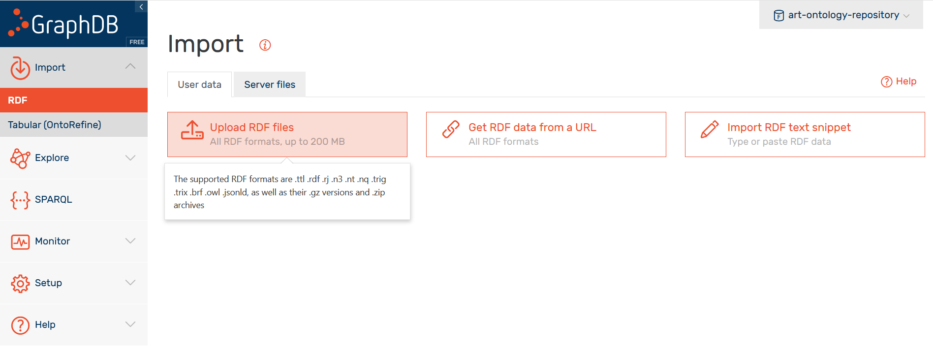
To upload the required file to the repository, we select the menu Import -> RDF -> Upload RDF files:
We select to upload the required file and click the “Import” button for the file. Select the Base URI to be http://www.art-ontology.com/fmi#, and we again select “Import”.

Slide 7
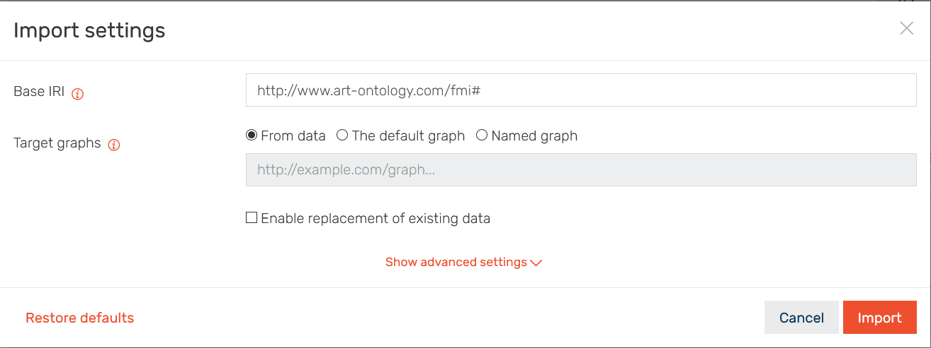
If everything is all right, we will see the following:

Slide 8
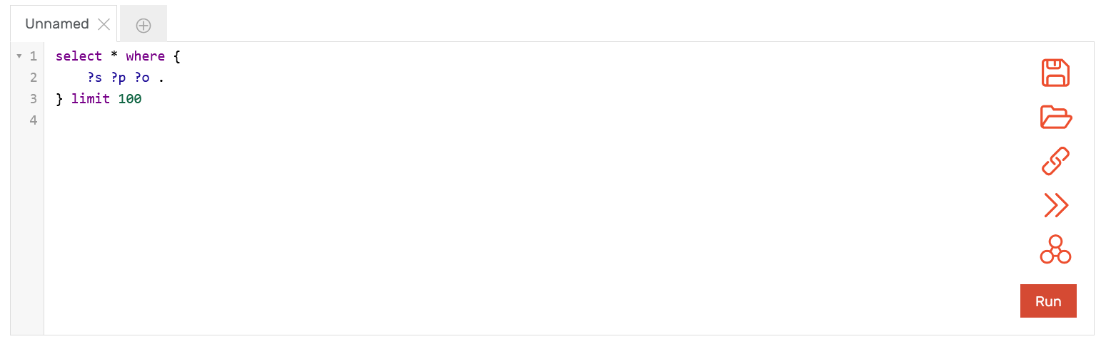
3. Queries
In GraphDB we write queries after we select “SPARQL” form the menu.

Slide 9
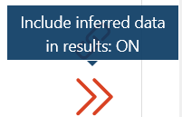

The request is written in the specified window. It is possible to specify whether reasoning should be used in its implementation based on a logical conclusion on the knowledge and data from the ontology or not.
If not, the result of the execution of the application will be based only on the knowledge and the data, that are included explicitly in the ontology.
If two arrows are visible in the right bar of the window, this means that the reasoning option is on.
if only one arrow is visible, this is an indication that the execution of the query does not include the results of reasoning.

Slide 10
3.1. Queries without reasoning
Only information that is explicit in the ontology is searched.
Example: All paintings by Italian artists in the High Renaissance style, located in the Louvre:
PREFIX rdf: <http://www.w3.org/1999/02/22-rdf-syntax-ns#>
PREFIX art: <http://www.art-ontology.com/fmi#>
select ?person ?artWork where{
?person art:hasProfession art:Painter;
art:style ?style .
filter( str(?style) = "High Renaissance" ).
?person art:birthPlace ?loc.
?loc art:locationName ?locname . filter( str(?locname) = "Italy" ).
?person art:creatorOf ?artWork.
?artWork rdf:type art:Painting;
art:locationIn ?museum.
?museum art:museumName ?mname. filter( str(?mname) = "Louvre" ).
}

Slide 11
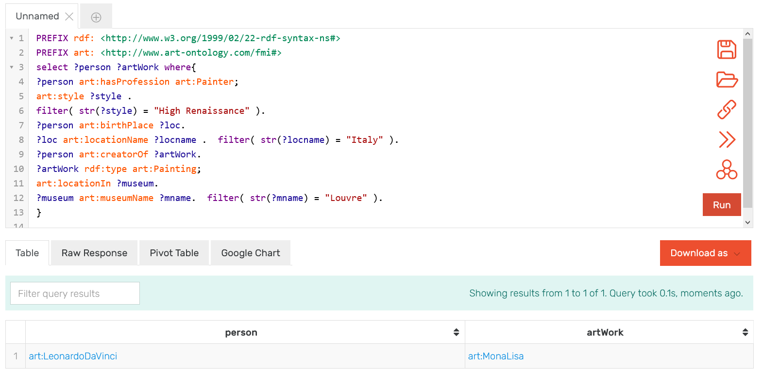
The artists and their paintings are shown as a result. The requirements are: the style is High Renaissance, the person has a profession painter and is born in Italy; the artwork he created is created a is a painting, and that painting is in the Louvre.
In the ontology there is only one pair that meets the requirements, and it is art: LeonardoDaVinci - art: MonaLisa.

Slide 12
2. Queries with reasoning
We search for information, gathered with reasoning on the ontology.
Example: All paintings, created by Leonardo Da Vinci in Italy:
PREFIX rdf: <http://www.w3.org/1999/02/22-rdf-syntax-ns#>
PREFIX art: <http://www.art-ontology.com/fmi#>
select ?artWork where{
?person art:firstName ?fname;
art:lastName ?sname; art:hasProfession art:Painter; art:creatorOf ?artWork.
filter( str(?fname) = "Leonardo" ). filter( str(?sname) = "Da Vinci").
?artWork rdf:type art:Painting;
art:creationPlace ?loc.
?loc art:locationName ?crlocname; art:subRegionOf art:Italy.
}

Slide 13
When the request is executed without reasoning, the result is the picture art:LadyWithAnErmine, which is directly set to be created in Milan (direct subRegionOf Italy).
If reasoning is enabled, two results are obtained: LadyWithAnErmine and TheLastSupper. The second is derived from reasoning, as according to the data in the database ,TheLastSupper is painted in SanVittore, which is a subRegionOf Milan, which is a subRegionOf Italy. In the ontology, the subRegionOf property is defined as transitive.

Slide 14
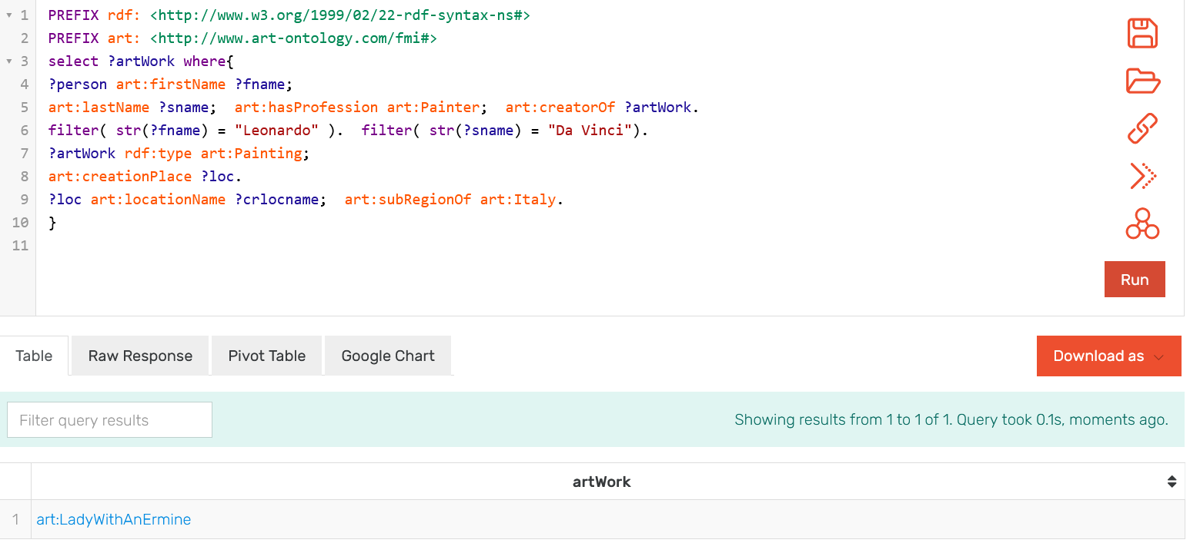
Result without reasoning:

Slide 15
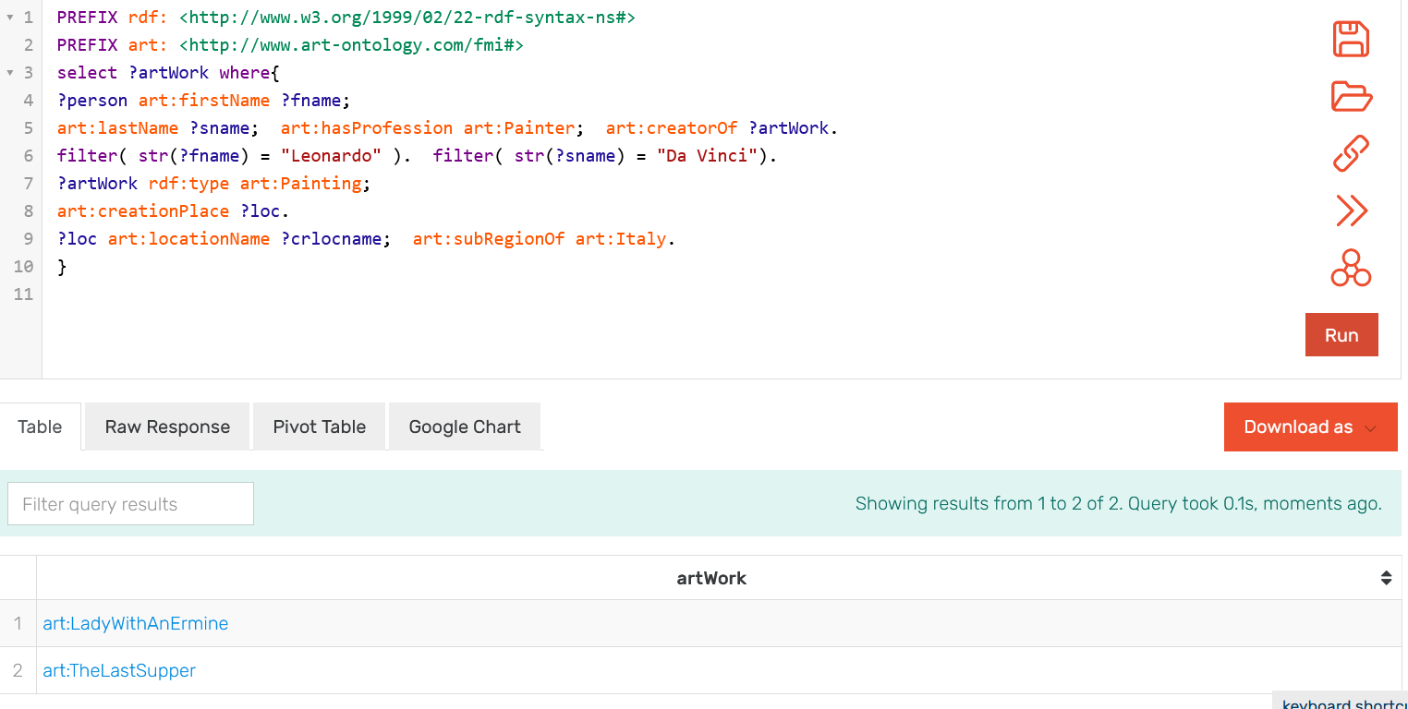
Result with reasoning:

Slide 16
Maybe one more example?

Slide 17
Questions?

Slide 18
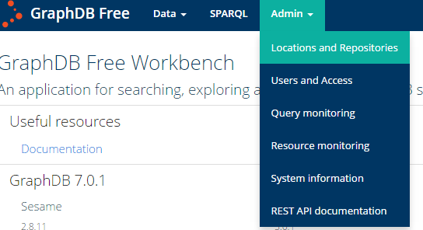
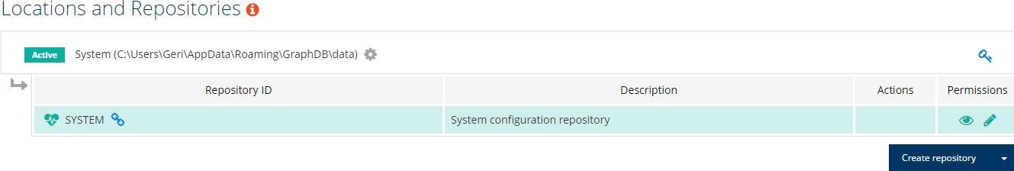
From the Admin menu, we chose Location and Repositories:
This opens the page with the current repositories. In the beginning, there is only one system repository:

