Slide 1
Introduction to Graph Databases
Knowledge bases course
Master program of AI
Sofia University, Bulgaria

Slide 2


About me
Melania Berbatova
Master of AI’2020
Freelance data scientist and
Previously – ML engineer @Sciant
and @ReceiptBank
Email me: melania.berbatova@gmail.com
GitHub: http://github.com/melaniab

Slide 3
About you?

Slide 4
From previous semester
What is an ontology?
What is OWL?
What is RDF?

Slide 5
Agenda
Trends in Data
NOSQL
What is a Graph?
What is a Graph Database?
What is GraphDB?

Slide 6

Data is more Semi-Structured:
If you tried to collect all the data of every movie ever made, how would you model it?
Actors, Characters, Locations, Dates, Costs, Ratings, Showings, Ticket Sales, etc.

Slide 7
NOSQL
Not Only SQL

Slide 8
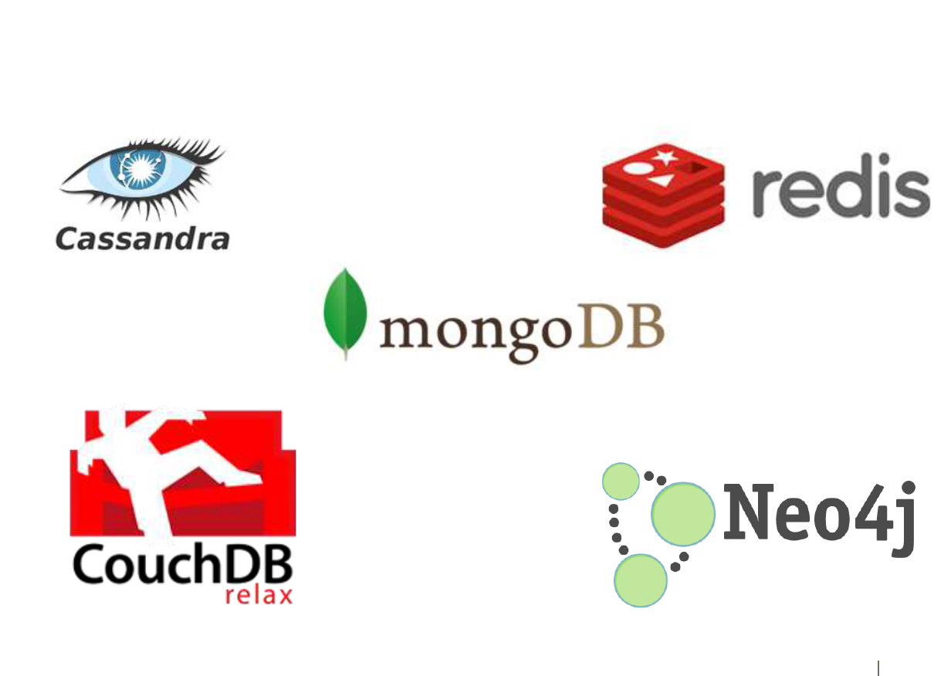
NoSQL

Slide 9
Key Value Stores: Pros and Cons
Pros:
Simple data model
Scalable
Cons
- Poor for complex data

Slide 10
Column Family: Pros and Cons
Pros:
Supports Simi-Structured Data
Naturally Indexed (columns)
Scalable
Cons
Poor for interconnected data

Slide 11
Document Databases
Data Model:
A collection of documents
A document is a key value collection
Index-centric, lots of map-reduce
Examples:
– CouchDB, MongoDB

Slide 12
Document Databases: Pros and Cons
Pros:
Simple, powerful data model
Scalable
Cons
Poor for interconnected data
Query model limited to keys and indexes
Map reduce for larger queries

Slide 13
Graph Databases
Data Model:
– Nodes and Relationships
Examples:
– Neo4j, OrientDB, GraphDB

Slide 14
Graph Databases: Pros and Cons
Pros:
Powerful data model
Connected data locally indexed
Easy to query
Cons
Requires rewiring your brain

Slide 15







Living in a NOSQL World
GRraDpBhMS Databases
Complexity
Document Databases
BigTable Clones
Key-Value Store
Relational Databases
90% of Use Cases
Size

Slide 16
What is a Graph?

Slide 17

What is a Graph?
An abstract representation of a set of objects where some pairs are connected by links.
Object (Vertex, Node)
Link (Edge, Arc, Relationship)

Slide 18


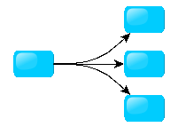
Different Kinds of Graphs
Undirected Graph
Directed Graph
Pseudo Graph
Multi Graph
Hyper Graph

Slide 19



More Kinds of Graphs
Weighted Graph
Labeled Graph
Property Graph

Slide 20
What is a Graph Database?
A database with an explicit graph structure
Each node knows its adjacent nodes
As the number of nodes increases, the cost of a local step (or hop) remains the same
Plus an Index for lookups

Slide 21
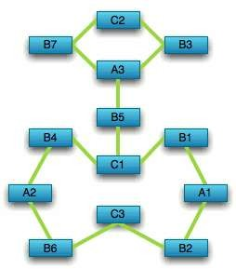
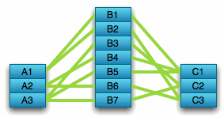
Compared to Relational Databases
Optimized for aggregation
Optimized for connections

Slide 22
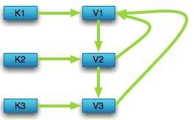

Compared to Key Value Stores
Optimized for simple look-ups
Optimized for traversing connected data

Slide 23
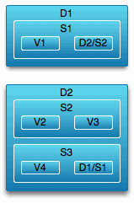
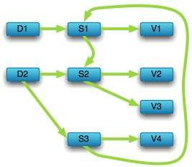
Compared to Key Value Stores
Optimized for “trees” of data
Optimized for seeing the forest and the
trees, and the branches, and the trunks

Slide 24
What is GraphDB?

Slide 25
What is GraphDB?
Semantic graph Database, created by the Bulgarian company Ontotext
Supports RDF and SPARQL
Suitable for loading and working with data, exploring relationships, data integration and scaling
In this course, we will use GraphDB Free

Slide 26
Good for
Semantically rich data
Highly connected data (social networks)
Recommendations (e-commerce)

Slide 27
Social Networks

Slide 28
Recommendations

Slide 29
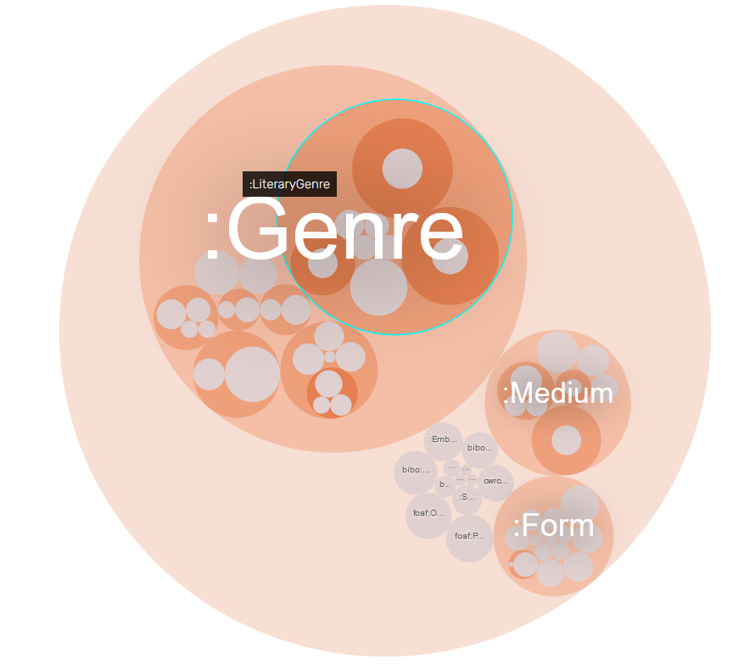
Example: Genre ontology
http://sparql.cwrc.ca/ontologies/genre.rdf
Find all the literature classes
and the hierarchy between them

Slide 30
Example: Genre ontology

Slide 31
Graph DB installation guide
https://graphdb.ontotext.com/documentation/free/quick-start-guide.html#

Slide 32
Questions?
?

Slide 33
Thank you!

