Slide 1

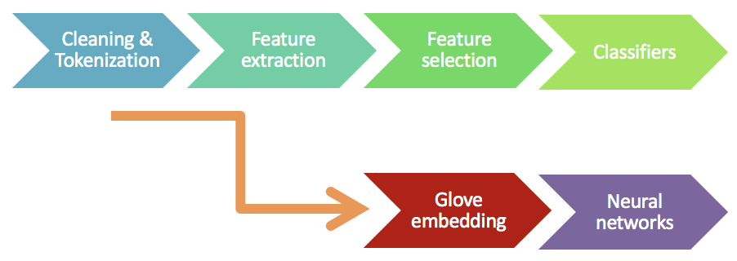
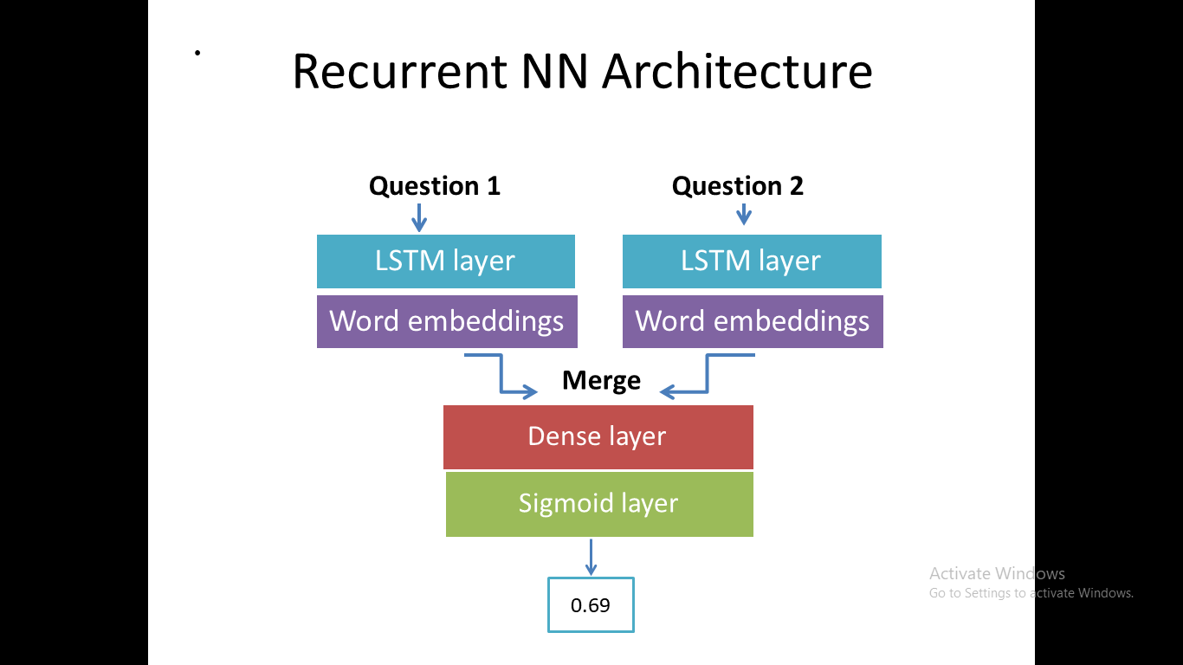
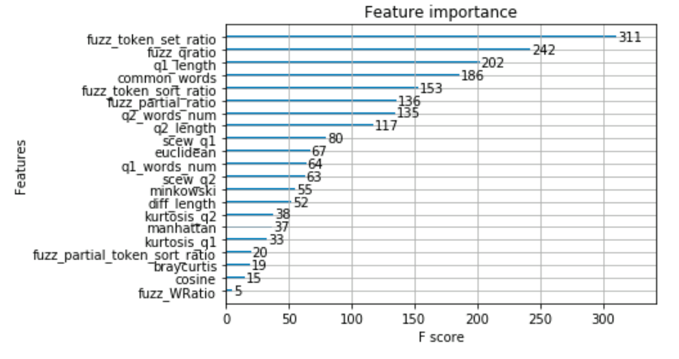
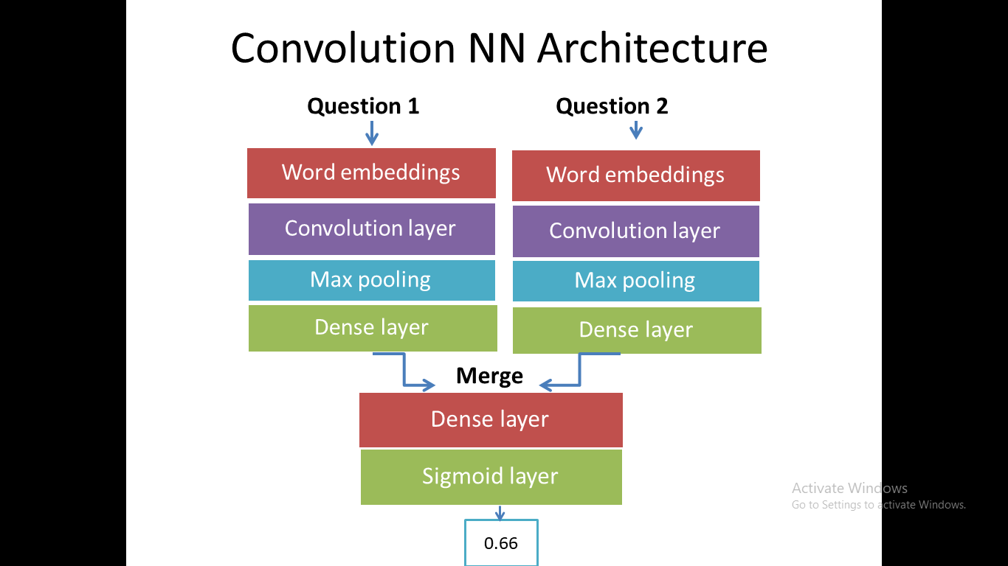
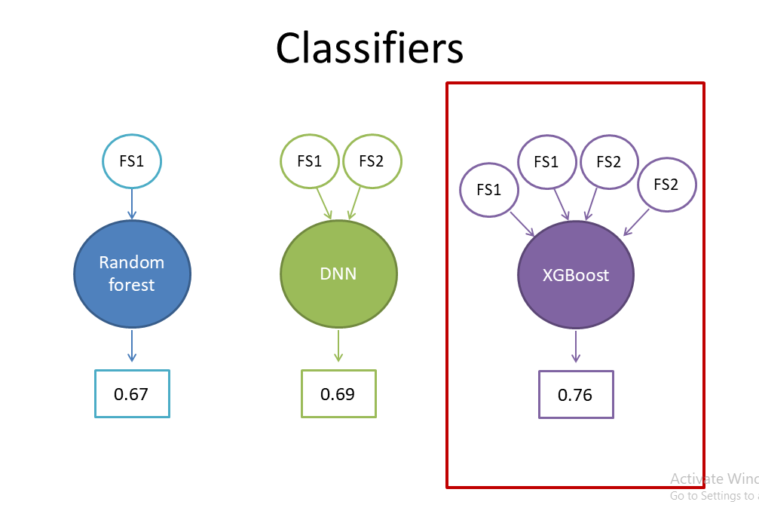
Kaggle Competition: Quora Question Pairs
Applied Machine Learning 2017
Melania Berbatova, Sophie Kamuf
Introduction
Data Analysis
Results
Conclusion
Goal
Identify duplicate Quora questions with maximum accuracy
Data
Training data: 323 325 labeled pairs
Test data: 80 960 unlabeled pairs
Process Pipeline
Model Evaluation
Accuracy Improvement
Kaggle Rank: 8
Accuracy: 0.765
Precision: 0.692
Recall: 0.674
F1 score: 0.683
Question Pair statistics
Average words in a question | 9
Average length of a question | 50
Average # of common words | 4
Range of common words | 0 - 34
Range of length difference | 0 - 872
XGBoost Feature Importance
Model Selection
Data Processing
Text cleaning
Remove numbers, punctuation and non-ascii symbols
Remove stop words and replace misspelled words
Tokenizing for word embeddings
Drop NaN questions from Training set
Feature extraction
Feature set 1 (FS1) – Basic Features: Number of words, length of question, difference of questions’ lengths, number of common words
Feature set 2 (FS2) - Fuzzy features : Q-ratio, W-ratio, partial ratio, partial token set ratio, partial token sort ratio, token set ratio, token sort ratio
Feature set 3 (FS3) – Word2vec distances and statistics: Euclidean, Manhattan, Euclidean, Canberra, Minkowski and Braycurtis distances, cosine similarity, Scew and Kurtosis statistics
Feature set 4 (FS4) – Same starting word, number of unique words
Final XGBoost Model
References
FS1
FS2
Parameters
Max_depth: 20
FS3
FS4
Gamma: 0
n_estimators
=1000
Features
Kaggle user Currie32. “The importance of cleaning text”. March 2017. goo.gl/fomeRv
Kaggle user Anocas. “Data Analysis & XGBoost Starter”. March 2017. goo.gl/3oNZM7
Abhishek Thakur. “Is That A Duplicate Quora Question?”. February 2017. goo.gl/jz1MPp
Hubert Lin. “Kaggle Competition: Quora Question Pairs”. June 2017. goo.gl/ccbnqp
Kaggle user SRK, “Keras Starter Script with Word Embeddings”. February 2017. goo.gl/1SHWRg
Kaggle user Lystdo. “LSTM with word2vec embeddings”. April 2017. goo.gl/LzCVbo
Christopher Olah, “Understanding LSTM Networks”. August 27, 2015. goo.gl/hnryCq
Model Training: XGBoost Parameter Tuning
Max_depth
[3,5,7,9]
[10,20,30]
Min_child
weight
[1,2,3]
[3,5,10]
Gamma
[0-5]
0
[15,20,25]
[18,20,22]
[4,5,6]

