Slide 1
Know the Warning Signs
Before it’s too Late!

Slide 2
Did You Know?
85%
of heart damage occurs within the first two hours of a hear attack!

Slide 3
What are the Risk Factors?
Family history of heart disease
High blood pressure
Overweight or obese
Lack of exercise
Use of tobacco products
Diabetes or other diseases
For women, use of birth control pills

Slide 4
Coronary Heart Disease American Heart Association Data

Slide 5
Men vs Women
What is the difference?

Slide 6
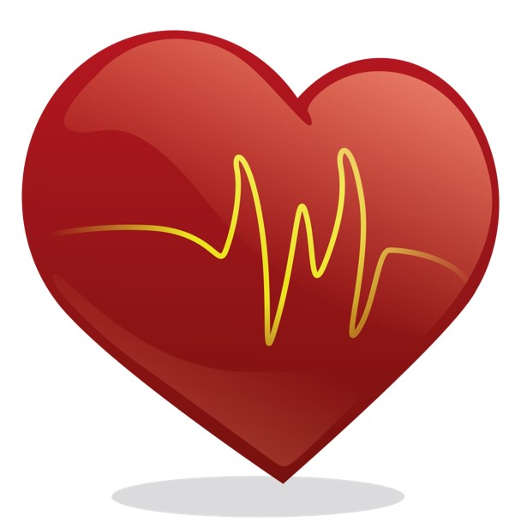
Heart Attack Warning Signs
Men |  | Women
Chest pain/discomfort |  | Chest pressure
Rapid or irregular heartbeat |  | Fatigue for several days
Dizzy or light-headed |  | Anxiety and sleep disturbances
Cold sweat |  | Back, neck, arm, or jaw pain
Stomach discomfort/indigestion |  | Nausea
Shortness of breath |  | Shortness of breath

Slide 7
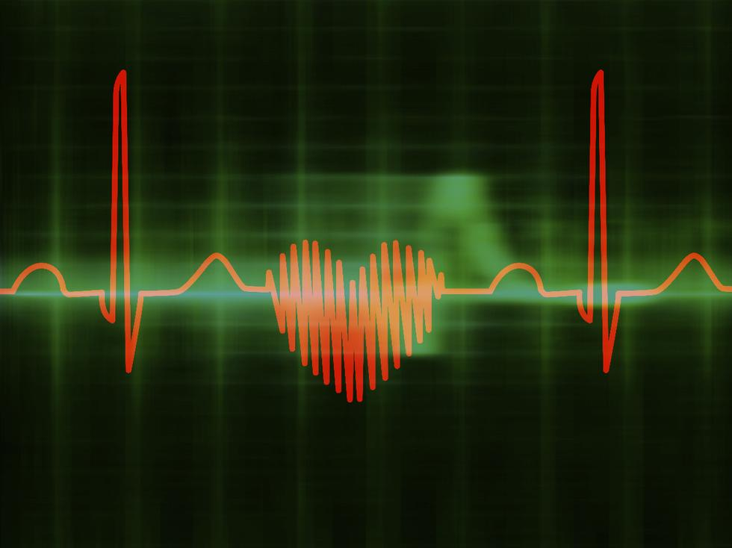
Why Does it Matter?
Women are less likely to seek immediate medical care and are more likely to die!

