Slide 1
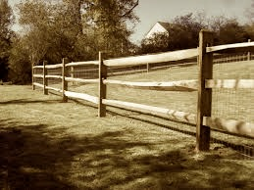

Agriculture 2017
Trevor O’Hearn
Hua Shi

Slide 2




Goal
To research the relationship between income and other variables and to determine which one affects the income the most; as well as, do a Regression on the different Regions of the United States of America.

Slide 3
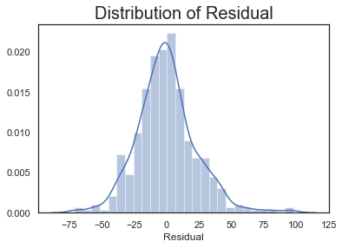
Overall Data
Top 5 Features
Horses and Ponies
Total Received From Government Payments
Estimated Market Value of Machinery on Operation
Net Cash Farm Income of Producers
Acres of Total Cropland as Percent of Land Areas
Ridge RMSE : 22.88

Slide 4
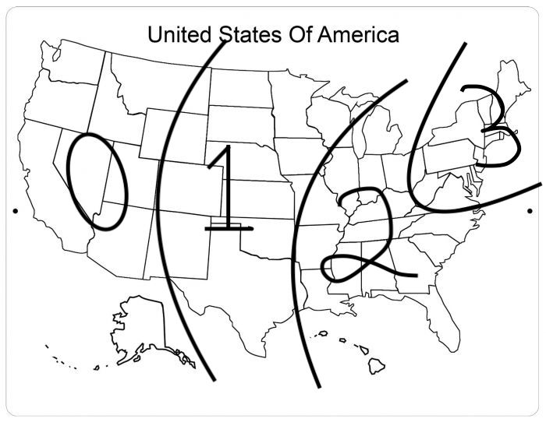
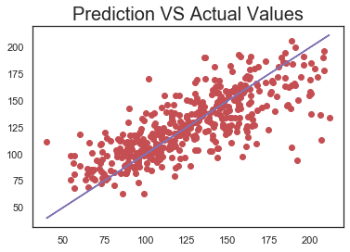
Dividing By Region

Slide 5
Region 1 Data
Top 2 Features
Ridge RMSE
22.77
Estimated Market Value of Land And Buildings
Average Net Cash Farm Income of Producers

Slide 6
Region 2 Data
Top 5 Features
Ridge RMSE
22.77
Horses and Ponies - Inventory
Net Cash Farm Income of Producers
Acres of Total Copland As Percent of Land
Estimated Market Value of land and buildings
Percent of Farms Operated by Family

Slide 7
Region 3 Data
Top 5 Features
Ridge RMSE
22.77
Horse and Ponies - Inventory
Net Cash Farm Income of Producers
Acres of Total Cropland as Percent of Land
Estimated Market Value of Land and Buildings
Percent of Farms Operated by Family

Slide 8
Region 4 Data
Top 5 Features
Ridge RMSE
22.77
Horse and Ponies - Inventory
Net Cash Farm Income of Producers
Acres of Total Cropland as Percent of Land
Estimated Market Value of Land and Buildings
Percent of Farms Operated by Family

Slide 9
Principles of Agriculture
Every farm needs a horse
Get that Government Stipend
Understanding the Importance of your tools
Maximizing the amount of farmable land on your property
Ideal amount of acres : 269 - 491

