Slide 1
Testbed Point Runs for Harvard Forest
Melannie Hartman
November 5, 2018

Slide 2
Overview of Harvard Forest Results
CASA, MIMICS, and CORPSE were run with Carbon only.
MIMICS assumed a soil depth of 30 cm (instead of 100 cm).
DayCent was run with an N fertilizer addition that alleviated N limitation.
DayCent was run first with observed weather, then CASA, MIMICS, and CORPSE were driven with DayCent GPP, soil temperature, and soil moisture.
CASA computes NPP by subtracting autotrophic respiration from GPP. CASA litterfall feeds the MIMICS and CORPSE models.

Slide 3
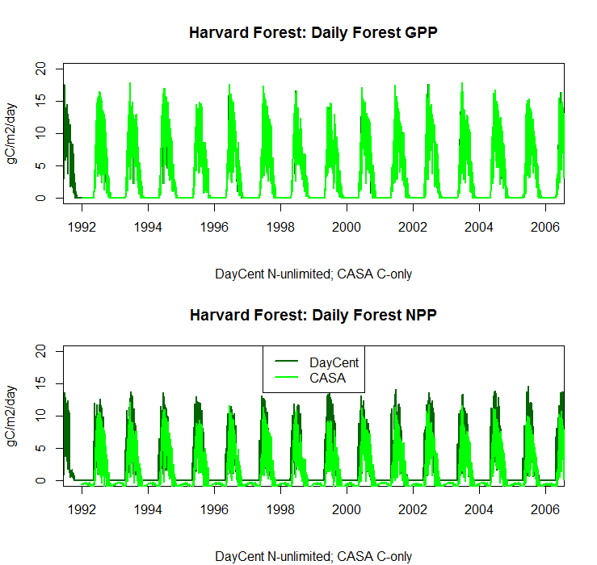
GPP should be identical for both DayCent and CASA.
CASA’s NPP can be negative. DayCent’s NPP is always > 0.

Slide 4
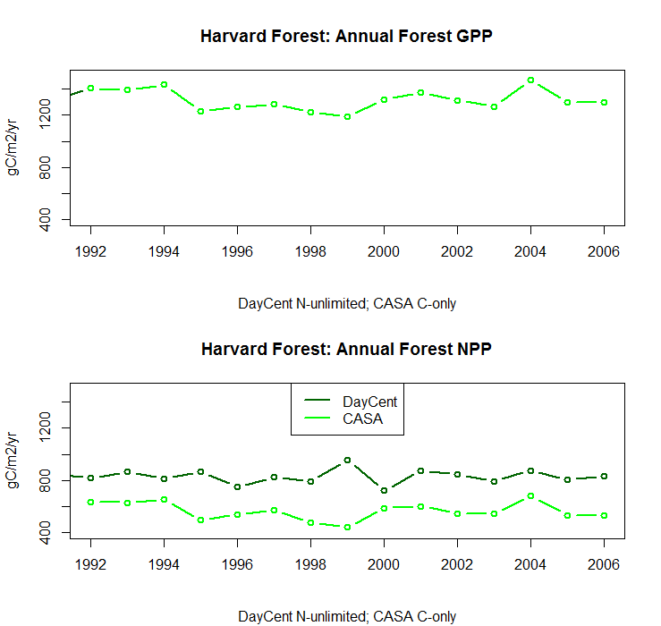
GPP should be identical for both DayCent and CASA.
With DayCent’s higher NPP one might expect it to have greater SOC, but instead DayCent’s soil and temperature decomposition factors are much higher than CASA’s.

Slide 5
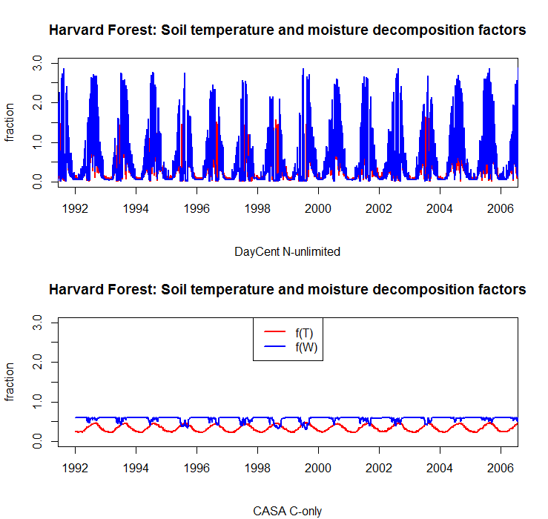

Slide 6
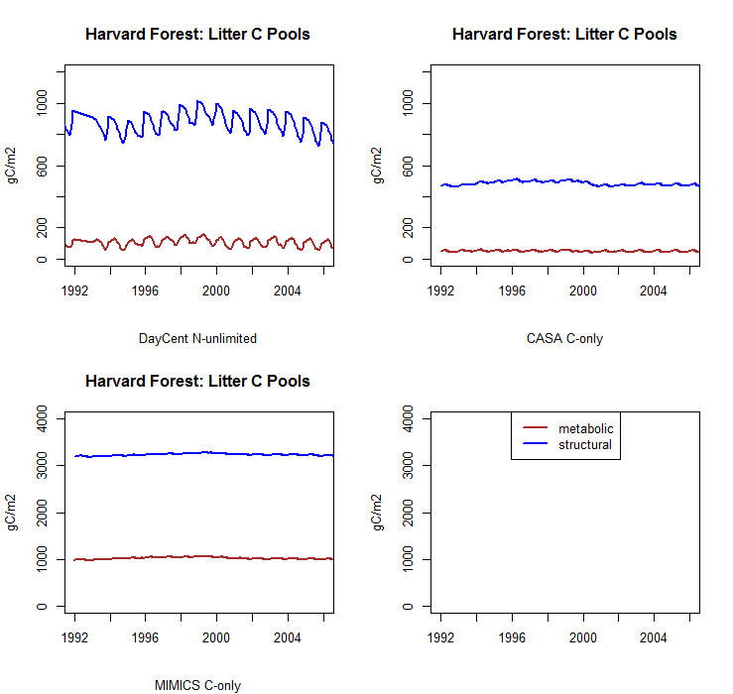

Slide 7
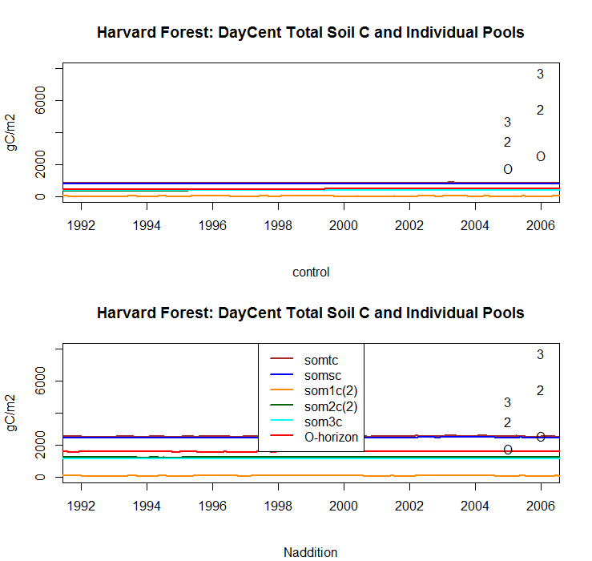
DayCent’s “control” run had severe N-limitation.
DayCent’s O-horizon is the surface slow pool, som2c(1).
The ‘O’, ‘2’, and ‘3’ are the observed O-horizon, 20-cm, and 30-cm SOC stocks from site BW (on the left) and site Prospect Hill (on the right).

Slide 8
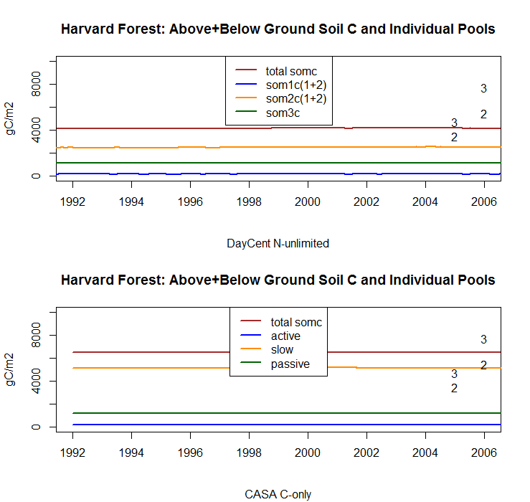
The ‘2’ and the ‘3’ are the observed 20-cm and 30-cm SOC stocks from site BW (on the left) and site Prospect Hill (on the right).

Slide 9
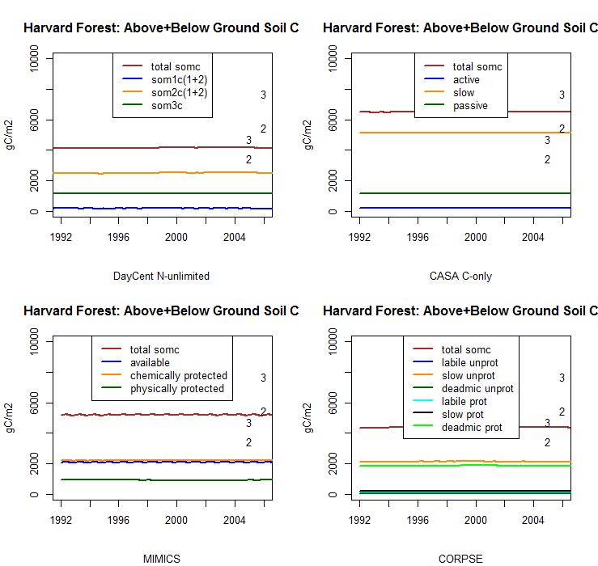

Slide 10
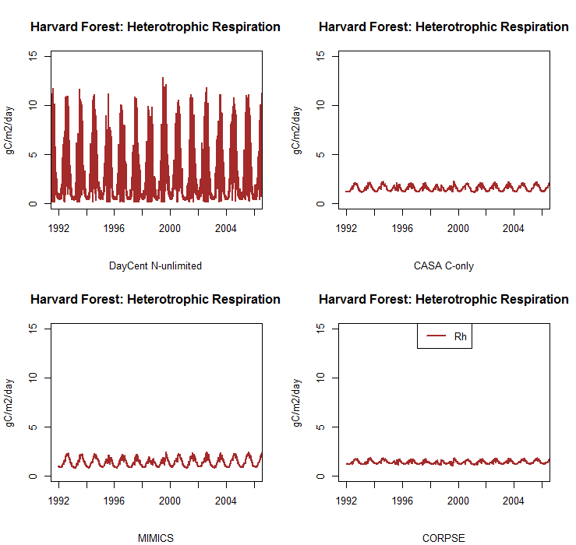

Slide 11
Soil temperature warming and NPP perturbations…

Slide 12
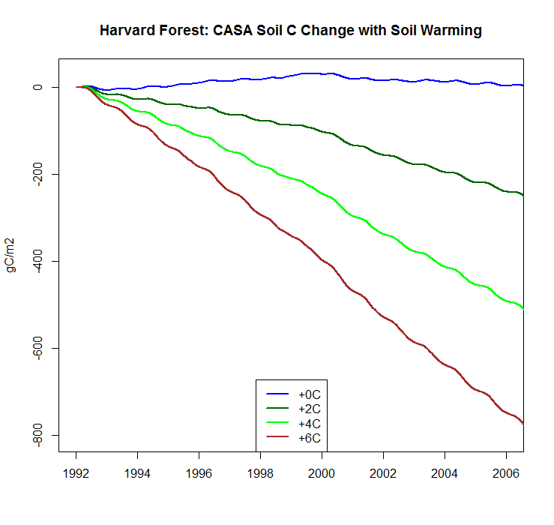
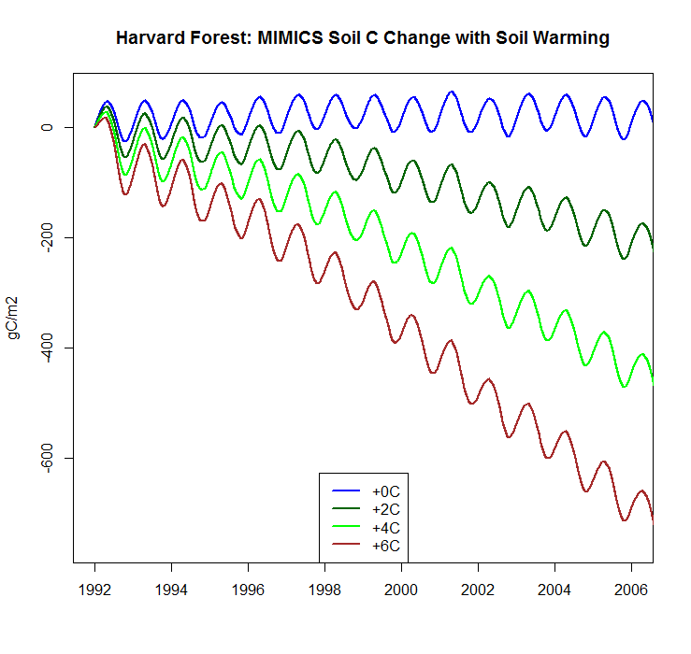
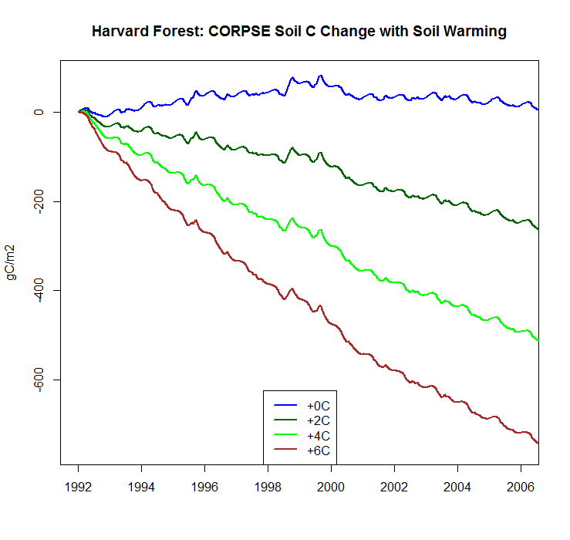
Change in SOC with soil warming
Soil temperature warming (+0 °C, +2 °C, +4 °C, and +6 °C) started in 1992. The blue line is the control.

Slide 13
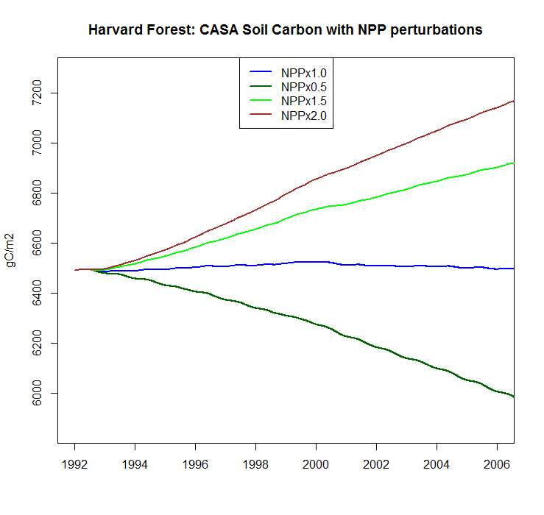
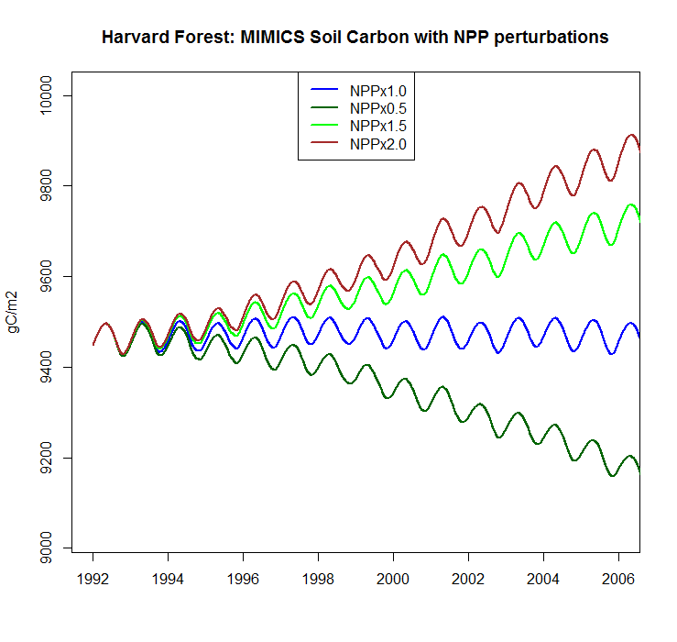
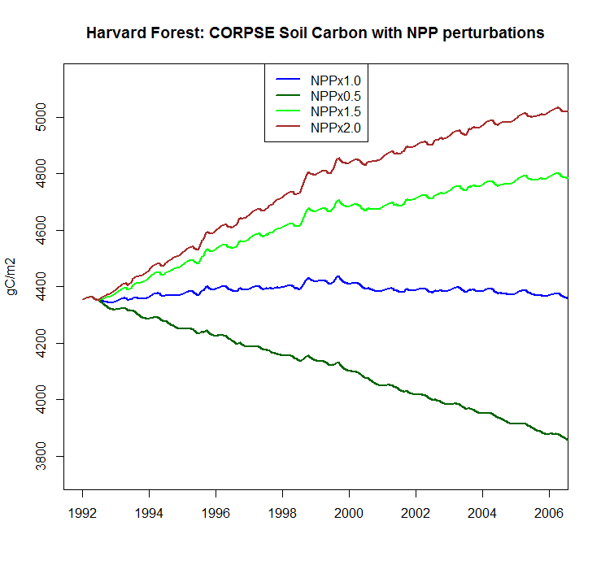
Change in SOC with NPP perturbations
NPP reductions (-50%) and increases (+50%, +100%) started in 1992. The blue line is the control.

Slide 14
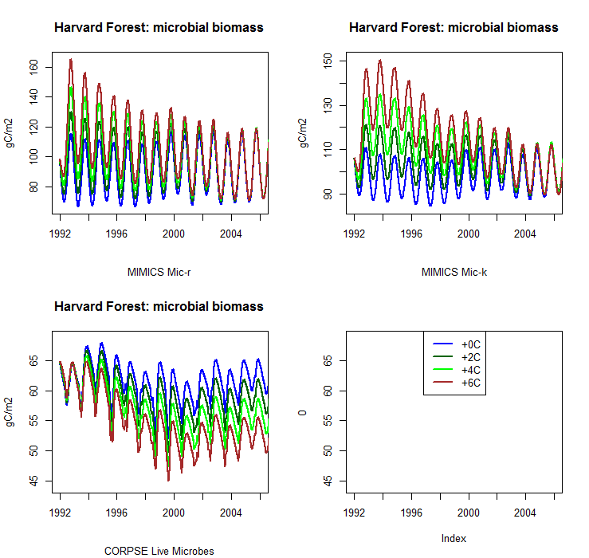
Soil temperature warming started in 1992. The blue line is the control.

Slide 15
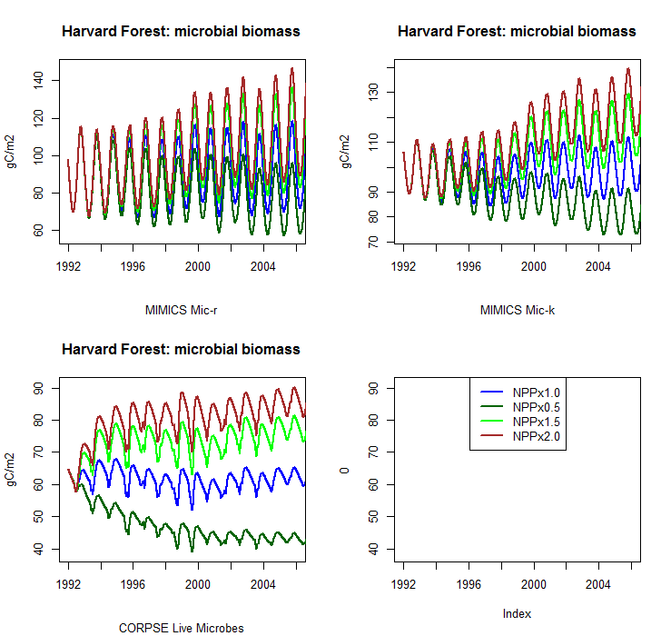
NPP reductions and increases started in 1992. The blue line is the control.

