Slide 1
Ethiopia Agricultural Export Prediction Model
An Overview of Model Analysis and Insights

Slide 2
Problem Definition
Goal: Predict Agricultural Exports (in million US$) for Ethiopia
Problem Type: Regression
Success Criteria: High predictive accuracy (low MSE, high R²)

Slide 3
Data Collection
Dataset Features:
- Population
- Rural Population Growth
- Agriculture Value Added
- Employment in Agriculture
Sources: Publicly available datasets
Key Challenges: Missing values in several columns

Slide 4
Data Exploration and Preparation
Steps Taken:
- Handled missing values with forward/backward fill and mean imputation
- Removed features with all missing values
- Transposed data (years as rows, indicators as columns)
- Encoded and normalized features as required

Slide 5
Model Training
Model: Linear Regression
Target Variable: Agricultural Exports (in million US$)
Training Data: 6 points (years 2001–2005, averages included)
Testing Data: 2 points (years 2008–2010)

Slide 6
Model Evaluation
Metrics:
- Training MSE: 5.71e-22 (overfitting potential)
- Testing MSE: 0.540
- Testing R²: 99.9997%
Insights: Strong predictive performance but possible overfitting

Slide 7
Feature Importance
Positive Correlations:
- Agricultural Imports
- Net Agricultural Trade
- Roads (Total Network)
Negative Correlations:
- Employment in Agriculture
- Agriculture, Value Added (% of GDP)

Slide 8
Recommendations
1. Enhance infrastructure (e.g., roads) to boost exports
2. Increase trade activities (imports and exports)
3. Address inefficiencies in the agricultural sector
4. Promote diversification beyond agricultural employment

Slide 9
Conclusion
The model highlights key economic and demographic factors influencing agricultural exports in Ethiopia. Infrastructure, trade, and efficiency improvements can significantly enhance export performance.

Slide 10
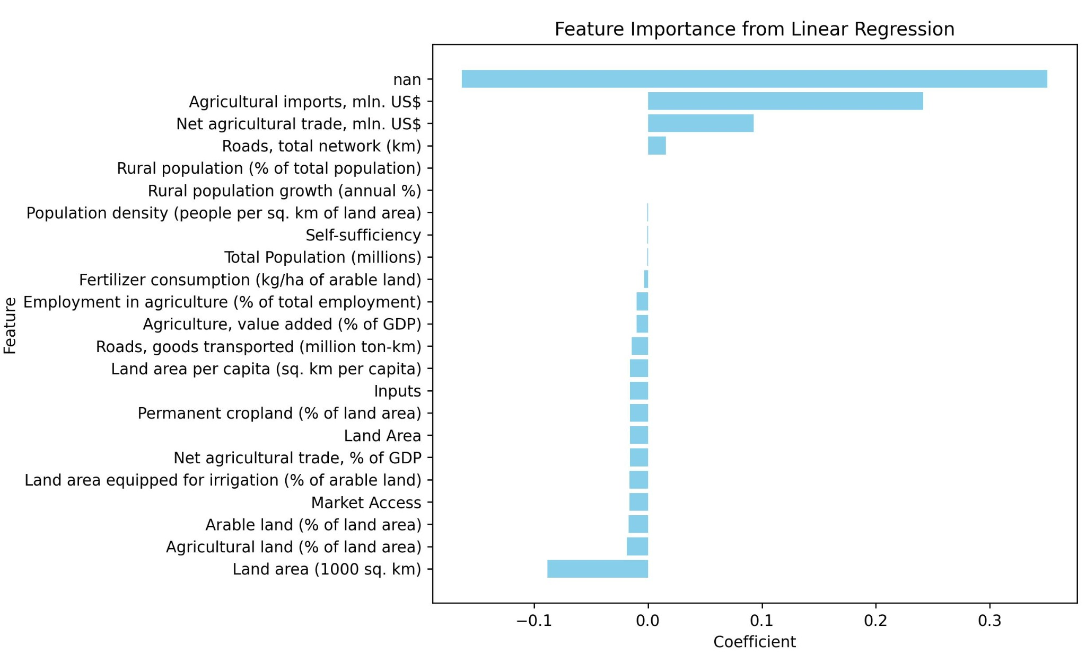
Predicted vs Actual Values

Slide 11
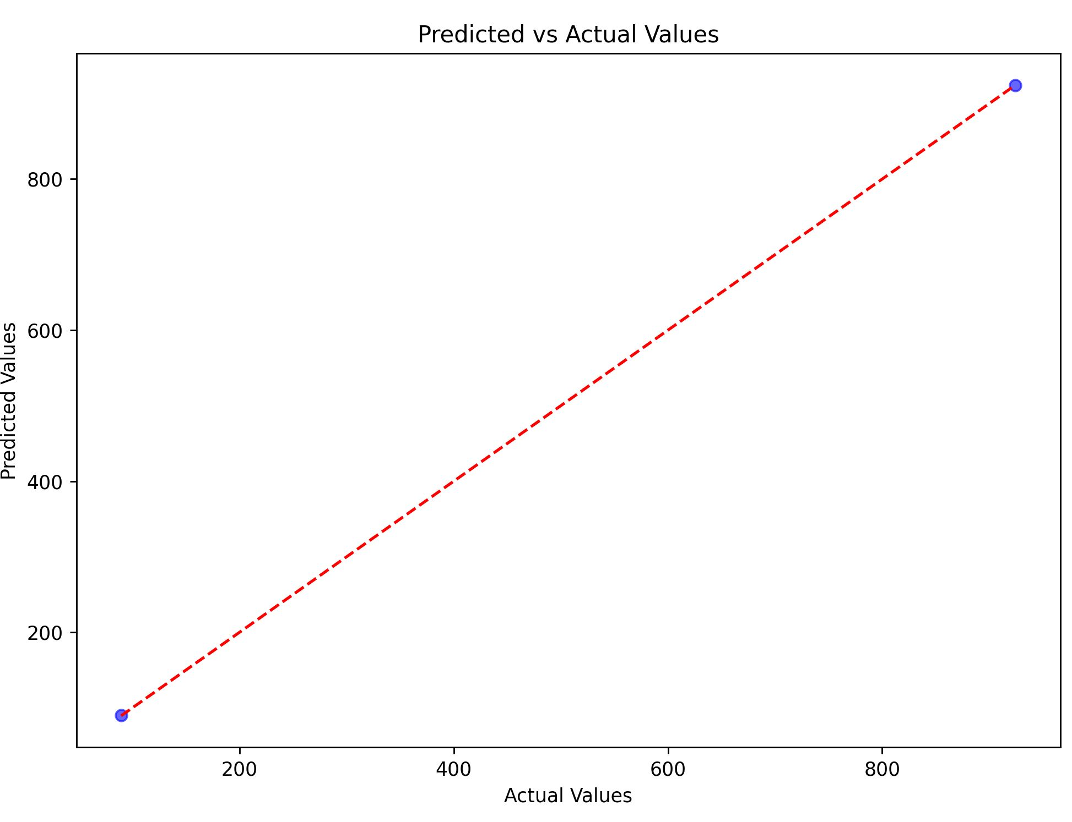
Feature Importance

Slide 12
Predicted vs Actual Values: Explanation
1. How It Was Calculated:
- Linear Regression model was trained using features such as population, rural population growth, and agricultural metrics.
- Predictions were made on test data and compared to actual values.
2. Why It Is Important:
- The graph visually demonstrates the model's accuracy.
- Close alignment between predicted and actual values confirms the model's reliability.
- Highlights the ability of the model to generalize well to unseen data.

Slide 13
Feature Importance: Explanation
1. How It Was Determined:
- Linear Regression coefficients represent the weight of each feature in predicting agricultural exports.
- Positive coefficients indicate features that positively impact exports, while negative coefficients indicate negative impacts.
2. Why It Is Important:
- Helps identify key drivers of agricultural exports (e.g., infrastructure, trade).
- Highlights inefficiencies in the sector (e.g., over-reliance on agricultural employment).
- Provides actionable insights for policymakers to improve agricultural performance.

Slide 14
Using Classification for Predicting Agricultural Yield Increase
Steps to Implement Classification for Predicting Agricultural Yield Increase:
1. Define the Target Variable:
- Create a categorical target variable representing different levels of yield increase (e.g., 'Low', 'Medium', 'High').
2. Select Features:
- Use relevant indicators such as total population, rural population, agricultural employment, etc.
3. Preprocess Data:
- Handle missing values, encode categorical variables, and split the dataset.
4. Train a Classification Model:
- Use a classification algorithm such as Random Forest, Decision Trees, or Logistic Regression.
5. Evaluate the Model:
- Assess the model's performance using metrics like accuracy, precision, recall, and confusion matrix.
Interpretation of Results:
- Precision: 1.00 indicates no false positives for the 'Low' class.
- Recall: 1.00 indicates no false negatives for the 'Low' class.
- F1-Score: 1.00 confirms perfect balance between precision and recall.
- Confusion Matrix: [[2]] indicates perfect classification of test set instances.

