Slide 1
Ethiopia Agricultural Export Prediction Model
An Overview of Model Analysis and Insights

Slide 2
Problem Definition
Goal: Predict Agricultural Exports (in million US$) for Ethiopia
Problem Type: Regression
Success Criteria: High predictive accuracy (low MSE, high R²)

Slide 3
Data Collection
Insights on Agriculture and Economic Indicators
1. Employment in Agriculture (% of Total Employment) vs. Agricultural Exports
- Observation: Employment levels in agriculture remain steady (~81%). Agricultural exports remain constant (~670 million US$).
- Insight: Minimal or no correlation observed between agricultural employment and exports.
- Lesson Learned: Exports are likely driven by productivity, policies, or external factors, rather than employment levels.
2. Agriculture Value Added (% of GDP) vs. Agricultural Exports
- Observation: Positive correlation observed; as agriculture value-added increases, so do exports.
Range: Value-added (44%-49%) and exports (900-1800 million US$).
- Insight: 1% increase in value-added corresponds to ~200-300 million US$ rise in exports (linear trend).
- Lesson Learned: Focus on value addition and efficiency (e.g., technology, process optimization) to boost exports.
3. Total Population vs. Agricultural Exports
- Observation: Positive relationship; as population grows, agricultural exports increase.
Population range: 72-86 million; Exports range: 600-1800 million US$.
- Insight: 1 million increase in population corresponds to an ~85-100 million US$ increase in exports.
- Lesson Learned: Larger populations can support greater agricultural productivity, enhancing exports.
Summary
- Key Findings:
- Employment in agriculture has minimal impact on exports.
- Value addition in agriculture strongly boosts exports.
- Population growth supports increased exports by possibly expanding labor and production.
- Policy Recommendations:
- Invest in technologies to increase value-added agricultural productivity.
- Promote policies to balance population growth and agricultural investments.
- Decouple labor dependency through mechanization and export-oriented strategies.

Slide 4
Data Exploration and Preparation
Steps Taken:
- Handled missing values with forward/backward fill and mean imputation
- Removed features with all missing values
- Transposed data (years as rows, indicators as columns)
- Encoded and normalized features as required

Slide 5
Model Training
Model: Linear Regression
Target Variable: Agricultural Exports (in million US$)
Training Data: 6 points (years 2001–2005, averages included)
Testing Data: 2 points (years 2008–2010)

Slide 6
Model Evaluation
Metrics:
- Training MSE: 5.71e-22 (overfitting potential)
- Testing MSE: 0.540
- Testing R²: 99.9997%
Insights: Strong predictive performance but possible overfitting

Slide 7
Feature Importance
Insights on Agriculture and Economic Indicators
1. Employment in Agriculture (% of Total Employment) vs. Agricultural Exports
- Observation: Employment levels in agriculture remain steady (~81%). Agricultural exports remain constant (~670 million US$).
- Insight: Minimal or no correlation observed between agricultural employment and exports.
- Lesson Learned: Exports are likely driven by productivity, policies, or external factors, rather than employment levels.
2. Agriculture Value Added (% of GDP) vs. Agricultural Exports
- Observation: Positive correlation observed; as agriculture value-added increases, so do exports.
Range: Value-added (44%-49%) and exports (900-1800 million US$).
- Insight: 1% increase in value-added corresponds to ~200-300 million US$ rise in exports (linear trend).
- Lesson Learned: Focus on value addition and efficiency (e.g., technology, process optimization) to boost exports.
3. Total Population vs. Agricultural Exports
- Observation: Positive relationship; as population grows, agricultural exports increase.
Population range: 72-86 million; Exports range: 600-1800 million US$.
- Insight: 1 million increase in population corresponds to an ~85-100 million US$ increase in exports.
- Lesson Learned: Larger populations can support greater agricultural productivity, enhancing exports.
Summary
- Key Findings:
- Employment in agriculture has minimal impact on exports.
- Value addition in agriculture strongly boosts exports.
- Population growth supports increased exports by possibly expanding labor and production.
- Policy Recommendations:
- Invest in technologies to increase value-added agricultural productivity.
- Promote policies to balance population growth and agricultural investments.
- Decouple labor dependency through mechanization and export-oriented strategies.

Slide 8
Recommendations
1. Enhance infrastructure (e.g., roads) to boost exports
2. Increase trade activities (imports and exports)
3. Address inefficiencies in the agricultural sector
4. Promote diversification beyond agricultural employment

Slide 9
Conclusion
The model highlights key economic and demographic factors influencing agricultural exports in Ethiopia. Infrastructure, trade, and efficiency improvements can significantly enhance export performance.

Slide 10
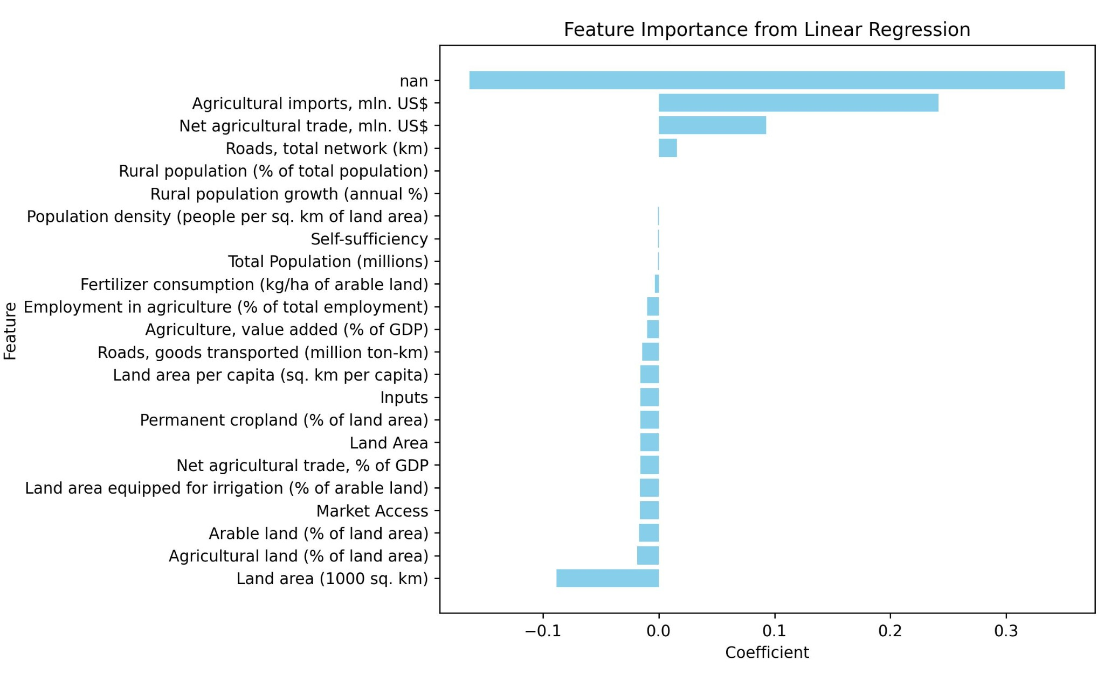
Predicted vs Actual Values

Slide 11
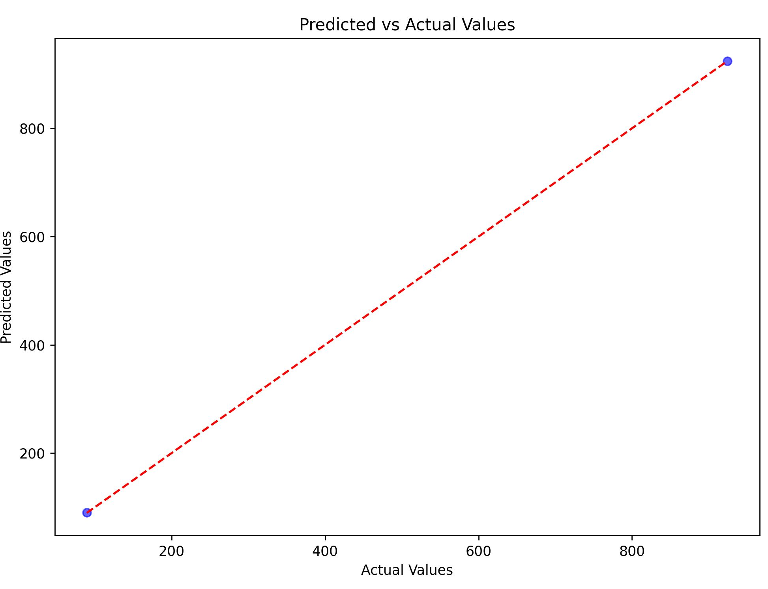
Feature Importance

Slide 12
Predicted vs Actual Values: Explanation
1. How It Was Calculated:
- Linear Regression model was trained using features such as population, rural population growth, and agricultural metrics.
- Predictions were made on test data and compared to actual values.
2. Why It Is Important:
- The graph visually demonstrates the model's accuracy.
- Close alignment between predicted and actual values confirms the model's reliability.
- Highlights the ability of the model to generalize well to unseen data.

Slide 13
Feature Importance: Explanation
1. How It Was Determined:
- Linear Regression coefficients represent the weight of each feature in predicting agricultural exports.
- Positive coefficients indicate features that positively impact exports, while negative coefficients indicate negative impacts.
2. Why It Is Important:
- Helps identify key drivers of agricultural exports (e.g., infrastructure, trade).
- Highlights inefficiencies in the sector (e.g., over-reliance on agricultural employment).
- Provides actionable insights for policymakers to improve agricultural performance.

Slide 14
Using Classification for Predicting Agricultural Yield Increase
Steps to Implement Classification for Predicting Agricultural Yield Increase:
1. Define the Target Variable:
- Create a categorical target variable representing different levels of yield increase (e.g., 'Low', 'Medium', 'High').
2. Select Features:
- Use relevant indicators such as total population, rural population, agricultural employment, etc.
3. Preprocess Data:
- Handle missing values, encode categorical variables, and split the dataset.
4. Train a Classification Model:
- Use a classification algorithm such as Random Forest, Decision Trees, or Logistic Regression.
5. Evaluate the Model:
- Assess the model's performance using metrics like accuracy, precision, recall, and confusion matrix.
Interpretation of Results:
- Precision: 1.00 indicates no false positives for the 'Low' class.
- Recall: 1.00 indicates no false negatives for the 'Low' class.
- F1-Score: 1.00 confirms perfect balance between precision and recall.
- Confusion Matrix: [[2]] indicates perfect classification of test set instances.

