Slide 1

Building Systems That Last: Holland’s Journey Through the Onsite Review
Melissa Remillard, Associate Superintendent of School Improvement

Slide 2

What We Will Cover
Leadership Matters
Holland’s Journey
Our Starting Point
Who Was Involved
Leadership Teams
Written Procedures
Lessons Learned
Final Takeaways

Slide 3
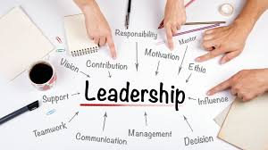
Leadership Matters
Collaborative
Data-Driven
Grounded in Integrity
Persistent
Relationships
Student-Focused
Visionary

Slide 4
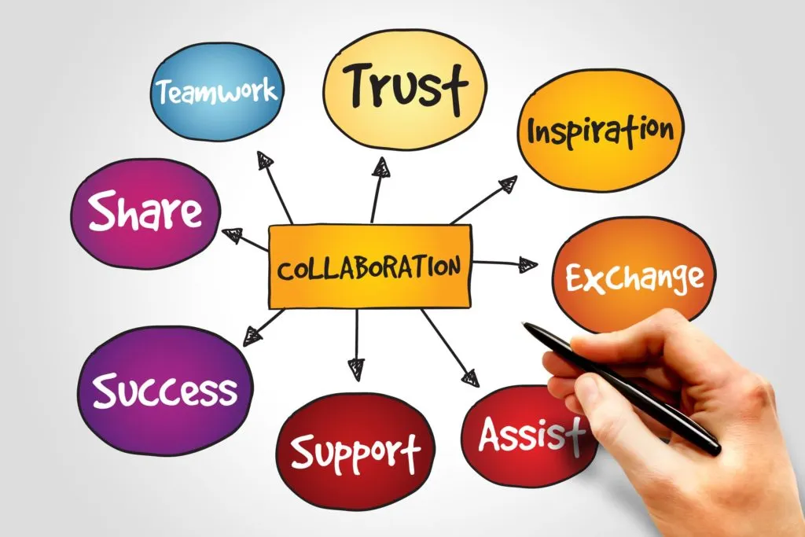
Holland’s Journey
We embraced the opportunity and we used the process to:
Analyze district and building data
Strengthen alignment across the buildings
Embed and reinforced district level supports
Foster deeper collaboration across the district
Implement and strentghten best practices
Established systems to support curriculum and collaboration
This became a turning point for long term improvement.

Slide 5

Our Starting Point
Review expectations for the Onsite Review process
Establish a timeline to ensure we were prepared for our May presentation
Collaborate and design meeting structures
Develop written procedures
Gathering data

Slide 6

Strength of Leadership Team
Administrators
Board of Education
Cabinet
Coaches
Directors
Intervention Teachers
Multilingual Learner Director
Parents
School Improvement and PBIS Chairs
Students
Teachers
Notes:
Invite/ who is involved

Slide 7

Leadership Teams Roles and Responsibilities
Cabinet
District Improvement Meetings (DIT)
District Leadership Team Meetings (DLT)
Building Leadership Team Meetings (BLT)
School Improvement Meetings
Process used at meetings:
Teach
Collaborate
Gather
Data Review
Review
Feedback
Notes:
It is ongoing

Slide 8

Organizing the Review Process
Introduction to the Process:
Building and District Onsite Review study guides
Google Drive
Common Calendar
Meeting Agendas
DIT
DLT
Gathering Evidence / Data
Building our Systems
Communication Plan
Written Procedures
Timelines
Notes:
All underlines have attached documentation

Slide 9

Create Shared Understanding
Our leadership teams paused often to reflect:
“What are we learning? How do we implement change?”
Through guided discussions we identified:
Our instructional gaps
Systems of support
A shared vision for learning
Professional development opportunities / learning walks
Intervention strategies
Pathways for feedback

Slide 10

What Helped Us the Most
Relationship with Michigan Department Education (MDE)
Role of the advocate
Strong district leadership model
Opportunities for reflection
Intentional Communication with ALL Stakeholders
Bi-Weekly / Monthly Check Ins
Progress over time
Meetings with MDE
Celebrations

Slide 11

What to Expect the Day of Presentation
Two Day Process (food is important)
Day One: Building
Building Presentation-Tell your story
School Study Guide
School Tour
Parent Interviews
Day Two: District
District Presentation-Tell your story
District Study Guide
Verbal Review of Information (optional)
Compliance Plan
30 days after receiving
Ensure time for reflection and feedback from your teams

Slide 12

What We Achieved
Improved teaching and learning
Horizontal and vertical alignment
Consitent use of instructional data
Implemented written procedures
Designed systems of collaboration
Strengthened systems of support
Created ownership within the district
Stronger vision for leadership within the district

Slide 13

Takeaways and Reflections
Documention
Feedback
Review Early and Often
Linking Documents: Share with All
Clarity of the Work
Don’t Wait
By focusing on clarity, collaboration, and consistency, we made great progress on our journey to improve teaching and student learning.

Slide 14
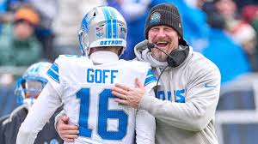


Be a Dan Campbell
As a leader, embrace this process with your team!
Genuine leadership
Passoniate and energetic
Develop strong relationships and trust
Positive culture builder
Adaptable strategist
Work ethic
Resilient and gritty

Slide 15
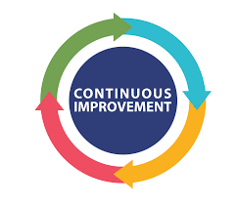
After Onsite Review
After the Onsite Review, our work has not stopped. We continue to learn, reflect, refine, and grow. Strengthening our systems of support across all buildings. What began as a compliance process has evolved into a culture of continuous improvement rooted in improved learning, alignment, accountability and collaboration.
Happy to share tools, templates, and lessons learned.
Let’s Talk!!
Melissa Remillard
mremilla@hollandpublicschools.org

