Slide 1

Professional Learning Communities:
Our Journey and Support for Yours
Presented by:
Dr. Mark W. French, Assistant Superintendent, Bedford Public Schools
Mrs. Sherry Farnan, Principal, Jackman Road Elementary School
Mr. Roderick Hurley, Principal, Bedford Junior High School
Mr. Kevin Weber, Principal, Bedford Senior High School

Slide 2
Today’s OUTCOMES…
Learn/Know important PLC Definitions
Describe the background and process for our district and schools becoming PLCs
Describe how PLC dispositions and processes have been implemented at each grade level span
What does the data tell us about the impact of our PLC journey?
What are the remaining/ongoing challenges for our journey?
Questions and Support

Slide 3
The PLC FOCUS
“[Great organizations] simplify a complex world into a single organizing idea, a basic principle, or concept that unifies and guides everything.... [They] see what is essential, and ignore the rest.” —Jim Collins, 2001

Slide 4
KEY PLC Definitions
What IS a PLC?
Elbow partner…
15-30 second ‘elevator pitch’....
Take turns…

Slide 5
PLC: Definition
A Professional Learning Community is an ongoing (never ending) process in which educators work collaboratively in recurring cycles of collective inquiry (‘Four Question Cycles’) and action research to achieve better results for the students they serve.
PLCs operate under the assumption that the key to improved learning for students is continuous job-embedded learning for educators.

Slide 6
PLC: THREE Big Ideas
Focus on Learning: The primary purpose of a PLC is to ensure that all students learn at high levels, with a focus on what students should know and be able to do.
Collaborative Culture and Collective Responsibility: PLCs emphasize working together, sharing expertise, and taking collective responsibility for student success.
Results Orientation: PLCs are driven by results, using data to inform instruction and measure the effectiveness of their efforts to improve student learning.

Slide 7
PLC: FOUR Pillars
MISSION
What is our day to day work?
VISION
What do we want to become?
VALUES (NORMS)
What behaviors will govern our collaborative work?
GOALS
What short and long term SMART Goals are we measuring?

Slide 8
PLC: FOUR Key Questions
What do we want students to know and be able to do?
How will we know if they have learned it?
What will we do to provide time and support during the day if they don't learn it?
What will we do to extend and enrich during the day if they already know it?

Slide 9
PLC: FIVE Essentials
All educators work in collaborative teams and take collective responsibility for student learning (rather than working in isolation).
Implementation of a guaranteed and viable curriculum standard by standard, unit by unit. (ELA, Mathematics, Core, Other)
Monitoring of student learning through an ongoing assessment process that includes frequent, team-developed common formative assessments.
Use the results of common assessments to:
Improve individual teacher practice
Build the team’s capacity to achieve its goals
Intervene or extend for students according to their need
5) Provide systematic, embedded (during the day) interventions and enrichment

Slide 10
Critical Issues for Team Consideration
BPS Annotated Critical Issues for Team Consideration
Teamwork and Team Products
Monitor the TEAM PRODUCTS

Slide 11
PLC Trivia: The first authentic PLC…
The first authentic, high functioning PLC was a:
NO PEEKING!! :)

Slide 12
Bedford’s PLC Journey…
2018:
PLC Institute, Lincolnshire, IL (and ongoing…)
Introductory Professional Learning
Use the time you have
Identify Promise (Essential) Standards
2022-2025:
Breakthrough in negotiations: More time, PLT Leaders
Intervention/Enrichment Time/WIN Time

Slide 13

The BHS recipe…
Essential Ingredients, but you have to adjust them according to your situation
District support
Collaborative leadership team to develop
Tiered Supports
Building teams
Notes:
Proposed cut

Slide 14

District Vision
PLC Institute each year (7 years running)
Contractual Language - increase requirement for PLT meeting time (last 3 years)
District support with local EA- They will question things (why do we have to meet, I am a singleton, data takes time,)
Priority
Solution Tree online videos

Slide 15
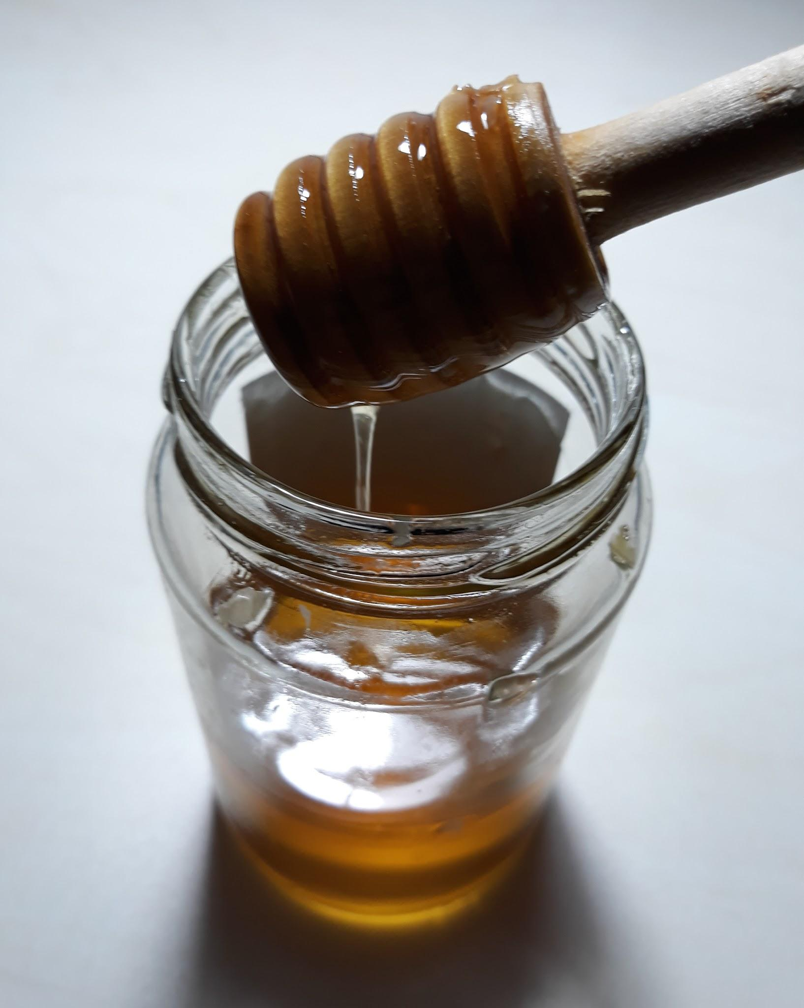
Collaborative Leadership Team
Our team was JHS and BHS teachers and one admin
Team had common learning, then set course with a deadline (very Mattos- 3 months- design it)
Met as team and made decision- bell schedule, times per week, norms for meetings, reviewed how to communicate it
Videos shared Agenda from first Meeting

Slide 16
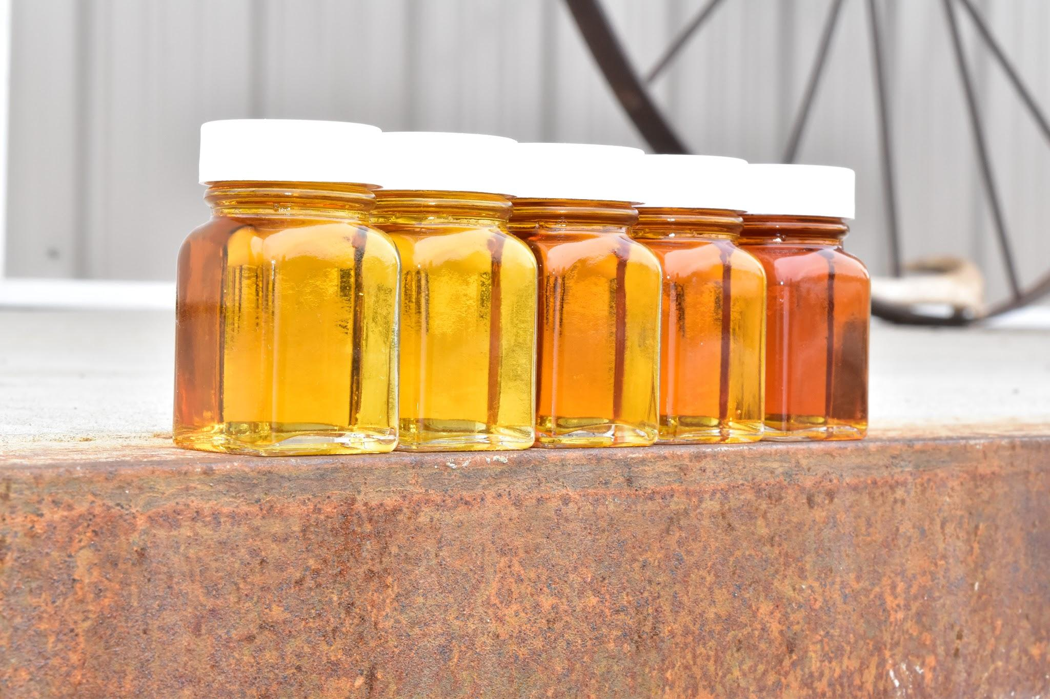
Collaborative Leadership Team
RTI Scheduler First two presentations to staff
Lowell HS
Staff Guidelines and Expectations
WIN Time At- A-Glance
1st WIN Time- Common Presentation

Slide 17

Tiered Supports
Enriched Homeroom/At-risk Coordinator- Failure rate is at just over 3% for three consecutive semesters- down from 5-over 6%. - coupled with common grading by department
Math Foundations- Double Dose Math
Restructuring of special education- Support in HR and Individual Skills
Tutoring and Math Lab

Slide 18

Building Teams
Principal- Lead learner- Learning by Doing, plus all the things
Common Assessments for Promise Standards
Focus on products not minutes- Tracking Documents
Early Tracking Document PLT Outcomes- Current format
PLT Leads
PLT Lead Meetings (Guiding Coalition)

Slide 19
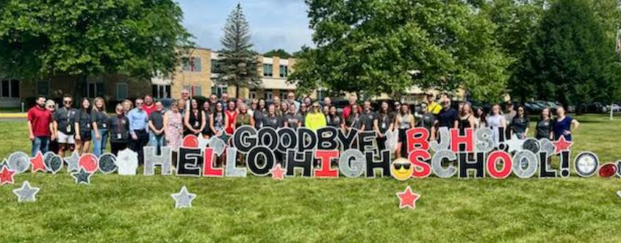
The JHS Story
Teamwork and Responsibility

Slide 20
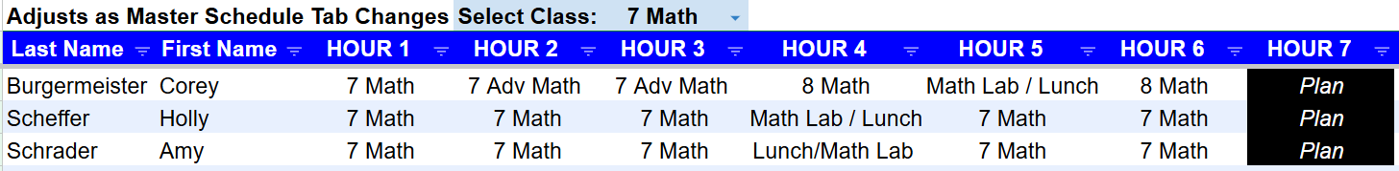
Teams
Contractual Language
Group Responsibility
Meeting
Scheduling

Slide 21
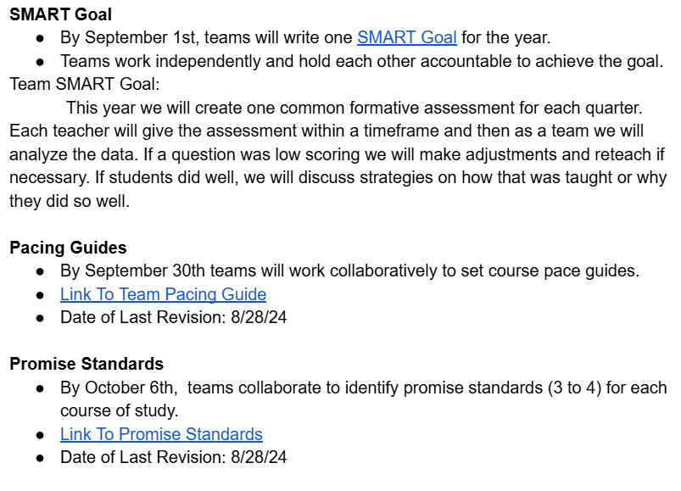
Guaranteed and Viable Curriculum

Slide 22
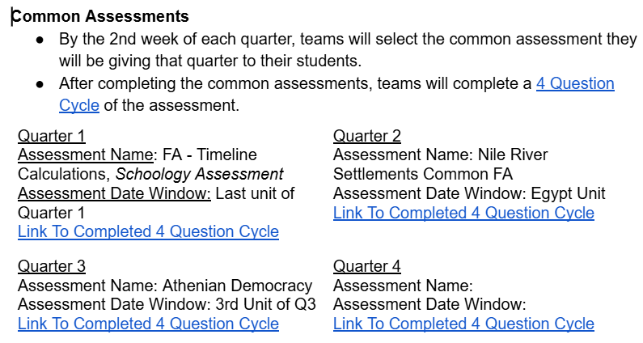
Assessment Process

Slide 23
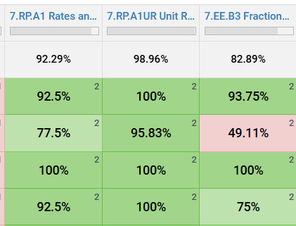
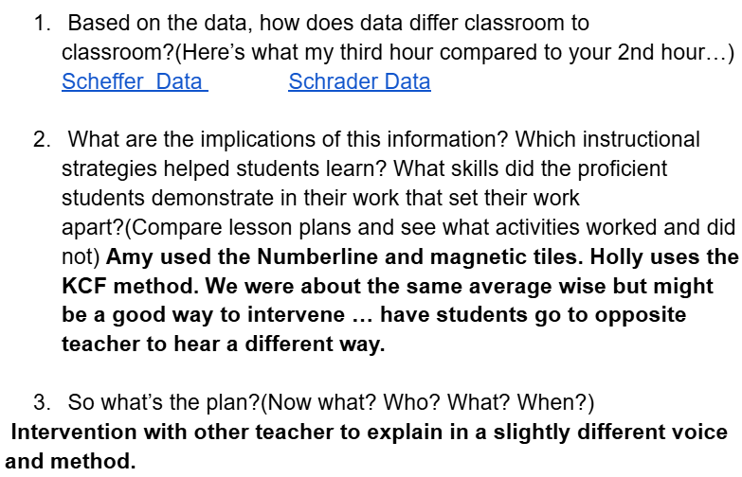
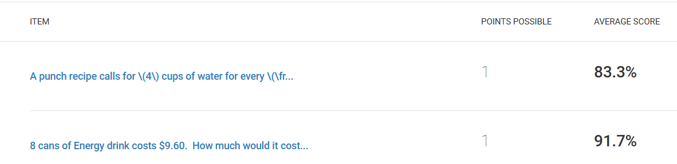
Results/Data

Slide 24
PLC/PLT Four Critical Questions
4 Critical Questions of Learning:
What do you want the students to know and be able to do?
How will you know if they learned?
How will you provide time and support for those who have not learned yet?
How will you extend and enrich for those who have learned?

Slide 25
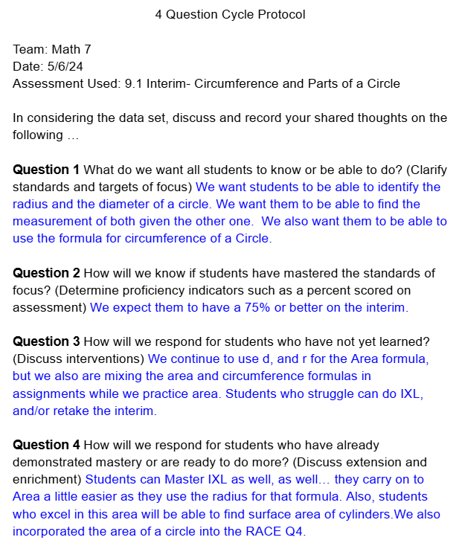
Four Critical Questions Example

Slide 26
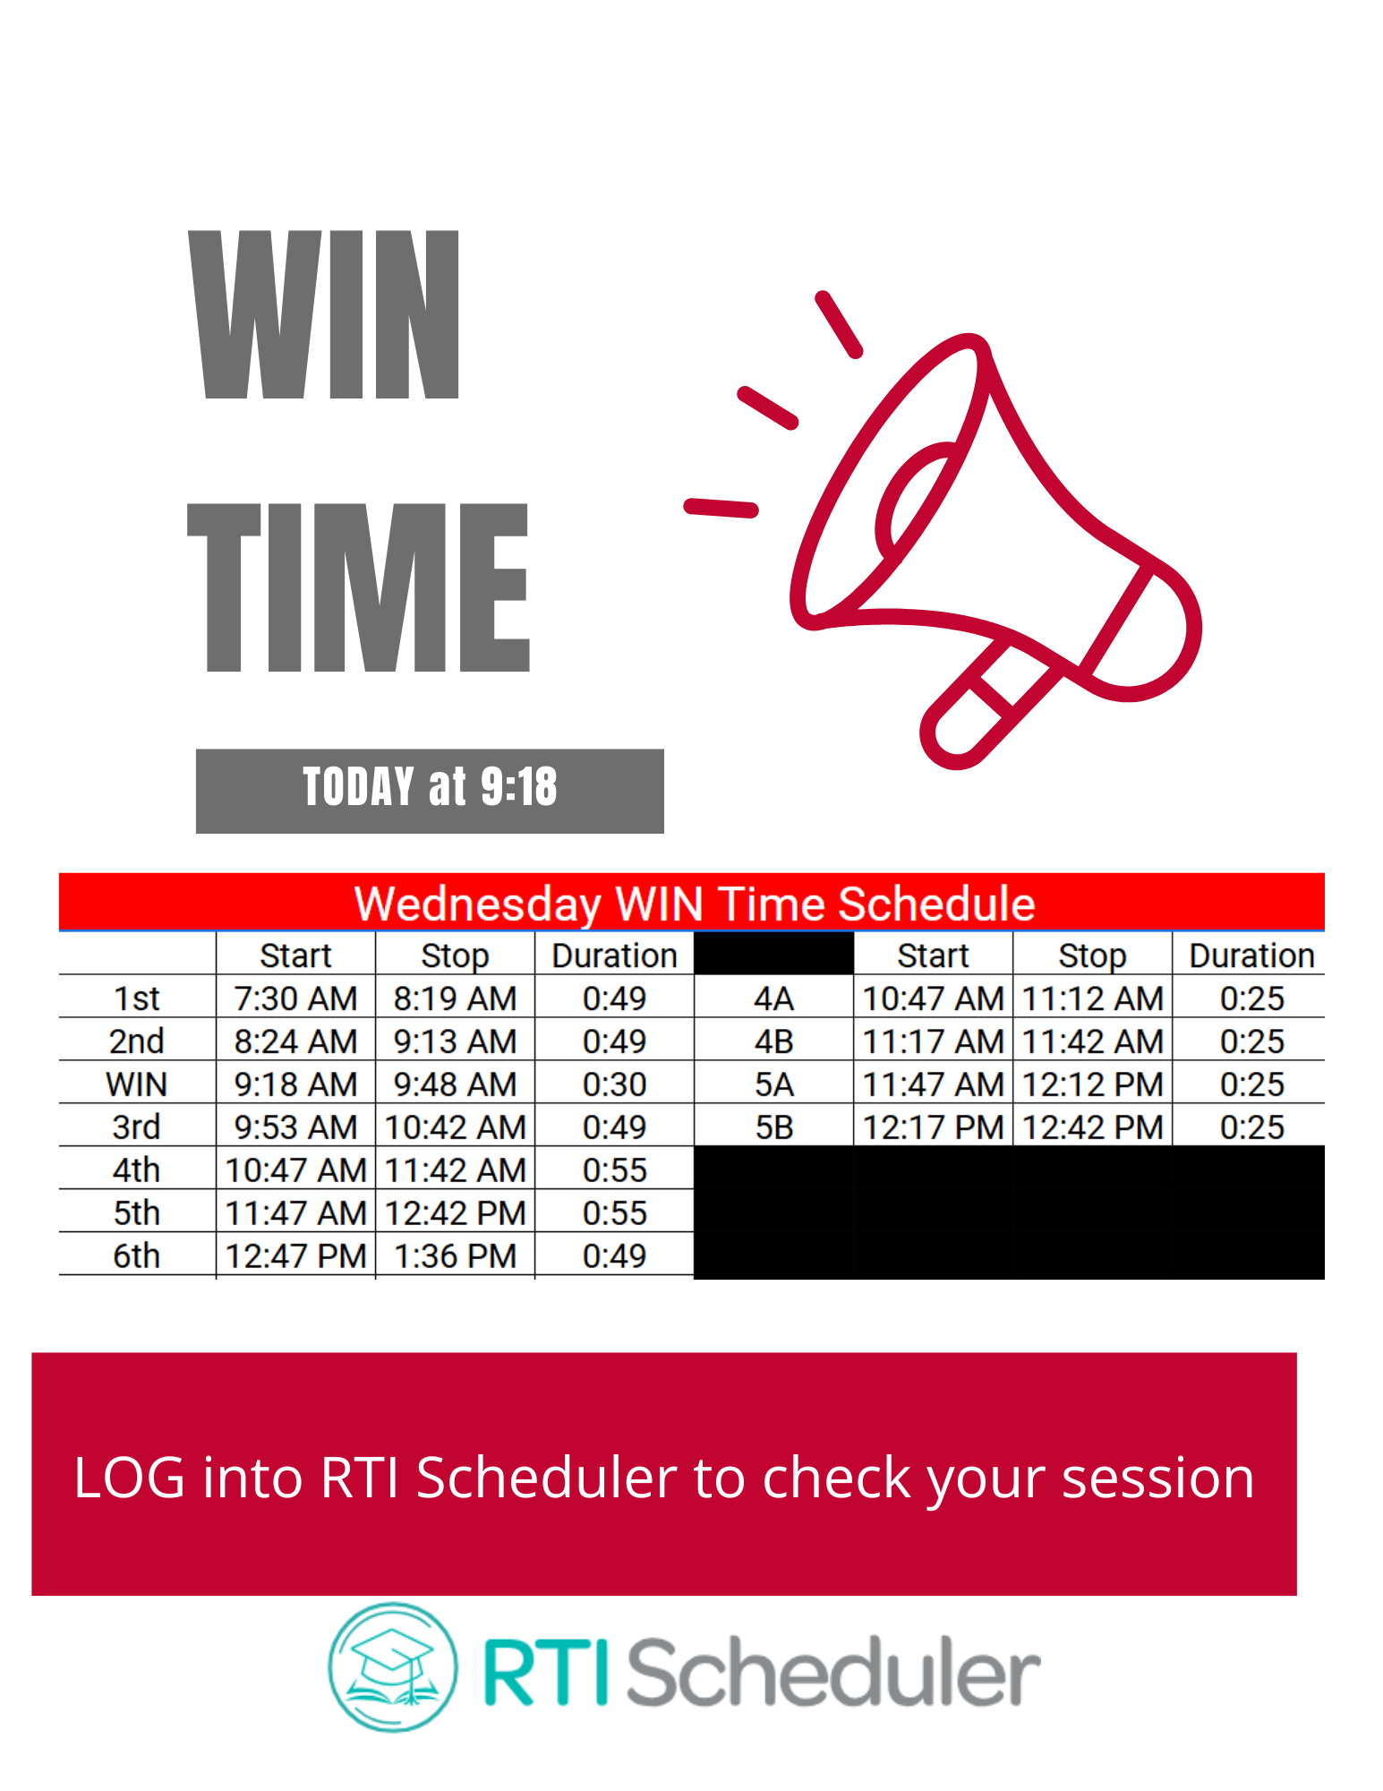
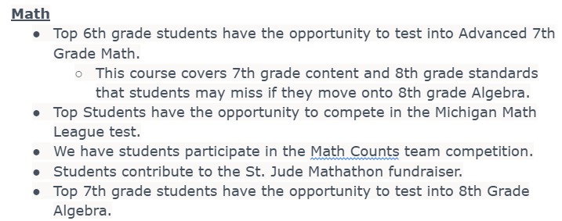
Question 3 & 4
Interventionist, WIN Time, Math Lab

Slide 27
JHS Links
PLC Outcomes Template
PLC 4 Question Data Protocol Template
PLC Promise Standard Template

Slide 28
The Elementary Story
Define what is “tight” in this process:
Elementary Master Schedules
Student Teacher Assistant Team: Defined process for STAT meeting
Meeting Schedules with Clear Agendas: Weekly meetings
Data Driven Decisions: Assessments and data reviewed and instruction is driven by these results.
After School and Summer School Programs, including enrichment
All hands on deck for learning!

Slide 29
Elementary Successes
Increases in FastBridge and M-Step Scores
Decrease in students who qualify for specially designed instruction via IEPs. A majority of students who qualify are students who haven’t had the benefit of our instruction and the PLC process.
Examples:
JRE 2024-2025 Inclusive Practice IEPs 18
(5 were move ins during this school year.)
JRE 2025-2026 Inclusive Practice IEPs 11

Slide 30
Research: Collective Efficacy
Collective teacher efficacy refers to the collective belief of teachers that they have the expertise to be able to positively impact students' learning.
John Hattie identifies collective teacher efficacy as having an extraordinary impact on student achievement, with an effect size of 1.57.

Slide 31
A PLC/PLT Data Celebration!
Our COLLECTIVE efforts are making a difference in:
Mathematics Achievement
ELA Achievement

Slide 32
Mathematics Achievement
2024 M-Step: Highest in Monroe County
3rd Grade
4th Grade
All three schools showed growth in 5th Grade Mathematics, with one school 3rd in the County.

Slide 33
Mathematics Achievement
2019 vs. 2024 Fastbridge: Mathematics
Average Achievement Percentile Rank:
2019: 49.7
2024: 62.3
Average Growth Percentile: (40-60 is Average Range):
2019: 49.7
2024: 61.7

Slide 34
ELA Achievement
2024 M-Step: Highest in Monroe County
3rd Grade
4th Grade
5th Grade
Other schools showed growth in 5th Grade Language Arts.

Slide 35
ELA Achievement
2019 vs. 2024 Fastbridge: ELA
Average Achievement Percentile Rank:
2019: 56
2024: 58.7
Average Growth Percentile: (40-60 is Average Range):
2019: 50.3
2024: 59

Slide 36
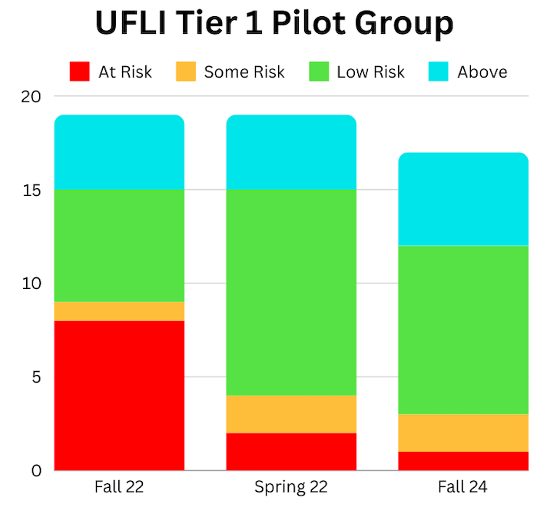
ELA Achievement:
The Science of Reading

Slide 37
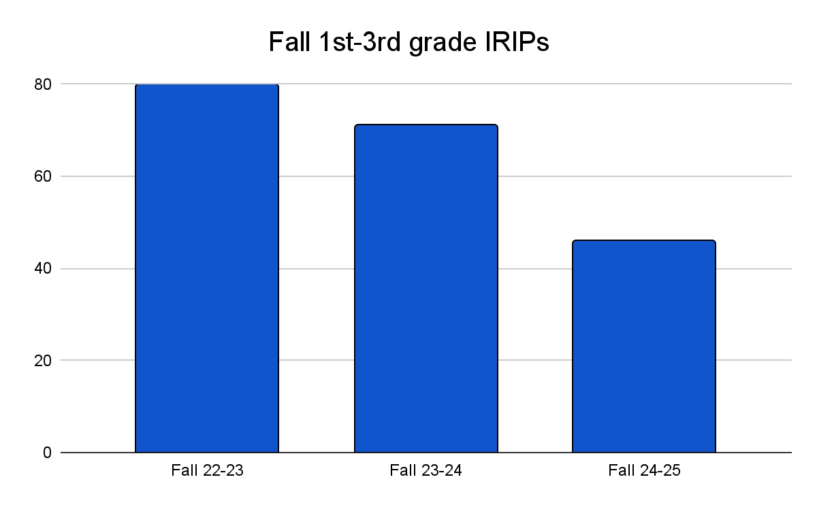
ELA Achievement:
The Science of Reading

Slide 38
JHS Achievement Highlights
8th Grade Reading and Writing 2024 PSAT:
75% Proficient
8th Grade Social Studies 2024 PSAT:
Highest in Monroe County among regular Public Schools

Slide 39
SHS Achievement Highlights
10th Grade Reading and Writing 2024 PSAT:
71.4% Proficient
Highest in Monroe County among regular Public Schools
10th Grade Math 2024 PSAT:
2nd in Monroe County among regular Public Schools

Slide 40
SHS Achievement Highlights
11th Grade SAT 2024:
2nd in Monroe County among regular Public Schools
Significant GROWTH in both ELA and Mathematics
College Readiness in ELA: 2nd in Monroe County
College Readiness in Mathematics: 1st in Monroe County

Slide 41
PLC Essentials:
Don’t be a PLCINO :)
Self Assessment:
4 = Sustaining, 3 = Building, 2 = Starting, 1 = Learning, 0 = Not Started
All educators work in collaborative teams and take collective responsibility for student learning (rather than working in isolation).
Implementation of a guaranteed and viable curriculum standard by standard, unit by unit. (Mathematics)
Monitoring of student learning through an ongoing assessment process that includes frequent, team-developed common formative assessments.
Use the results of common assessments to:
Improve individual teacher practice
Build the team’s capacity to achieve its goals
Intervene or extend for students according to their need
5) Provide systematic, embedded (during the day) interventions and enrichment

Slide 42
Remaining Challenges
Secondary WIN Time is just beginning
Elementary implementing new reading materials
Incorporating ELA into Elementary PLT Time

Slide 43
What questions do you have?
Questions???

Slide 44
Please REACH OUT…
Dr. Mark French
mark.french@mybedford.us
Call or TEXT:
708-921-7443

