Slide 1
COMMON FEDERAL PROGRAM AND FISCAL FINDINGS
Andrea Rogers, Regional Consultant, Office of Educational Supports
Shelly Patton, Interim Manager, Office of Educational Supports

Slide 2
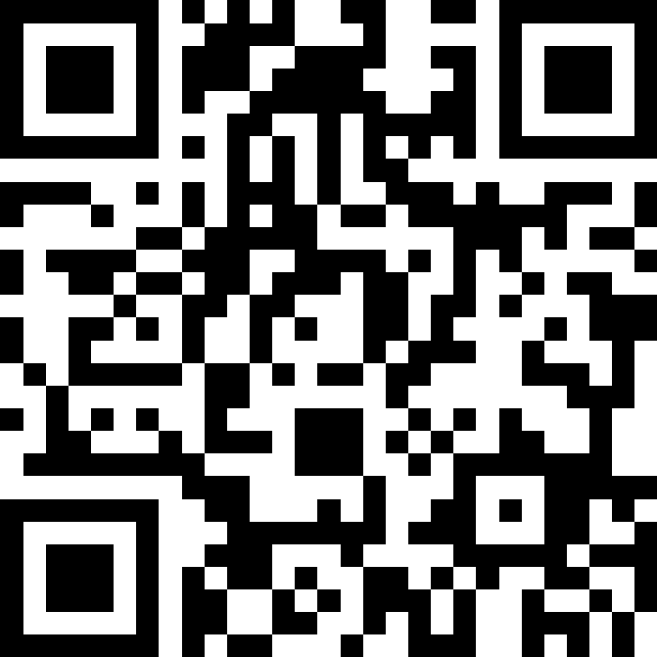
Please join our SLIDO
SLIDO NAME:
Common Findings MASFPS 2022.pptx
SLIDO CODE: 8508463

Slide 3
COMMON PROGRAM FINDINGS
Regional On-Site Review Materials

Slide 4
CURRICULUM SYSTEM
Year at a glance, pacing guides, units, standards, resources, vocabulary, essential questions, common assessments.
Not just a textbook, not only the standards.
Blank Curriculum Template
Curriculum Example
Notes:
MDE is in the process of developing and releasing Curriculum Guidance.

Slide 5
WRITTEN PROCESSES
Creation of written processes.
Implementation of written processes.
MAISD WRITTEN PROCESSES COLLABORATIVE

Slide 6
Parent and Family Engagement
Genuine family input (Title I plan, Family Engagement Plan, Compact, Title I meeting).
Genuine input into the planning, reviewing, and evaluating of Title I programs and activities.
Providing staff and parents with appropriate professional development.
Parent and Family Engagement Plan Template - OES
Color Coded Requirements – WP Collab.
Parent-Friendly Template
Family Engagement Presentation

Slide 7
Private Schools
Timely, meaningful, and ongoing consultation.
Accurate private school count data is vital to ensure calculations for the equitable share in NexSys are correct.
Amendments and required carryover.
Technical Assistance for Working with Private Schools

Slide 8
Professional Learning
Creating the plan with stakeholders.
Federally funded professional learning must be supplemental, sustained and ongoing.
Implementing the plan.
Blank Professional Development Plan
Professional Development Plan Example

Slide 9
Allowability of Activities/Programs
Does it meet the intent and purpose of the funding source?
Is it evidence based?
Is it reasonable, necessary, and allocable?

Slide 10
School Level Decision Making Authority
Title IA
Budget/program decisions, implementation, and evaluation authority remains at the school level.
The district is responsible for ensuring buildings understand intent and purpose and allowability.
Building staff plan for how the Title I, Part A funds will be spent at their building based on data and evaluating previous programming.
Building staff and administration and parents are involved in the process.

Slide 11
Written Entrance and Exit Criteria
Required for both Targeted and Schoolwide programs to determine which students are most at-risk and in need of services.
Use multiple assessments/data points.
Should be by subject area and grade level.
Teacher recommendation can be part of the criteria.
Written evidence that the written entrance and exit criteria was followed must be kept.

Slide 12
Identification of Immigrant Students
Ensure that you are asking the proper Immigrant Identification questions:
Was the student born outside of the US or Puerto Rico?
If yes, when did the student enter US schools?

Slide 13
Identifying Immigrant Students
The student has immigrated to the United States from another country and is aged 3 through 21 years, was not born in any State in America, and has not attended one or more schools in any one or more States for more than three full academic years. NOTE: The United States Department of Education (USED) includes foreign exchange students as eligible for Title III Immigrant programs.
CODE: 9130

Slide 14
Title III Immigrant Funding 2024
372 districts received an allocation.
149 of those districts did not apply for the funding.
$119,266 funds not applied for in FY 2024.
Title III EL and Immigrant Allowable Uses
Notes:
GET UPDATED INFO

Slide 15
English Learners
Language Assistance Plan:
The written plan is not what is being implemented in the district.
Home Language Survey:
NEW for implementation in 2025. ALL district are required to use the NEW HLS:
Questions:
What language is used most at home?
What language is used most by the student?
The HLS MUST include the paragraph
proceeding the questions.
Notes:
The NEW HLS questions only need to be asked to new students registering and do NOT need to be asked to all.

Slide 16
Please join our SLIDO
SLIDO NAME:
Common Findings MASFPS 2022.pptx
SLIDO CODE: 8508463

Slide 17
Common Fiscal Findings

Slide 18
Common Fiscal Findings
Individual expenditures must not exceed authorized amounts by more than 10 percent.
Obligation Date.
Misclassifications – Expenditures recorded in the wrong function and/or object code. Charging the incorrect building (Title I, Part A only) or program.
Michigan Accounting Codes Manual Appendix
Notes:
Examples of obligation date issues: ordering, registering for conferences, signing of contracted services, etc.

Slide 19
Common Fiscal Findings
Funding must benefit the students in the current budget year.
Coordination between program and business contact.
Gift/gas cards and student incentives.

Slide 20
Common Fiscal Findings
Failure to submit or certify the final expenditure report by November 29, resulting in a recovery by OES of all Title payments.
Time and effort documents that do not reflect the activity or time. Activity logs are important!
Expenditures for items not approved in the Consolidated Application.

Slide 21
Common Fiscal Findings
Amounts reported in the FER do not match amount recorded in general ledger.
Failure to retain general ledgers which support individual cash draws.
Paraprofessionals that do not meet HQ requirements.
Failure to maintain inventory listing that meets federal requirements.
Notes:
Important for business and program contacts to meet on a regular basis to ensure coordination. Note: when transferring funds, the funds don’t actually “move”. The district will charge back to the original funding source.

Slide 22
Common Fiscal Findings
Failure to have purchased services contracts that meet federal requirements.
Salaries and/or benefit amounts that exceed by more than 10% of the amounts approved in the Con App.
Hotel invoices at check-out are not provided to substantiate hotel charges.
Notes:
Check on purchased service contract requirements – what are the federal requirements and thresholds (what is the change)

Slide 23
Common Fiscal Findings
Agenda and sign-in sheets not provided for Title funded parent/family activities and in-house training (name of activity and date it occurred must be on the sign-in sheet) to confirm stipends.
Failure to have documented policies and procedures which cover:
Time and effort
Cash management
Allowability of cost
Conflicts of interest
Equipment management
Procurement
Travel reimbursement

Slide 24
Please join our SLIDO
SLIDO NAME:
Common Findings MASFPS 2022.pptx
SLIDO CODE: 8508463

Slide 25
Contact Information
Shelly Patton, Interim Manager, MDE/OES
PattonM@michigan.gov
Andrea Rogers, Education Consultant Region 2, MDE/OES
RogersA19@michigan.gov
517-241-6970

