Slide 1
State & Federal Programs 101 MASFPS Spring Conference
April 25, 2025
Link to Slide Deck
https://bit.ly/4jDOO8y

Slide 2

Lindsey Bolhouse, M.Ed.
Professional Pre-Kindergarten & Kindergarten teacher, Zeeland Public Schools - 10 years 4th grade teacher, Zeeland Public Schools - 5 years State & Federal Program Coordinator, Hudsonville Public Schools - 2 years Personal Married for 20 years to Cliff 17 year old twins (Claire and Carter) 1 precious dog named Teddy

Slide 3
Sam Ewing, MS Mathematics
Professional K-12 Teacher - 26 Years College Instructor - 15 Years Director of Federal Programs -17 years MASFPS Treasurer - 37 years Assisted over 300 schools to become Schoolwide Title I Personal Married 58 years to Dianne (quilter) 3 kids Teacher, Doctor and Rocket Scientist

Slide 4
Stand Up If….
Stand up if you’ve ever had to complete the CROSSACT Report 🙃
Stand up if you’ve ever had to explain the difference between state and federal funding
Stand up if your inbox has more than 20 unread emails 📧
Stand up if you support Title programs in your building or district
Stand up if you’ve ever had to explain your job to a colleague/friend/community member/school board, etc. 🤷‍♀️
Stand up if you’ve worked in education for longer than 10 years
Stand up if you feel proud of the impact your work has, even if it behind the scenes 🥇

Slide 5
Today’s Agenda:
Purpose of S & F Programs
Types of State and Federal Grants
District and School Improvement
Program Evaluation
Platforms
Resources
MASFPS
Q & A

Slide 6




What is the purpose of State and Federal Programs?
Promote Equity
Ensure all students — especially those who are disadvantaged — have access to high-quality education.
Supplement Local Funding (not supplant!)
Provide additional resources to meet student needs beyond what local funding can cover.
Support Targeted Interventions
Address academic achievement gaps and support student groups such as English learners, students in poverty, and students with disabilities.
Ensure Compliance & Accountability
Align district practices with state and federal education laws and expectations (e.g., ESSA, Title funding).
Foster Continuous Improvement
Encourage data-driven planning, monitoring, and support for school and district goals.
Local + State + Federal = Whole Child

Slide 7
Types of Grants/Funds
State Funds/Grants
Start with ‘Section’ followed by a number and a lower case letter
EXA. Section 31a (At Risk Funding)
Federal Funds/Grants/Programs
Start with ‘Title’ followed by a numeral and capital letter
EXA. Title IA (Improving Basic Programs)
Designated Grants
Only available to specify entities
Formula Grants
EXA. Section 31a (At Risk)
Legislation dictates the formula for how the funding is calculated
Competitive Grants
Based on a review of applications

Slide 8
Federal Programs Overview
Title IA: Improving Basic Programs
Supports students at risk of failing or in poverty
Funds can be used for additional staff, intervention programs, parent engagement, and professional development
Schools are either Targeted Assistance or Schoolwide based on poverty thresholds
Requires a schoolwide plan and stakeholder involvement
Title II, A: Supporting Effective Instruction
Professional development
Mentoring and coaching
Recruitment and retention of qualified staff
Reducing class size in targeted areas
Title III (EL): Language Instruction for English Learners
Focuses on English language development and academic achievement of EL students
Provides:
Language instruction programs
Professional learning for teachers
Family and community engagement
Districts must meet annual EL progress indicators (e.g., WIDA scores)

Slide 9
Federal Programs Overview
Title III (IM): Support for Immigrant Students
Separate from Title III, EL — targets recent immigrant students, regardless of English proficiency
Funds are allocated based on a significant increase in immigrant enrollment (compared to previous two years)
Supports supplemental services specifically for immigrant students and their families
Common uses include:
Newcomer programs or welcome centers
Family engagement and translation/interpretation services
Academic tutoring and orientation to U.S. school systems
Professional learning for staff on cultural responsiveness
Funds must be used in addition to core district responsibilities
May be directly allocated to districts or retained at the consortium/ISD level
Title IV, A: Student Support and Academic Enrichment
Flexible block grant with three focus areas:
Well-rounded education (e.g., arts, STEM, civics)
Safe and healthy schools (e.g., mental health, drug prevention)
Effective use of technology (e.g., digital tools, tech integration)
Must complete needs assessment for funding decisions

Slide 10
Michigan Programs Overview
Section 31a (At Risk)
Supports students identified as academically at risk
Commonly used for:
Intervention staff (academic or behavioral)
Social-emotional learning supports
Instructional materials and extended learning time
Requires a targeted plan based on data
Must align with a comprehensive needs assessment
Section 23g: MI Kids Back on Track
Tutoring Intervention and Support
Section 35a - Early Literacy Support
Funds targeted reading interventions in grades K–3
Supports literacy coaches, assessment tools, and professional development

Slide 11
District and School Improvement
Purpose
Drive continuous improvement in teaching, learning, and student outcomes
Align programs, funding, and strategies to identified student needs
MICIP
Resources
Agenda Examples from Hudsonville
District Continuous Improvement Team Meeting Agendas
School Improvement (Guiding Coalition) Agendas

Slide 12
Program Evaluation
Purpose
Ensure funds are making an impact on student achievement
Support ongoing improvement of programs and services
Meet state and federal compliance requirements
Connection to MICIP
Program evaluation is a key part of the MICIP Continuous Improvement Cycle:
Identify Needs (through CNA)
Plan strategies and align resources
Implement programs with fidelity
Monitor & Evaluate progress and impact
Adjust strategies and plans as needed
What to Evaluate
Student outcome data (achievement, growth, SEL, etc.)
Participation and implementation fidelity
Staff and stakeholder feedback
Alignment to district goals and strategy
Resources
Meaningful Program Evaluation- Bjorkman 2024
Hudsonville 1 Pager
Hudsonville Program Evaluation
Lakeview Example

Slide 13
Platforms
GEMS/MARS
Grant Electronic System/Michigan Administrative Review System
Access via MiLogin
NexSys
Next Generation Grant, Application, and Cash Management
Access via MiLogin
MEGS+
Michigan Electronic Grants System
Login Page

Slide 14
Resources from today’s presentation can be found in the Folder linked in the Bitly below or by clicking here.
https://bit.ly/3GkBpUt

Slide 15
MASFPS

Slide 16
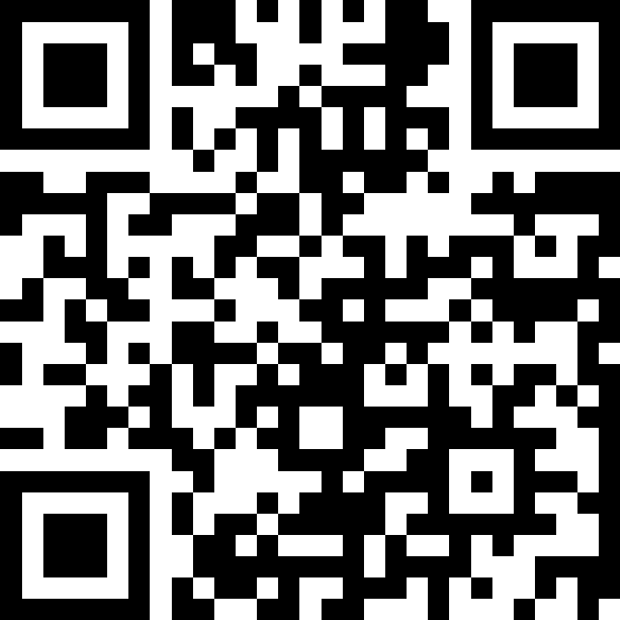
What questions do you have?

