Slide 1
Data Visualization and Storytelling Using Tableau Railroad Operations Analytics Dashboard Suite
DAS7000 – Data Analytics & Visualisation
Notes:
This presentation focuses on Task 2 of the DAS7000 assessment, which involves data visualisation and storytelling using Tableau. The project analyses U.S. railroad operations data and presents insights through a structured set of dashboards designed to support business and policy-level decision-making.

Slide 2
Task Overview
Clean, transform, and prepare the dataset from Data.gov
Create 4 interactive dashboards in Tableau
Build a narrative-driven Tableau Story
Provide business insights for transportation, planning & corporate strategy
Notes:
The objective of this task was to convert a large, complex dataset into meaningful business insights. This involved cleaning and transforming the data, building four interactive dashboards in Tableau, and developing a narrative-driven Tableau Story. The final outputs are aimed at stakeholders such as transportation planners, operational managers, and corporate strategists.

Slide 3
Dataset Summary
U.S. railroad dataset with 390,000+ records
Includes:
Train miles (freight, passenger, switching)
Employee man-hours
State & county
Railroad class & type
Parent company
Year & reporting period
Required significant data cleaning & transformation
Notes:
The dataset was sourced from Data.gov and contains over 390,000 records related to railroad operations across the United States. It includes operational metrics such as freight and passenger train miles, employee man-hours, geographic information, railroad class, and parent company ownership. Due to the size and structure of the data, extensive cleaning and transformation were required before analysis.

Slide 4
Data Preparation
Missing Values: median/mode imputation, unknown labels, remove empty rows
Outlier Removal: IQR method applied
Data Transformation: converted numeric fields, standardized categories
Exported cleaned dataset for Tableau
Notes:
Several preprocessing steps were applied to ensure data quality. Missing values were handled using median or mode imputation, while invalid or empty rows were removed. Outliers were identified and treated using the IQR method to prevent skewed analysis. Numeric fields were converted and categorical variables standardised before exporting the cleaned dataset into Tableau.

Slide 5
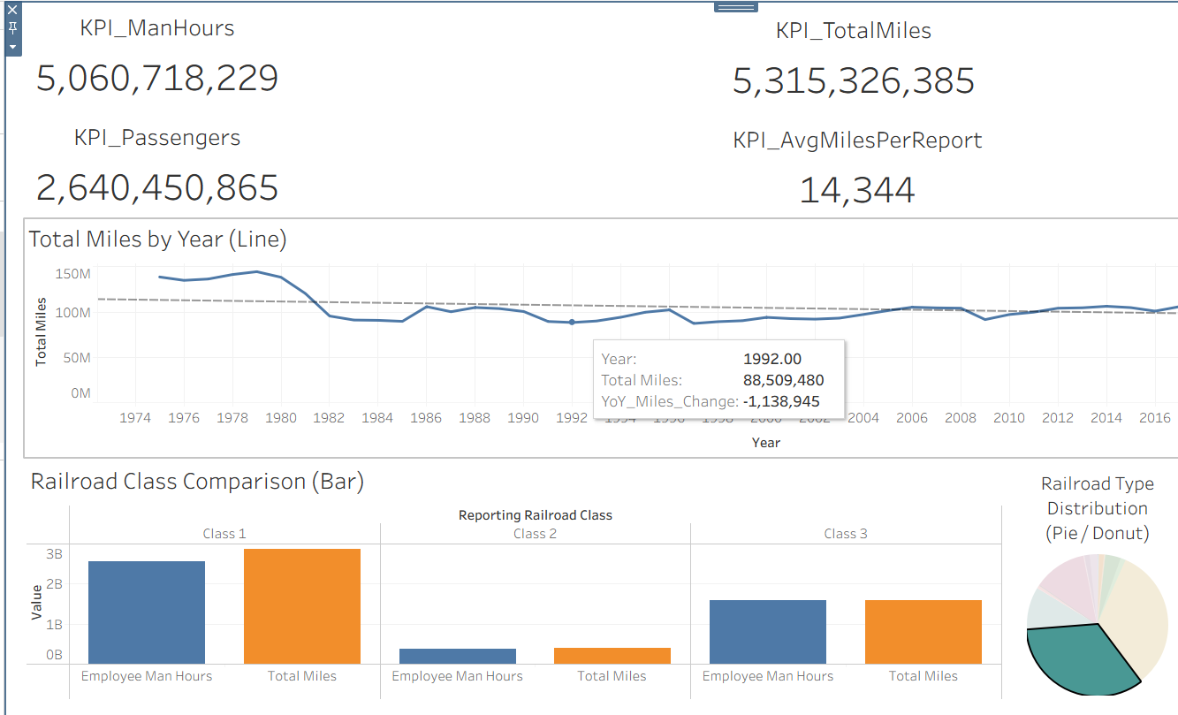
Dashboard 1: Executive Overview
KPI Cards: Total Miles, Passenger Miles, Man-Hours, Number of Railroads
Yearly trend in total miles
Class distribution comparison (Class 1, Class 2, Short Line)
Reporting completeness indicator
Shows national performance trends
Highlights growth or decline in rail activity
Class comparison reveals which classes dominate
Reporting completeness ensures data reliability
Sets context for deeper analysis in later dashboards
Notes:
The Executive Overview Dashboard provides a high-level summary of national railroad operations. KPI cards highlight total miles, passenger miles, employee man-hours, and the number of railroads. Yearly trend analysis shows changes over time, while class distribution comparisons reveal which railroad classes dominate the industry. A reporting completeness indicator helps establish data reliability and context for further analysis.

Slide 6
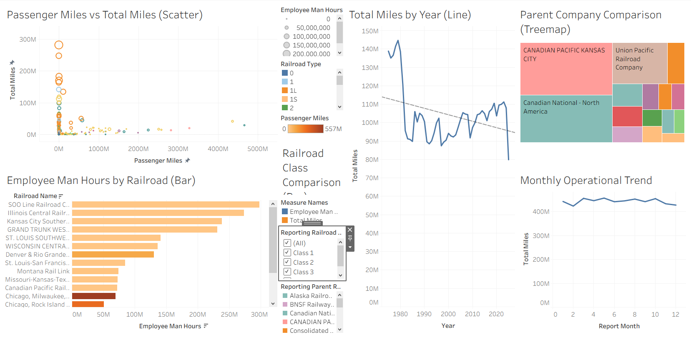
Dashboard 2: Operational Performance
Identifies labor-intensive railroads
Shows difference between freight-heavy vs passenger-heavy operators
Parent company dominance indicates corporate influence
Seasonal patterns support resource planning & optimization
Notes:
This dashboard focuses on operational efficiency and workforce exposure. It highlights labor-intensive railroads, differentiates between freight-heavy and passenger-heavy operators, and shows parent company dominance across the network. Seasonal trends are also included, supporting operational planning and resource optimisation throughout the year.

Slide 7
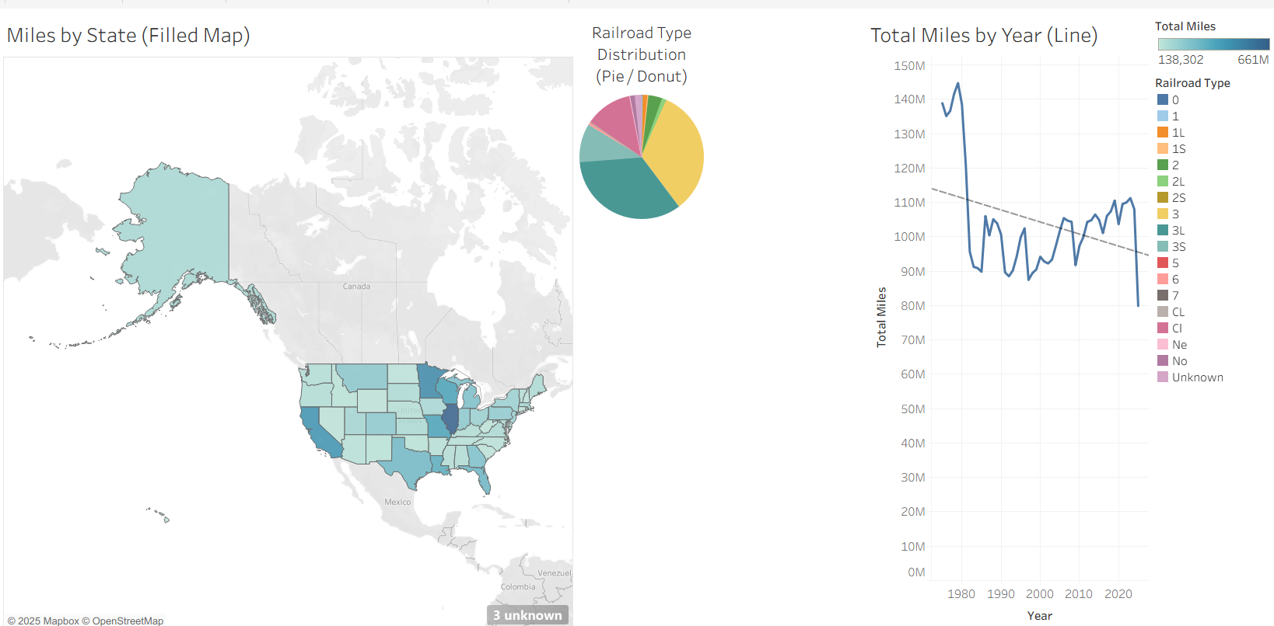
Dashboard 3: Geographic Operations
Identifies high-activity hotspots (TX, IL, CA, PA)
Supports infrastructure and funding decisions
Shows operational nature per state (freight, passenger, mixed)
Year-over-year trends show states with growing or declining activity
Notes:
The Geographic Operations Dashboard analyses railroad activity at a state level. It identifies high-activity hotspots such as Texas, Illinois, California, and Pennsylvania. The dashboard supports infrastructure investment and funding decisions by showing operational patterns, railroad types by state, and year-over-year trends that indicate growth or decline in activity.

Slide 8
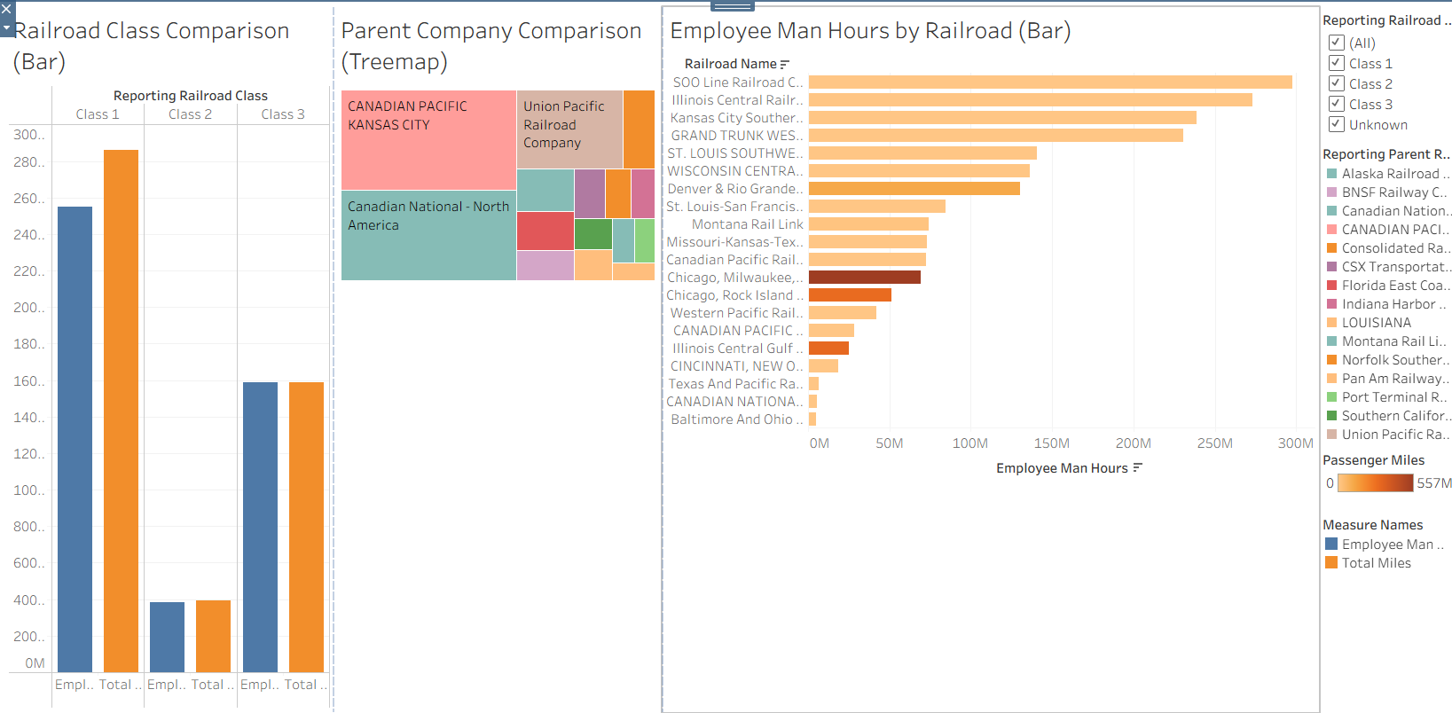
Dashboard 4: Parent Company & Corporate
Shows which corporations dominate U.S. rail operations
Identifies subsidiaries with high labor requirements
Class distribution helps strategic comparison
Supports benchmarking, investment decisions, and regulatory oversight
Notes:
This dashboard explores the corporate structure behind U.S. railroad operations. It highlights which parent companies dominate operational mileage, identifies subsidiaries with high labour requirements, and compares railroad classes at a corporate level. These insights support benchmarking, investment decisions, and regulatory oversight.

Slide 9
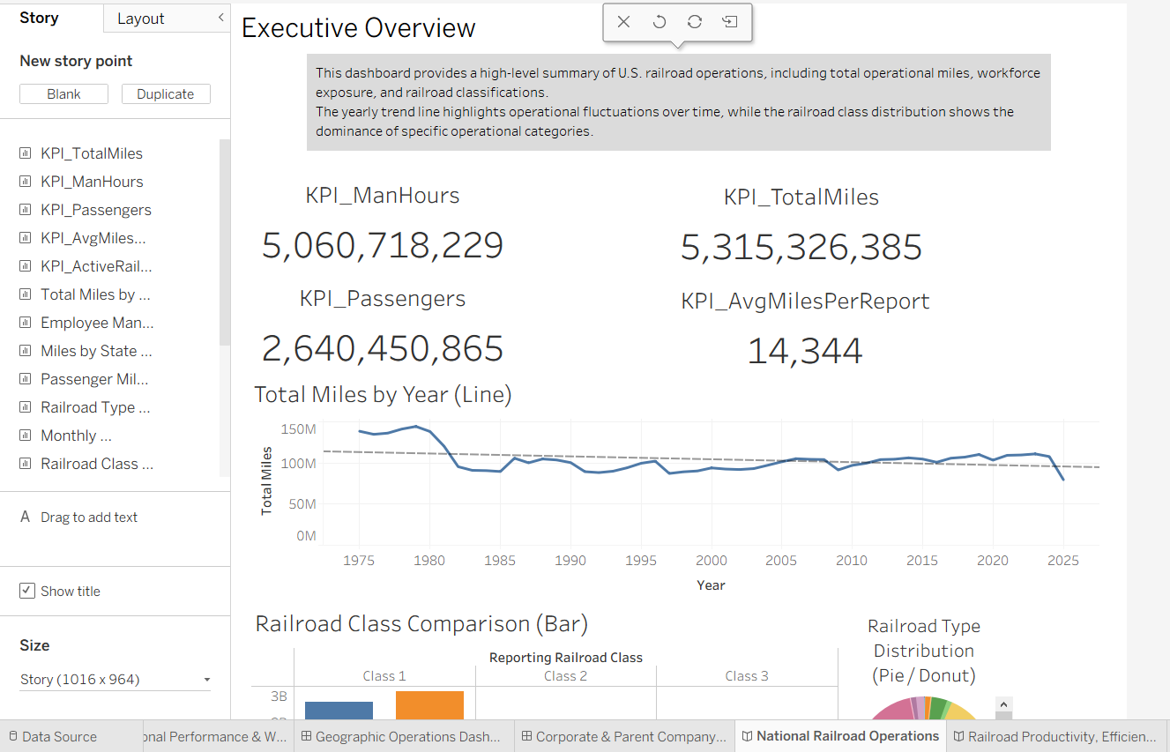
Purpose of the Story
Guides users through insights in a clear, narrative order
Improves understanding for non-technical stakeholders
Makes analysis actionable for decision-makers
Enhances communication with business users
Notes:
The Tableau Story connects all dashboards into a single narrative. It guides users through insights in a logical order, making complex analysis accessible to non-technical stakeholders. By structuring insights sequentially, the story ensures findings are actionable and aligned with business objectives.

Slide 10
Conclusion
Tableau dashboards provide insights across national, operational, geographic, and corporate levels
Help identify:
High-activity states
Corporate dominance
Labor-intensive railroads
Seasonal trends
Data reliability
Supports strategic planning, safety management, and infrastructure decisions
Notes:
In conclusion, the Tableau dashboards provide insights across national, operational, geographic, and corporate levels. They help identify high-activity states, corporate dominance, labour-intensive railroads, seasonal patterns, and data reliability. Overall, the solution supports strategic planning, safety management, and infrastructure decision-making in the U.S. railroad industry.

