Slide 1

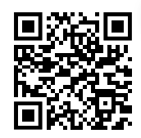
Intro to R: Get started with an RNA-seq dataset
Saritha Kodikara, Eva Hamrud
Aim for today:
Get everyone comfortable with using R
Timings:
9.30am first session
10.45am break
11am second session
12.15pm wrap-up – feedback!
12.30pm end
Getting help:
This is a hands-on session, feel free to explore and ask questions!
Sticky note system if you’re stuck
You will need:
A computer with R, Rstudio and tidyverse installed
HTML workshop document – our main focus of today
Padlet link – extra questions to challenge yourself
Find these links on our Github page (emailed to you or scan QR)

Slide 2
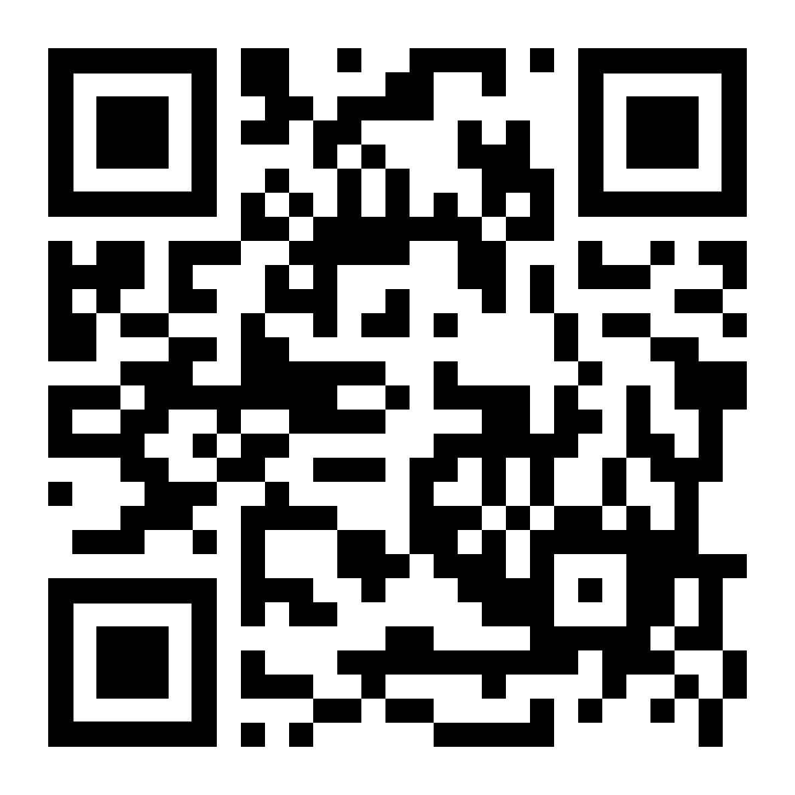

Intro to R: Get started with an RNA-seq dataset
Saritha Kodikara, Eva Hamrud
Aim for today:
Get everyone comfortable with using R
Timings:
9.30am first session
10.45am break
11am second session
12.15pm wrap-up – feedback!
12.30pm end
Please fill in this 3-question form before you leave!
It’s really important for you to send us feedback so that we can continue delivering these workshops!

