Slide 1

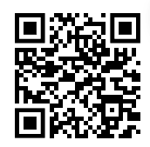
Intro to R: Get started with an RNA-seq dataset
Saritha Kodikara, Eva Hamrud
Welcome!
You will need:
A computer with R, Rstudio and tidyverse installed
HTML workshop document – our main focus of today
Padlet link – extra questions to challenge yourself
Find these links on our Github page (emailed to you or scan QR)
Please let us know before we start if you haven’t been able to install R, Rstudio and the tidyverse package

Slide 2
Intro to R: Get started with an RNA-seq dataset
Saritha Kodikara, Eva Hamrud
Aim for today:
Get everyone comfortable with using R
Timings:
9.30am first session
10.45am break
11am second session
12.15pm wrap-up – feedback!
12.30pm end
Getting help:
This is a hands-on session, feel free to explore and ask questions!
Sticky note system if you’re stuck
You will need:
A computer with R, Rstudio and tidyverse installed
HTML workshop document – our main focus of today
Padlet link – extra questions to challenge yourself
Find these links on our Github page (emailed to you or scan QR)

Slide 3
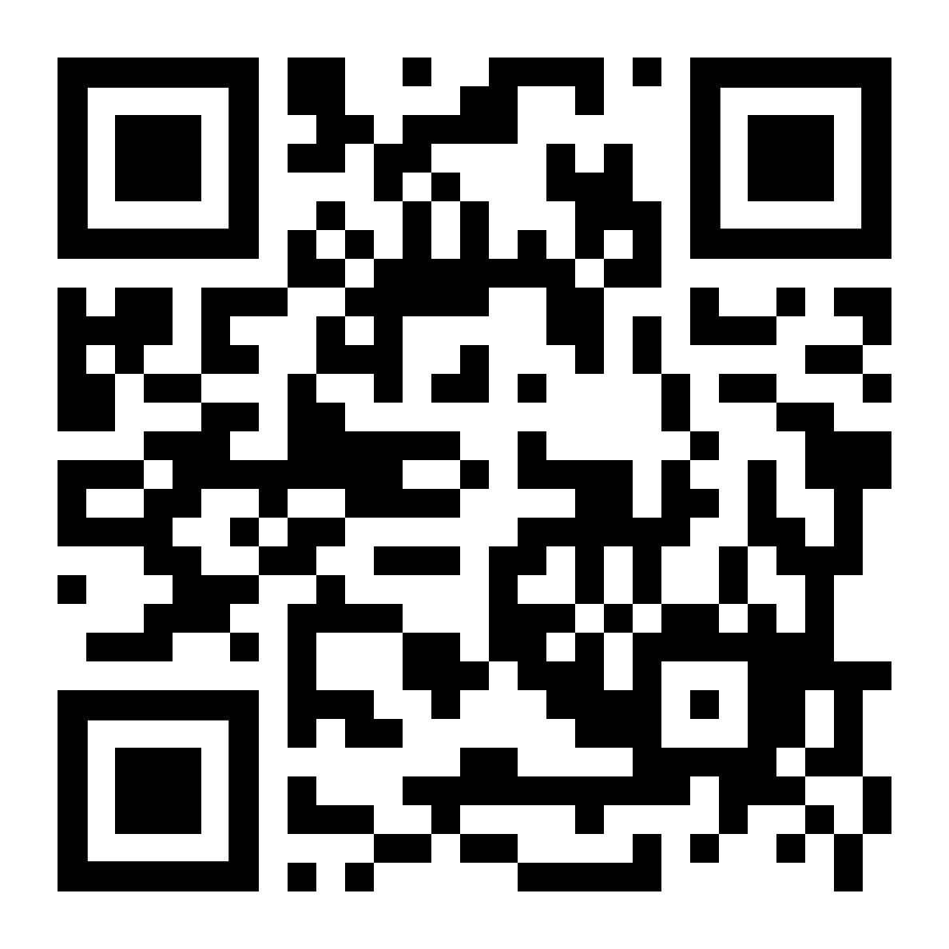

Intro to R: Get started with an RNA-seq dataset
Saritha Kodikara, Eva Hamrud
Aim for today:
Get everyone comfortable with using R
Timings:
9.30am first session
10.45am break
11am second session
12.15pm wrap-up – feedback!
12.30pm end
Please fill in this 3-question form before you leave!
It’s really important for you to send us feedback so that we can continue delivering these workshops!

