Slide 1

Application Performance Monitoring, Insights and Diagnostics using Application Insights
Taavi Koosaar
VS ALM MVP & DevOps Consultant

Slide 2
Lets start with a story …
A company was developing and hosting a SaaS that was running in several different datacenters. There were multiple copies and versions of the SaaS running for different groupings of customers.
Majority of feedback after deployment and while SaaS was running, came through Customer Support or Customer Training
The company had an application that had been built for long time with massive amount of functionality for its customers that had to be maintained
They needed to release updates to their SaaS more often

Slide 3
Lets start with a story …
With the massive amount of existing code that needed to be maintained – it became key to understand WHAT was acutally used by users?
With the ever increasing need to release more often with quality to all environments – they needed to get feedback faster and continuously
They needed to start being proactive, instead of reactive – the alternative was to keep firefighting and running where it burned the hardest. Never really being in control.

Slide 4
The answer was …
To use Application Performance Monitoring and …
Through tracing, events and metrices to monitor and understand users behavior and usage of SaaS
Through alerts and proactive diagnostics to be able to know when issues occured and to react faster, sometimes even automatically
Through connection between releases and APM to visually see the effects of the last deployment and mitigate early with patches
To monitor availability and performance live on the screens
To start removing functionality, that was rarely used and low business value, to drive down maintenance costs

Slide 5
What is Application Insights?
“Application Insights monitors your running web app. It tells you about failures and performance issues, and helps you analyze how customers use your app. It works for apps running on many platforms (ASP.NET, J2EE, Node.js, ...) and is hosted either in the Cloud or on-premises.”

Slide 6
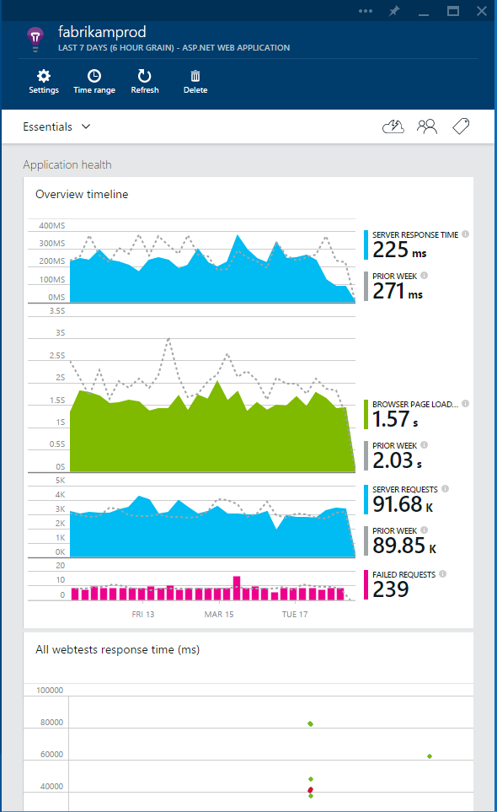
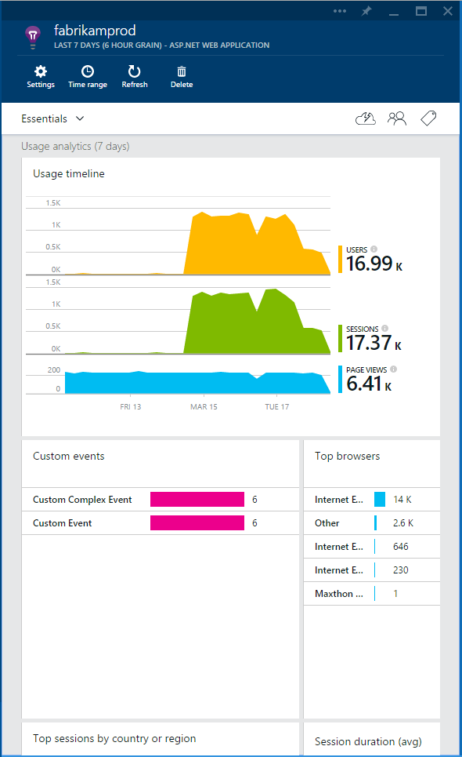
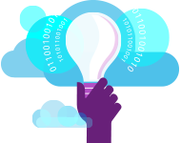
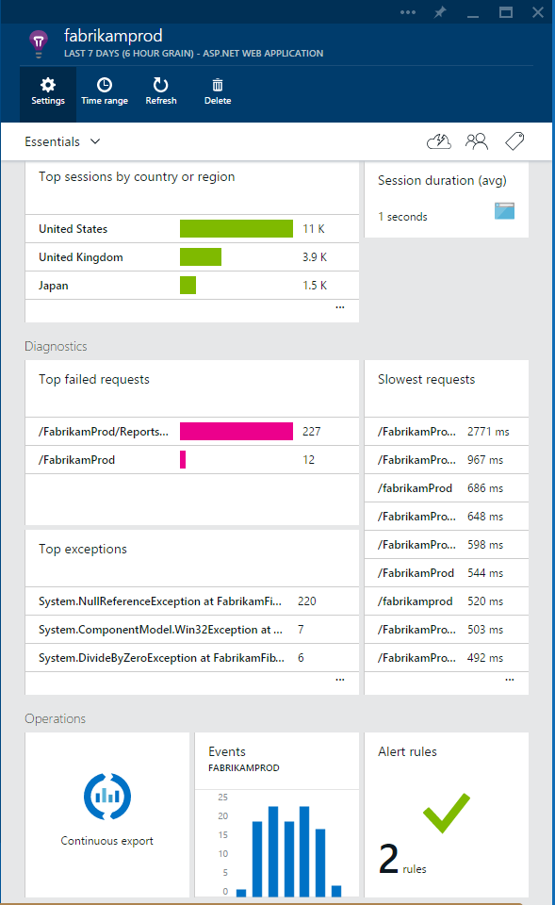

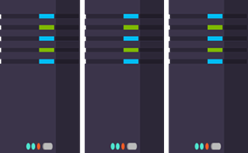
What is Application Insights?
3
1
Get a 360° view of the application including availability, performance and usage patterns
Telemetry is collected at each tier: server applications and browser
2
Telemetry arrives in the Application Insights service in the cloud where it is processed & stored

Slide 7




Sources of Telemetry
1
Outside-in monitoring
URL pings and web tests from 16 global points of presence
2
Observed user behavior
How is the application being used?
app
3
Developer traces and events
Whatever the developer would like to send to Application Insights
4
Observed application behavior
platform
No coding required – service dependencies, queries, response time, exceptions, logs, etc.
infrastructure
5
Infrastructure performance
System performance counters

Slide 8
Platforms and Features
Usage
monitoring
Ruby
WCF
PHP
Proactive
detection
Instrument
existing app
Availability
monitoring
Docker
Java / J2EE
nodejs
Azure Cloud Services
Server
and Client
Diagnostics
and Exceptions
ASP.NET
.NET Core
Client side (JS)
Windows Desktop
Performance
Windows Service
Python
Custom Events
Api Access
Custom metrices
Analytics
Application Map
Server Monitor
Web Tests
Performance Tests
Metrics Explorer
https://azure.microsoft.com/en-us/documentation/articles/app-insights-platforms/
https://github.com/search?q=org%3AMicrosoft+applicationinsight

Slide 9
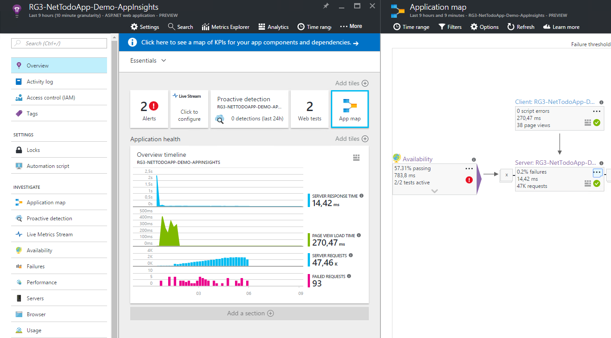
Demo: Implementation, Configuration and Analytics

Slide 10
More …
Release annotations - correlate performance implications with releases
API integration for reports, graphs, analytics (e.g. show info in dashboard of VSTS)
Create work items to VSTS / Github from search events or pro-active detection events
Performance testing / Availability Testing
HockeyApp for iOS, Android, Windows Store and Windows Phone apps
Transition to HockeyApp
Documentation for Application Insight is comprehensive!

Slide 11
Pros and Cons
Pros
Mostly agentless, except for Status Monitor for IIS
Deployes with your code
Easy configuration and implementation to get going
Pricing
Cons
Currently in Preview & data in West US
Only in the cloud
Alternatives
Dynatrace, AppDynamics, Newrelic, …
ELK stack (Elastic Stack) – Kibana, logstash | apache kafka, elastic search, …

Slide 12
Getting started
Easiest to add the nuget package to your project
Microsoft.ApplicationInsights
Instrument existing applications using Status Monitor, Azure AI extenion, HttpFilter
IIS, ASP.NET, Java, ACS
If you dont have a project to play with – take one from Azure Samples
https://azure.microsoft.com/en-us/documentation/samples/
Or go to Get Started on the Application Insight resource in Azure Portal

Slide 13
Thank you!
Taavi Koosaar
taavik@solidify.se | @melborp | melborp.net

Slide 15
Demo details to replicate
Demo is based on Document DB with ASP.NET MVC on Azure code sample
My Application Insight customizations are at https://github.com/melborp/documentdb-dotnet-todo-app-complex (branch event)
You can find all Azure Code Samples
with all combinations of application insights supported platforms e.g. java, nodejs, ACS, etc and easily trial adding app insights

Slide 16
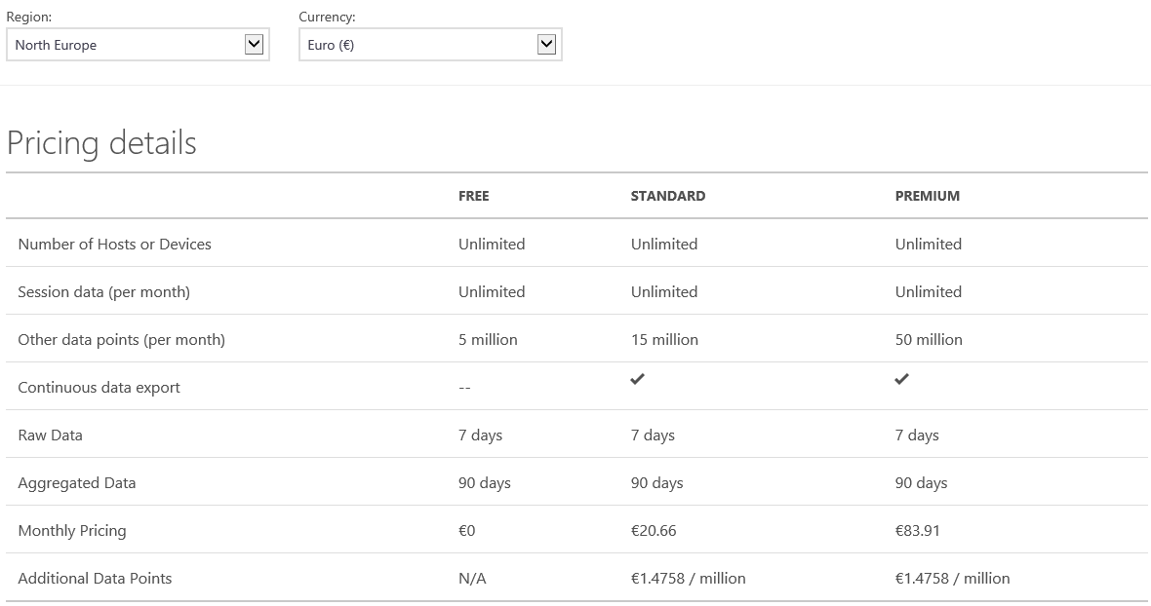
Pricing (end of august)

