Slide 1
Tutorial 10
COMP90014 Algorithm for Bioinformatics
Semester 2, 2025

Slide 2
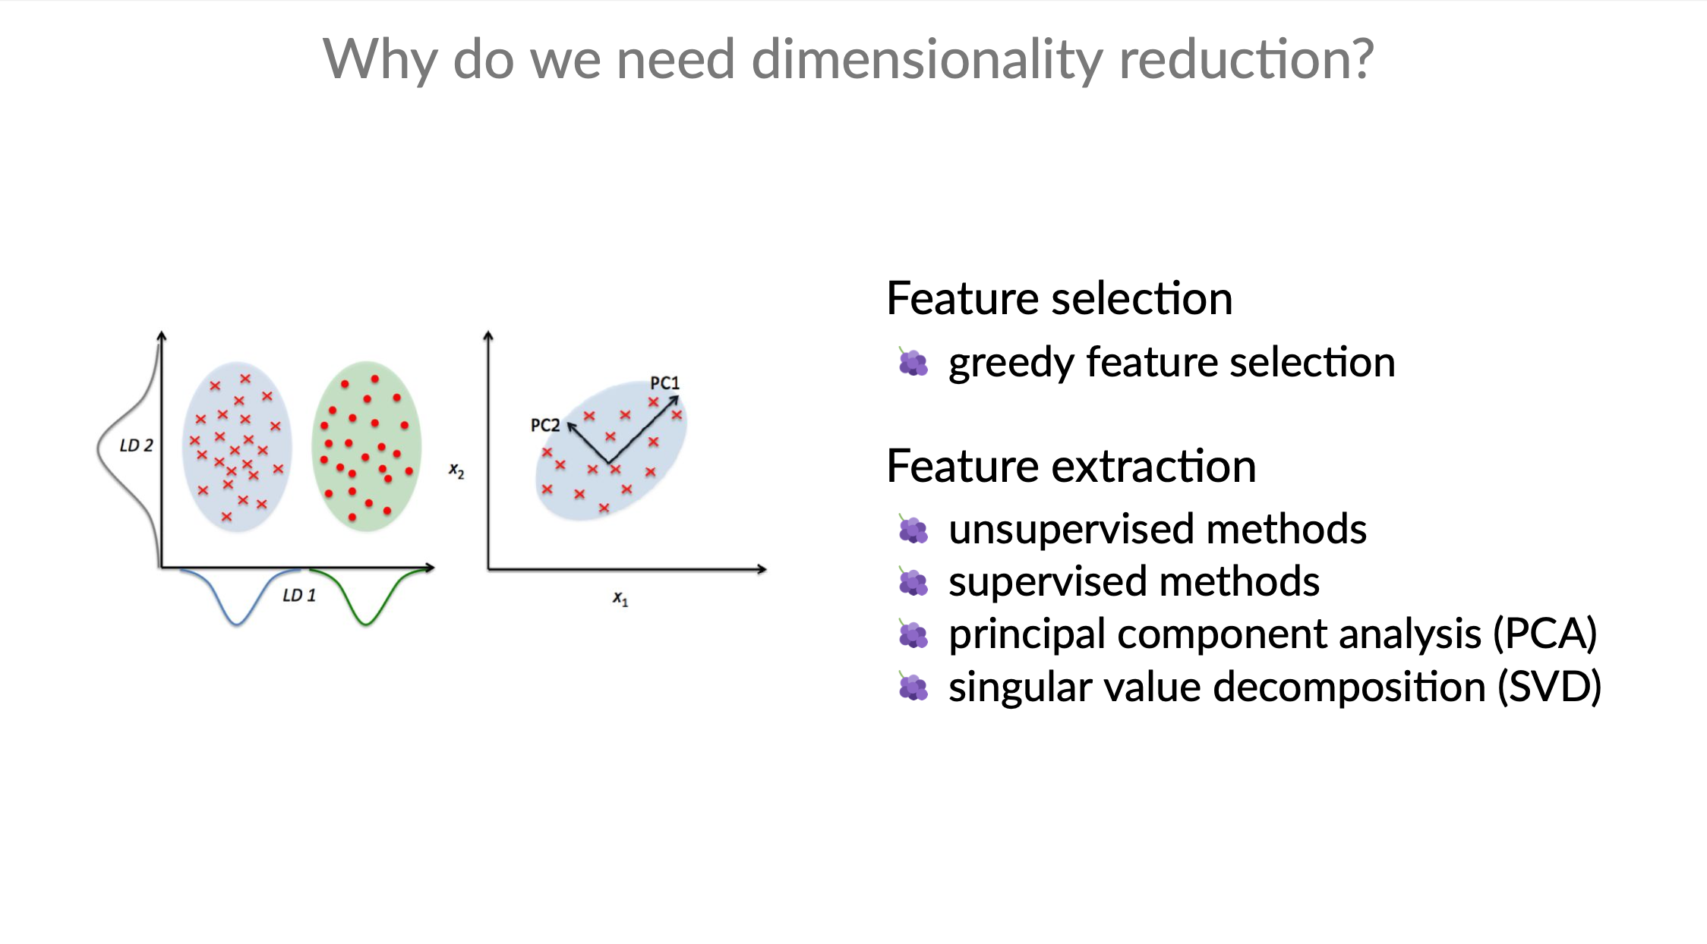

Slide 3
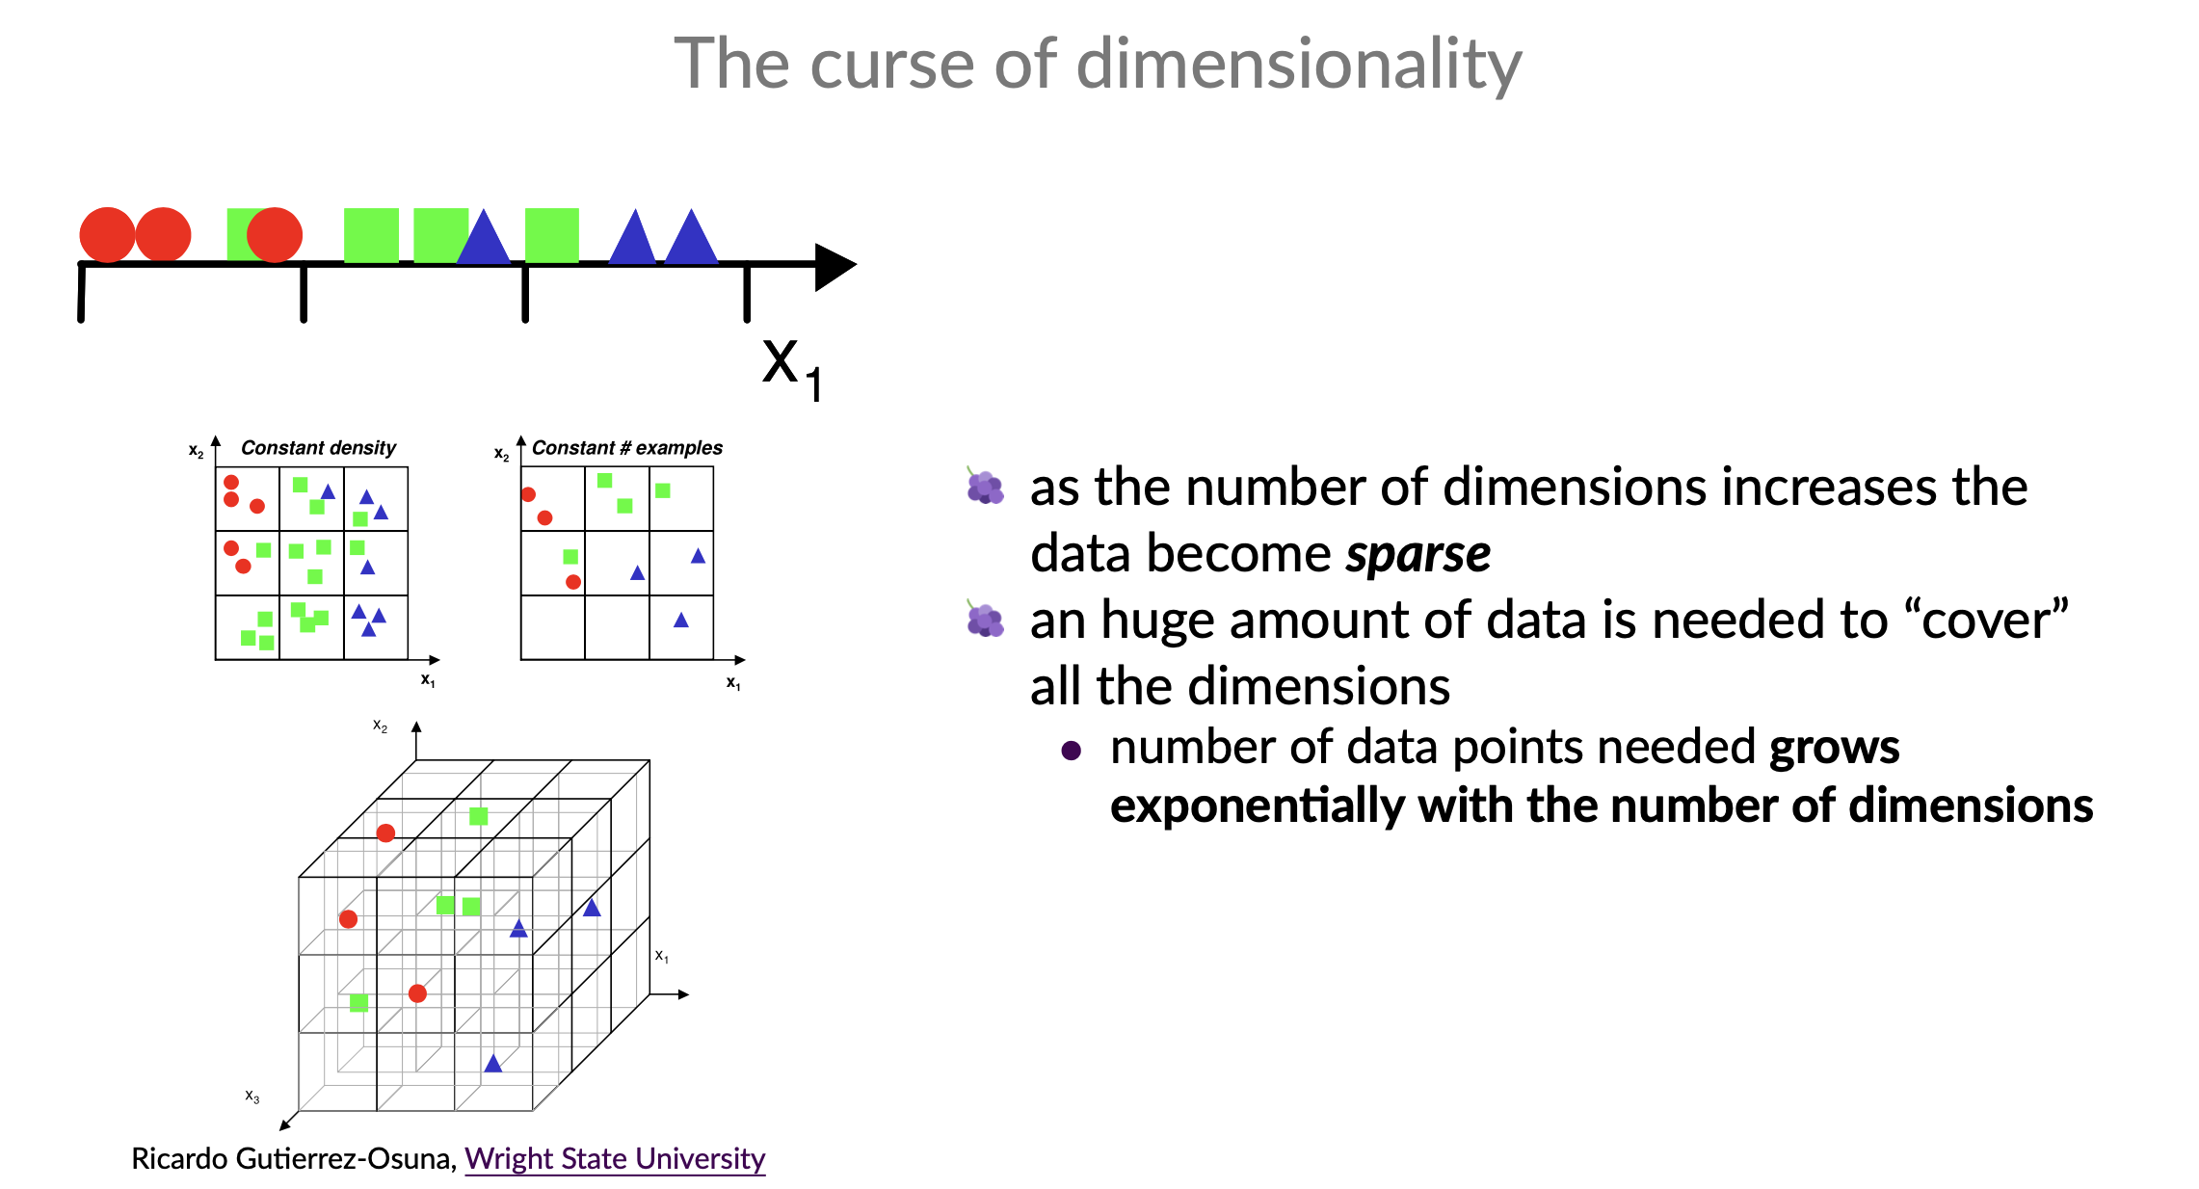
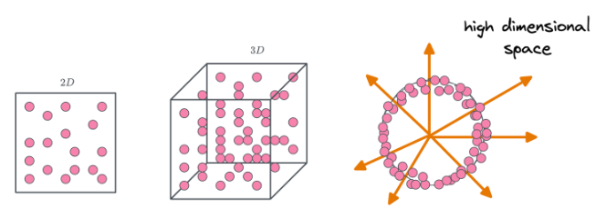
https://www.dailydoseofds.com/a-mathematical-deep-dive-into-the-curse-of-dimensionality/

Slide 4
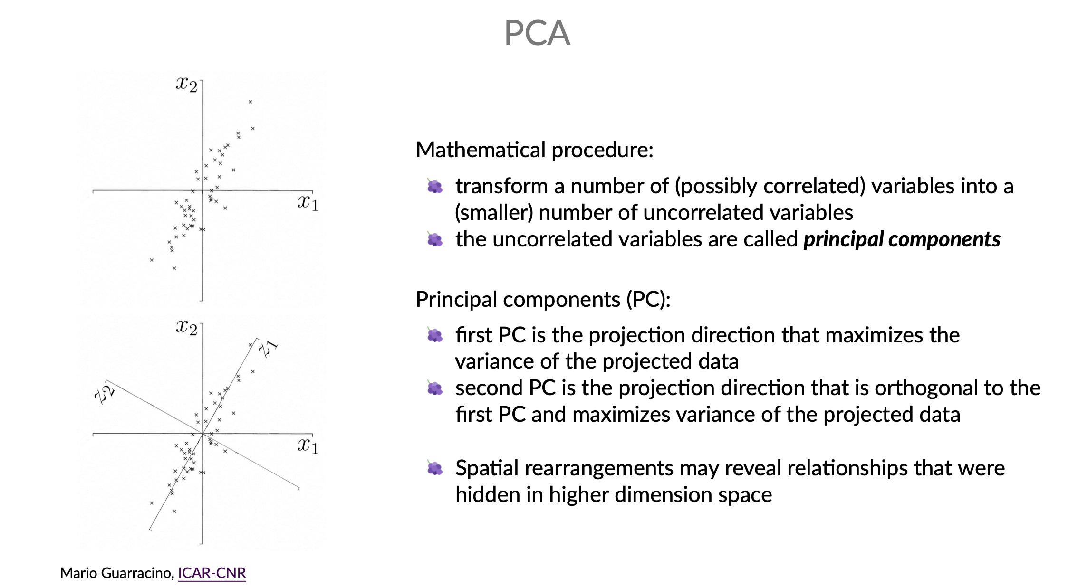

Slide 5
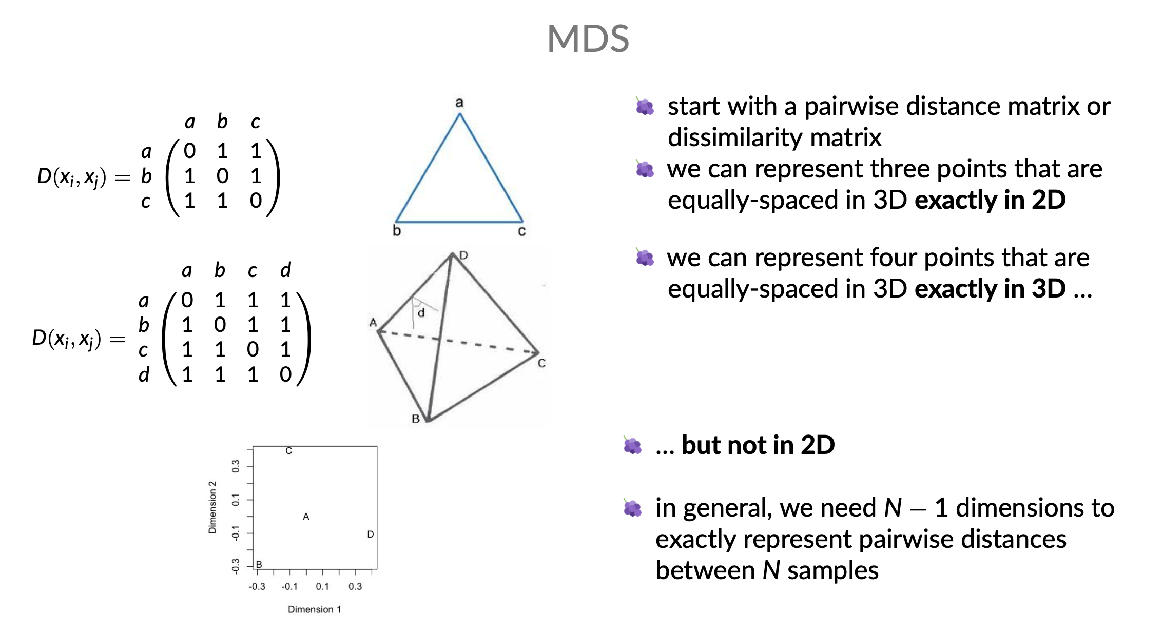
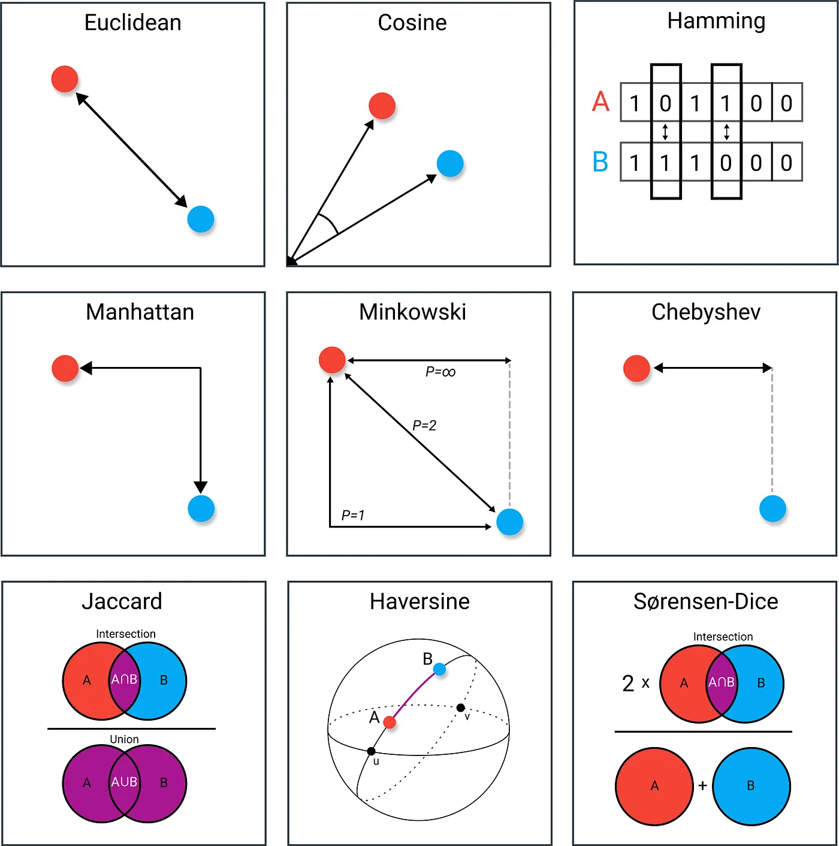

Slide 6
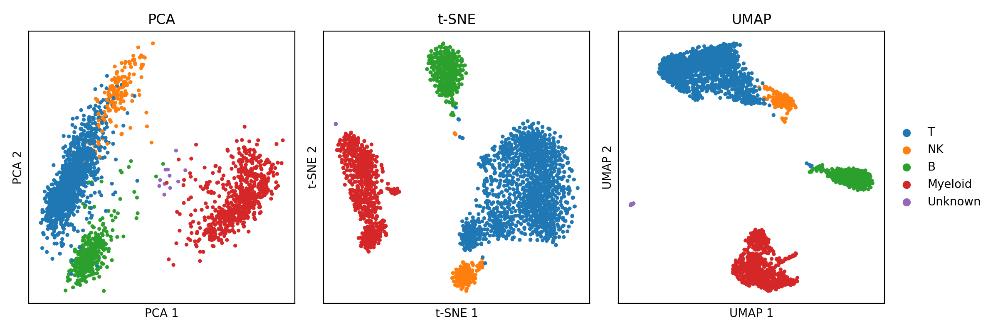
T-SNE vs UMAP
https://pair-code.github.io/understanding-umap/
https://distill.pub/2016/misread-tsne/

