Slide 1

Introduction to Unix
Melbourne Bioinformatics
Workshop written by Steven Morgan
Special thanks to Gayle Phillip, Bernie Pope and Andrew Robinson
Notes:
Like Vicky said I’m Steven from Melbourne Bioinformatics and I use he and him pronouns.
This is the introduction to Unix workshop and I have to make special mention of the colleagues listed at the bottom of the slide.
And by the way these slides are available online and they will remain so after the workshop. There is a link in the training material so you won’t have to frantically take notes or photos; it’s all there for you.

Slide 2

About this workshop
This workshop is for people new to Unix.
We aim to teach you the basics.
We hope that afterwards you will have the tools to discover the rest of the system on your own.
Notes:
If you know nothing about Unix at all, this workshop is for you. If you have some limited knowledge that’s great too. In this workshop we go through the basics of Unix programming, which is really just the tip of the iceberg. Once you have this foundation we hope that you will be able to build on that knowledge on your own afterwards.

Slide 3


About this workshop
The workshop will consist of:
Introductions to each topic.
Some code along activities.
Hands-on tasks.
This workshop is split into 8 sections.

Slide 4


What is Unix?
Unix is an operating system that consists of a set of programs that act as a link between a computer and users.
Unix is everywhere. Apple MacOS, iOS, Linux and Android OS are all derived from Unix.
9:30
Notes:
So what is Unix? It’s a set of programs that act as a link between you the user and a computer. You write commands, provided that they are in the right syntax, and they can be interpreted and some sort of action can be taken by the computer. Now it’s not new, it’s been around since the 1960s. And since then it’s become the basis for a lot of the operating systems that run the technology we use every day.

Slide 5


Why Unix?
Unix is flexible and robust.
Philosophy: Do one thing and do it well.
Use these simple tools together to achieve complex tasks.
Notes:
Unix remains popular because of it’s robustness and flexibility.

Slide 6






Command line interface
user@host $ command
user@host $
Graphical User Interface (GUI)
Command Line Interface (CLI)
Notes:
We will be entering our Unix commands into a command line interface (on the right here). It’s a text based interface. You type your commands and your output is returned to you in text. That differs from what you might be more used to which is a graphical user interface (or GUI) on the left where you have have pictures on your screen you have icons to click on, you have windows and a mouse as aids. So why use a CLI? Well it takes resources to render the graphics. The graphics in some ways are a limitation. And that’s not to say command line interfaces are superior, it’s just another way of working.

Slide 7
Command prompt
beta@test-i5:~/samples$
Username
Host
Working directory
Prompt
Type your commands here!

Slide 8
Command syntax
$ cal -j -m february
Command
Flag
Option

Slide 9
Command syntax
$ cal -j -m february
Command
Flag
Option

Slide 10
Command syntax
$ cal -j -m february
Command
Flag
Option
Notes:
Separated by whitespace.

Slide 11

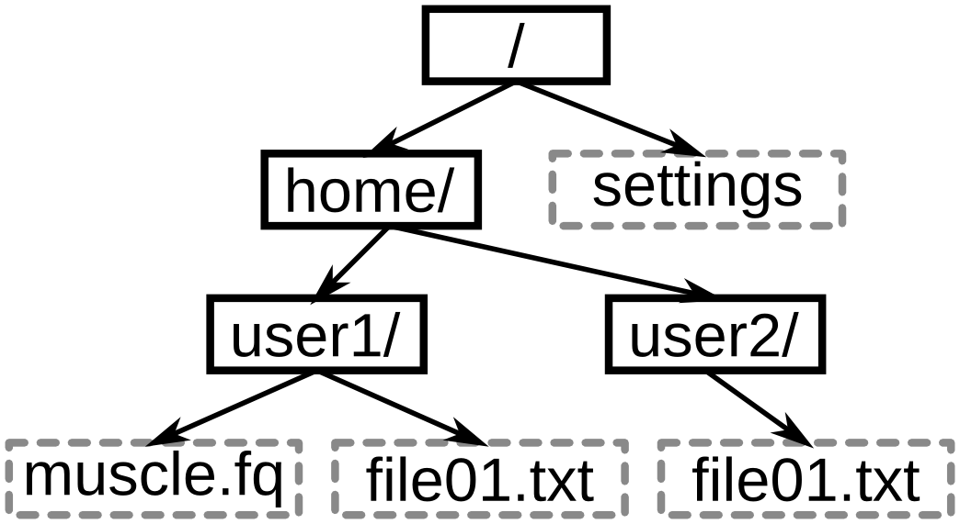
File system
Directory/Folder
Root
File
Notes:
One important concept is the file system. And specifically this tree structure. You can see how it’s set up like a hierarchy with directories (another word for folder) in solid boxes and files in dotted boxes. The very top level is called root and its signified with a forward slash.

Slide 12
Absolute paths
Absolute (full) path to muscle.fq:
/home/user1/muscle.fq
Notes:
One way to refer to a directory or an object is called an absolute path (or a full path). And it traces a path through the tree from the root. Example

Slide 13
Absolute paths
/home/user2/
Absolute (full) path to user2:

Slide 14
Where am I?
pwd
command prints the full path of the current working directory
Notes:
The pwd command help us to answer the question where am I? It will give the you the full path of the directory you are currently in (we call that the current working directory)

Slide 15

Relative paths
Current working directory
Relative path:
user1/
Notes:
The other way to specify a file or directory (other than the full path) is to use a relative path. Importantly the path is relative to the current working directory. So if the current working directory is home, instead of writing the full path to user1 directory, you can use a relative path. Notice it doesn’t begin with a slash, because we don’t need to start at the root.

Slide 16
Relative paths
Current working directory
Relative path:
user1/muscle.fq

Slide 17

Special file names
/ Root directory
~ Home directory
. Current working directory
.. Parent of current working directory
Notes:
Some special file names to be aware of.

Slide 18



Remote login
Network
Local computer
Remote computer
Notes:
As you know already, today we will be making a connection to a remote computer. This means that you will be typing commands on your computer and they will be executed by a computer located somewhere else (a Nectar data centre somewhere). Why are we doing this? Well it means that everyone here will get an identical environment that isn’t influenced by what’s on your local device. We also have some data files on there that we will be talking about later.

Slide 19

Remote login
Network
Local computer
Remote computer
https://ardc.edu.au/services/nectar-research-cloud/
Special thanks to Simon Gladman and Catherine Bromhead for supporting this workshop.
Notes:
We have the Nectar research cloud to thank for the remote machines today. There’s a link at the bottom of the slides if you are interested in learning more. And special thanks to Simon and Catherine who helped with the workshop setup.

Slide 20
Remote login
Network
Local computer
High performance computing system
Notes:
And of course another reason is to practice making the remote connection, because this is exactly the same process as you would use to connect to other remote servers, which could include a high-performance computing system. That’s a shared resource that you may have access to via your institution that will help you to accomplish computational tasks that are too strenuous for your local machine. The HPC system at the University of Melbourne is called Spartan.

Slide 21

Tips
Commands are case sensitive
Avoid whitespace in filenames
try_underscores
Pay attention to error messages.
Help is just an internet search away.
Notes:
Some other important tips.

Slide 22


Your turn
To the training material!

