Slide 1


DOKUZ EYLUL UNIVERSITY
FACULTY OF ENGINEERING
PROJECT PRESENTATION
for
CME 4403 Term Project
Melda karadağ - 2014510048

Slide 2
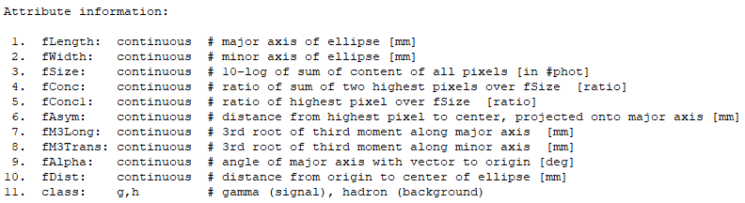
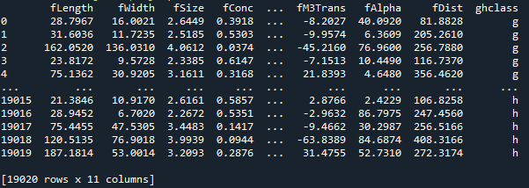
descrıptıon
My data set is MAGIC Gamma Telescope Data Set. The number of instances in my data set is 19020. It has 11 attributes. There aren't any missing value. Target value is categoric and feature values are continuous. Since there is no missing value, no data cleaning has been done. I trained my data set using K nearest neighbors and Decision Trees machine learning models.

Slide 3
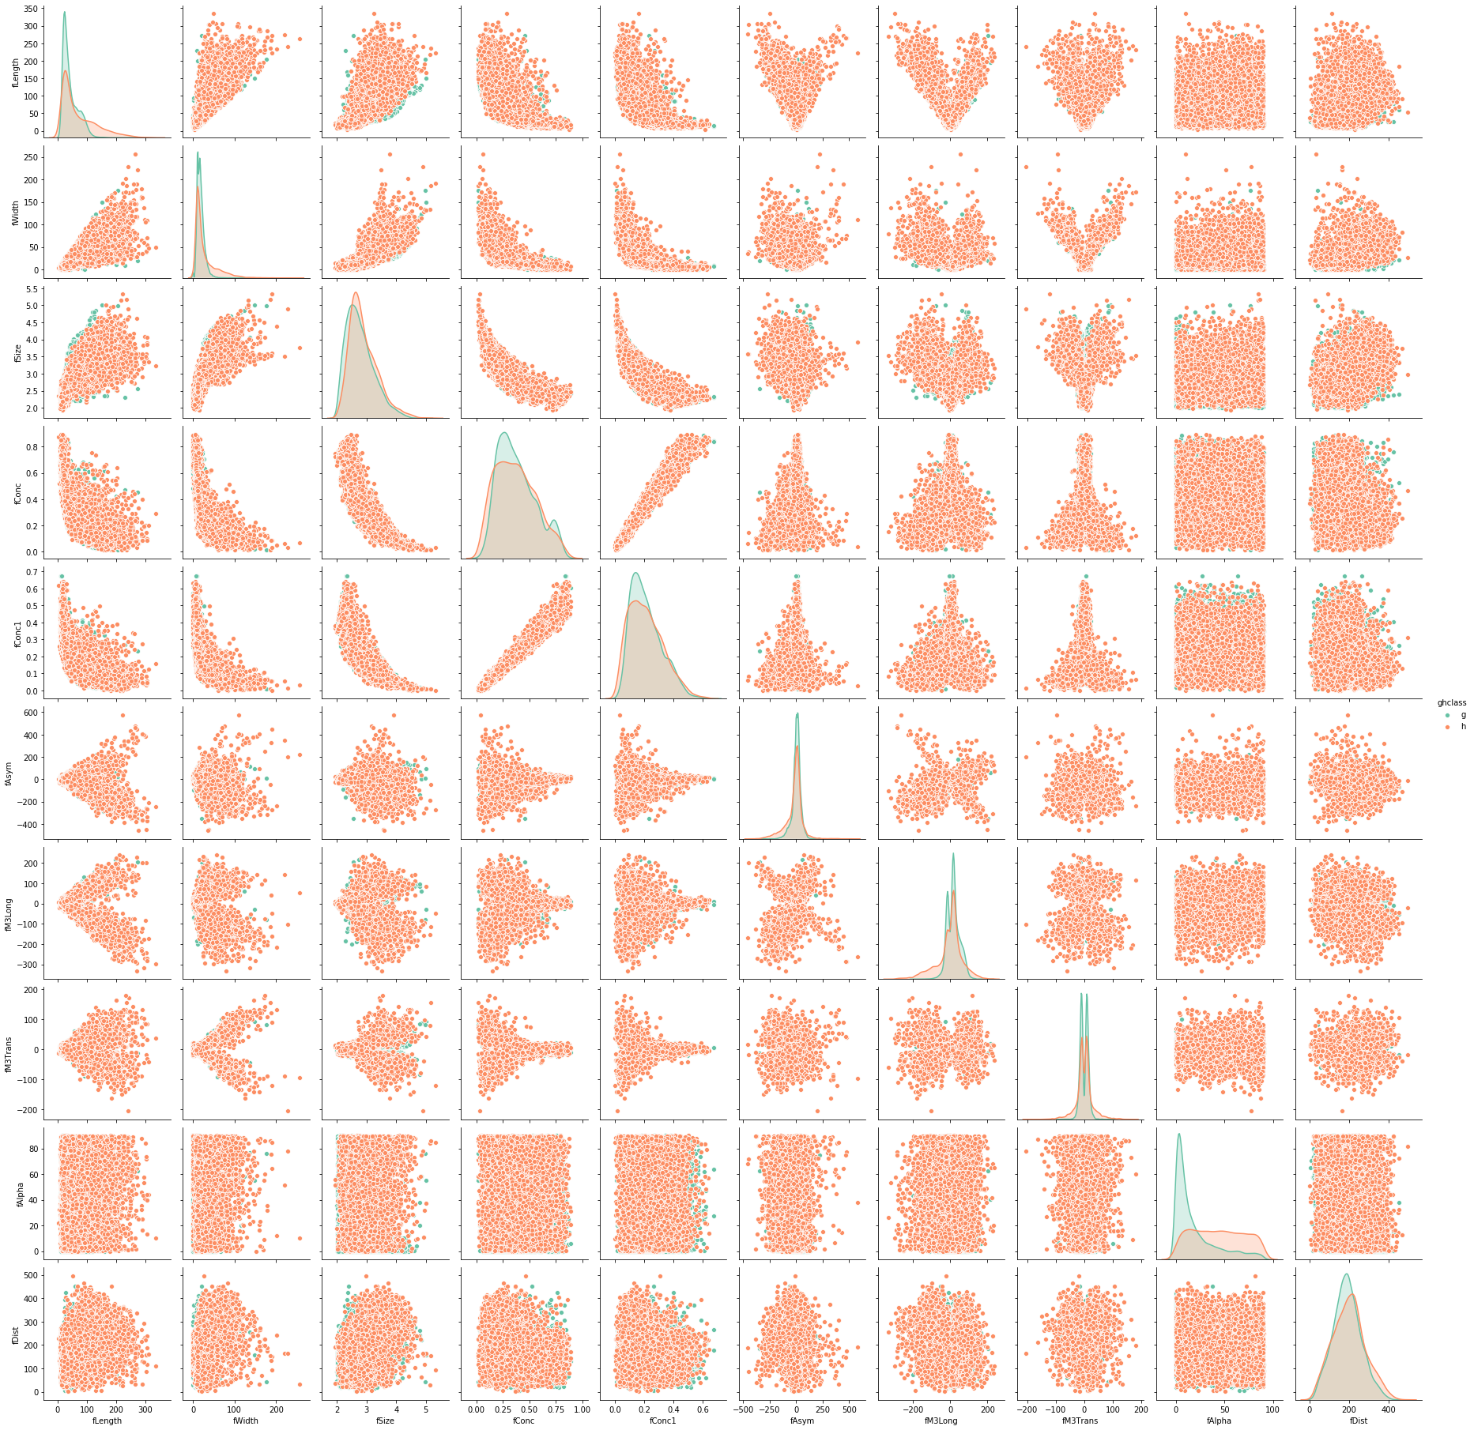
Machıne learnıng models
K Nearest Neighbor
Decision Tree
K nearest neighbors is a simple algorithm that stores all available cases and classifies new cases based on a similarity measure (e.g., distance functions). A case is classified by a majority vote of its neighbors, with the case being assigned to the class most common amongst its K nearest neighbors measured by a distance function. If K = 1, then the case is simply assigned to the class of its nearest neighbor. In project there is a function that works for kNN algorithm. Algorithm works with range of k between 1 to 25. Algorithm pick the k acoording to highest accuracy value, Also it calculates Log Loss and ROC AUC by does cross validation values for eack k value. For the best k value creates the confusion matrix and classification report.

Slide 4
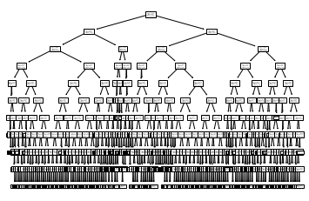
Machıne learnıng models
Decision Tree
A tree has many analogies in real life, and turns out that it has influenced a wide area of machine learning, covering both classification and regression. In decision analysis, a decision tree can be used to visually and explicitly represent decisions and decision making. As the name goes, it uses a tree-like model of decisions. Though a commonly used tool in data mining for deriving a strategy to reach a particular goal, its also widely used in machine learning.
In the project there is one decision tree function that finds best depth of tree, calculate accuracy, log loss and ROC AUC values bycross validation. For the best depth value creates the confusion matrix and classification report. Also shows the tree.

Slide 5
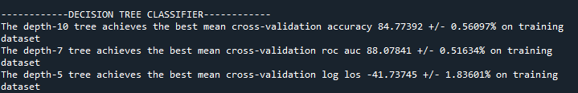
Cross valıdatıons
After evaluating the validation values between 5 and 50, it was observed that the most appropriate values were at 10. Here are the results both wih kNN and decision tree.

Slide 6
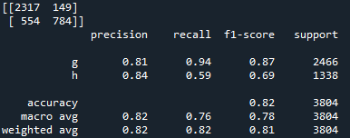
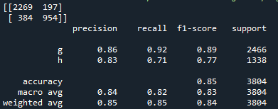
Confusion matrix and classification reports
After evaluating the test values between 0.10 to 0.50, it was observed that the most appropriate value is at 0.20. Confusion matrix and classification reports by 0.20 test size values are shown below with kNN and decision tree.
kNN
Decision Tree

Slide 7
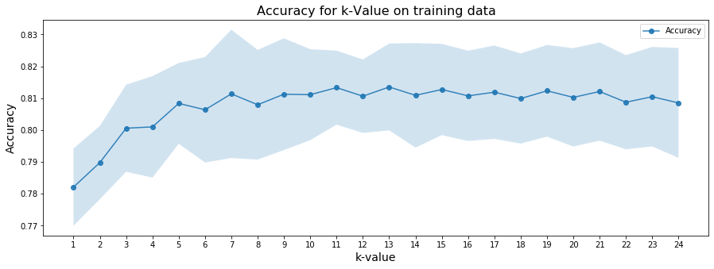
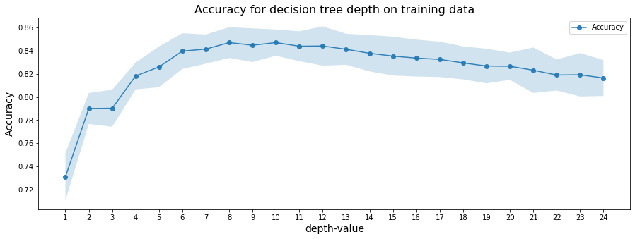
Accuracy for k and depth values

Slide 8
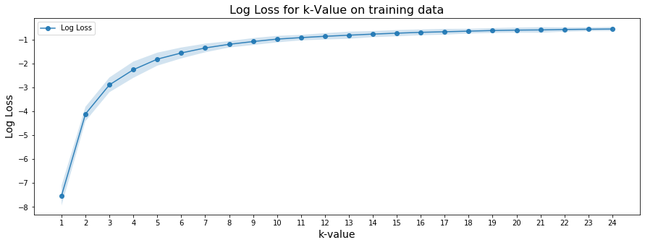
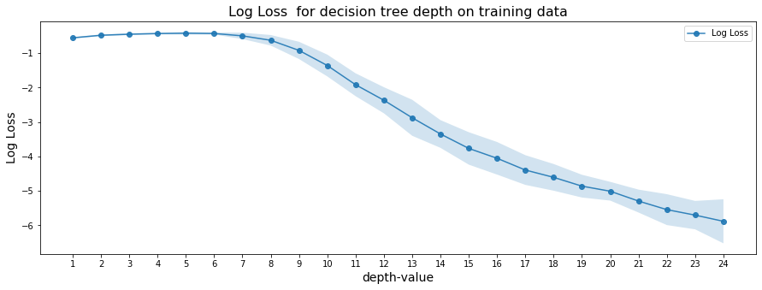
Log Loss for k and depth values

Slide 9
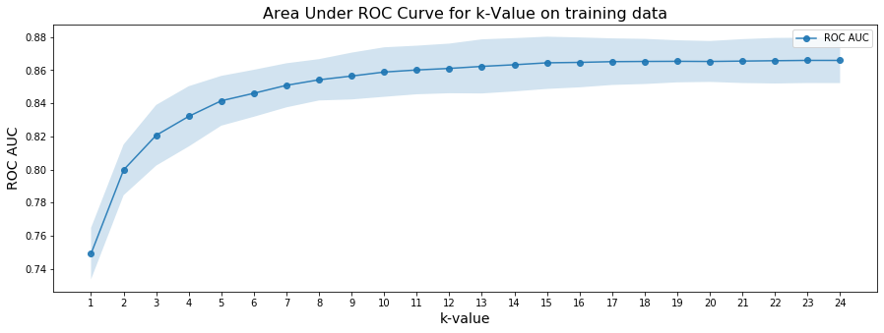
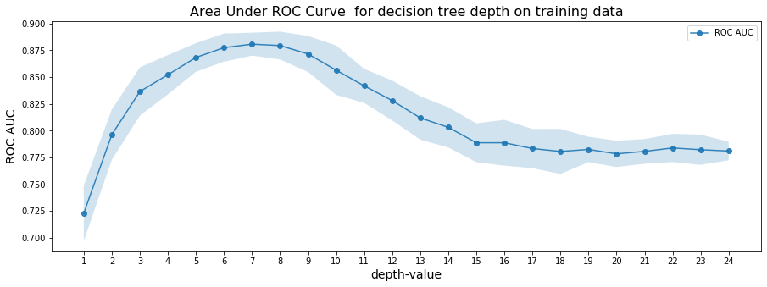
Area Under ROC Curve plot for k and depth values

Slide 10
REFERENCES
http://archive.ics.uci.edu/ml/datasets/MAGIC+Gamma+Telescope
https://towardsdatascience.com/which-machine-learning-model-to-use-db5fdf37f3dd
https://gist.github.com/chalg/c1a7d707c10d496bb3139719b6aff258
https://medium.com/@randerson112358/python-decision-tree-classifier-example-d73bc3aeca6
https://medium.com/pursuitnotes/decision-tree-classification-in-9-steps-with-python-600c85ef56de
https://www.kaggle.com/amolbhivarkar/knn-for-classification-using-scikit-learn

