Slide 1
Application of Machine learning on Predictive maintenance
Dnivek
Notes:
https://learning.oreilly.com/library/view/hands-on-machine-learning/9781492032632/

Slide 2
What Is Machine Learning
Machine Learning is the science (and art) of programming computers so they can learn from data.
Here is a slightly more general definition:
Machine Learning is the field of study that gives computers the ability to learn without being explicitly programmed.
by Arthur Samuel, 1959
And a more engineering-oriented one:
A computer program is said to learn from experience E with respect to some task T and some performance measure P, if its performance on T, as measured by P, improves with experience E.
by Tom Mitchell, 1997

Slide 3
Example: your spam filter
Your spam filter is a Machine Learning program that, given examples of spam emails (e.g., flagged by users) and examples of regular (nonspam, also called “ham”) emails, can learn to flag spam. The examples that the system uses to learn are called the training set. Each training example is called a training instance (or sample). In this case, the task T is to flag spam for new emails, the experience E is the training data, and the performance measure P needs to be defined; for example, you can use the ratio of correctly classified emails. This particular performance measure is called accuracy, and it is often used in classification tasks.

Slide 4
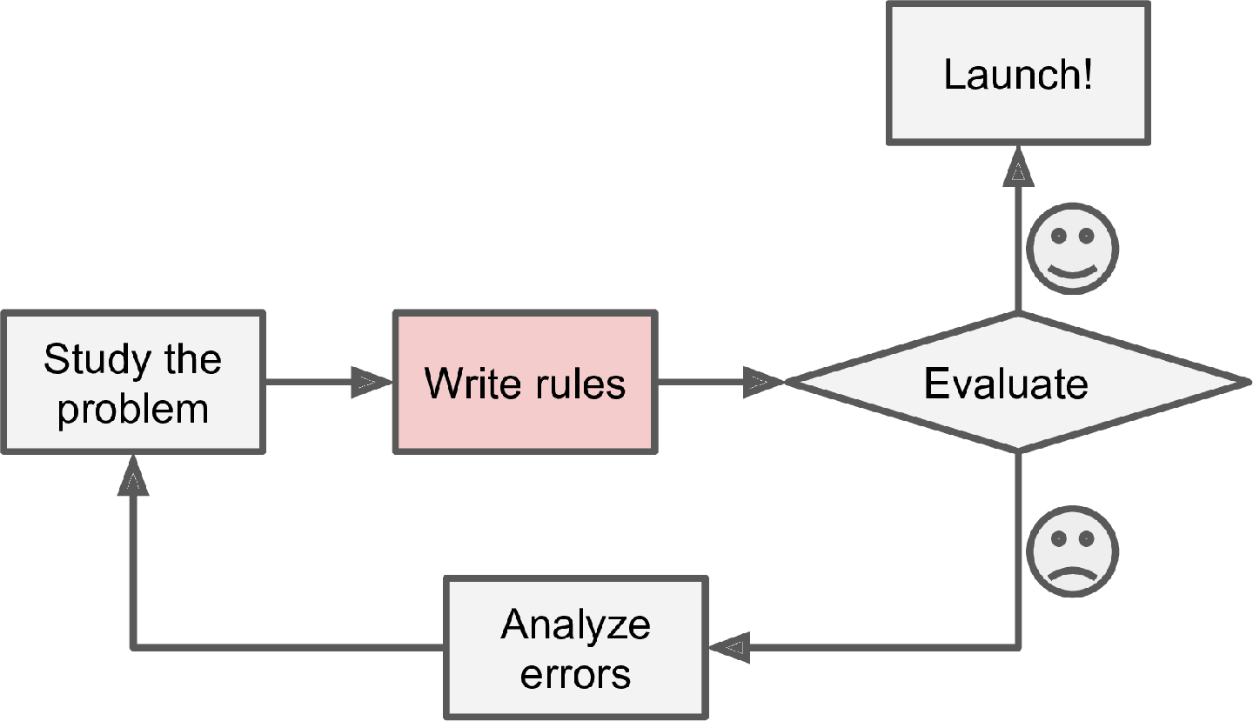
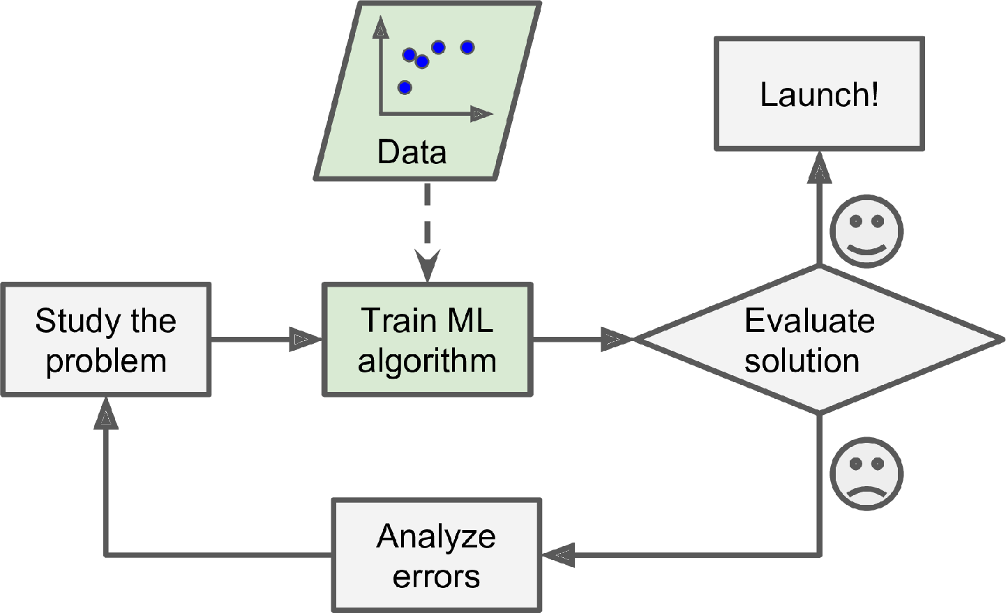
Why Use Machine Learning
Figure 1-1. The traditional approach
Figure 1-2. The Machine Learning approach

Slide 5
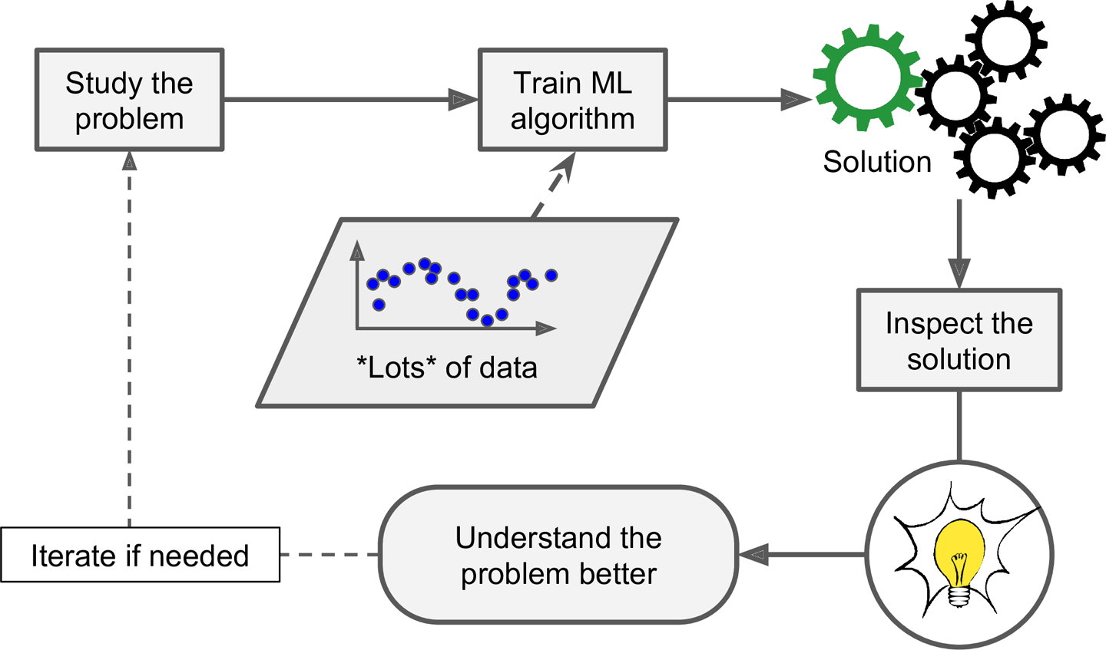
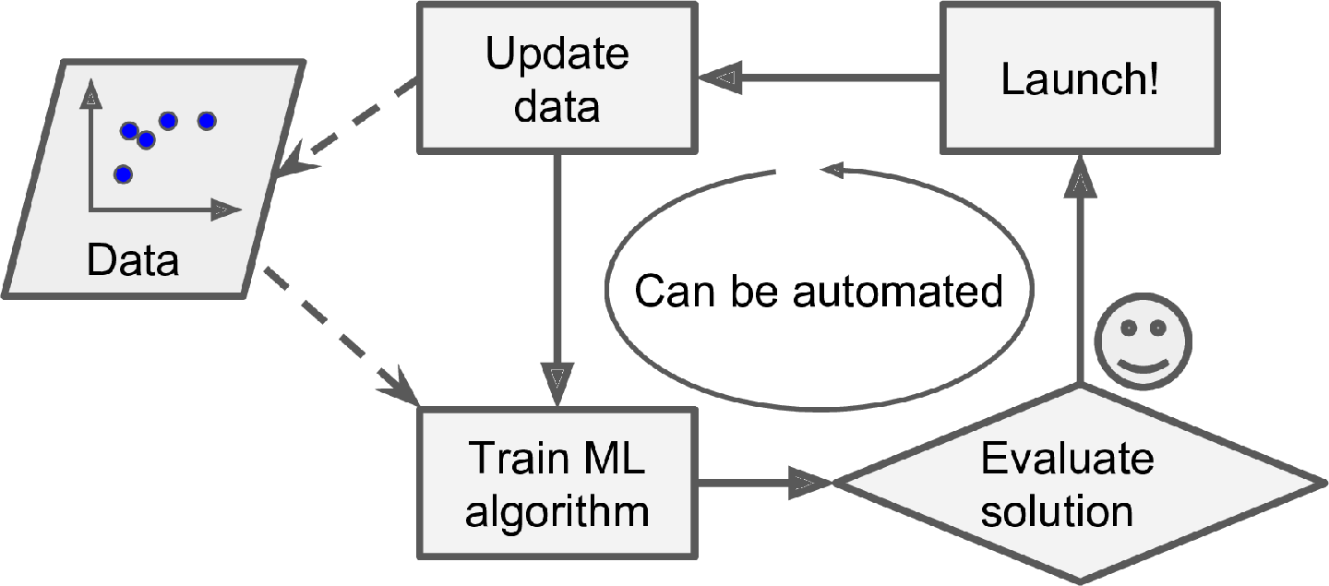
Be great for
Problems for which existing solutions require a lot of fine-tuning or long lists of rules: one Machine Learning algorithm can often simplify code and perform better than the traditional approach.
Complex problems for which using a traditional approach yields no good solution: the best Machine Learning techniques can perhaps find a solution.
Fluctuating environments: a Machine Learning system can adapt to new data.
Getting insights about complex problems and large amounts of data.
Figure 1-3. Automatically adapting to change
Figure 1-4. Machine Learning can help humans learn

Slide 6
Applications
Analyzing images of products on a production line to automatically classify them
Detecting tumors in brain scans
Automatically classifying news articles
Automatically flagging offensive comments on discussion forums
Summarizing long documents automatically
Creating a chatbot or a personal assistant
Forecasting your company’s revenue next year, based on many performance metrics
Making your app react to voice commands
Detecting credit card fraud
Segmenting clients based on their purchases so that you can design a different marketing strategy for each segment
Representing a complex, high-dimensional dataset in a clear and insightful diagram
Recommending a product that a client may be interested in, based on past purchases
Building an intelligent bot for a game
Notes:
This list could go on and on, but hopefully it gives you a sense of the incredible breadth and complexity of the tasks that Machine Learning can tackle, and the types of techniques that you would use for each task.

Slide 7
Predictive maintenance
Dnivek

Slide 8
Predictive maintenance
Predictive maintenance is the practice of using data analytics and machine learning algorithms to proactively identify when equipment or machinery is likely to fail, so that maintenance can be scheduled before the failure occurs. There are several approaches that can be used for predictive maintenance, depending on the specific requirements of the application. Here are three common approaches:
1. Condition-based maintenance - This approach involves monitoring the condition of the equipment or machinery in real-time, using sensors and other data sources, and using the data to predict when maintenance is required. For example, vibration sensors can be used to detect wear and tear on rotating equipment, while temperature sensors can be used to detect overheating in motors.
2. Failure analysis - This approach involves analyzing historical data on equipment failures, and using the insights gained to predict when similar failures are likely to occur in the future. For example, if a particular component has a known failure mode, the data can be analyzed to identify patterns or trends that indicate when the component is likely to fail.
3. Machine learning - This approach involves using machine learning algorithms to analyze large amounts of data on equipment performance and maintenance history, and using the insights gained to predict when maintenance is required. Machine learning algorithms can identify complex patterns and relationships in the data that may not be obvious to human analysts, and can provide more accurate and reliable predictions over time.
In general, the best approach for predictive maintenance will depend on the specific requirements of the application, including the type of equipment being monitored, the data sources available, and the resources and expertise available for implementing the solution. In many cases, a combination of different approaches may be required to achieve the best results. For example, condition-based monitoring can be combined with machine learning algorithms to better predict when maintenance is required, based on real-time data and historical performance data. Similarly, failure analysis can be combined with machine learning algorithms to identify more subtle patterns and trends in the data, and to improve the accuracy of predictions over time. Ultimately, the key to successful predictive maintenance is to use the right combination of data, algorithms, and expertise to achieve the desired outcomes.

Slide 9
Benefits
Predictive maintenance can help reduce downtime and maintenance costs in several ways:
1. Early detection of potential failures - By monitoring equipment in real-time and analyzing the data using predictive algorithms, predictive maintenance can detect potential failures before they occur. This allows maintenance to be scheduled proactively, before the equipment fails and causes downtime or damage.
2. More efficient maintenance scheduling - Instead of scheduling maintenance on a fixed schedule, predictive maintenance can schedule maintenance based on the actual condition of the equipment. This can help avoid unnecessary maintenance and reduce costs associated with over-maintenance, while ensuring that maintenance is performed when it is actually needed.
3. Reduced repair times - By identifying potential failures early, predictive maintenance can reduce the time required to perform repairs. This can help minimize downtime and reduce the impact of equipment failures on production or operations.
4. Longer equipment lifespan - By performing maintenance proactively and addressing potential issues before they cause damage, predictive maintenance can help extend the lifespan of equipment. This can reduce the need for costly equipment replacements and help ensure that equipment is operating at peak efficiency.
5. Optimized spare parts inventory - Predictive maintenance can help optimize the inventory of spare parts by identifying which parts are likely to fail and when they will need to be replaced. This can help reduce the inventory of spare parts and associated costs, while ensuring that the right parts are available when needed.
Overall, predictive maintenance can help organizations reduce downtime, maintenance costs, and equipment failures, while improving overall equipment effectiveness and productivity. By leveraging data and analytics to proactively identify and address potential issues, organizations can achieve significant cost savings and operational improvements, while ensuring that equipment is running at peak efficiency.

Slide 10
Plant Implementation
Predictive maintenance can be implemented in a manufacturing plant in several steps:
1. Identify the equipment to be monitored - The first step is to identify the critical equipment and machinery that need to be monitored. This can include machines such as motors, pumps, and conveyors, as well as other equipment such as HVAC systems and electrical systems.
2. Install sensors and data collection systems - The next step is to install sensors and data collection systems to monitor the equipment in real-time. This can include sensors such as vibration sensors, temperature sensors, and pressure sensors, as well as data logging systems to collect data from control systems and other sources.
3. Collect and analyze data - Once the sensors and data collection systems are in place, the next step is to collect and analyze the data using machine learning algorithms and other predictive analytics tools. This may involve developing models to predict equipment failure based on historical data, or using real-time data to detect anomalies and identify potential issues.
4. Integrate with maintenance systems - The predictive maintenance system should be integrated with the plant's maintenance systems to enable proactive maintenance scheduling. This can include integrating with a computerized maintenance management system (CMMS) or other maintenance planning tools.
5. Implement maintenance actions - Based on the predictions of the predictive maintenance system, maintenance actions can be implemented proactively to address potential issues before they cause downtime or damage. This may involve scheduling maintenance during planned downtime, or implementing emergency maintenance actions if a failure is imminent.
6. Monitor and refine -Finally, the predictive maintenance system should be continuously monitored and refined over time to ensure that it is providing accurate and reliable predictions. This may involve adjusting the algorithms based on feedback from maintenance personnel, or incorporating additional data sources to improve the accuracy of the predictions.
Overall, implementing predictive maintenance in a manufacturing plant requires a combination of hardware, software, and expertise. It requires careful planning and execution, as well as ongoing monitoring and refinement to ensure that it is delivering the desired outcomes. When implemented effectively, however, predictive maintenance can provide significant benefits in terms of reducing downtime, improving equipment reliability, and reducing maintenance costs.

Slide 11
predictive analytics tools
There are several predictive analytics tools that can be used for monitoring equipment in a manufacturing plant. Here are three popular options:
1. IBM Predictive Maintenance and Quality - IBM Predictive Maintenance and Quality is a cloud-based platform that uses machine learning algorithms to predict equipment failure and optimize maintenance schedules. It can be used to monitor equipment in real-time, and can integrate with existing data sources and maintenance systems.
2. Microsoft Azure IoT Suite - Microsoft Azure IoT Suite is a cloud-based platform that enables real-time monitoring and analysis of equipment data, using machine learning algorithms and other predictive analytics tools. It can be used to predict equipment failure, optimize maintenance schedules, and improve overall equipment effectiveness.
3. SAS Analytics for IoT - SAS Analytics for IoT is a suite of tools that enables real-time monitoring and analysis of equipment data, using machine learning algorithms and other advanced analytics techniques. It can be used to predict equipment failure, optimize maintenance schedules, and improve overall equipment effectiveness.
These tools all offer advanced predictive analytics capabilities for monitoring equipment, and can be customized to meet the specific needs of a manufacturing plant. However, the best tool for a particular application will depend on the specific requirements of the plant, including the type of equipment being monitored, the data sources available, and the resources and expertise available for implementing the solution. It's important to evaluate multiple options and choose the tool that best fits the specific needs of the plant.

Slide 12
references
Geoffrey E. Hinton et al., “A Fast Learning Algorithm for Deep Belief Nets,” Neural Computation 18 (2006): 1527–1554.
Aurélien Géron, Hands-On Machine Learning with Scikit-Learn, Keras, and TensorFlow, 2nd Edition (2019) https://github.com/ageron/handson-ml2

