Slide 1
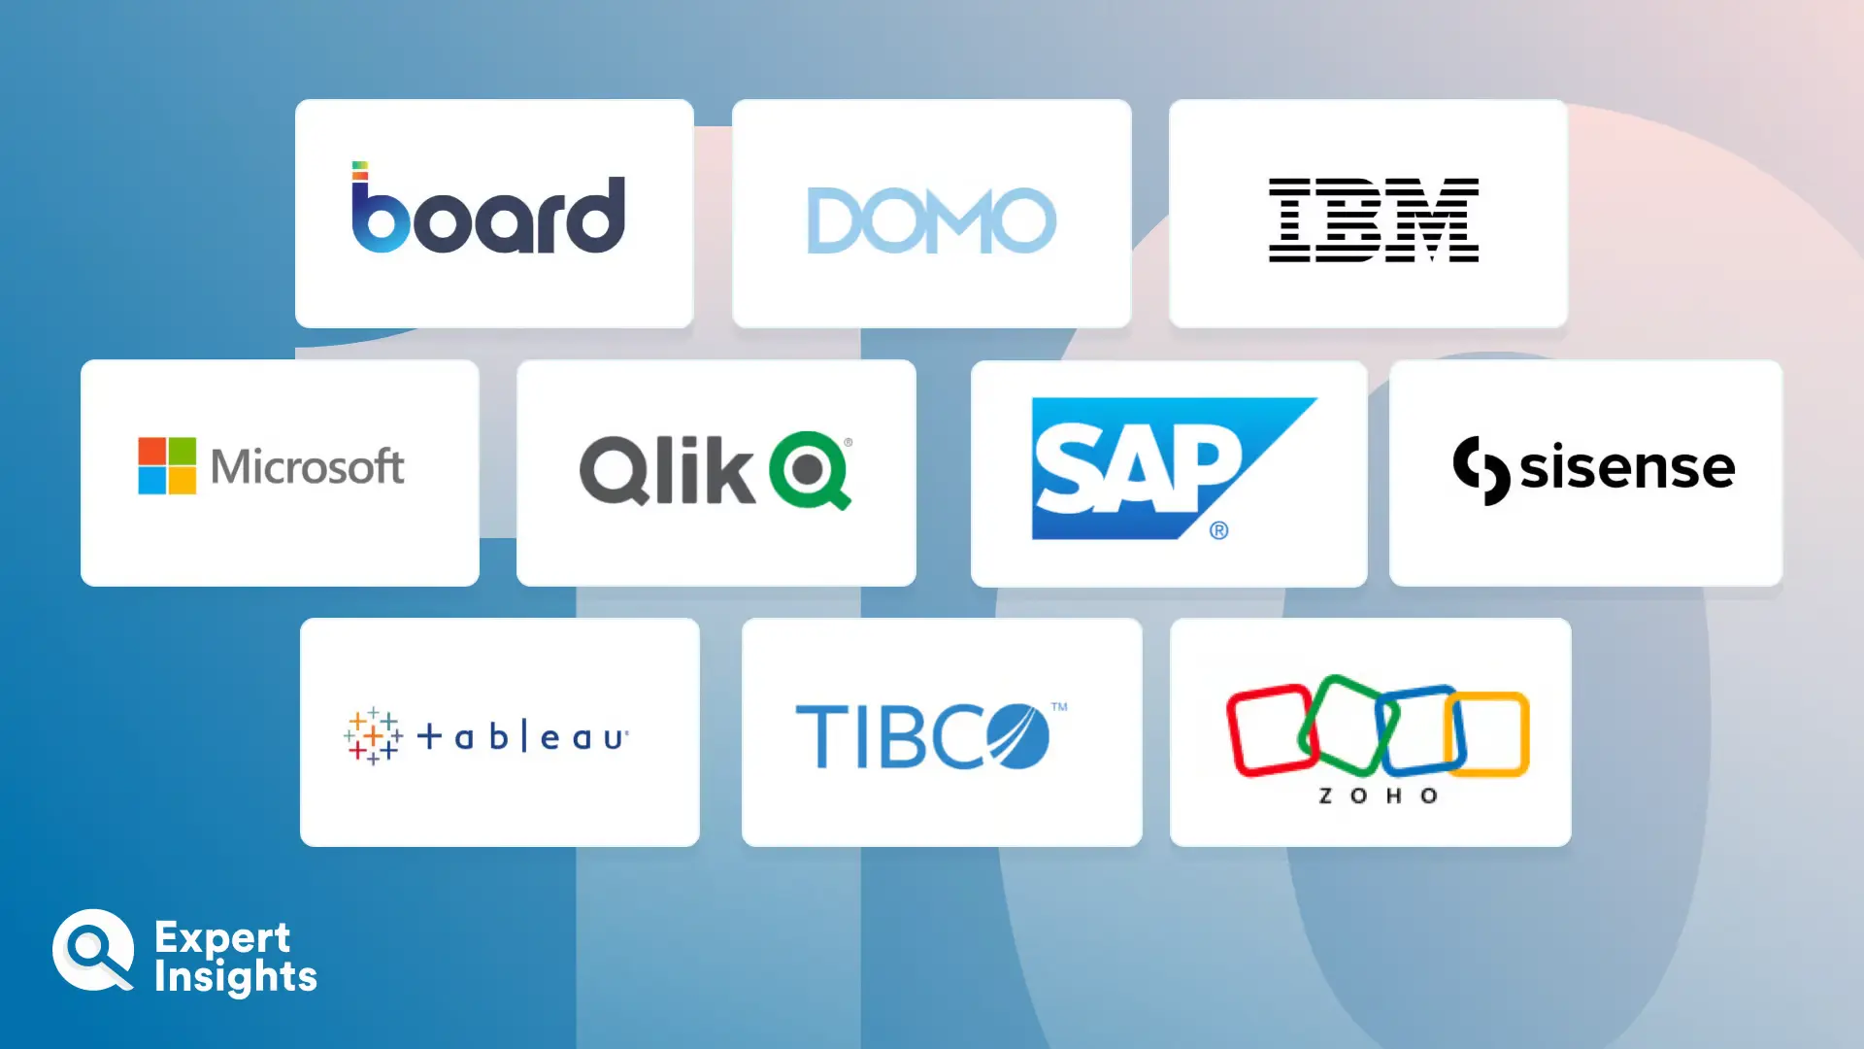
From Code to Insights:
Stack Overflow Developer Survey
Daryl Lim J. R.
6 Oct 2025

Slide 2
Outline
1) Executive Summary
2) Introduction
3) Methodology
4) Results
Visualization – Charts & Dashboards
5) Discussion
Findings & Implications
6) Conclusion
7) Appendix

Slide 3
Executive Summary
This report analyzes trends among developers. The majority of respondents are 25–34 years of age, working in Software Development, and hold at least a Bachelor’s degree, with job satisfaction averaging 8/10.
In terms of technology, JavaScript, SQL, HTML/CSS, TypeScript, and Python remain the most widely used languages, while PHP and PowerShell are declining. Go and Rust are gaining interest. React and Node.js dominate web frameworks, AWS leads cloud platforms, and PostgreSQL continues as the dominant database. Swift developers command the highest salaries, reflecting the high demand for iOS development skills.

Slide 4
Introduction
To analyze the 2025 Stack Overflow Developer Survey and uncover trends in developers’ demographics, technology usage, and workplace preferences.
To provide actionable insights for tech companies, educators and developers globally.
Software development languages and technologies are evolving rapidly.
Which direction do you see the industry moving? Where do global tech demands meet developers’ expectations?

Slide 5
Methodology
Data Collection
Jobs API via GitHub
Web Scrapping
Stack Overflow Developer Survey
Data Wrangling
Duplicates, Outliers, Missing values, ETL
Normalization
Data Exploration & Visualization
Python
IBM Cognos Analytics

Slide 6
Results

Slide 7
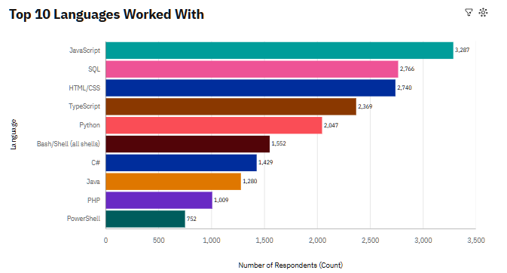
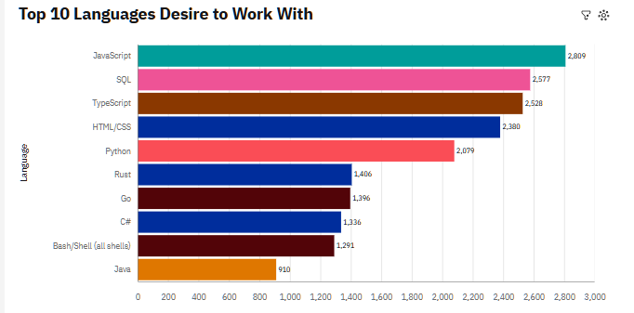
Programming Languages Trend

Slide 8
Programming Language Trends:
Findings & Implications
Findings
JavaScript, SQL, HTML/CSS, TypeScript and Python continues to be the leading programming languages.
PHP and PowerShell seems to be of declining interest.
Go and Rust have garnered increasing interest.
Implications
Developers may need to consider upskilling in emerging languages like Go and Rust to stay competitive in areas like system programming & backend development.
Organizations relying on PHP or PowerShell may need to evaluate the long-term viability of these technologies and consider migration or diversification.

Slide 9
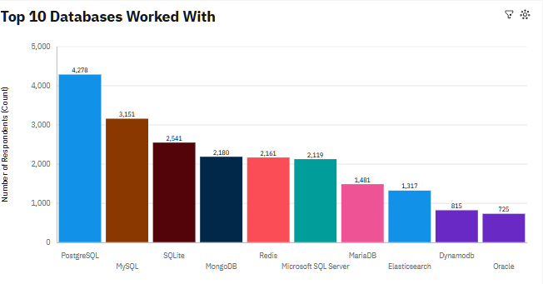
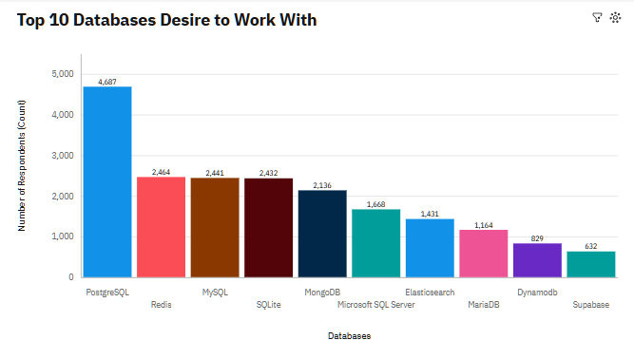
Database Trends

Slide 10
Database Trends:
Findings & Implications
Findings
PostgreSQL continues to be dominant database.
There is a surge interest in Redis, possibly due to its quick Retrieval-Augmented Generation (RAG) applications.
Other databases such as Firebase is not in the Top 10 trends, possibly due to limited adoption in large-scale applications.
Implications
Developers and organizations should continue investing in skills for relational databases like PostgreSQL and MySQL, as demand remains strong.
Emerging or niche databases may require strategic evaluation before adoption, as they may not yet have widespread market demand.

Slide 11
Dashboards
Link: https://github.com/meldrop66/IBMDataAnalyst_/blob/main/Dashboards_Module9.pdf

Slide 12
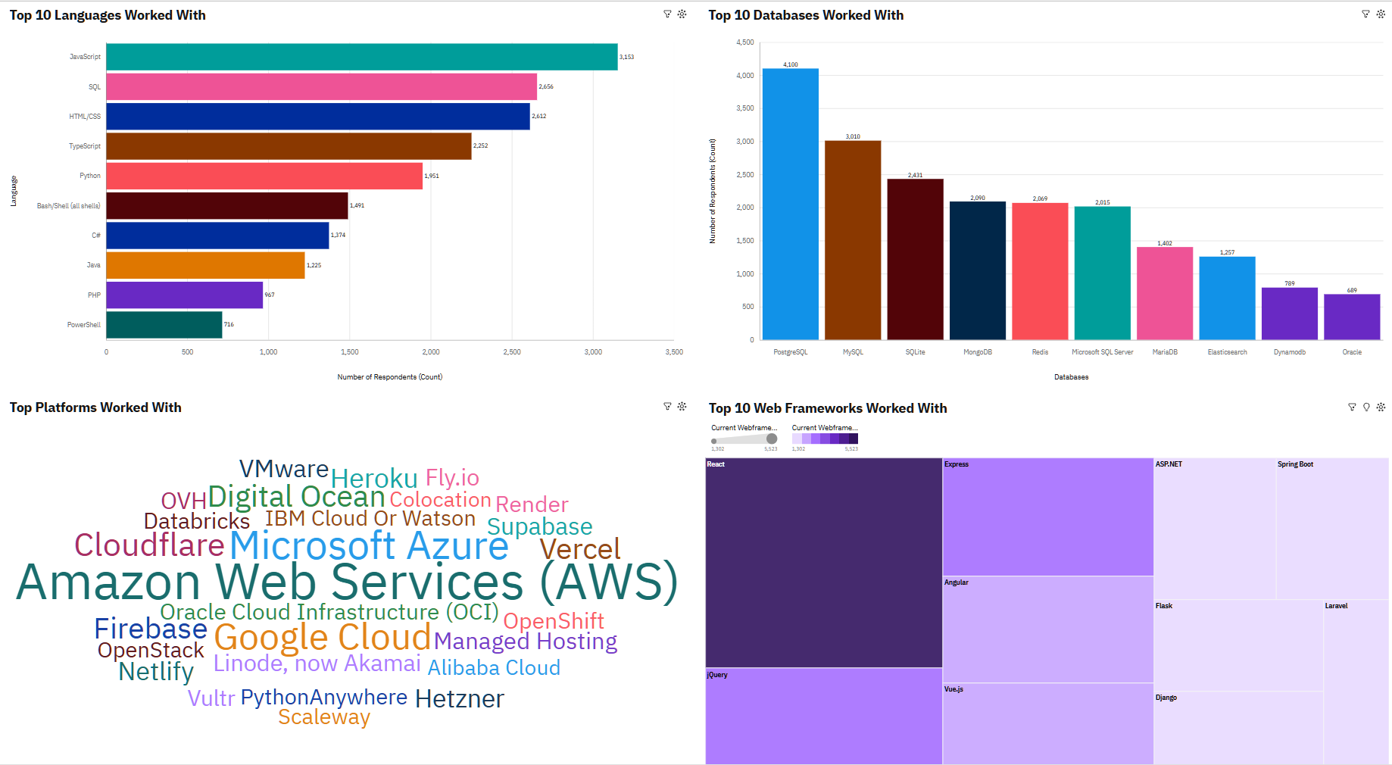
Current Technology Usage

Slide 13
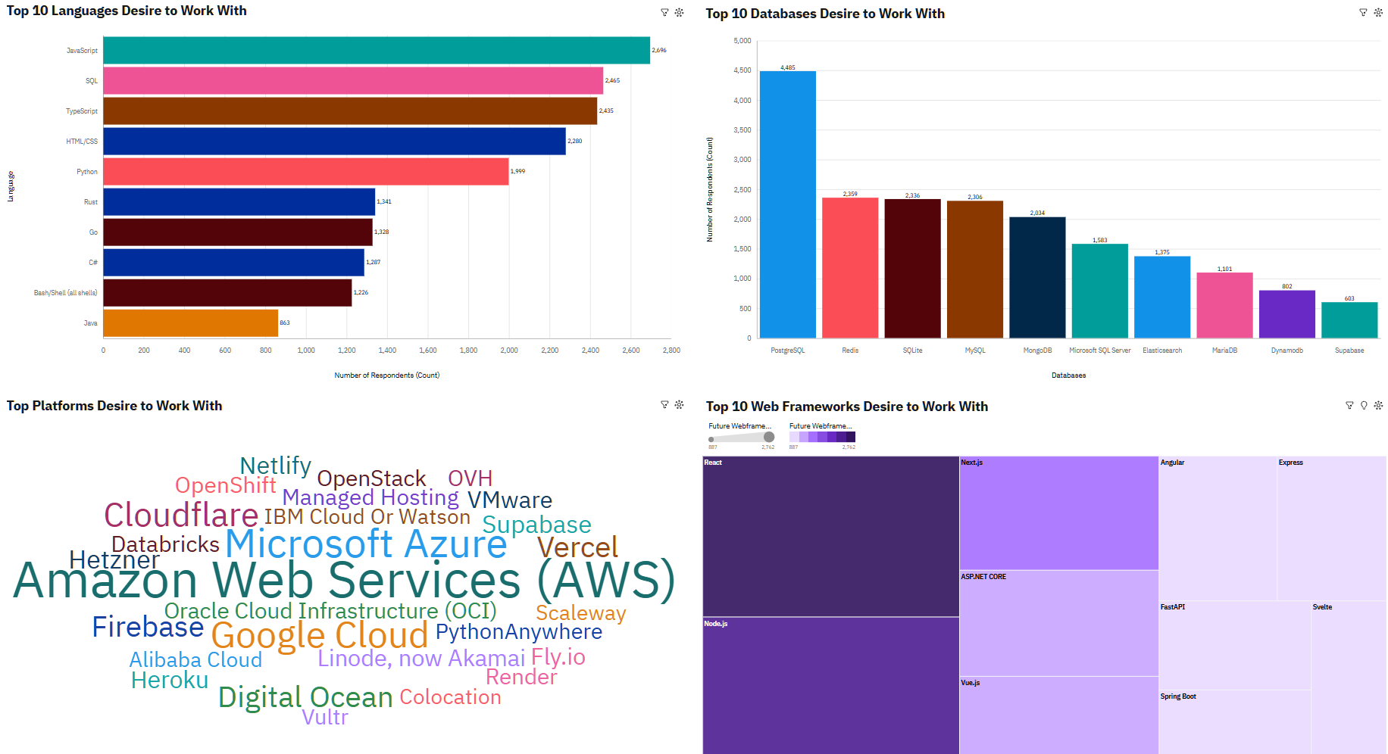
Future Technology Trend

Slide 14
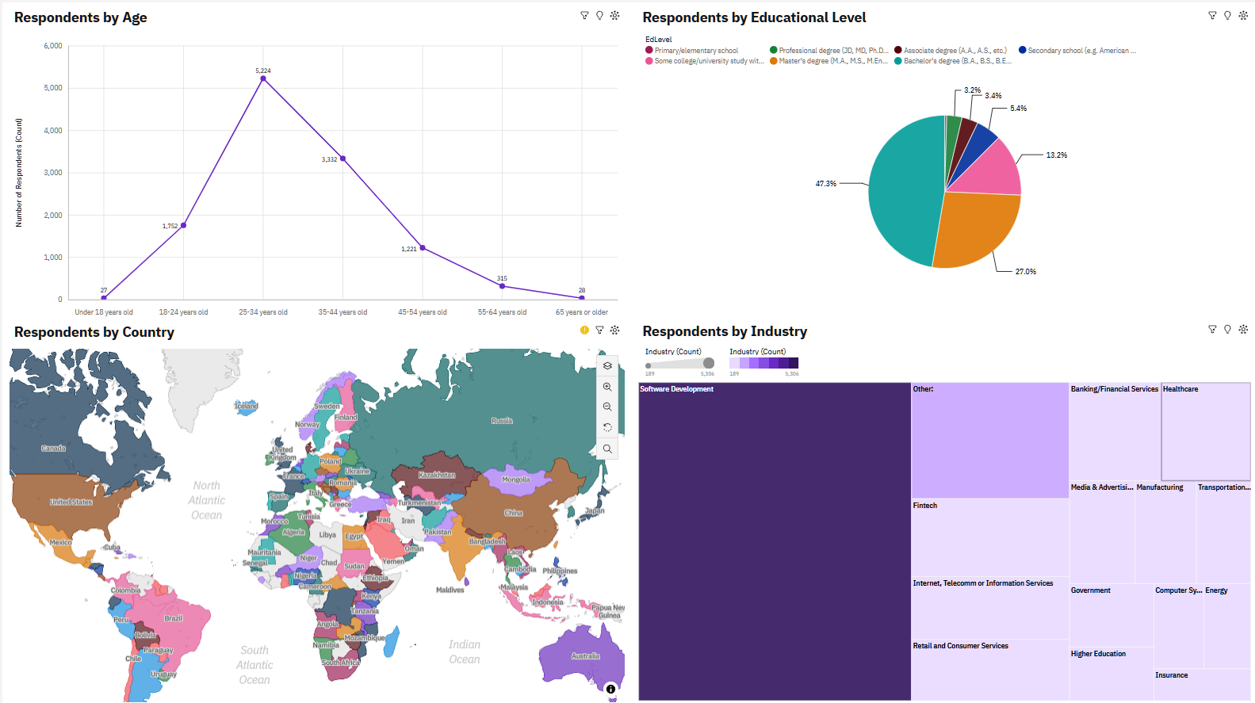
Demographics

Slide 15
Discussions

Slide 16
Overall Findings & Implications
Findings
Majority of the respondents fall between the age of 25-34 years old.
Majority of the respondents are in the Software Development industry.
Majority of the respondents hold at least a Bachelor’s Degree.
AWS remains to be the dominant cloud platform.
React & Node.js continue lead as the preferred the web frameworks.
Implications
Companies should continue investing in AWS infrastructure.
Continuous learning initiatives are important to help developers stay current in cloud and web technologies.
Employers can focus recruitment efforts on young professionals (25–34) with at least a bachelor’s degree.

Slide 17
Appendixes

Slide 18
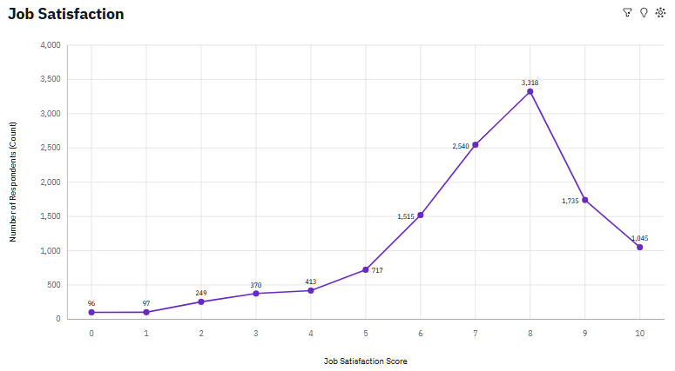
Job Satisfaction

Slide 19
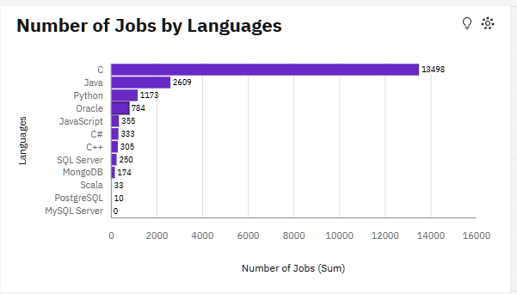
Job Postings by Languages

Slide 20
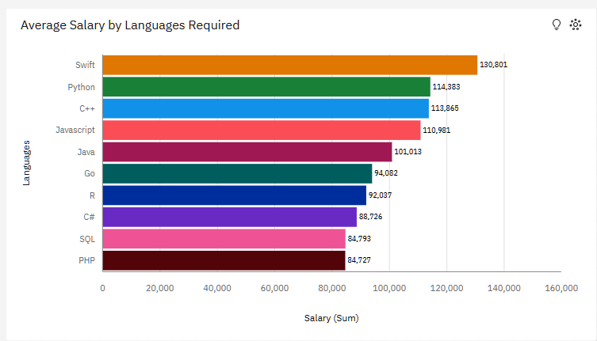
Job Postings by Languages

Slide 21
Findings & Implications
Findings
Majority of the respondents generally have a high job satisfaction (8/10).
Most jobs today requires C, Java & Python skills.
The highest average annual salary is associated with Swift developers.
Implications
Since most jobs require C, Java, and Python, educational institutions and training courses should prioritize these languages to prepare job-ready candidates.
While job satisfaction is generally high, employers could explore initiatives to improve satisfaction further, such as work-life balance programs.
Upskilling in Swift could be advantageous for developers aiming for higher-paying roles.

