Slide 1
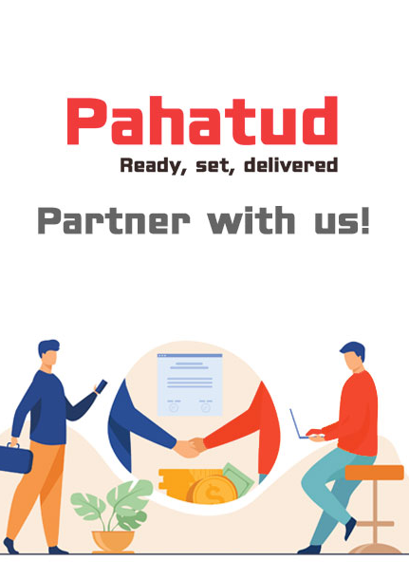
PAHATUDFOOD AGENT PROGRAM
Connect local
restaurants.
Grow together.
A practical introduction to the Pahatud Agent role, benefits, earnings, and tools.
AGENT ORIENTATION
2026
Notes:
Pahatud Agent orientation deck. Program language is based on resources/views/agent/auth/register.blade.php and resources/views/agent/help.blade.php.

Slide 2

YOUR ROLE
Agents connect restaurants to Pahatud.
You introduce, guide, and support restaurants as they join the marketplace.
Connect
Find restaurants that can benefit from online ordering and delivery.
Guide
Help owners complete enrollment, documents, and requested corrections.
Grow
Stay connected as approved restaurants receive qualifying orders.
LOCAL MARKETPLACE
02
Notes:
Source: resources/views/agent/auth/register.blade.php, sections 'How the Agent Program works' and 'What you get as a Pahatud agent'.

Slide 3
WHAT AGENTS GET
A clear way to build a network and see the value it creates.
03
Order visibility
01
Commission opportunities
See submitted orders and eligible sales tied to commission activity.
Earn a share of Pahatud's commission on qualifying successful orders.
WHAT
YOU GET
04
Transparent reporting
Review pending, approved, paid, and reversed entries by restaurant and order.
02
Your restaurant network
Enroll restaurants and monitor every partner connected to your account.
05
Help when you need it
Use the built-in guide and email agent support at info@pahatud.com.
03
Notes:
Source: resources/views/agent/auth/register.blade.php and resources/views/agent/help.blade.php. Benefits describe portal capabilities and do not promise a fixed income.

Slide 4
HOW EARNINGS WORK
Your earnings come from Pahatud's commission.
Your share is not calculated from the full order value. Example uses the current default rates.
ORDER VALUE
PAHATUD RATE
AGENT SHARE
₱1,000
15%
30%
eligible order
₱150 commission
₱45 earned
₱1,000 × 15% × 30% = ₱45
Actual rates are stored with each order. Your confirmed share appears in the Agent Dashboard.
04
Notes:
Source: config/agent.php. Current defaults are 15% Pahatud commission and a 30% agent share, producing ₱45 on a qualifying ₱1,000 order. Actual agent and restaurant rates may vary and are stored per order.

Slide 5
FROM ORDER TO PAYOUT
Track every commission from order to payout.
The ledger keeps qualifying and reversed activity visible.
✓
✓
✓
PENDING
APPROVED
PAID
Recorded for review
Confirmed as eligible
Payout recorded
A qualifying delivered order creates a commission entry.
Pahatud validates the entry before payout.
Operations coordinates payment and marks the entry paid.
Reversed entries remain visible for transparency. The current portal tracks commissions but does not initiate self-service withdrawals.
05
Notes:
Source: resources/views/agent/auth/register.blade.php and resources/views/agent/help.blade.php. Pahatud operations coordinates approved payouts; the dashboard does not currently offer self-service withdrawal.

Slide 6
YOUR JOURNEY
Five steps from application to active earnings.
01
02
03
04
05
Apply
Get approved
Enroll
Activate
Earn and track
Create your agent account application.
Wait for Pahatud's review and email decision.
Add a restaurant and send its private invitation.
Complete details, documents, and final review.
Qualifying delivered orders record commission.
Restaurant enrollment alone does not generate commission.
06
Notes:
Source: resources/views/agent/auth/register.blade.php. Agent application and restaurant enrollment alone do not generate commission; a linked approved restaurant must complete a qualifying delivered order.

Slide 7
Required business details
Required documents
HELP A LOCAL
RESTAURANT
GET READY
Restaurant and registered business names
VALID GOVERNMENT ID
Contact details and full address
A clear, current ID for the owner or authorized enrollee.
TIN and business structure
BUSINESS REGISTRATION
Payout account name and account details
DTI, SEC, or CDA registration certificate, as applicable.
Complete details and current documents make review easier.
Enrollment authority
WHEN REPRESENTING THE OWNER
ENROLLMENT CHECKLIST
Include an authorization letter, secretary's certificate, board resolution, or SPA.
07
Notes:
Source: resources/views/agent/help.blade.php and resources/views/agent/dashboard.blade.php. Required standard documents are a valid government-issued ID and a DTI, SEC, or CDA business registration certificate. Representatives also need an authorization document.

Slide 8
YOUR WORKING SPACE
The Agent Dashboard keeps progress visible.
Four focused areas help you move from enrollment to commission tracking.
DASHBOARD
REPORTS
At-a-glance restaurants, orders, sales, and commission.
Order references, rates, commission amounts, and status.
AGENT
DASHBOARD
RESTAURANTS
HELP & FAQ
Enrollment status, files, corrections, and restaurant details.
Practical guidance plus direct support by email.
08
Notes:
Source: resources/views/agent/layouts/app.blade.php, resources/views/agent/dashboard.blade.php, resources/views/agent/reports/index.blade.php, and resources/views/agent/help.blade.php.

Slide 9



AGENT PLAYBOOK
The best agents make the process easier for restaurant owners.
01
Set clear expectations
Approval comes first. Earnings begin only after qualifying delivered orders.
02
Check every detail
Use accurate business, contact, address, and payout account information.
03
Follow the review
Watch document statuses and help owners respond to admin remarks.
04
Use the report
Match questions to the restaurant, order number, date, and expected amount.
09
Notes:
Source: resources/views/agent/help.blade.php. Restaurant images are existing Pahatud partner assets from public/images/partners.

Slide 10

READY TO
BECOME A
PAHATUD AGENT?
Apply. Get approved. Start building your restaurant network.
pahatud.com/agent/register
Help more local restaurants become discoverable, order-ready, and connected to delivery.
Agent support: info@pahatud.com
10
Notes:
Call to action. Agent application route: /agent/register. Support email: info@pahatud.com.

