Slide 1



What Pahatud Really Is
A customer and investor overview of Pahatud's local commerce and delivery platform.
READY, SET, DELIVERED
Notes:
Sources: resources/views/pages/about.blade.php and resources/views/pages/home.blade.php. Assets: public/images/logo-big.png, public/images/motor.png, public/images/app-preview/home.png.

Slide 2
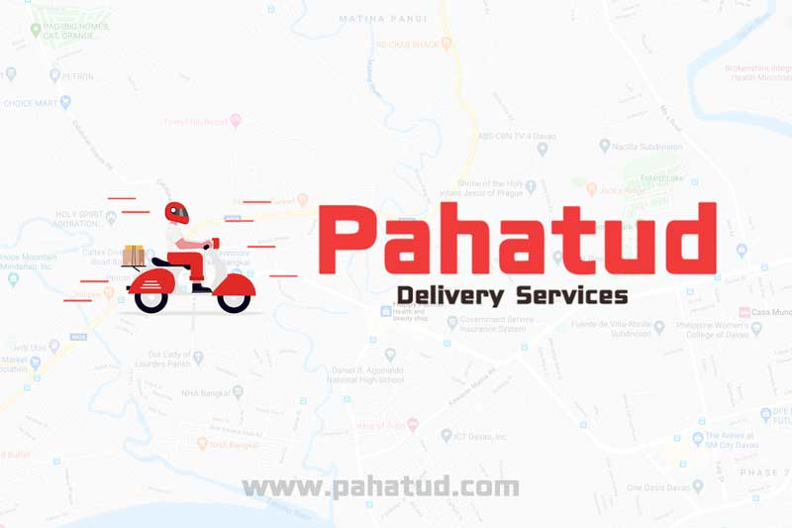
A local delivery marketplace
Pahatud connects customers with neighborhood restaurants and merchants, then coordinates the people and tools needed to complete delivery.
Pahatud means “to request to deliver.”
01
For customers
Discover local choices, place orders, use discounts, and follow delivery from the mobile experience.
Davao-born
02
For local businesses
Built around the daily needs of Davao customers, restaurants, merchants, riders, and local entrepreneurs.
Publish products, manage locations and orders, run promotions, and review sales and commission.
03
For the local network
Coordinate riders, agents, merchant applications, support, and operational reporting.
02
Notes:
Sources: resources/views/pages/about.blade.php; resources/views/pages/home.blade.php; AGENTS.md platform summary. Brand image: public/images/pahatud-logo-with-motor.jpg.

Slide 3

The customer experience
One simple journey from local discovery to delivery at the door.
01
Choose
Browse nearby restaurants and see delivery estimates and fees.
02
Order
Select products, quantities, add-ons, address, and payment method.
03
Save
Apply available coupon discounts when an order qualifies.
04
Track
Follow the order and delivery status until it reaches the customer.
Convenient cash on delivery is promoted in the current customer experience.
03
Notes:
Sources: resources/views/pages/home.blade.php; routes/api.php checkout coupon routes; app/Http/Controllers/Api/User/Cart/CheckoutController.php. Screenshot: public/images/app-preview/restaurants.png.

Slide 4
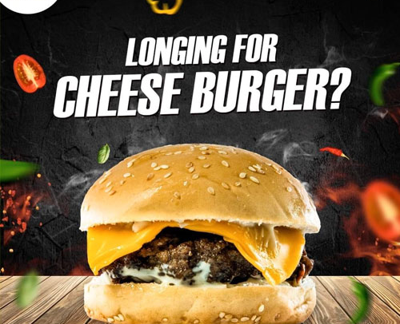

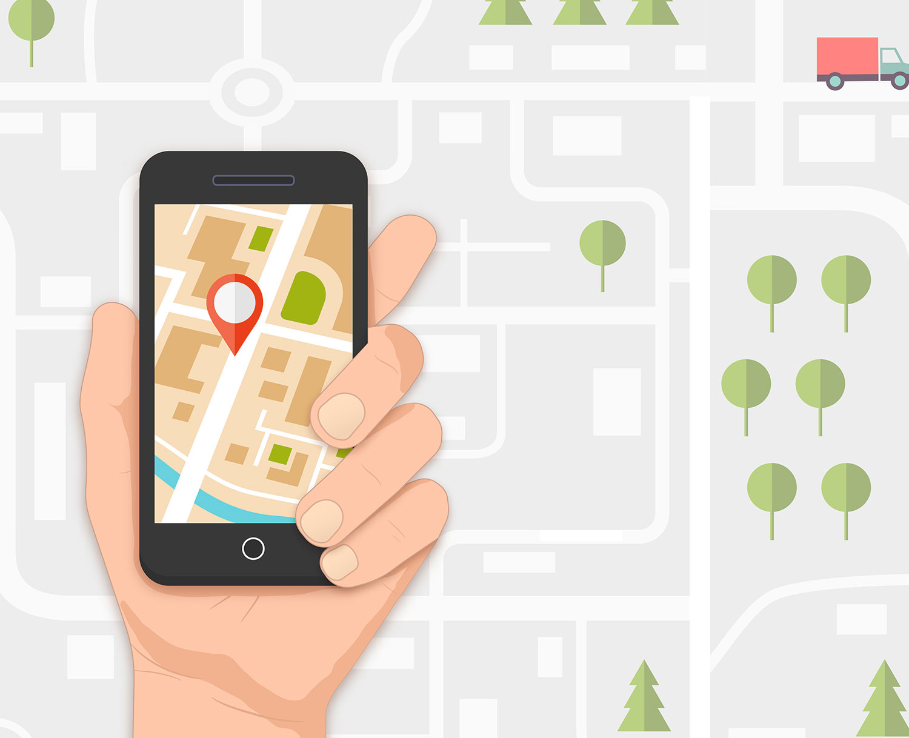
More than restaurant ordering
The platform already supports several ways for local customers to request products and delivery.
Food and restaurants
Flowers and gifts
Delivery requests
Local restaurant discovery, menu ordering, cart, checkout, discounts, and order history.
A dedicated flower-store experience supports local florists and same-day delivery offers.
Booking routes and rider workflows support customer requests beyond standard restaurant orders.
04
Notes:
Sources: routes/web.php restaurant, flower-store, and booking routes; resources/views/pages/flower/view.blade.php; resources/views/pages/booking/view.blade.php; checkout and customer profile routes. Assets are existing Pahatud files under public/uploads and public/images.

Slide 5

A practical operating system for merchants
Pahatud gives restaurants a way to join the marketplace and run daily commerce from one dashboard.
01
02
Get ready
Build the menu
Maintain business profile, branch addresses, contacts, and payout details.
Add products, prices, categories, availability, and add-ons.
03
04
Run orders
Learn and improve
Review new orders, prepare items, and follow delivery status.
Review sales, commission, discounts, net amount, vouchers, and coupons.
05
Notes:
Source: resources/views/merchant/partials/documentation.blade.php and merchant routes in routes/web.php. Illustration: public/images/partner-with-us.jpg.

Slide 6
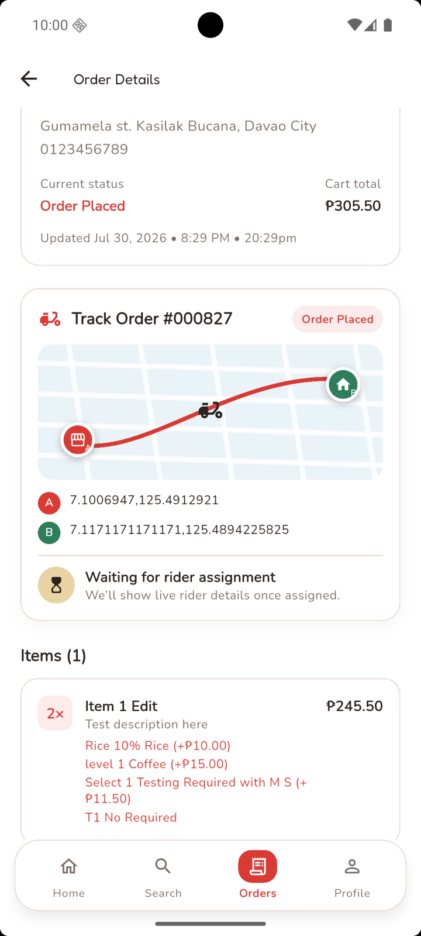
The operating network behind each order
Riders, agents, and Pahatud operations turn marketplace demand into completed local delivery.
Rider operations
Nearby job offers
Route and delivery events
Pickup and customer verification
COD, proof, wallet, and earnings tools
Pahatud operations
Approves applications
Coordinates support
Monitors orders and bookings
Reviews reports and payouts
Agent-led supply growth
Agents enroll restaurants, help complete document review, monitor approval, and earn a share of Pahatud's commission on qualifying delivered orders.
06
Notes:
Sources: routes/rider.php; app/Services/RiderOfferDispatcher.php; resources/views/agent/dashboard.blade.php; app/Services/AgentCommissionService.php; admin routes in routes/web.php. Screenshot: public/images/app-preview/order-tracking.png.

Slide 7
A marketplace that improves as the network grows
More local supply creates more customer choice. More orders create more value for merchants, riders, agents, and Pahatud.
CUSTOMERS
RIDERS
Choice, convenience, discounts, and delivery tracking
Delivery offers, routing, earnings, and service proof
PAHATUD
MERCHANTS
AGENTS
Digital storefront, orders, promotions, and reporting
Merchant enrollment, guidance, and network growth
The same platform coordinates demand, local supply, delivery, and merchant growth.
07
Notes:
Diagram synthesized from current customer, merchant, rider, agent, and admin capabilities in routes/web.php, routes/api.php, routes/rider.php, resources/views/pages/home.blade.php, resources/views/merchant/partials/documentation.blade.php, and resources/views/agent/dashboard.blade.php.

Slide 8
How value and revenue move
Pahatud's current transaction mechanics connect revenue to completed marketplace activity.
01
Customer transaction
The customer pays for products, applies any discount, and pays the calculated delivery fee.
ORDER VALUE + DELIVERY FEE
02
Merchant commission
Pahatud records an agreed commission percentage on the eligible product subtotal of delivered orders.
TRANSACTION-LINKED PLATFORM REVENUE
03
Delivery commission and incentives
The rider workflow records a platform commission on delivery earnings. Qualifying merchant commission can also fund agent incentives.
DELIVERY ECONOMICS + NETWORK GROWTH
Rates are configurable and should be confirmed in commercial agreements. This slide explains the mechanics, not historical financial performance.
08
Notes:
Sources: app/Services/AgentCommissionService.php; app/Services/RiderCommissionService.php; app/Services/RiderOfferDispatcher.php; app/Model/Cart.php; resources/views/merchant/pages/reports/today.blade.php. No financial totals or forecasts are claimed.

Slide 9
The investor view
The opportunity is to scale a working local marketplace foundation, then prove repeatable demand and healthy unit economics.
What already exists
What investment can accelerate
01
Customer ordering and delivery tracking
Merchant density
Add strong local supply in focused service areas.
02
Merchant onboarding and operations dashboard
Customer frequency
Improve repeat ordering, offers, and retention.
03
Rider onboarding, dispatch, proof, COD, and wallet flows
Agent-led restaurant acquisition and commission reporting
Delivery reliability
Strengthen rider availability, support, and service quality.
04
05
Food, flower-store, coupon, voucher, and booking capabilities
Measurement
Track acquisition cost, order frequency, contribution margin, and cohort retention.
Investor diligence should add verified traction, financial history, market size, and fundraising terms.
09
Notes:
Current-capability sources: routes/web.php, routes/api.php, routes/rider.php, resources/views/pages/home.blade.php, resources/views/merchant/partials/documentation.blade.php, resources/views/agent/dashboard.blade.php. Growth priorities are strategic opportunities, not promises or forecasts. No traction or financial metrics were supplied.

Slide 10
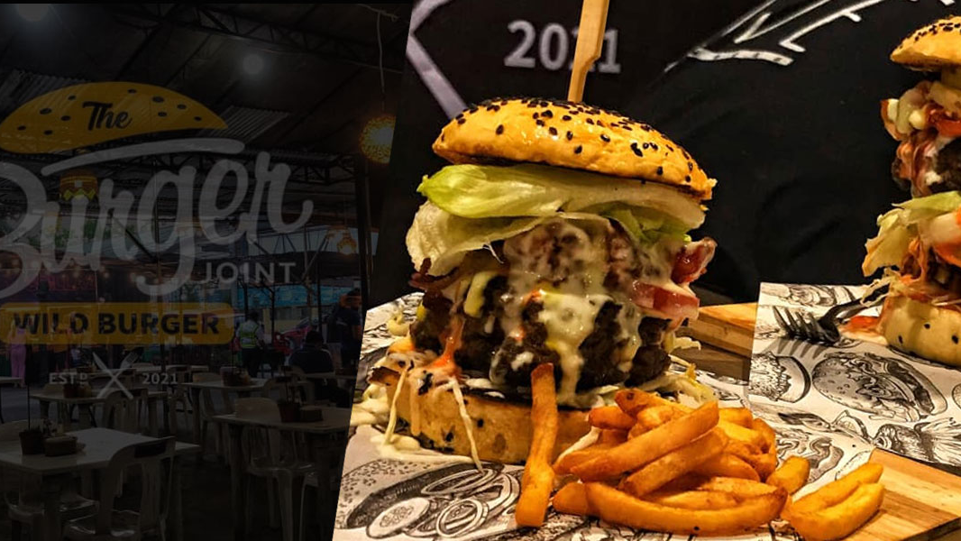
Pahatud makes local commerce easier to discover, operate, and deliver.
For customers
For partners and investors
Discover local favorites and order through the PahatudFood app.
Help build a stronger local marketplace with more merchants, reliable delivery, and measurable growth.
www.pahatud.com
info@pahatud.com
Ready, set, delivered.
10
Notes:
Sources: resources/views/pages/about.blade.php, resources/views/pages/home.blade.php, and resources/views/merchant/partials/documentation.blade.php for contact details. Background: public/uploads/user/29/banner/2021-04-10-banner-burgerjoint.jpg. Logo: public/images/logo-big.png.

