Slide 1
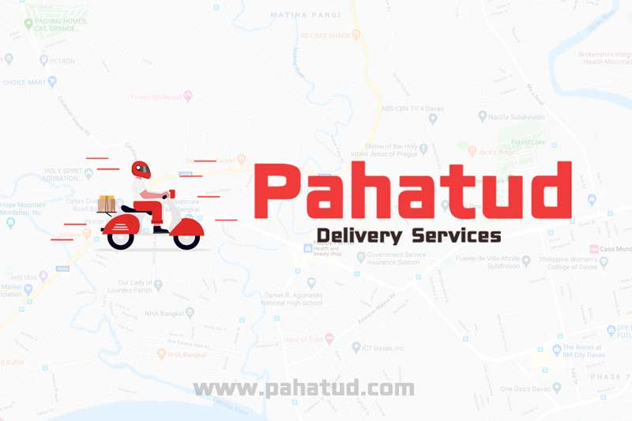
Pahatud Merchant
The merchant workspace behind the Pahatud customer experience
Store setup · catalog · orders · promotions · sales
Merchant overview
Notes:
Sources: public/images/pahatud-logo-with-motor.jpg; routes/web.php
Presenter note: Introduce Pahatud Merchant as the operational workspace that keeps the customer-facing app accurate and responsive.

Slide 2

PRODUCT OVERVIEW
One connected service for customers and merchants
Customers discover and order in Pahatud. Merchants manage the storefront and fulfillment behind it.
CUSTOMER APP
MERCHANT WORKSPACE
Storefront
Profile, branches, categories, and online status
Catalog
Products, pricing, availability, variants, and add-ons
Operations
Incoming orders, preparation, rider pickup, and proof
+
Growth
Coupons, promotional banners, and app visibility
Reporting
Completed sales, commission, and merchant net
PAHATUD MERCHANT
02
Notes:
Sources: resources/views/merchant/includes/menu.blade.php; resources/views/merchant/pages/dashboard.blade.php; public/images/app-preview/home.png
Presenter note: Explain that the customer app and merchant portal are two sides of the same transaction, with merchant updates flowing into the customer experience.

Slide 3

MERCHANT ONBOARDING
From application to an order-ready store
The merchant journey includes business details, required documents, review, and operational setup.
1
Create the merchant account
Provide the restaurant and administrator information.
2
Complete the application
Confirm business, contact, address, and payout details.
3
Upload required documents
Government ID and business registration are standard requirements.
4
Resolve review findings
Replace rejected or expired files using administrator remarks.
5
Prepare the store
Check menu, categories, branches, pricing, and availability before going online.
PAHATUD MERCHANT
03
Notes:
Sources: resources/views/merchant/pages/help.blade.php; resources/views/merchant/pages/application.blade.php; routes/web.php
Presenter note: Clarify that approval documents apply to the application flow and that merchants should not open the store until operational information is complete.

Slide 4

STOREFRONT MANAGEMENT
Merchant updates shape what customers see before ordering
The portal controls essential discovery and availability information shown through Pahatud.
01
Profile
Restaurant name and customer-facing contact information
02
Branches
Address, telephone, mobile, and service location details
03
Categories
Menu organization that helps customers browse
04
Online status
Whether the store is currently accepting orders
Visible to customers
PAHATUD MERCHANT
04
Notes:
Sources: resources/views/merchant/includes/menu.blade.php; resources/views/merchant/pages/help.blade.php; public/images/app-preview/restaurants.png
Presenter note: Use the customer screen to show why profile, branch, category, and status accuracy matters.

Slide 5

CATALOG MANAGEMENT
A menu customers can order with confidence
Clear product information reduces avoidable substitutions and cancellations.
✓
Product basics
Name, description, price, image, and category
✓
Availability
Publish active items and hide sold-out products quickly
✓
Customer choices
Use variants and add-ons for size, flavor, extras, or preparation
✓
Catalog hygiene
Keep labels short and show every additional charge clearly
PAHATUD MERCHANT
05
Notes:
Sources: resources/js/components/merchant/pages/products/ViewComponent.vue; resources/views/merchant/pages/help.blade.php; public/images/banner-left.png
Presenter note: Emphasize real-time availability and transparent add-on pricing as practical controls for order accuracy.

Slide 6
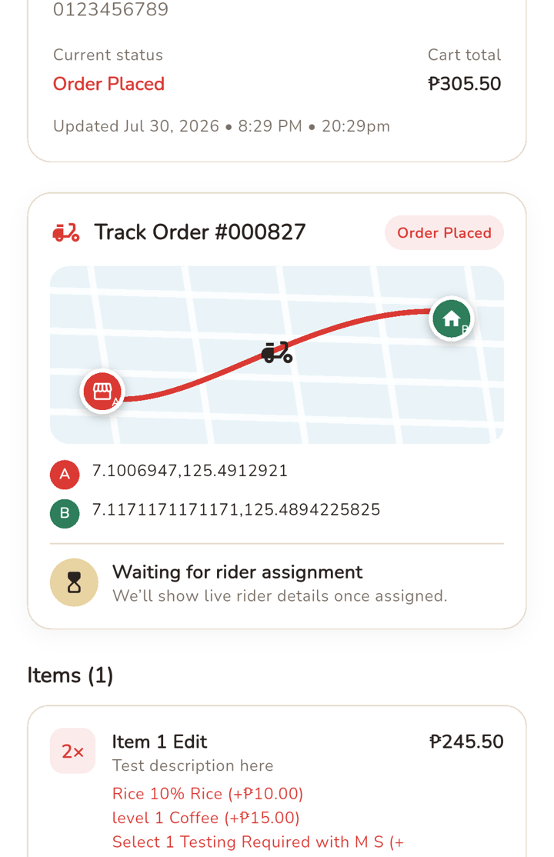

ORDER OPERATIONS
Each order stays visible from acceptance to rider pickup
The merchant workspace refreshes order activity and exposes the details needed to prepare the right package.
1
Review
Check every item, quantity, option, customer note, and delivery time.
2
Confirm
Respond promptly and keep the order visible during preparation.
3
Prepare
Complete, pack, and check the full order before changing its status.
4
Release
Mark ready when the package can be collected, then coordinate rider pickup.
Order detail includes totals, discounts, customer information, rider status, and delivery proof when available.
PAHATUD MERCHANT
06
Notes:
Sources: resources/views/merchant/pages/help.blade.php; resources/js/components/merchant/pages/orders/ViewComponent.vue; routes/web.php; public/images/app-preview/order-tracking.png
Presenter note: Connect merchant preparation steps with the customer's order-tracking experience. Avoid promising a specific rider assignment time.

Slide 7
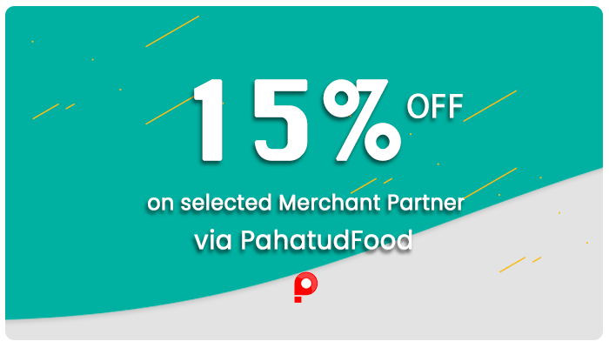
MERCHANT MARKETING
Two tools support store-specific offers
Coupons change the checkout price. Promotional banners increase visibility after administrator approval.
COUPONS
Flexible checkout discounts
Choose a fixed peso value or percentage. Add a minimum order, usage limit, validity window, and active switch.
PROMOTIONAL BANNERS
Scheduled app visibility
Upload a 1600 × 800 banner, set timing and display order, then submit it for review. Approved offers can move through scheduled, live, and expired states.
Administrator approval protects what appears in the customer app.
PAHATUD MERCHANT
07
Notes:
Sources: resources/views/merchant/pages/promotions/index.blade.php; resources/views/merchant/pages/promotions/form.blade.php; resources/views/merchant/pages/coupons/form.blade.php; public/images/highlights/ads1.png
Presenter note: Separate the two mechanics clearly: checkout coupons take effect through coupon settings, while promotional banners require administrator approval before app publication.

Slide 8

SALES REPORTING
Completed orders explain gross sales and merchant net
Merchants can run a date-range report and inspect the components behind each completed order.
GROSS COMPLETED SALES
PLATFORM COMMISSION
ESTIMATED MERCHANT NET
Order value
−
Commission
=
Net earnings
Includes completed order totals for the selected reporting period.
Reported separately so the merchant can see the platform share.
The amount assigned to the restaurant after commission and applicable entries.
The order-level report also shows items, subtotal, delivery fee, discount, rider, completion time, and status.
Only completed orders contribute to the displayed sales totals.
PAHATUD MERCHANT
08
Notes:
Sources: resources/js/components/merchant/pages/report/OrderReportTodayComponent.vue; resources/views/merchant/pages/reports/today.blade.php; resources/views/merchant/pages/help.blade.php
Presenter note: Do not insert sample revenue figures. Explain the relationship between gross, commission, and estimated merchant net using the labels from the implementation.

Slide 9

MERCHANT ROUTINE
A simple operating rhythm keeps the store reliable
Most merchant work falls into four moments across the service day.
01
02
03
04
Before opening
During service
For every order
After service
Review profile and branch details. Confirm menu prices and stock. Switch the store online only when staff can monitor orders.
Keep sold-out items unavailable. Watch incoming orders and respond quickly when a new request appears.
Check options and notes. Prepare the complete package, mark it ready, and release it to the correct rider.
Review completed sales, commission, and net. Update tomorrow's availability and switch the store offline when needed.
Help and documentation covers account setup, application status, products, orders, sales, payouts, and support.
PAHATUD MERCHANT
09
Notes:
Sources: resources/views/merchant/pages/help.blade.php; resources/views/merchant/pages/dashboard.blade.php; resources/js/components/merchant/includes/MerchantStoreOnlineComponent.vue
Presenter note: Frame these as practical habits based on the implemented controls, not as contractual service-level commitments.

Slide 10

PAHATUD MERCHANT
Merchant outcomes
A clear operating workspace connected to the Pahatud customer experience
✓
A customer-facing storefront in the Pahatud app
✓
Direct control of catalog and product availability
✓
Order visibility through preparation and rider pickup
✓
Sales reporting with gross, commission, and net amounts
Merchant support
info@pahatud.com · +63 916 298 6547 · (082) 224 3919
PAHATUD MERCHANT
10
Notes:
Sources: resources/views/merchant/pages/help.blade.php; resources/views/merchant/includes/menu.blade.php; public/images/announcements/pahatud-new-website.png
Presenter note: Close with concrete merchant capabilities and the support channels implemented in the merchant help page.

