Slide 1


PAHATUDFOOD
Merchant Partner
Orientation
Commission, dashboard, and service journeys
Prepared for prospective restaurant partners
October 2026
Notes:
Brand and layout reference: Pahatud_Agent_Orientation_2026-09-29_v3 (1).pptx. Hero illustration generated for this presentation with OpenAI image generation.

Slide 2


What the partnership includes
A single merchant account connects the customer marketplace, restaurant operations, and fulfilment
One storefront. Three ways to serve.
Customer discovery: Your restaurant and menu appear in the PahatudFood marketplace.
Order control: Your team reviews, prepares, and updates every order from the merchant dashboard.
Flexible service: Activate dine-in, pickup, delivery, or the service mix agreed for each branch.
Clear reporting: Track sales, recorded platform commission, and estimated net revenue.
Merchant manages the menu and orders. PahatudFood provides marketplace access and delivery coordination.
Customer app
02
Notes:
Sources: public/images/app-preview/home.png; public/images/app-preview/restaurants.png; resources/views/merchant/partials/documentation.blade.php; routes/web.php merchant dashboard routes.

Slide 3
Merchant journey from setup to growth
The operating model becomes simple once the commercial policy and service modes are agreed
01
02
03
04
05
Apply and receive approval
Complete the account
Build the menu
Go online
Review and improve
Submit the restaurant and required documents.
Confirm profile, branch, contact, and payout details.
Add categories, products, prices, add-ons, and availability.
Receive and fulfil orders through the dashboard.
Check sales, commission, estimated earnings, and order outcomes.
Service availability depends on the modes activated for the restaurant or branch.
03
Notes:
Sources: resources/views/merchant/partials/documentation.blade.php; routes/web.php merchant routes; resources/views/merchant/pages/application.blade.php.

Slide 4
PahatudFood commission structure
The proposed standard rate is calculated from the eligible food subtotal for each completed order
Platform commission
PROPOSED STANDARD RATE
15%
Eligible food subtotal × agreed commission rate = platform commission
Merchant amount before adjustments
of eligible item prices and paid add-ons
Eligible food subtotal − platform commission = merchant amount
The merchant agreement confirms the final rate before activation.
₱500 subtotal
₱2,000 subtotal
PahatudFood ₱75
Merchant ₱425
PahatudFood ₱300
Merchant ₱1,700
Examples exclude other applicable adjustments.
04
Notes:
Sources: resources/views/pages/home.blade.php states a straightforward 15% commission confirmed before activation. app/Http/Controllers/Api/Merchant/ItemController.php stores commission from item price and the merchant percentage. Examples are arithmetic illustrations, not contract terms.

Slide 5
15% commission on a ₱1,000 food subtotal
A simple settlement example before discounts, refunds, taxes, or other applicable adjustments
₱1,000 × 15% = ₱150
Settlement line | Amount (₱)
PahatudFood commission | 150.00
Merchant share | 850.00
Total food subtotal | 1,000.00
PahatudFood commission
₱1,000 − ₱150 = ₱850
Merchant amount before other adjustments
Current product logic keeps the delivery fee outside the item commission base.
Confirm the final merchant agreement before using this example as a contractual statement.
05
Notes:
Sources: resources/views/pages/home.blade.php; app/Model/Cart.php; app/Http/Controllers/Api/Merchant/ItemController.php. Arithmetic: ₱1,000 × 15% = ₱150; ₱1,000 − ₱150 = ₱850.

Slide 6
Treatment of fees, discounts, and other charges
The current implementation answers some questions. Commercial policy must confirm the rest.
Order component | Current product logic | Status for partner discussion
Item prices and paid add-ons | Included in the stored item commission amount. | Confirmed in current code
Delivery fee | Calculated and displayed separately from item commission. | Confirmed in current code
Convenience fee | Added as a separate customer charge and excluded from the stored item commission field. | Confirmed in current code
VAT on convenience fee | Calculated separately from item commission when configured. | Confirmed in current code
Discounts and vouchers | Reduce the customer total. The merchant or platform funding rule is not defined as a commercial policy in the materials reviewed. | Needs confirmation
Refunds, cancellations, and other adjustments | The final settlement and any commission reversal or clawback rule require a written policy. | Needs confirmation
Use the signed merchant agreement as the final authority if it differs from current system behavior.
06
Notes:
Sources: app/Model/Cart.php cartItemAmounts(); app/Http/Controllers/Api/Merchant/ItemController.php; resources/js/components/merchant/pages/report/OrderListComponent.vue. Items marked Needs confirmation are intentionally unresolved because the supplied materials do not define a final commercial policy.

Slide 7
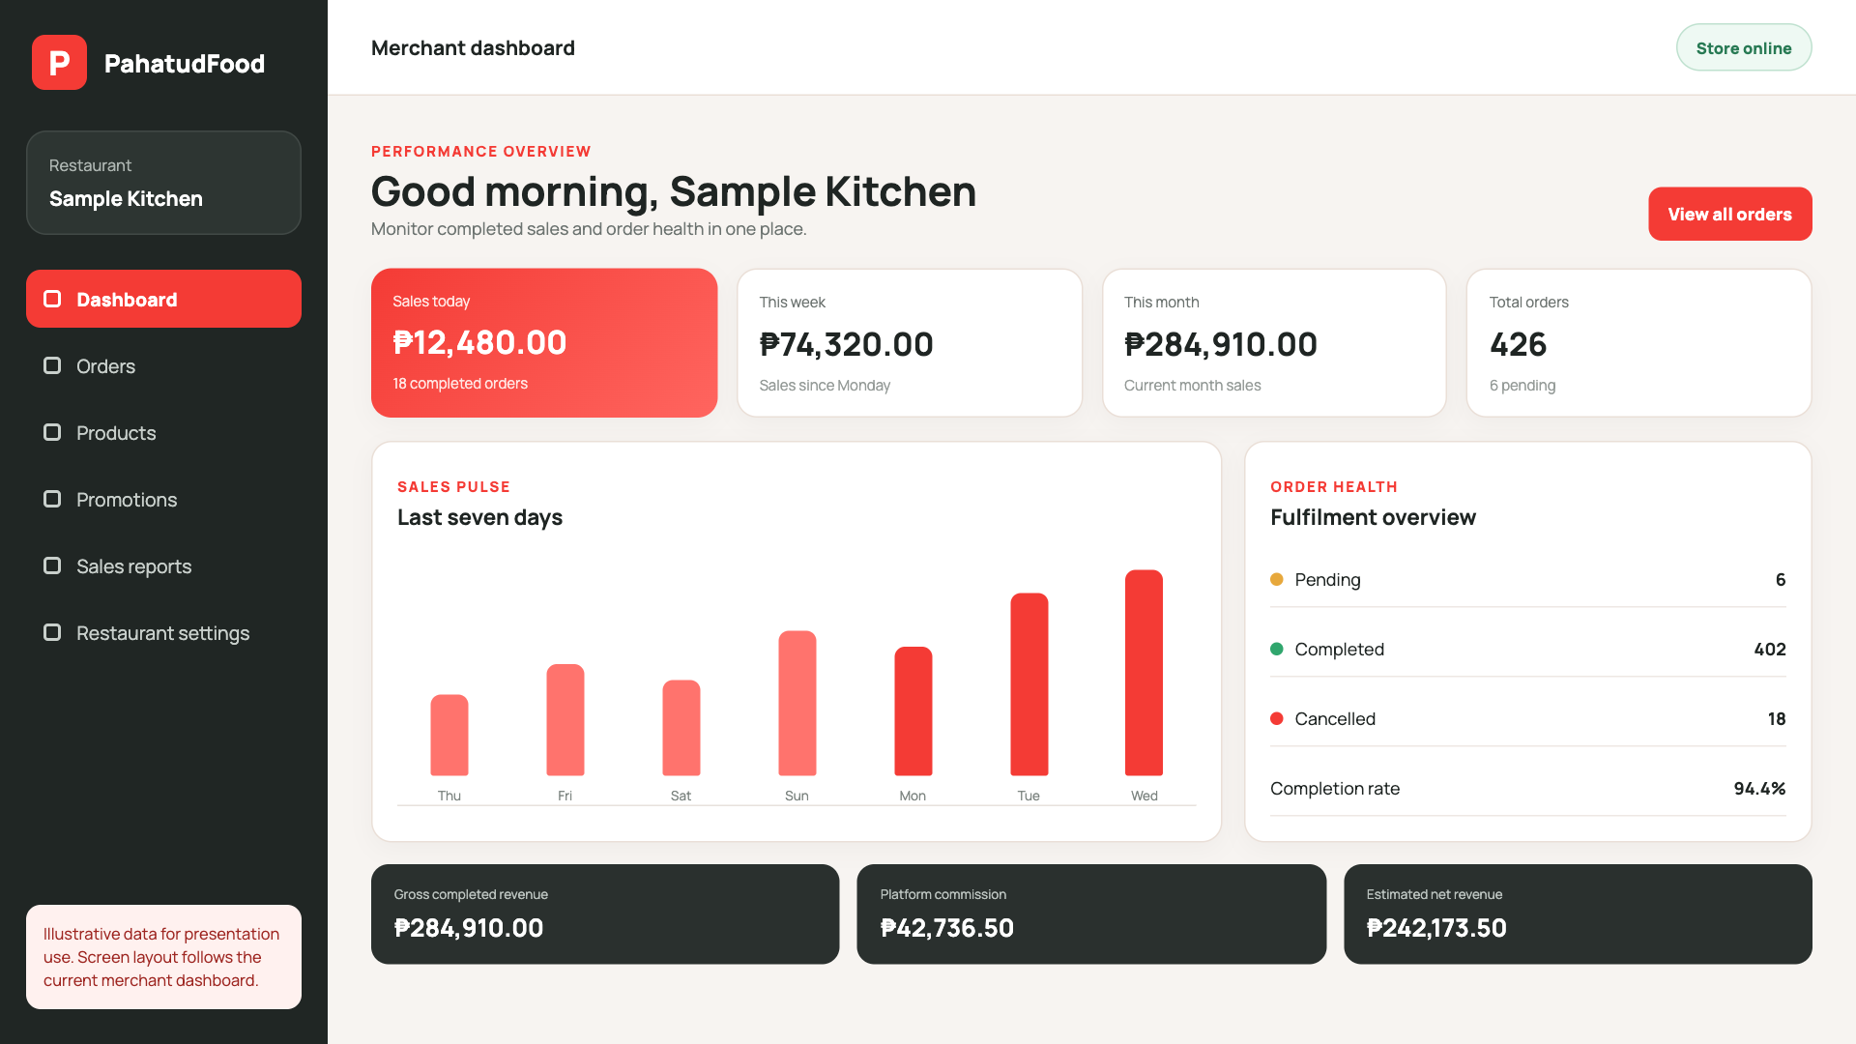
Merchant dashboard at a glance
The home view combines store status, order health, sales activity, commission, and estimated net revenue
Five questions answered
01
Is the store online?
02
What needs attention now?
03
How much did we sell?
04
What commission was recorded?
05
What is the estimated net revenue?
Illustrative data. Layout follows the current merchant dashboard.
07
Notes:
Sources: resources/js/components/merchant/pages/orders/SummaryComponent.vue; app/Http/Controllers/Api/Merchant/OrderController.php. Screenshot is a presentation preview based on the current UI code and uses sample data only.

Slide 8
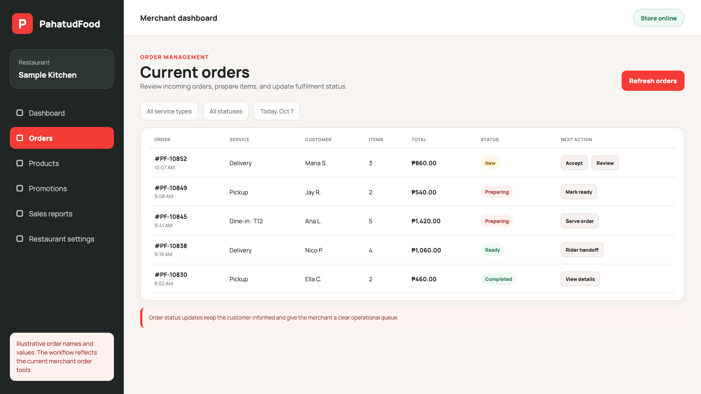
Manage orders from one queue
A clear status workflow helps the kitchen, customer, and rider stay aligned
01
Review
Check items, add-ons, instructions, payment, and service mode.
02
Accept and prepare
Confirm the order promptly and start kitchen preparation.
03
Mark ready
Signal that a table, pickup customer, or rider can receive the order.
04
Complete or cancel
Close the order accurately and preserve the reason when it cannot be fulfilled.
Illustrative data. Actual status labels and actions depend on the enabled service mode.
08
Notes:
Sources: resources/js/components/merchant/pages/report/OrderListComponent.vue; routes/merchant.php; resources/views/merchant/partials/documentation.blade.php. Screenshot uses sample data.

Slide 9
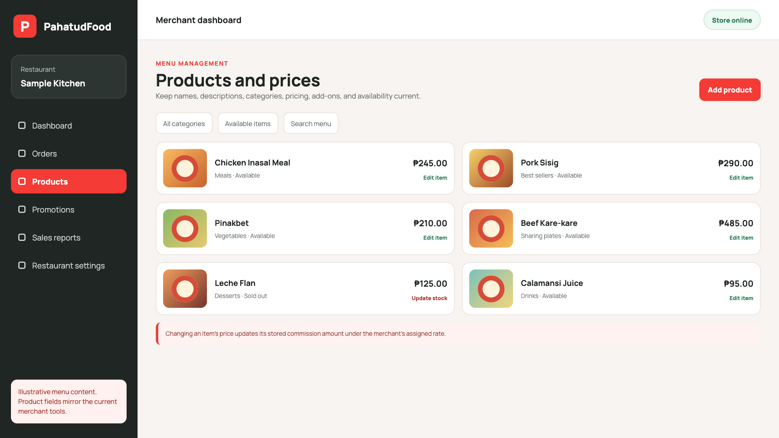
Update menu items and prices
Menu accuracy reduces order issues and keeps commission calculations aligned with current prices
What merchants can maintain
Product name and description
Category and branch availability
Regular and promotional prices
Add-ons and item variations
Available or sold-out status
New item prices store a commission amount using the merchant’s assigned percentage.
Illustrative data based on current product fields.
09
Notes:
Sources: app/Http/Controllers/Api/Merchant/ItemController.php; resources/js/components/merchant/pages/products/ViewComponent.vue; app/Products.php. Screenshot uses sample menu data.

Slide 10
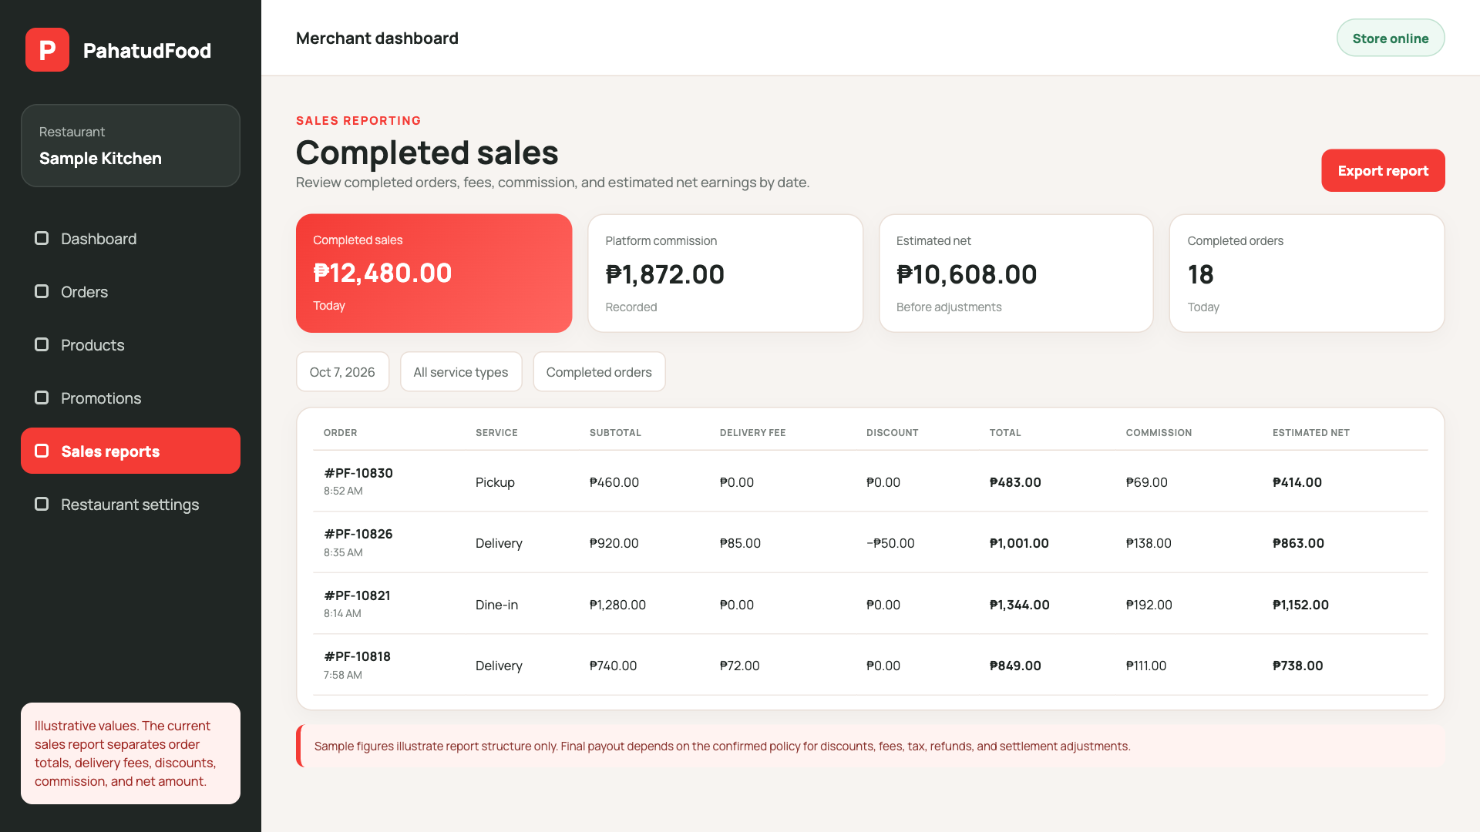
Sales and earnings
Merchant reports separate completed sales, platform commission, and estimated net revenue
What to review
Sales today, this week, and this month
Completed, pending, and cancelled orders
Gross completed revenue
Recorded platform commission
Estimated net revenue and date-based reports
Current dashboard formula
Order total − recorded commission
= estimated net revenue
Final payout may differ if the confirmed policy applies discounts, refunds, tax, or other settlement adjustments.
10
Notes:
Sources: resources/js/components/merchant/pages/orders/SummaryComponent.vue; app/Http/Controllers/Api/Merchant/OrderController.php; resources/views/merchant/pages/reports/today.blade.php. The screenshot is reused here because the same merchant dashboard is the source for the sales and earnings view; data are illustrative.

Slide 11
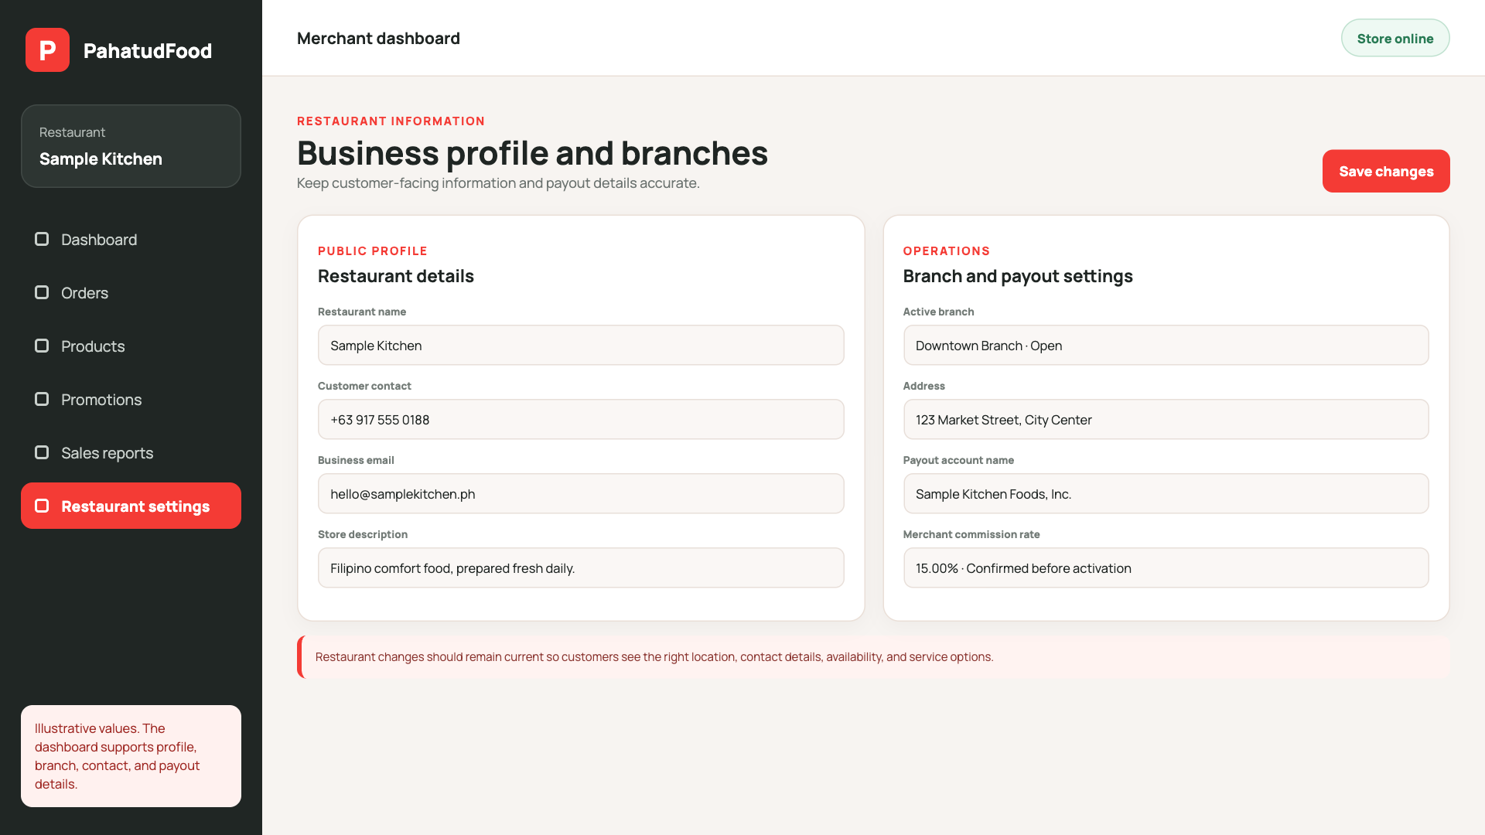
Restaurant information and branches
Keeping customer-facing and payout information current supports smoother fulfilment
Merchant controls
Restaurant name and description
Customer contact information
Branch addresses and availability
Payout account name and details
Activated service modes and store status
Profile changes should match the restaurant’s current operating details before the store goes online.
Illustrative data based on current merchant settings fields.
11
Notes:
Sources: resources/views/merchant/partials/documentation.blade.php; resources/js/components/merchant/pages/profile/ViewComponent.vue; routes/web.php. Screenshot uses sample data.

Slide 12
Dine-in, pickup, and delivery at a glance
Each mode changes the handoff. The merchant still receives, prepares, and completes the order.
Journey point | Dine-in / order to table | Pickup | Delivery
Customer starts | At the restaurant table | Away from the restaurant | Away from the restaurant
Customer receives | Prepared food at the table | Prepared order at the counter | Prepared order at the delivery address
Merchant handoff | Serve the identified table | Release to the customer | Release to the assigned rider
Rider involved | No | No | Yes
Delivery fee | Not expected | Not expected | Applies according to the confirmed delivery-fee policy
Confirm service availability, operating hours, handoff verification, and delivery-fee rules before activation.
12
Notes:
The three service definitions follow the user's supplied brief. Delivery fee treatment is intentionally subject to confirmation because no final commercial policy was supplied.

Slide 13

Dine-in / Order to table
The customer orders for a specific table. The merchant prepares and serves the meal in the restaurant.
01
Customer starts
Selects the restaurant, confirms the table, and submits the order.
02
Merchant receives
Reviews the order and table reference in the dashboard.
03
Kitchen prepares
Prepares the items and updates the order status.
04
Merchant serves
Delivers the prepared order to the correct table.
05
Order closes
Marks the order complete after service.
Confirm how the customer identifies the table: QR code, table number, or staff-provided link.
13
Notes:
Journey definition supplied by the user. Illustration generated for this presentation with OpenAI image generation. Table-identification method requires product confirmation.

Slide 14

Pickup
The customer orders ahead. The merchant prepares the food and releases it at the restaurant.
01
Customer orders ahead
Chooses pickup and submits the order before arriving.
02
Merchant confirms
Reviews the order and expected pickup timing.
03
Kitchen prepares
Prepares and packs the order for collection.
04
Merchant marks ready
Lets the customer know the order can be collected.
05
Customer collects
Receives the order at the agreed pickup point.
Confirm pickup windows and the order-verification method used at handoff.
14
Notes:
Journey definition supplied by the user. Illustration generated for this presentation with OpenAI image generation. Pickup timing and handoff verification require confirmation.

Slide 15

Delivery
The merchant prepares the order. A Pahatud rider collects it and completes the last-mile delivery.
01
Customer submits
Chooses delivery, confirms the address, and places the order.
02
Merchant accepts
Reviews the items and starts preparation.
03
Merchant marks ready
Seals the order and signals that it is ready for pickup.
04
Rider collects
Receives the order from the merchant and verifies the handoff.
05
Rider delivers
Transports the order to the customer’s address.
Confirm delivery-fee calculation, rider assignment, proof of delivery, and exception handling.
15
Notes:
Journey definition supplied by the user. Illustration generated for this presentation with OpenAI image generation. Delivery-fee and exception policies require confirmation.

Slide 16
P
Before launch
Resolve the commercial details, complete the dashboard setup, and test each activated service mode
Merchant readiness
Pahatud confirmations
Business profile and branch details are current
Menu, prices, add-ons, and availability are complete
Operating hours and service modes are set
Contact and payout information are verified
Team completes a test order for each active service mode
Final commission rate and eligible subtotal definition
Discount and voucher funding rules
Delivery-fee and other customer-charge treatment
Payout schedule, refunds, and settlement adjustments
Support contacts and escalation process
Merchant support
info@pahatud.com +63 916 298 6547
Agree the policy. Activate the dashboard. Run the test orders.
16
Notes:
Sources: resources/views/merchant/partials/documentation.blade.php for support contact and merchant tasks. Commercial-policy items remain intentionally flagged for confirmation.

