Slide 1
Insert name ^{1,2}
¹ Center for Advancing the Radiation Resilience of Electronics (CARRE)
² Affiliation (University)
Sep 15, 2025

Slide 4
References
Morgan, J. P., Variansyah, I., Pasmann, S. L., Clements, K. B., Cuneo, B., Mote, A., Goodman, C., Shaw, C., Northrop, J., Pankaj, R., Lame, E., Whewell, B., McClarren, R. G., Palmer, T. S., Chen, L., Anistratov, D. Y., Kelley, C. T., Palmer, C. J., & Niemeyer, K. E. (2024). Monte Carlo / Dynamic Code (MC/DC): An accelerated Python package for fully transient neutron transport and rapid methods development. Journal of Open Source Software, 9(96), 6415. https://doi.org/10.21105/joss.06415
C. T. Kelley. Solving Nonlinear Equations with Iterative Methods: Solvers and Examples in Julia. Number 20 in Fundamentals of Algorithms. SIAM, Philadelphia (2022) ISBN 978-1-61197-726-4.
R. G. McClarren, Machine Learning for Engineers: Using data to solve problems for physical systems, Springer, New York (2021) ISBN: 978-3030703875.
V. N. Novellino, D. Y. Anistratov Multi-Level Hybrid Monte Carlo / Deterministic Methods for Particle Transport Problems. 2025 (submitted)
J. P. Morgan, I. Variansyah, K. B. Clements, T. S. Palmer and K. E. Niemeyer. Hybrid Delta Tracking Schemes Using a Track-Length Estimator. 2025.(submitted). arXiv:2510.00152
J. Northrop, I. Variansyah, T. S. Palmer, and C. J. Palmer. Interplay of Variance Reduction and Population Control in Monte Carlo Neutron Transport”, In Press Nuclear Science and Engineering. arXiv:2509.22943
J. P. Morgan, I. Variansyah, T. S. Palmer and K. E. Niemeyer. 2024.. Impacts of dynamic radiation transport to one-cell inversions on modern GPUs with higher-order discretization. Nuclear Science and Engineering doi 10.1080/00295639.2025.2510004 arXiv:2503.00264.
A. Mote T. S. Palmer and L. Chen. 2024. Neurons for Neutrons: A Transformer Model for Computation Load Estimation on Domain-Decomposed Neutron Transport Problems. Nuclear Science and Engineering 54 (5) pp 381–407. doi 10.1080/23324309.2025.2540757, arXiv:2411.03389
J. P. Morgan, I. Variansyah, B. Cuneo, T. S. Palmer and K. E. Niemeyer. 2024. Accepted IEEE Computing in Science and Engineering. Performance Portable Monte Carlo Neutron Transport in MCDC via Numba. Preprint DOI 10.48550/arXiv.2409.04668. DOI 10.1109/MCSE.2025.3550863.

Slide 5
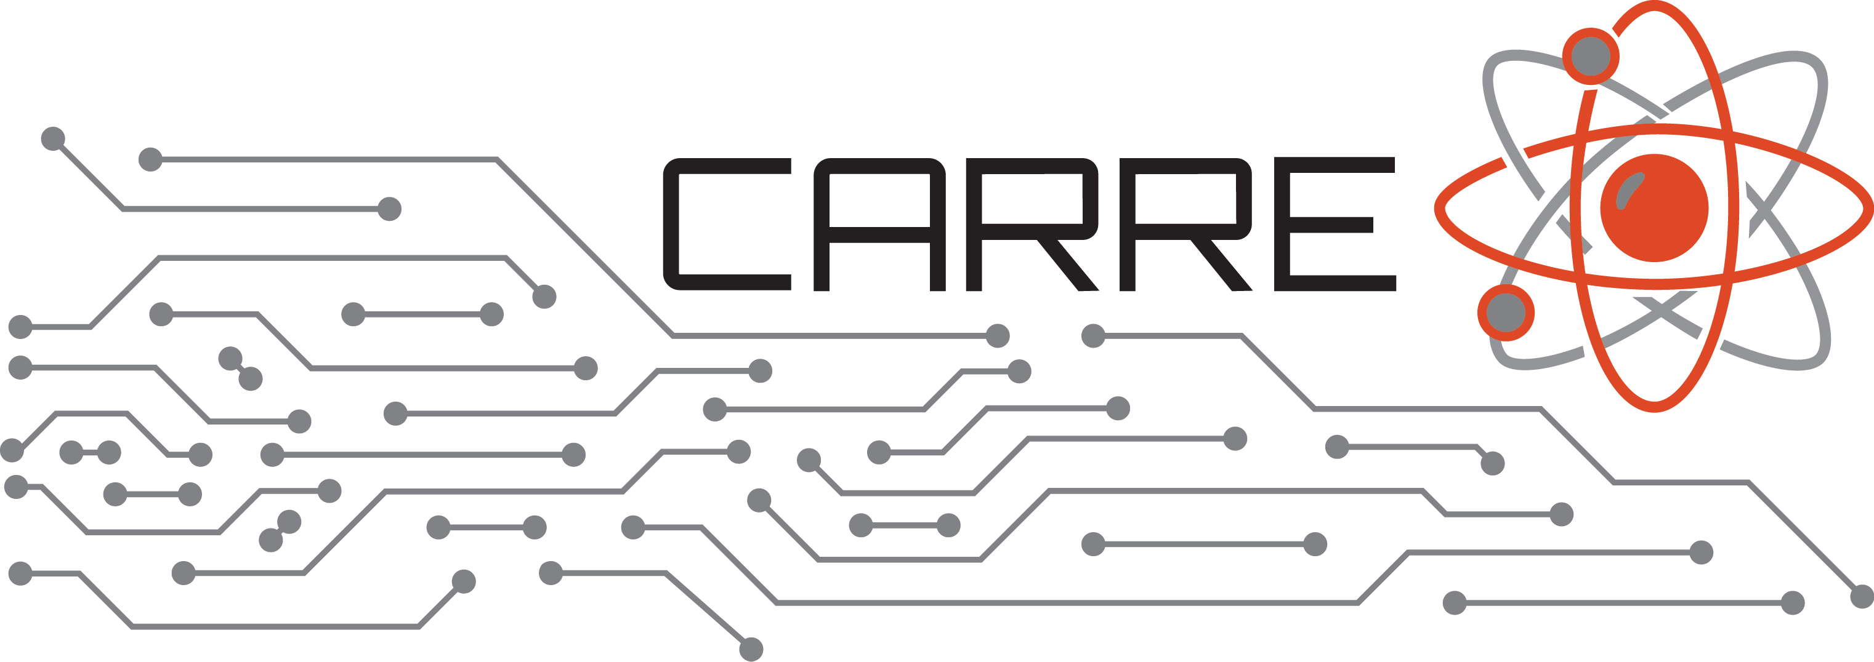
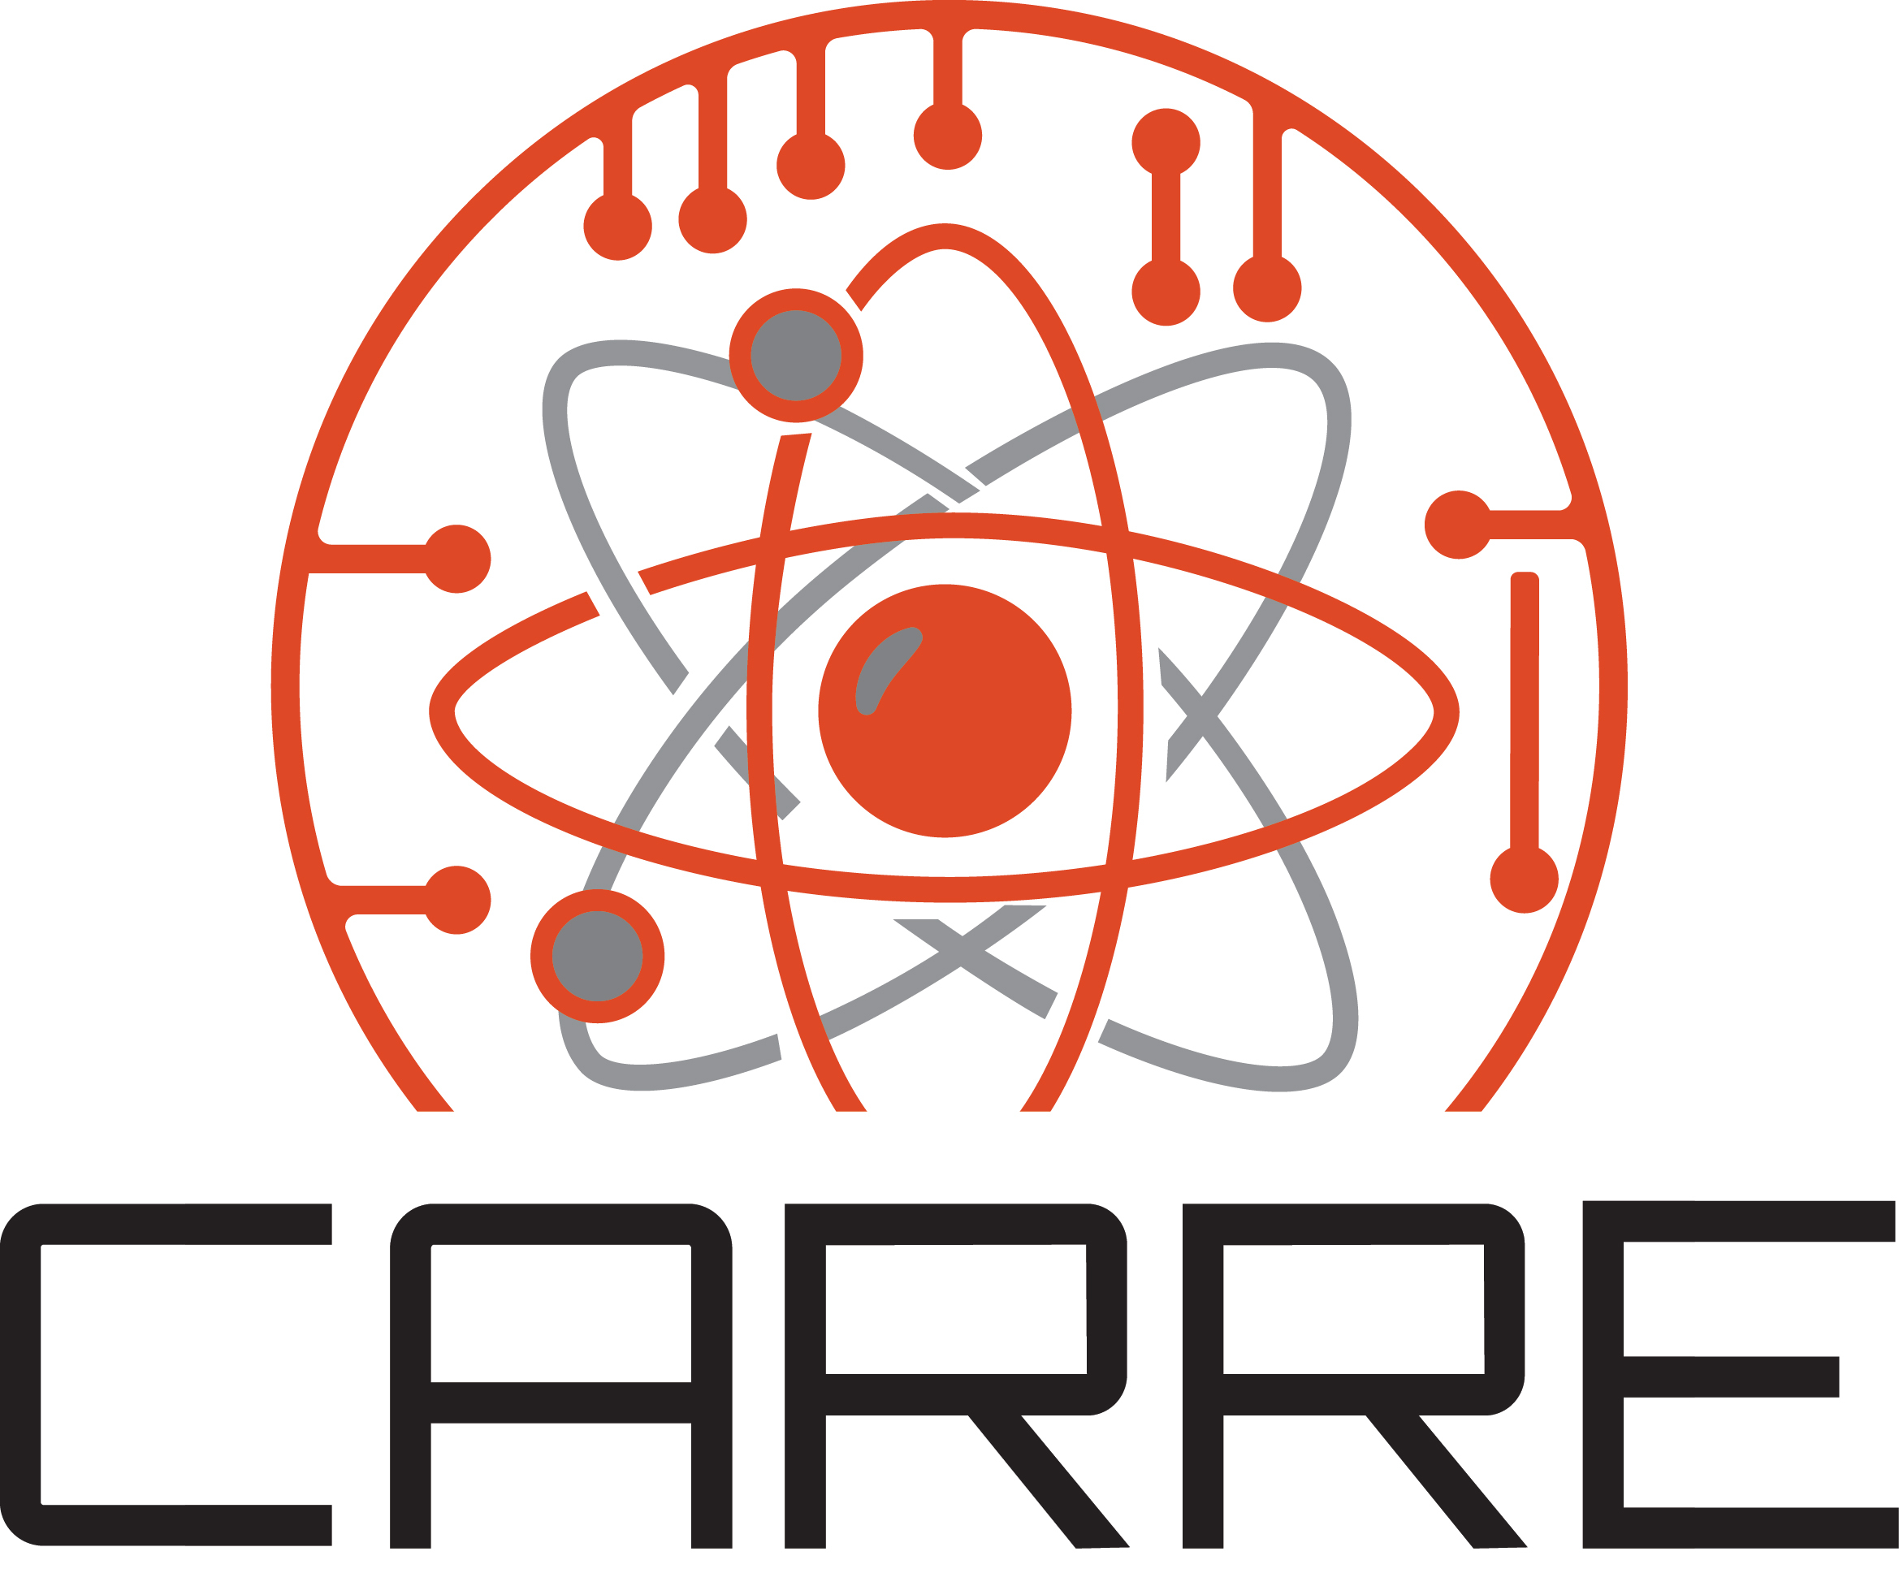


LOGOs 1

Slide 6







LOGOs 2 – Individual University Logos

Slide 7





QR Codes - CARRE Website

Slide 8





QR Codes – MCDC

Slide 9
Acknowledgements
This work was supported by the Center for Advancing the Radiation Resilience of Electronics (CARRE),
a PSAAP-IV project funded by the Department of Energy, grant number:
DE-NA0004268.

Slide 10
Thank you!
Questions?

