Slide 1



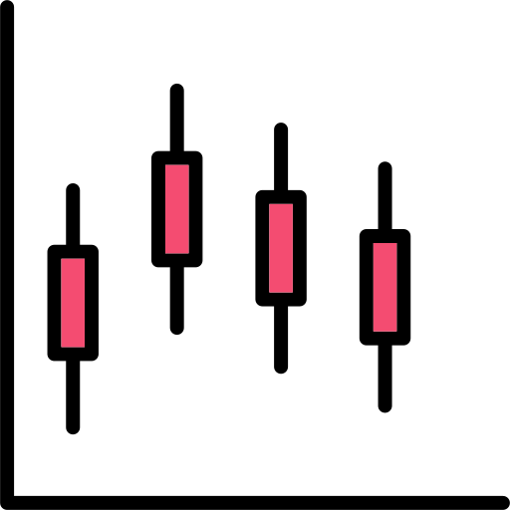


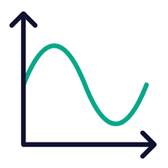

Insert Title
Author ª
ª Radiation Transport and Reactor Physics Research Group, Oregon State University
Objective
Results
Conclusions
This work aims to …
This work…
Introduction
Future Work
Methods
References
Morgan, J. P., et al.(2024). Monte Carlo / Dynamic Code (MC/DC): An accelerated Python package for fully transient neutron transport and rapid methods development. Journal of Open Source Software, 9(96), 6415. https://doi.org/10.21105/joss.06415
Acknowledgements
This work was supported by the Center for Advancing the Radiation Resilience of Electronics (CARRE), a PSAAP-IV project funded by the Department of Energy, grant number:
DE-NA0004268.

Slide 2

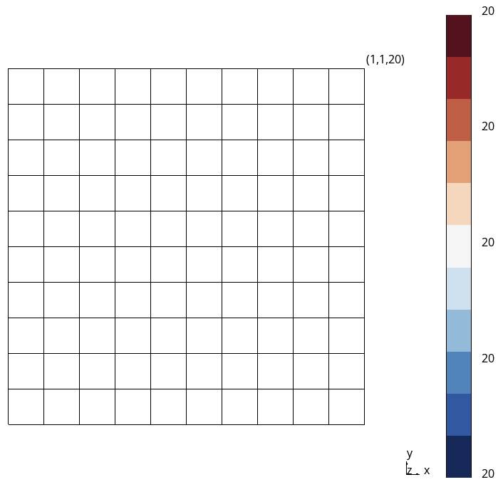
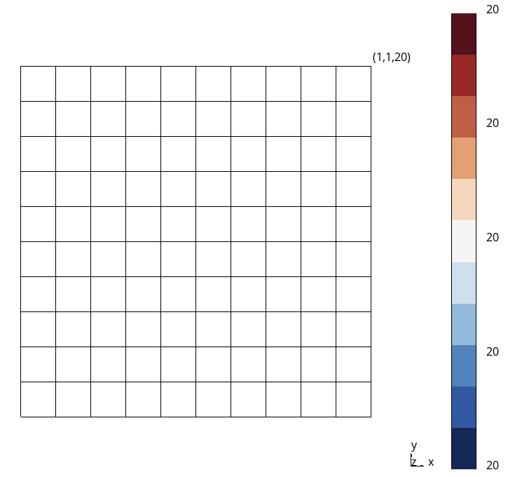
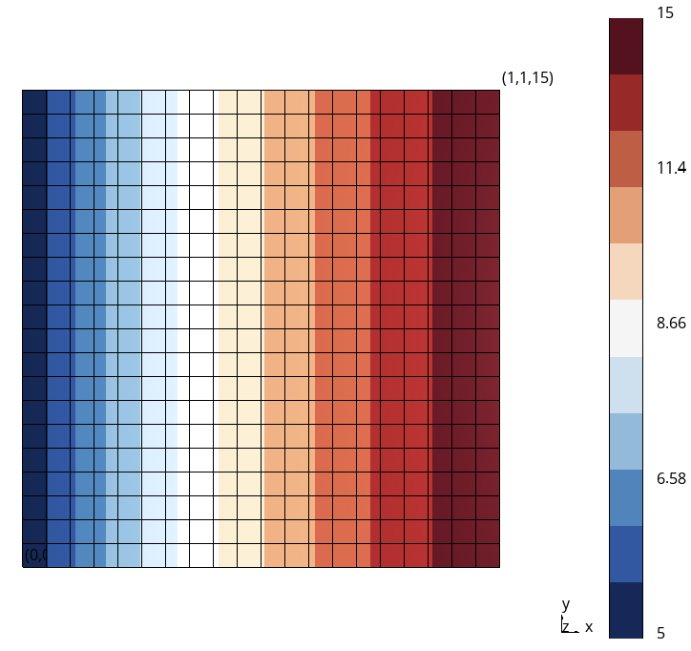

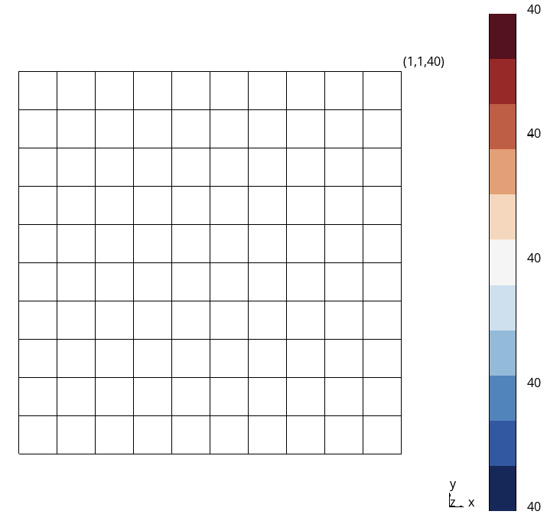
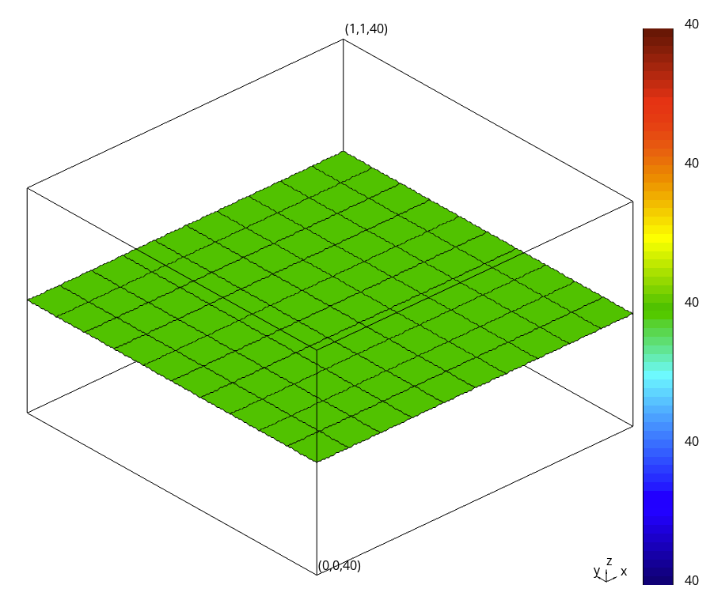
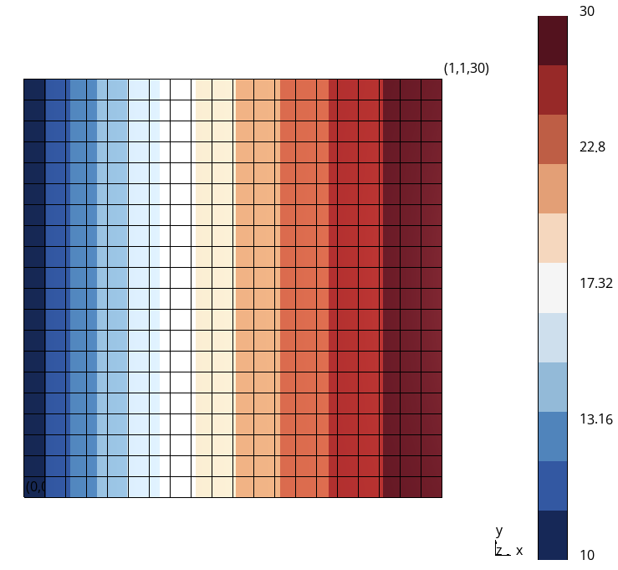
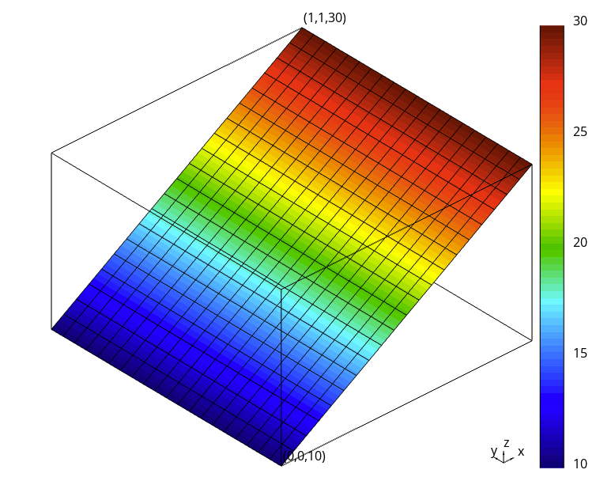
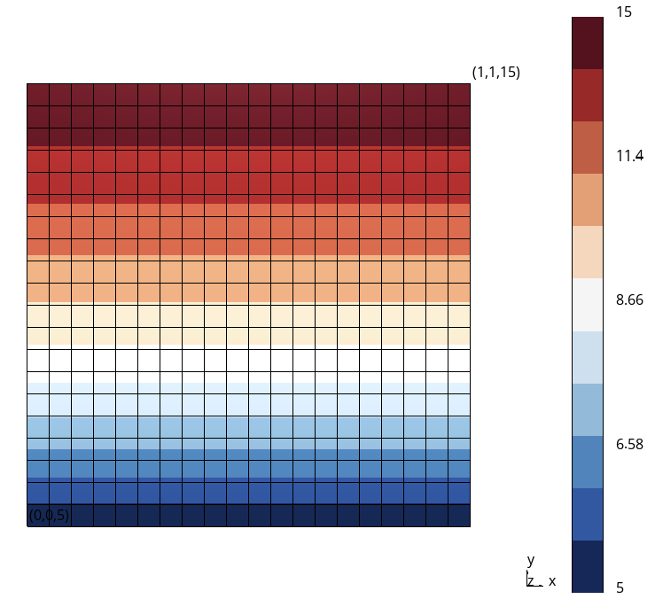
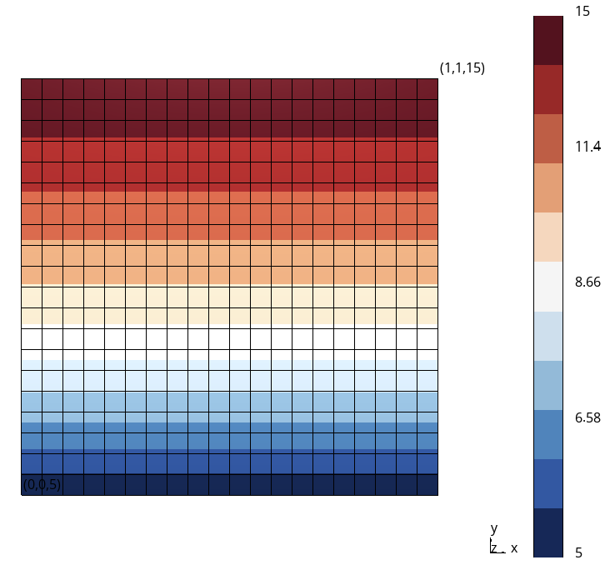
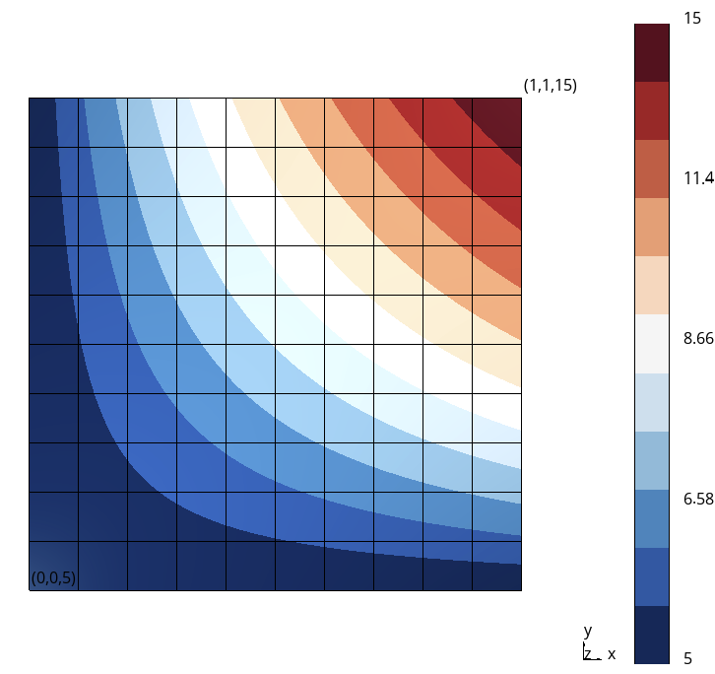
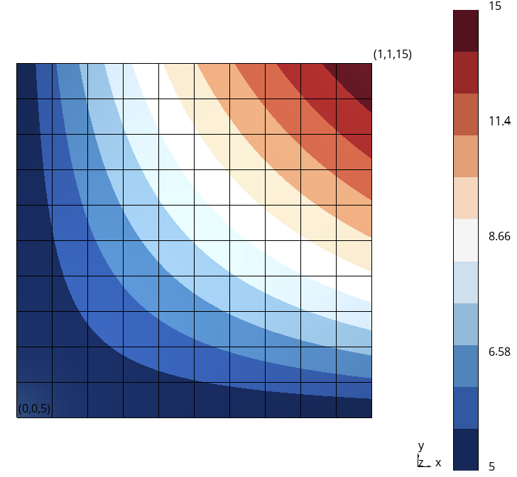
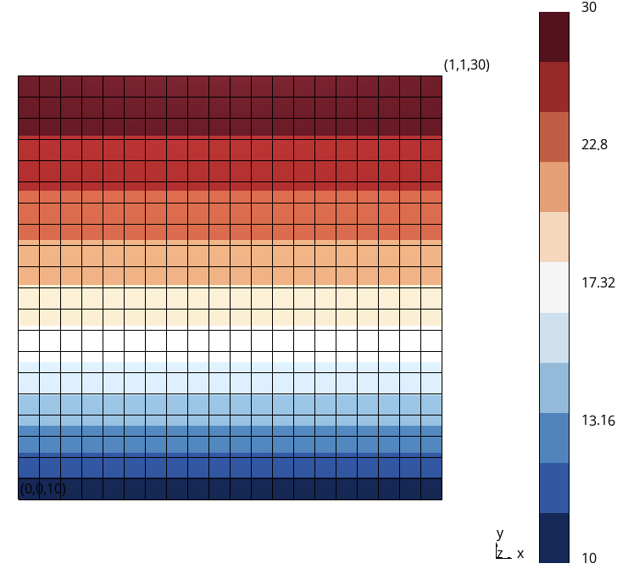
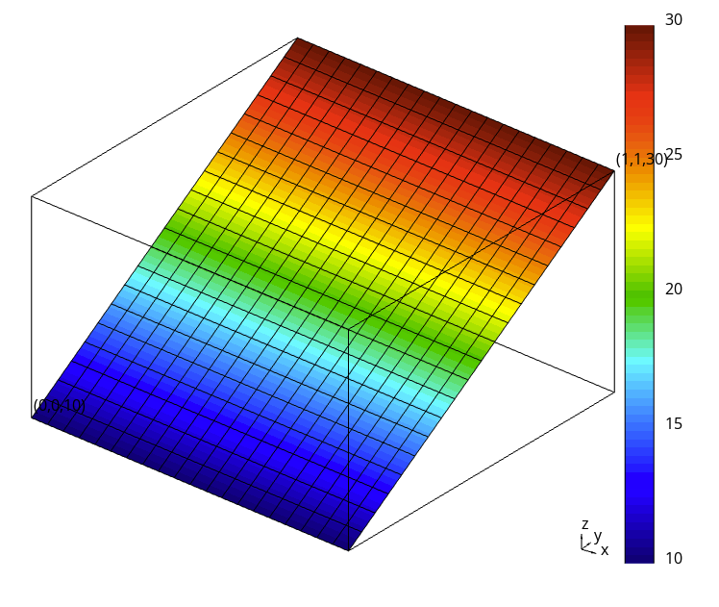
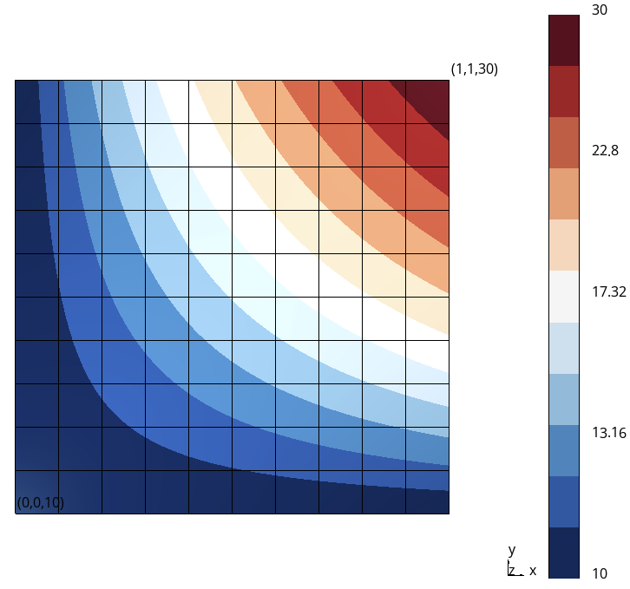
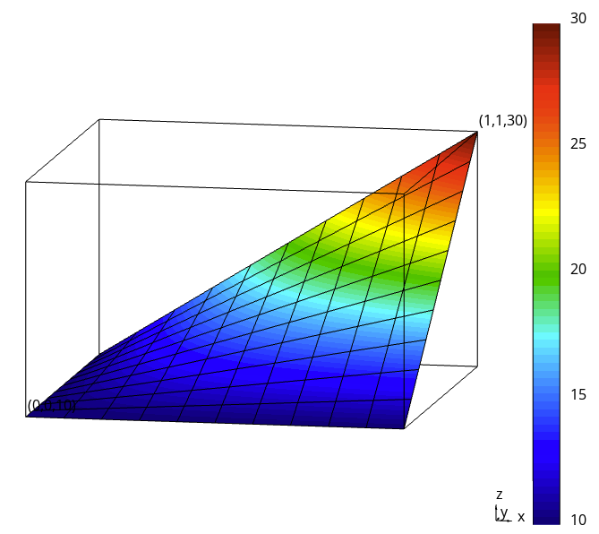
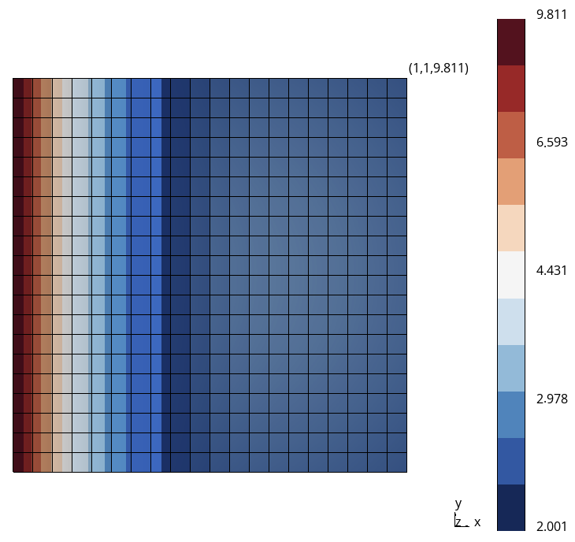
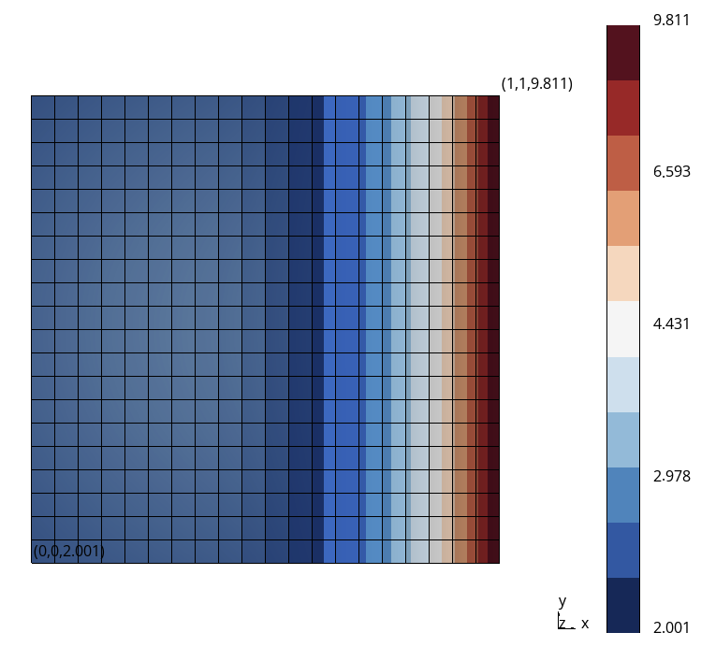
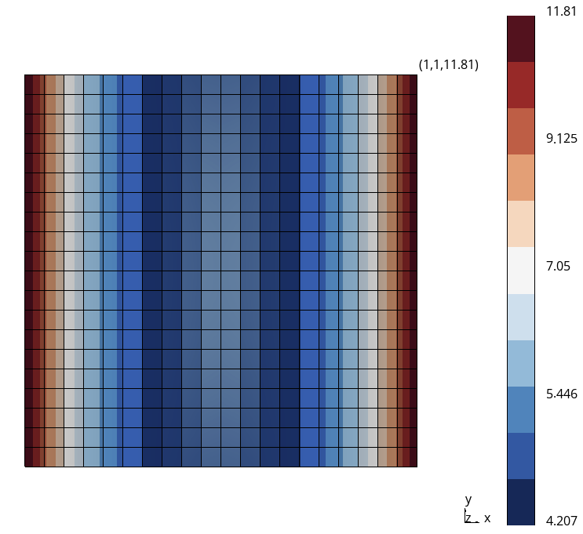
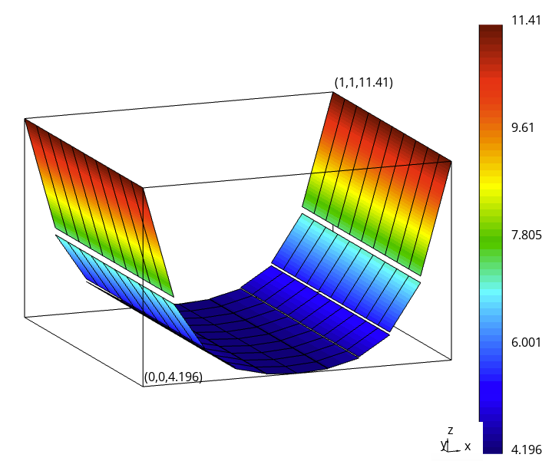







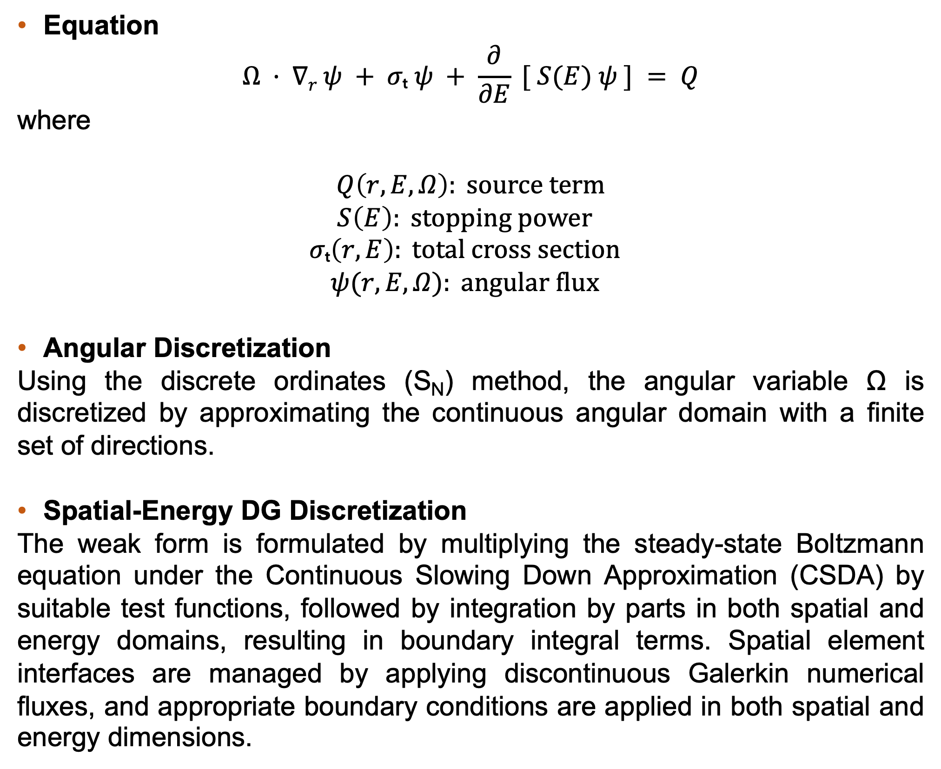




















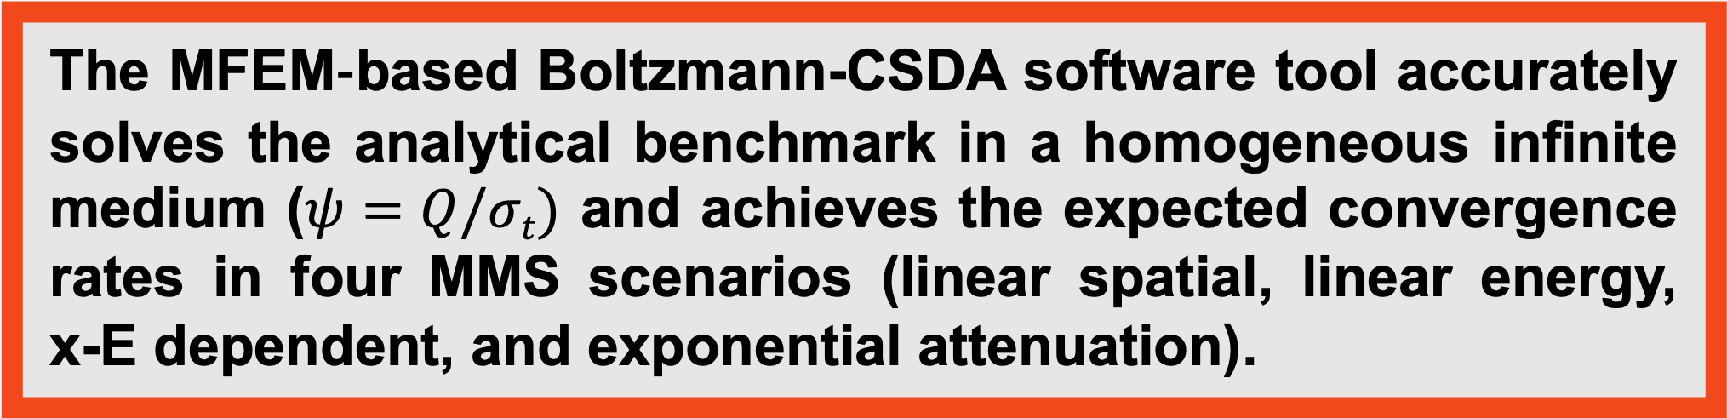








MFEM-based Finite Element Solver for the Boltzmann Equation with Energy-Spatial Coupling Using the Continuous Slowing Down Approximation
Melek Dermanª, Todd S. Palmerª
Center for Exascale Monte-Carlo Neutron Transport (CEMeNT), ªOregon State University
Objective
Results
Conclusions
This work aims to implement and validate a discontinuous‐Galerkin (DG) finite element solver for the steady‐state Boltzmann transport equation under the Continuous Slowing Down Approximation (CSDA) with coupled spatial-energy discretizations.
E
E
E
E
The MFEM‐based Boltzmann-CSDA software tool accurately solves the analytical benchmark in a homogeneous infinite medium ($ψ=Q/σt$) and achieves the expected convergence rates in four MMS scenarios (linear spatial, linear energy,
x-E dependent, and exponential attenuation). ​
$$ψ(x,E) for μ≅+ 0.577$$
x
$$ψ(x,E)for μ≅− 0.577$$
x
$$ψ(x,E)$$
$$ψ(x,E) for μ≅+ 0.577$$
x
$$ψ(x,E)$$
$$ψ(x,E)for μ≅− 0.577$$
x
$$ψ(x,E)$$
Introduction
E
$$ψ(x,E)$$
$$φ$$
E
$$φ$$
Future Work
In this study, we employed the linear DG finite element (FE) method, an effective numerical approach for solving transport equations. The DG method offers numerous advantages by utilizing discontinuous basis functions that inherently capture steep gradients and discontinuities in particle distributions. This use of piecewise-linear functions is particularly good at resolving singular features, such as corner points, in the solution domain. The CSDA approach we applied makes coupled spatial-energy domain representation (x,E) possible through its energy-derivative operator. Our numerical implementation utilized the PyMFEM finite element library, a Python wrapper to the high-performance MFEM code developed at Lawrence Livermore National Laboratory (LLNL), providing scalable parallel discretization tools and efficient solver integration.
E
x
Extend validation to benchmark problems in heterogeneous media with complex source terms.
Integrate the full Boltzmann-Fokker-Planck scattering operator to accurately capture strongly forward-peaked scattering.
Enable parallel execution using MFEM’s internal parallel solvers for 3D (x-y-E) simulations
Investigate whether the CSDA operator’s energy-derivative can be solved using algorithms analogous to time-dependent transport methods and assess its performance and scalability with parallel solvers such as Block Jacobi preconditioners.
x
E
x
x
$$φ(x,E)$$
$$φ(x,E)$$
$$φ(x,E)$$
$$φ(x,E)$$
Figure 1: Infinite Medium Problem
Figure 2: x-dependent MMS
E
E
E
E
x
x
x
x
Methods
$$ψ(x,E) for μ≅+ 0.577$$
$$ψ(x,E)$$
$$ψ(x,E)for μ≅− 0.577$$
$$ψ(x,E)$$
$$ψ(x,E) for μ≅+ 0.577$$
$$ψ(x,E)$$
$$ψ(x,E)for μ≅− 0.577$$
$$ψ(x,E)$$
E
$$φ$$
E
$$φ$$
Equation
$$Ω · ∇r ψ + σₜ ψ + \frac{∂}{∂E} [ S(E) ψ ] = Q$$
where
$$Q\left(r, E, Ω\right): source term$$
$$S\left(E\right): stopping power$$
$$σₜ\left(r, E\right): total cross section$$
$$ψ(r, E, Ω): angular flux$$
Angular Discretization
Using the discrete ordinates (S_{N}) method, the angular variable Ω is discretized by approximating the continuous angular domain with a finite set of directions.
Spatial-Energy DG Discretization
The weak form is formulated by multiplying the steady-state Boltzmann equation under the Continuous Slowing Down Approximation (CSDA) by suitable test functions, followed by integration by parts in both spatial and energy domains, resulting in boundary integral terms. Spatial element interfaces are managed by applying discontinuous Galerkin numerical fluxes, and appropriate boundary conditions are applied in both spatial and energy dimensions.
References
x
E
x
E
x
Anderson, R., et al. (2020). MFEM: A modular finite element methods library. Computers & Mathematics with Applications.
Kolev, T., Dobrev, V. GLVis: OpenGL finite element visualization tool [Software]. Lawrence Livermore National Laboratory.
Harris, C. R., et al. (2020). Array programming with NumPy. Nature, 585(7825), 357–362.
$$φ(x,E)$$
x
$$φ(x,E)$$
$$φ(x,E)$$
$$φ(x,E)$$
Figure 3: E-dependent MMS
Figure 4: x-E dependent MMS
E
E
Acknowledgements
$$ψ(x,E) for μ≅+ 0.577$$
x
x
This work was supported by the Center for Exascale Monte Carlo Neutron Transport (CEMeNT) a PSAAP-III project funded by the Department of Energy, grant number DE-NA003967.
$$ψ(x,E)$$
$$ψ(x,E)for μ≅− 0.577$$
$$ψ(x,E)$$
E
$$φ$$
x
E
x
$$φ(x,E)$$
$$φ(x,E)$$
* All visualizations in this work were generated using GLVis, the visualization tool developed specifically for the MFEM library.
Figure 5: x-dependent exponential attenuation MMS

Slide 3




$$ψ(x,E) for μ≅+ 0.577$$
$$φ(x,E)$$
$$ψ(x,E)$$
$$ψ(x,E)for μ≅− 0.577$$
E
x

Slide 4



































E
E
E
E
E
E
$$ψ(x,E) for μ≅+ 0.577$$
x
$$ψ(x,E)for μ≅− 0.577$$
x
x
x
$$ψ(x,E)$$
$$φ(x,E)$$
$$ψ(x,E)$$
$$ψ(x,E) for μ≅+ 0.577$$
$$ψ(x,E)for μ≅− 0.577$$
E
E
$$ψ(x,E)$$
$$φ(x,E)$$
$$ψ(x,E)$$
$$ψ(x,E) for μ≅+ 0.577$$
x
$$ψ(x,E)for μ≅− 0.577$$
x
$$ψ(x,E)$$
$$ψ(x,E)$$
$$φ(x,E)$$
E
x
E
x
x
E
$$φ(x,E)$$
$$φ(x,E)$$
x
$$φ(x,E)$$
Figure 2: x-dependent MMS
$$φ(x,E)$$
Figure 3: E-dependent MMS
x
E
x
$$φ(x,E)$$
$$φ(x,E)$$
Figure 1: Infinite Medium Problem
E
E
E
E
x
x
$$ψ(x,E) for μ≅+ 0.577$$
$$ψ(x,E)$$
$$ψ(x,E)for μ≅− 0.577$$
$$ψ(x,E)$$
E
$$φ(x,E)$$
$$ψ(x,E) for μ≅+ 0.577$$
$$ψ(x,E)$$
$$ψ(x,E)for μ≅− 0.577$$
$$ψ(x,E)$$
E
$$φ(x,E)$$
E
x
x
$$φ(x,E)$$
$$φ(x,E)$$
E
Figure 5: x-dependent exponential attenuation MMS
x
x
$$φ(x,E)$$
$$φ(x,E)$$
Figure 4: x-E dependent MMS
$$ψ(x,E)$$
$$φ(x,E)$$
x
E
x
$$ψ(x,E)$$
$$ψ(x,E) for μ≅+ 0.577$$
$$ψ(x,E)for μ≅− 0.577$$
x
E

Slide 5
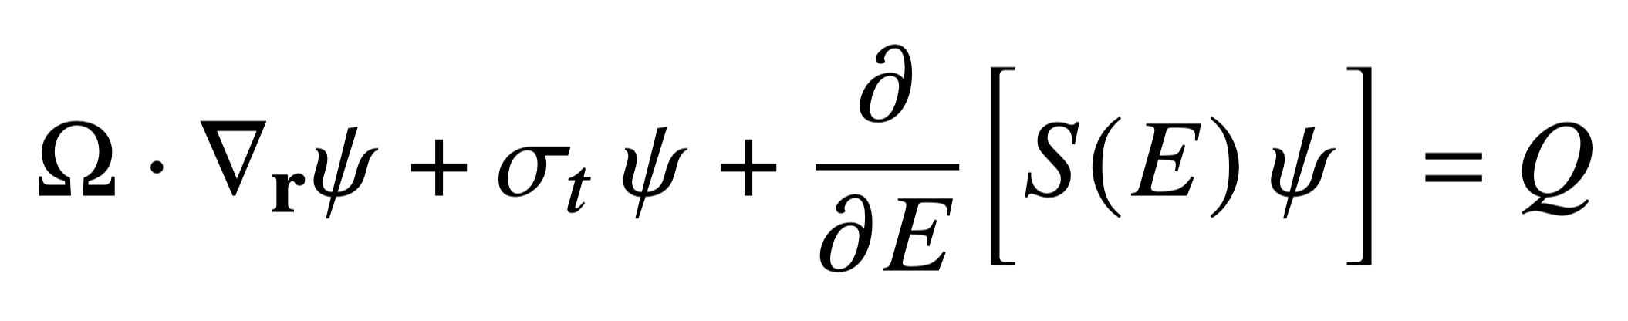
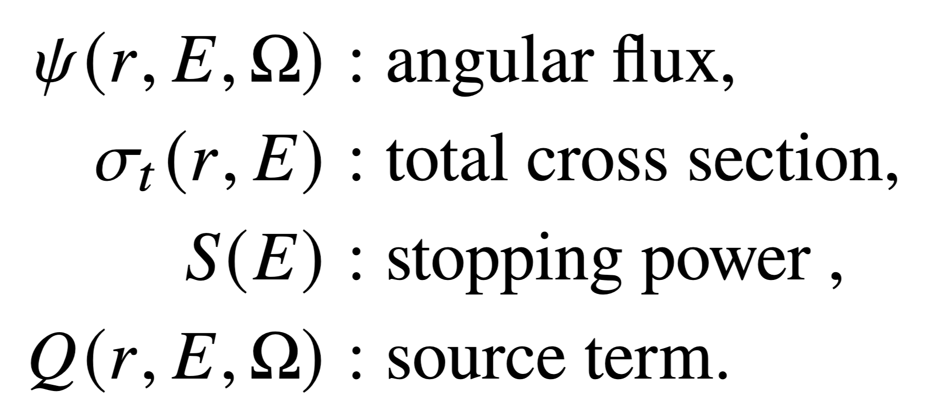

Slide 6
5 test problemini de koymayi unutma bfpye

