Slide 1
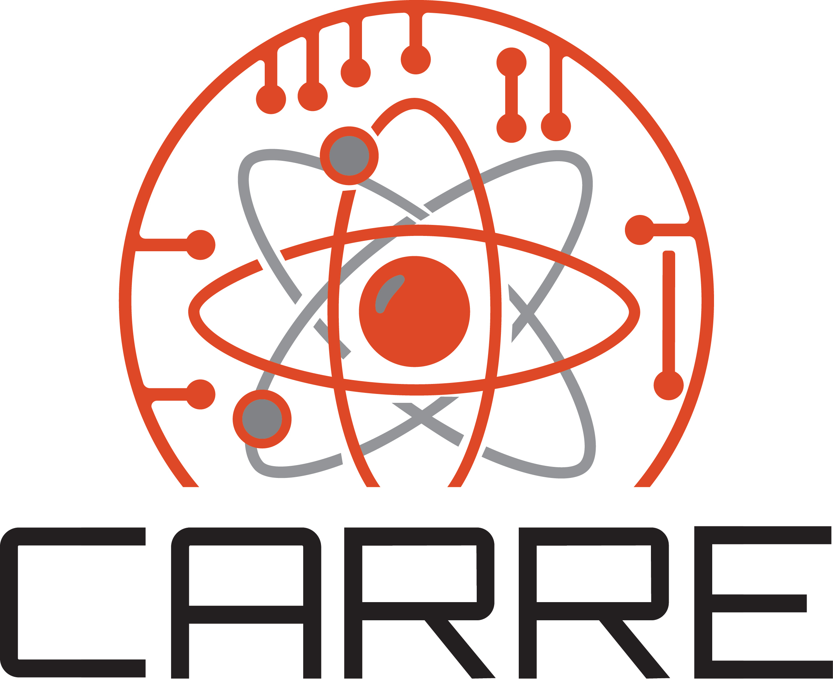




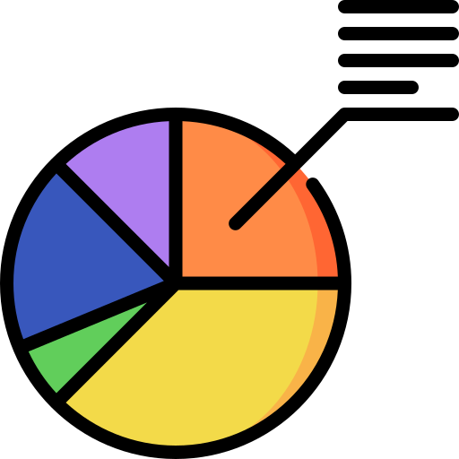
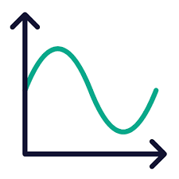

Insert Title
Author 1 ª, Author 2 ª
Center for Advancing the Radiation Resilience of Electronics (CARRE), ª University of California, Berkeley
Objective
Results
Conclusions
This work aims to …
This work…
Introduction
Future Work
Methods
References
Morgan, J. P., et al.(2024). Monte Carlo / Dynamic Code (MC/DC): An accelerated Python package for fully transient neutron transport and rapid methods development. Journal of Open Source Software, 9(96), 6415. https://doi.org/10.21105/joss.06415
Acknowledgements
This work was supported by the Center for Advancing the Radiation Resilience of Electronics (CARRE), a PSAAP-IV project funded by the Department of Energy, grant number: DE-NA0004268.

