Slide 1

Adventures in Proguarding
Marko Elezović
Mentat Labs d.o.o.

Slide 2
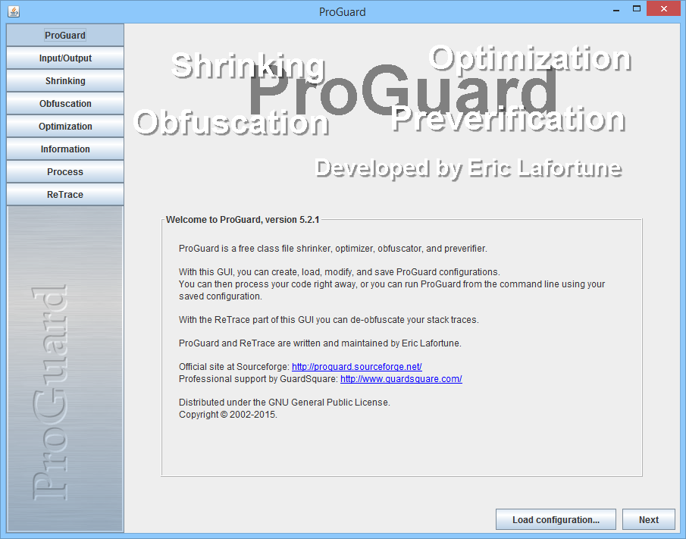

Slide 3
Hvala!
Marko Elezović
Mentat Labs d.o.o.

