Slide 1
DATABASE NORMALIZATION PROJECT
Data Normalization is the process of removing redundancies and improving data integrity of a database. This will prevent different anomalies that may arise from poor database design. Ideally, a database should reach the Third Normal Form.
In this project, a store named Hello Coffee has their sales data stored in a MySQL database. However, the database only contains a single table, containing attributes that represent other entities aside from sales.

Slide 2
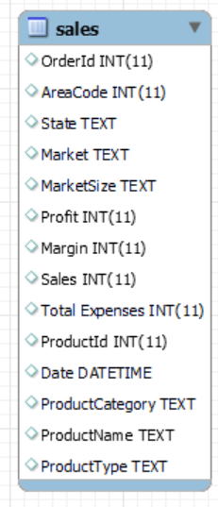
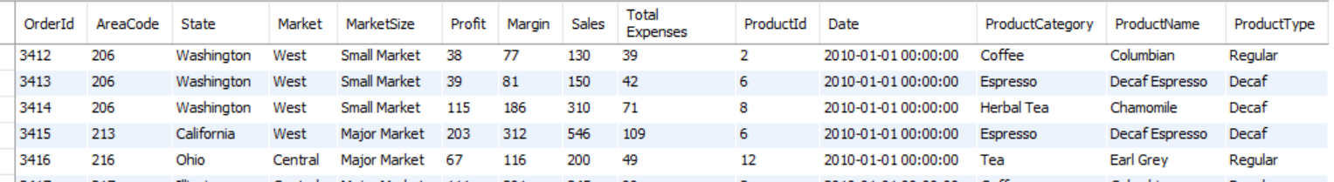
hello_coffee database: sales table
This database, contains only one single table named sales. This was the table prior to normalization.
This table is a standalone table inside the database.
The table adheres to the 1NF. However, there are non-key attributes that are partially dependent only to the composite keys OrderId, AreaCode, ProductId.
Further design improvement is needed to reach 2NF and 3NF.

Slide 3
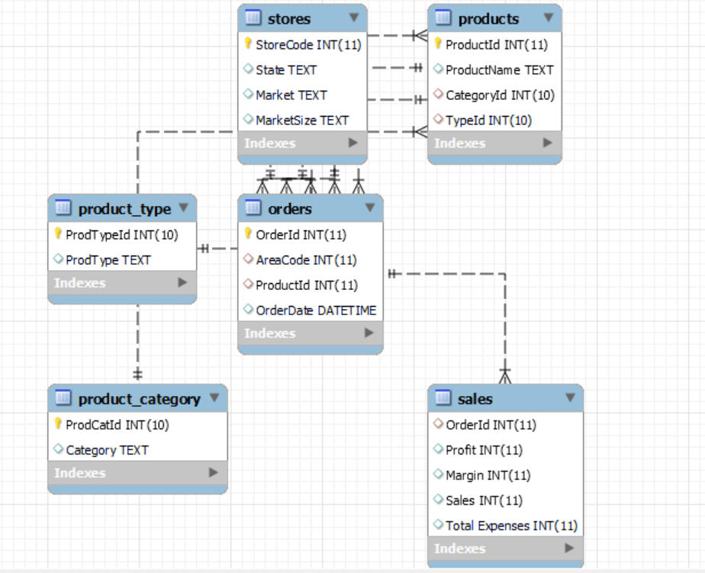
After Normalization
After normalizing hello_coffee, this is now the new EER diagrams. Each table in this database now only represents a single entity.

