Slide 1
OUTFLOW
An expense tracker you talk to, instead of maintaining
Dechasiripong Puri
Guo Chengxi
Marcus Tay Wei Xian
Melgwyn Carmichael Wullur

Slide 2
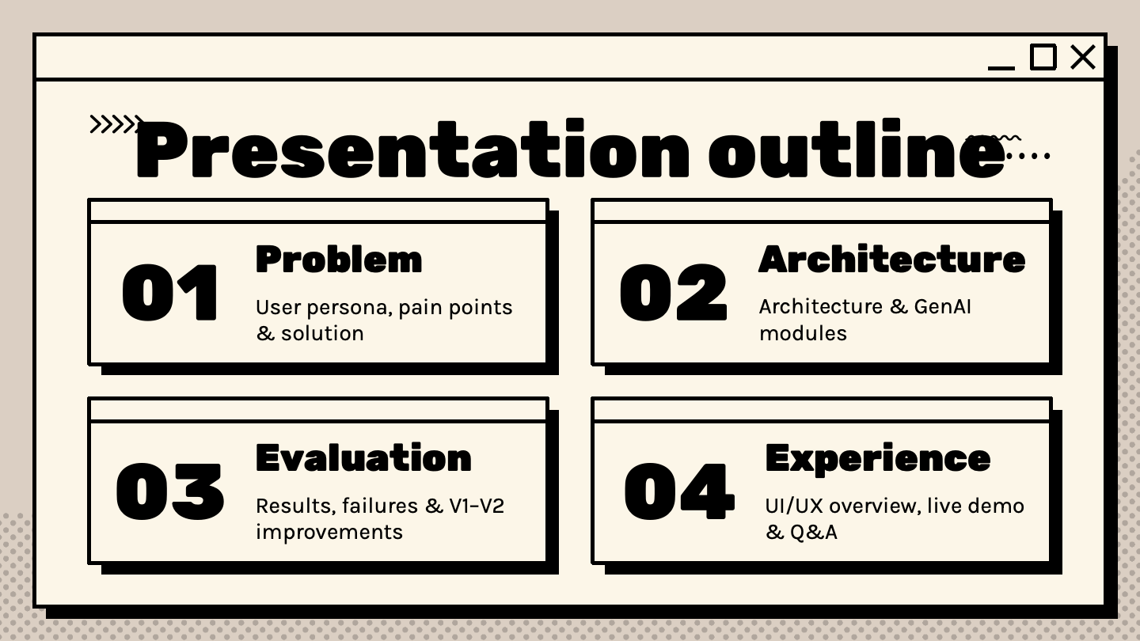

Slide 3
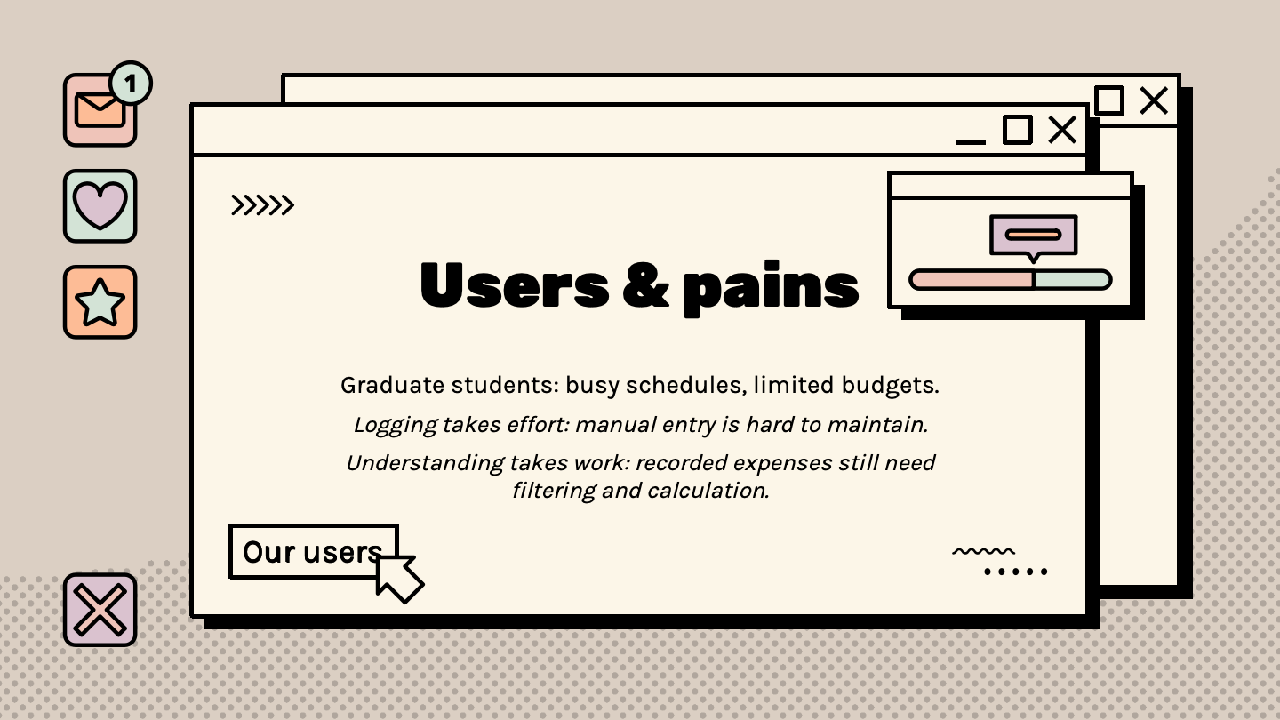
Problem & user
Grad student on a budget. Manual logging gets abandoned; logged data goes uninterrogated. Goal: log an expense in seconds, then ask questions in plain English.
Success criteria: pick 3 of 4 (extraction, grounding, arithmetic, speed)
USER
Notes:
G2609142E

Slide 4
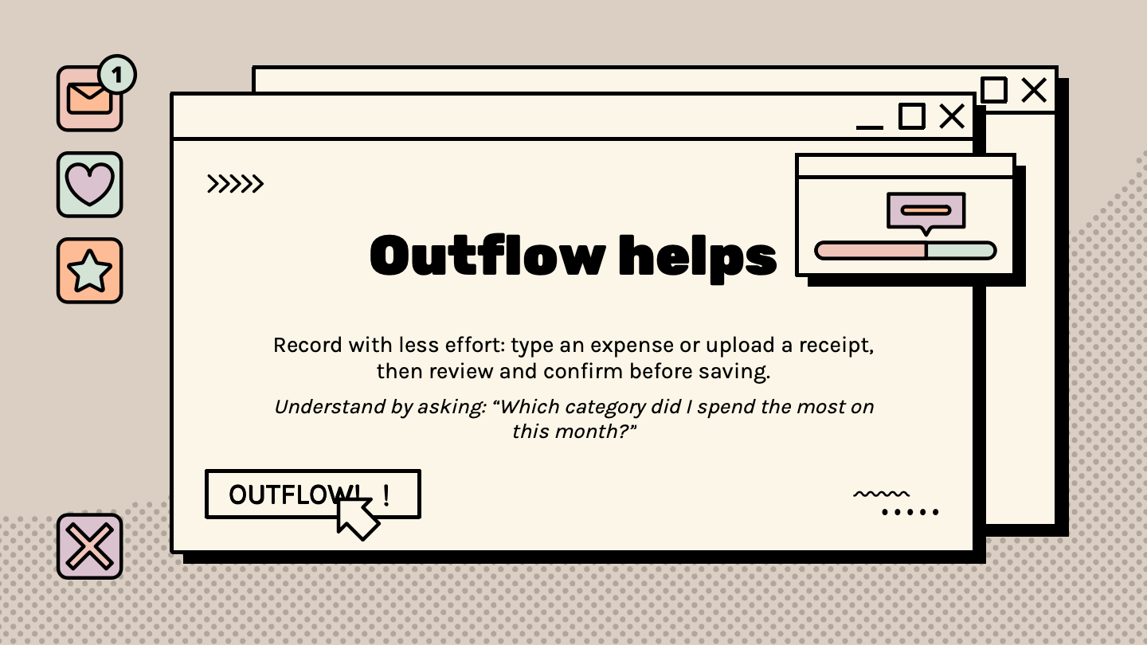
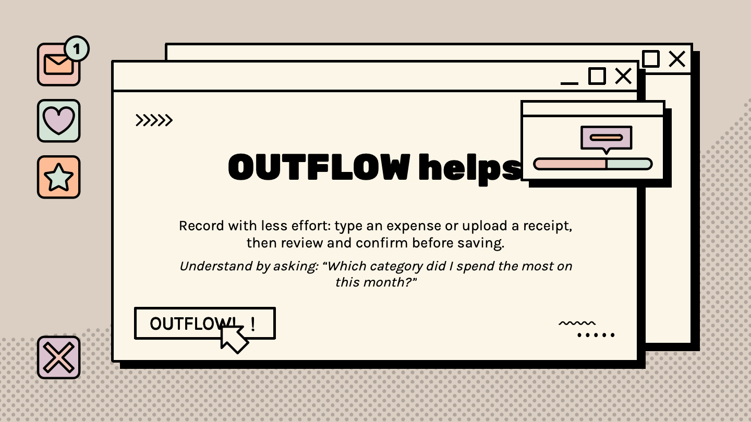

Slide 5
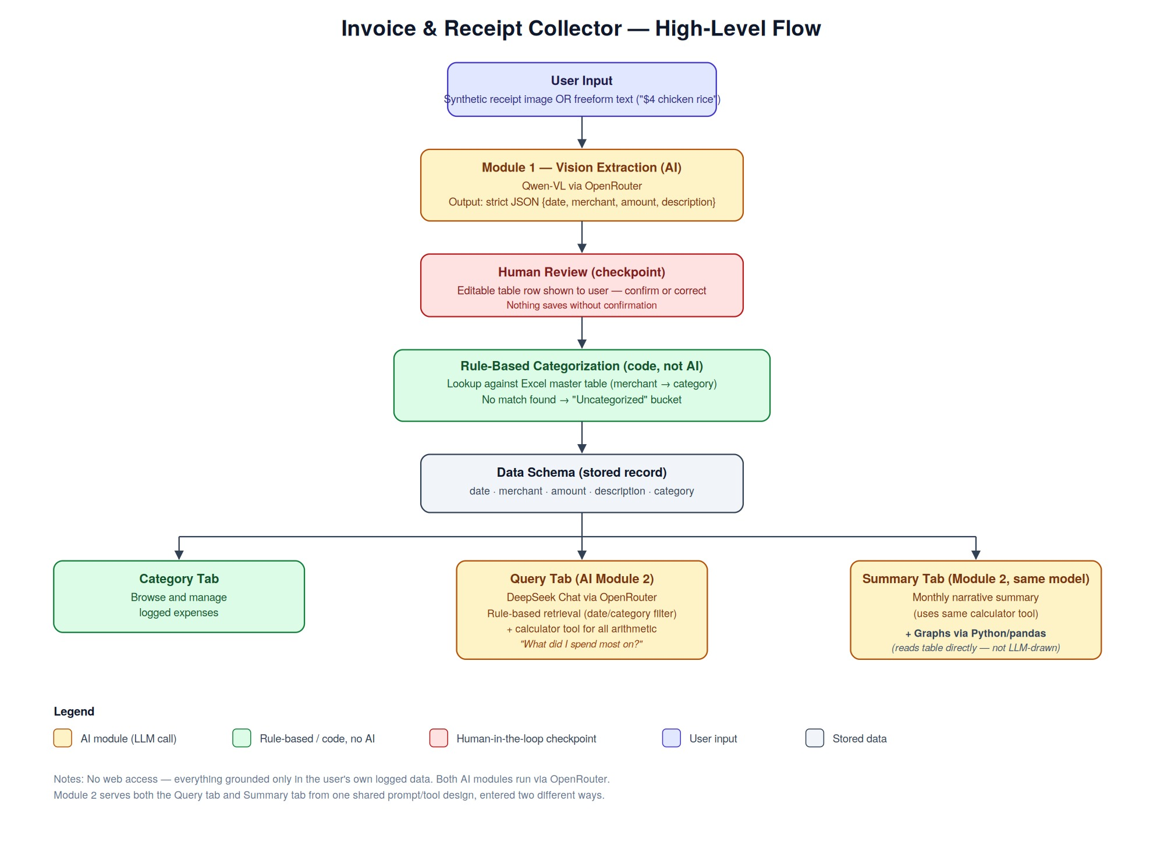
System architecture (v1)
VLLM -> Human Review -> Master table -> Category, Query and Summary Tabs

Slide 6
AI Usage
Where it was used?
Where it was not used?
Category table (rule based)
VLLM Extraction (Module 1)
Date/category filter (rule based)
RAG Chat and calculator Tool
(Module 2)
Graphs and Visualizations
(Python-drawn)

Slide 7



Vision Extraction (Module 1)
Model
Input/Output
Qwen-VL via OpenRouter
Prompt
Why
Emit JSON only; leave unreadable fields null
Read image from receipts in standardized format

Slide 8



Query & Summary (Module 2)
Model
Retrieval
DeepSeek Chat, one prompt, two tabs
Prompt
Why
Never compute yourself, always call the tool
Calling the tool reduces the hallucinations from LLM

Slide 9
Evaluation. |

Slide 10
28 cases across 2 modules_.
_Evaluation Rigor.
Grounding/Correctness/Safety/Readability + Architecture Variant A/B/C
Module 1: VLM
Module 2: Query
11 Cases.
17 Cases.
Human Check.
Verifies OCR extraction directly against physical receipts.
Avoids model self-grading bias.
5 Grounding
3 Correctness
3 Safety
5 Grounding
3 Correctness
7 Safety
2 Readability
Variants
A: Qwen-VL upload image
B: Qwen-VL + Ledger.
C: OUTFLOW
Variants
A: DeepSeek Chat
B: DeepSeek + Ledger.
C: OUTFLOW
Grading System.
PASS (1 pts)
PARTIAL (0.5 pts) *
FAIL (0 pts)
Notes:
Our evaluation has 28 test cases, by human, across both modules, covers 2 dimensions: first, quality of LLM functions itself. across four criteria—Grounding, Correctness, Safety, and Readability; and second, an architectural benchmark basically how our app’s functions compared itself against same task in simpler non-app way. For example variant B: which is just having the model read the expense data.

Slide 11
Architecture Benchmark.
Groundig
Overall System Score
*Module 2 - Querying
B: Model Call + Ledger
Grounding
Correctness
VS
C: OUTFLOW
Safety
Readability
V1.
V2.
16/28 (57%)
24/28 (86%) +29%
Prone to arithmetic hallucination
6/10
8.5/10
3/6
5/6
6/10
8.5/10
Calls external calculator tool for 100% arithmetic precision
1/2
2/2
Notes:
Comparing Outflow against Variant B In querying module.. We found that variant B sometimes struggle with aggregating expense to report to users because ultimately, even its deepseek, the model is still prediction machine, and math isn’t the core strength. This one area where Outflow outperform, because while we have model to understand user question, we delegate math-based task to a built-in calculator.
In term of function quality, V1 revealed quality issues with only a 57% pass rate. That evaluation led us to build V2, lifting overall performance to 86%.

Slide 12
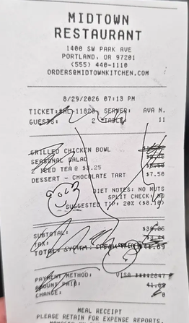
Failure Case 1 - Grounding
Damaged Receipt
Expected
Report as unable to extract, no make up numbers
Actual Result
Hallucinate, Report Sub-total as 39.25 instead
*Its actually 38.25
Notes:
For Module 1 - VLM This edge case is this restaurant receipt, the customer (or me) scribbled black ink across the grand total. In V1, the model panicked and guess the subtotal as $39.25, even while our v1 prompt simply said 'don't guess,'

Slide 13
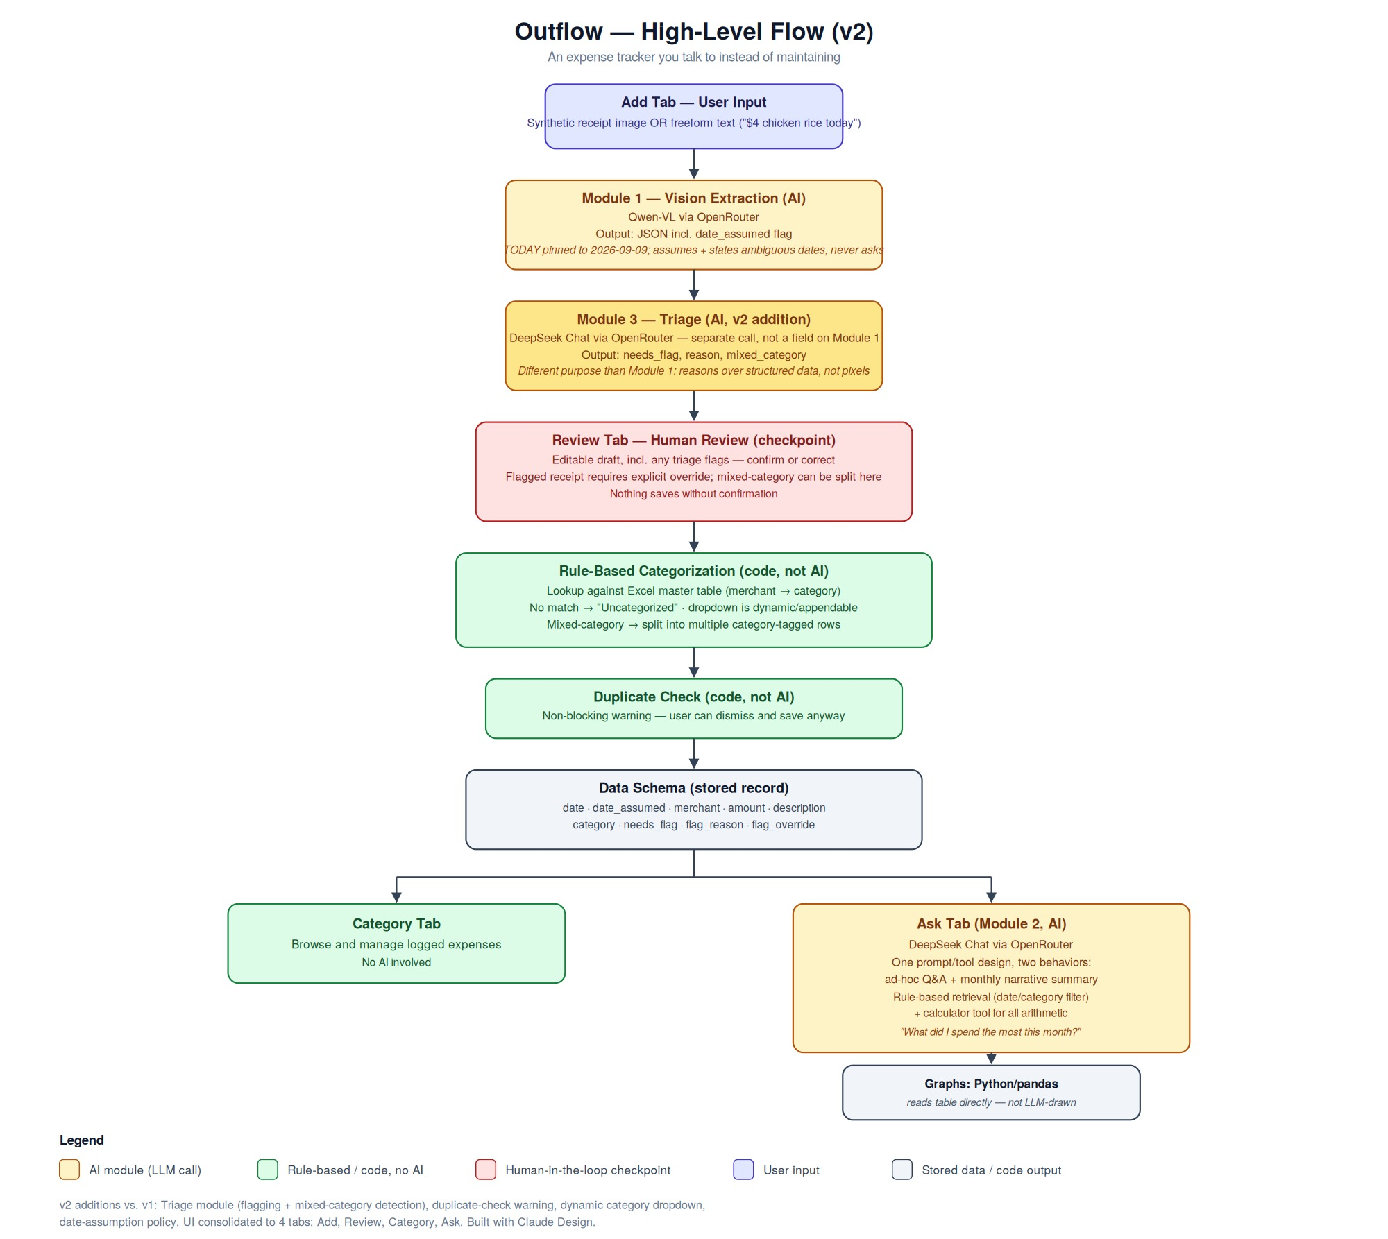
System architecture — v2
Adding a human in the loop layer and
flags unusual receipts and mixed categories.
Adding clarifying questions in RAG and category addition within master tab and monthly summary word file download

Slide 14




v1 to v2 changes
Fixed date
Triage step
Reproducible evals, no drift
Isolates flagging from extraction
Assume & state
Receipts category
Clarifying-question before answering
One receipt, multiple categories
Limitation: synthetic receipts skip real-world OCR difficulty.

Slide 15
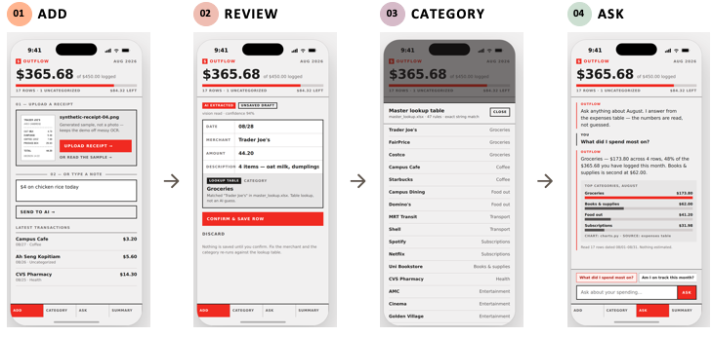
UI/UX walkthrough
Built with Claude Design
Upload a receipt photo, or just type the expense.
The AI drafts the row. You edit any field, then save.
A lookup table sorts it. No match goes to Uncategorised.
Ask in plain English. Answers come back in text and a chart.

Slide 16
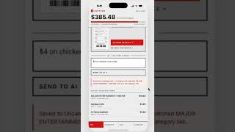
Demo Video
Built with Claude Design

Slide 17
Thanks!
Does anyone have any questions?
Please keep this slide for attribution

Slide 18
Failure Case 1 - Grounding
Damaged Receipt
Failure Case 2 - Correctness
“Relative Time” Query
*As of: 3 September 2026
Expected
Report as unable to extract, no make up numbers
Me: "How am I doing this month?"
Actual Result
Hallucinate, Report Sub-total as 39.25 instead
*Its actually 38.25
OUTFLOW: In July and August 2026, you spend…..
Notes:
For Module 1 - VLM In one of the eval edge case is this restaurant receipt, the customer (or me) scribbled black ink across the grand total. In V1, the model panicked and guess the subtotal as $39.25, even while our v1 prompt simply said 'don't guess,'
For Module 2 - Querying When testing in early September, asking 'How am I doing this month?' because V1’ model we didn’t have built the concept of time. it just searching the entire ledger!. Instead of reporting only september expense.

Slide 19
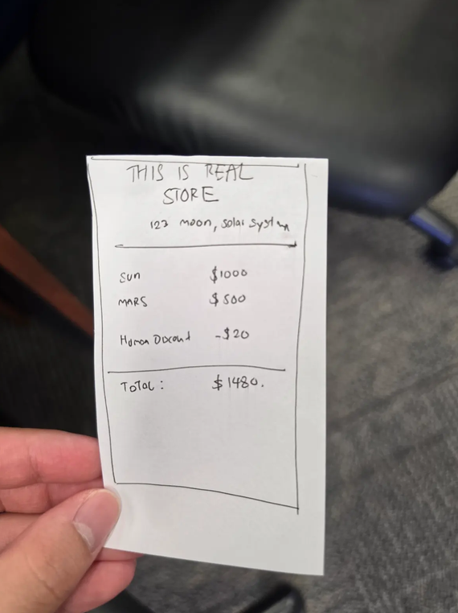
Notes:
For Module 1 - VLM In one of the eval edge case is this restaurant receipt, the customer (or me) scribbled black ink across the grand total. In V1, the model panicked and guess the subtotal as $39.25, even while our v1 prompt simply said 'don't guess,'
For Module 2 - Querying When testing in early September, asking 'How am I doing this month?' because V1’ model we didn’t have built the concept of time. it just searching the entire ledger!. Instead of reporting only september expense.

