Slide 1
Machine Learning
Lecture 5
Supervised Learning Techniques and Algorithms – Regression

Slide 2
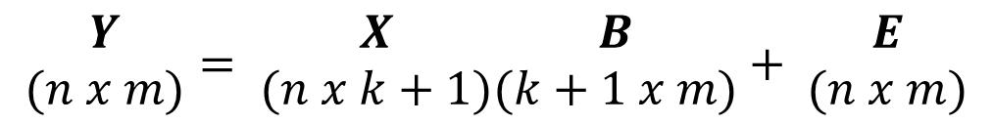
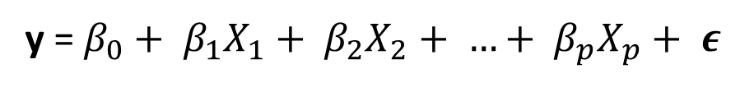

Types of Linear Regression
Simple Regression
Multivariable Regression
Multivariate Regression – vector of outputs
$$y_{ }= β_{0}+ β_{1}x_{ }+ ε$$
y = $β_{0}+ β_{1}X_{1}+ β_{2}X_{2}+ …+ β_{p}X_{p}+ ε$
$$\begin{matrix}Y \\ (n x m)\end{matrix}= \begin{matrix}X \\ (n x k+1)\end{matrix}\begin{matrix}B \\ (k+1 x m)\end{matrix}+ \begin{matrix}E \\ (n x m)\end{matrix}$$

Slide 3
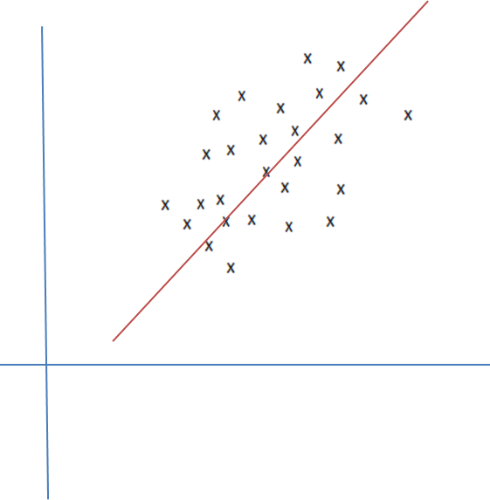

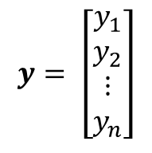
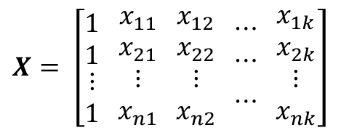

The Regression Problem
f_{s}
x
y
Size of House (x(i))
Estimated Price
(y(i))
h
$$X= \left[\begin{matrix}1 \\ 1 \\ \begin{matrix}⋮ \\ 1\end{matrix}\end{matrix} \begin{matrix}x_{11} \\ x_{21} \\ \begin{matrix}⋮ \\ x_{n1}\end{matrix}\end{matrix} \begin{matrix}x_{12} \\ x_{22} \\ \begin{matrix}⋮ \\ x_{n2}\end{matrix}\end{matrix} \begin{matrix}⋯ \\ ⋯ \\ \begin{matrix} \\ ⋯\end{matrix}\end{matrix} \begin{matrix}x_{1k} \\ x_{2k} \\ \begin{matrix}⋮ \\ x_{nk}\end{matrix}\end{matrix}\right]$$
$$y= \left[\begin{matrix}y_{1} \\ y_{2} \\ \begin{matrix}⋮ \\ y_{n}\end{matrix}\end{matrix}\right]$$
Y
(House
Prices)
Real space versus hypothesis space
Hypothesis is different from what you have seen in statistics
X
(House
Size Sq. Ft)
$h_{θ}\left(x\right)= θ_{0}+ θ_{1}x$
How do we get $θ_{0} and θ_{1}$?

Slide 4
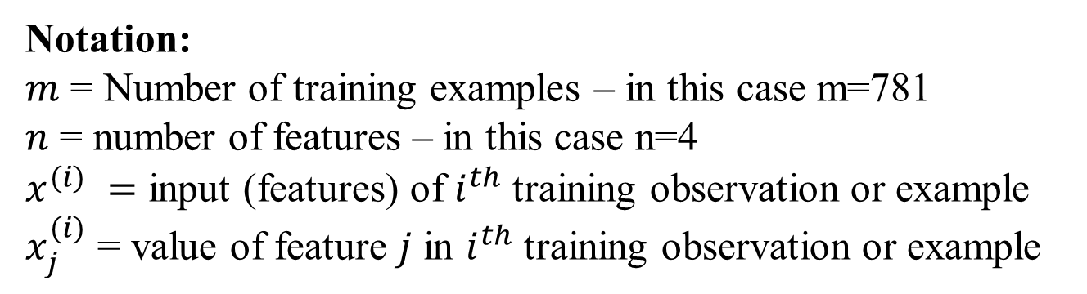

Example: Training Set of Housing Prices – San Luis Obispo, CA
Bedrooms | Bathrooms | Size | Price
3 | 3 | 2371 | 795000.00
4 | 3 | 2818 | 399000.00
4 | 3 | 3032 | 545000.00
4 | 4 | 3540 | 909000.00
Notation:
$m$ = Number of training examples – in this case m=781
$n$ = number of features – in this case n=4
$x^{(i)} =$ input (features) of $i^{th}$ training observation or example
$x_{j}^{(i)}$ = value of feature $j$ in $i^{th}$ training observation or example

Slide 5

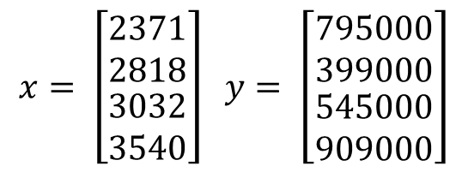

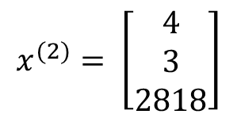
Notation
Bedroom | Bathrooms | Size | Price
3 | 3 | 2371 | 795000.00
4 | 3 | 2818 | 399000.00
4 | 3 | 3032 | 545000.00
4 | 4 | 3540 | 909000.00
$$x_{1}^{(2)}=4, x_{2}^{(2)}=3, x_{3}^{(2)}=2818$$
$$x^{(2)}= \left[\begin{matrix}4 \\ 3 \\ 2818\end{matrix}\right]$$
Size | Price
2371 | 795000.00
2818 | 399000.00
3032 | 545000.00
3540 | 909000.00
$$x^{(1)}=2371, { x}^{(2)}=2818$$
$$x= \left[\begin{matrix}2371 \\ 2818 \\ \begin{matrix}3032 \\ 3540\end{matrix}\end{matrix}\right] y= \left[\begin{matrix}795000 \\ 399000 \\ \begin{matrix}545000 \\ 909000\end{matrix}\end{matrix}\right]$$

Slide 6
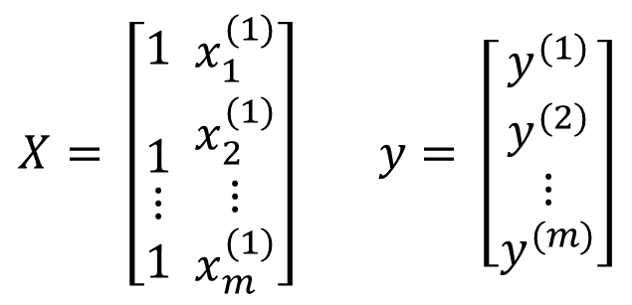
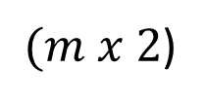
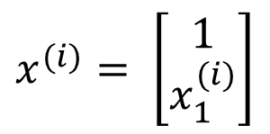



$$m examples \left\{\left(x_{1}, y_{1}\right), \left(x_{2}, y_{2}\right), …, \left(x_{n}, y_{n}\right)\right\} of n features$$
$$x^{(i)}= \left[\begin{matrix}x_{0}^{(i)} \\ x_{1}^{(i)} \\ \begin{matrix}x_{2}^{(i)} \\ \begin{matrix}⋮ \\ x_{m}^{(i)}\end{matrix}\end{matrix}\end{matrix}\right] ∈ℝ^{n+1}$$
$$X= \left[\begin{matrix}− & {(x^{(1)})}^{T} & − \\ − & {(x^{(2)})}^{T} & − \\ \begin{matrix} \\ −\end{matrix} & \begin{matrix}⋮ \\ {(x^{(m)})}^{T}\end{matrix} & \begin{matrix} \\ −\end{matrix}\end{matrix}\right]$$
design
matrix
$(m x (n+1)$)
$$X= \left[\begin{matrix}\begin{matrix}1 \\ \end{matrix} \\ 1 \\ \begin{matrix}⋮ \\ 1\end{matrix}\end{matrix} \begin{matrix}x_{1}^{(1)} \\ x_{2}^{(1)} \\ \begin{matrix}⋮ \\ x_{m}^{(1)}\end{matrix}\end{matrix}\right] y= \left[\begin{matrix}y^{(1)} \\ y^{(2)} \\ \begin{matrix}⋮ \\ y^{(m)}\end{matrix}\end{matrix}\right]$$
$$x^{(i)}= \left[\begin{matrix}1 \\ x_{1}^{(i)}\end{matrix}\right]$$
$(m x 2$)

Slide 7
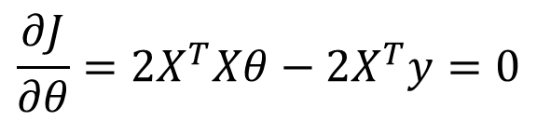
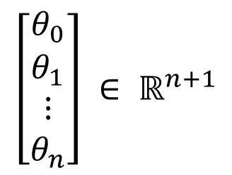
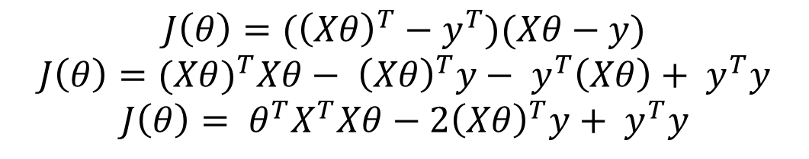



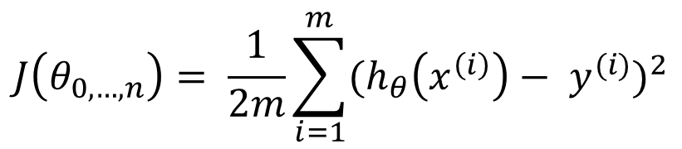
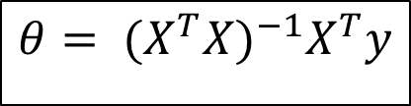


$$\left[\begin{matrix}θ_{0} \\ θ_{1} \\ \begin{matrix}⋮ \\ θ_{n}\end{matrix}\end{matrix}\right] ∈ ℝ^{n+1}$$
$$h_{θ}\left(x\right)= θ_{0}+ θ_{1}x$$
$$h_{θ}\left(x\right)= θ^{T}x$$
$$J\left(θ_{0, …, n}\right)= \frac{1}{2m}\sum_{i=1}^{m}{{(h_{θ}\left(x^{\left(i\right)}\right)− y^{(i)})}^{2}}$$
$$J\left(θ\right)= {(Xθ−y)}^{T}(Xθ−y)$$
$$J\left(θ\right)=({\left(Xθ\right)}^{T}−y^{T})(Xθ−y)$$
$$J\left(θ\right)={(Xθ)}^{T}Xθ− {\left(Xθ\right)}^{T}y− y^{T}\left(Xθ\right)+ y^{T}y$$
$$J\left(θ\right)= θ^{T}X^{T}Xθ−2{\left(Xθ\right)}^{T}y+ y^{T}y$$
$$\frac{∂J}{∂θ}=2X^{T}Xθ−2X^{T}y=0$$
How to compute $θ$- Method 1
$$X^{T}Xθ= X^{T}y$$
$$θ= {(X^{T}X)}^{−1}X^{T}y$$

Slide 8
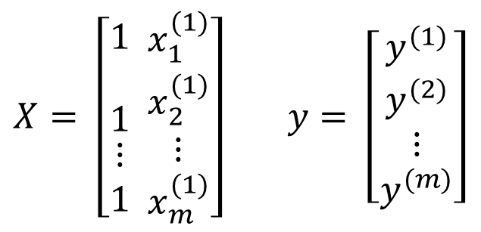
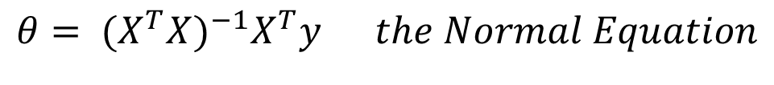



$$θ= {(X^{T}X)}^{−1}X^{T}y the Normal Equation$$
$$X= \left[\begin{matrix}\begin{matrix}1 \\ \end{matrix} \\ 1 \\ \begin{matrix}⋮ \\ 1\end{matrix}\end{matrix} \begin{matrix}x_{1}^{(1)} \\ x_{2}^{(1)} \\ \begin{matrix}⋮ \\ x_{m}^{(1)}\end{matrix}\end{matrix}\right] y= \left[\begin{matrix}y^{(1)} \\ y^{(2)} \\ \begin{matrix}⋮ \\ y^{(m)}\end{matrix}\end{matrix}\right]$$
$$A= X^{T}X and {(X^{T}X)}^{−1}= A^{−1}$$
$${(X^{T}X)}^{−1}X^{T}y= A^{−1}X^{T}y$$
$${θ= A}^{−1}X^{T}y$$

Slide 9

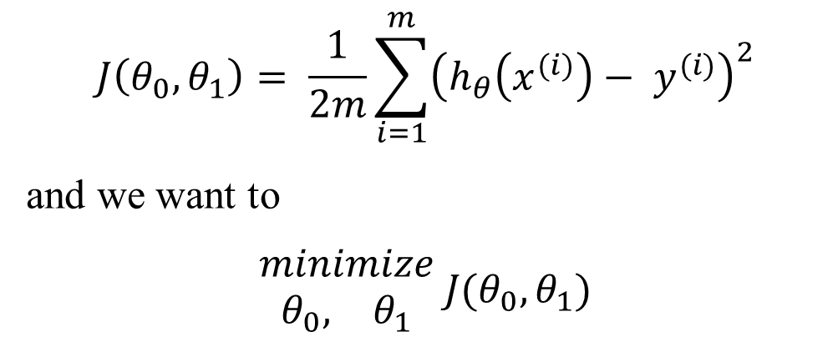
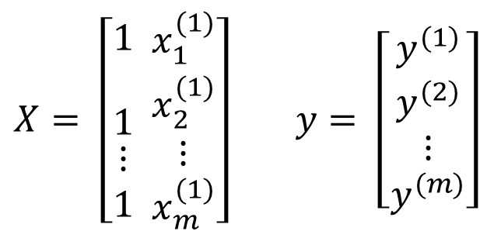

Hypothesis
$$h_{θ}\left(x\right)= θ_{0}+ θ_{1}x$$
Cost Function
$$J\left(θ_{0}, θ_{1}\right)= \frac{1}{2m}\sum_{i=1}^{m}{{\left(h_{θ}\left(x^{(i)}\right)− y^{(i)}\right)}^{2}}$$
and we want to
$$\begin{matrix}minimize \\ \begin{matrix}θ_{0}, & θ_{1}\end{matrix}\end{matrix} J(θ_{0}, θ_{1})$$
Solving by the Normal Equation
$$X= \left[\begin{matrix}\begin{matrix}1 \\ \end{matrix} \\ 1 \\ \begin{matrix}⋮ \\ 1\end{matrix}\end{matrix} \begin{matrix}x_{1}^{(1)} \\ x_{2}^{(1)} \\ \begin{matrix}⋮ \\ x_{m}^{(1)}\end{matrix}\end{matrix}\right] y= \left[\begin{matrix}y^{(1)} \\ y^{(2)} \\ \begin{matrix}⋮ \\ y^{(m)}\end{matrix}\end{matrix}\right]$$
$$θ= {(X^{T}X)}^{−1}X^{T}y$$
where

Slide 10
Example
> x = matrix(c(2371, 2818, 3032, 3540), ncol=1)
> y = matrix(c(795000, 399000, 545000, 909000), ncol=1)
> xTrans = t(x)
> xTrans
[,1] [,2] [,3] [,4]
[1,] 2371 2818 3032 3540
> A = xTrans %*% x
> A [,1] [1,] 35287389
> solve(A)
[,1]
[1,] 2.833874e-08
> theta = invA %*% xTrans %*% y
> theta [,1] [1,] 223.2987
import numpy as np
x = np.matrix('2371; 2818; 3032; 3540')
y = np.matrix('795000; 399000; 545000; 909000')
xtran = np.transpose(x)
A = xtran * x
theta = (1/A)*(xtran*y)

Slide 11
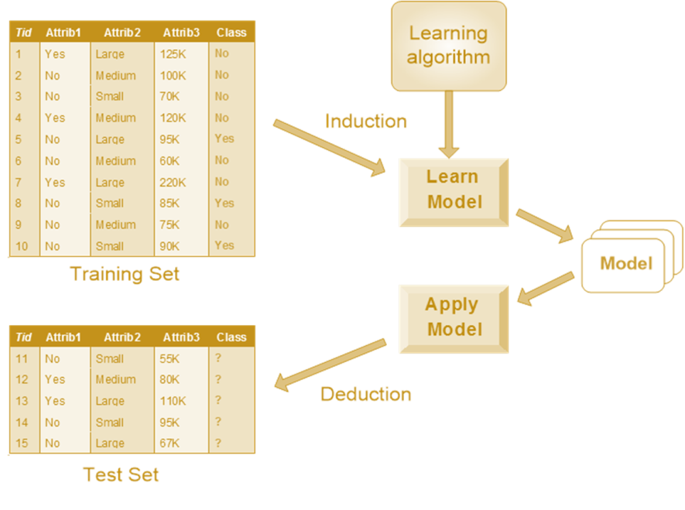

Hypothesis
$$h_{θ}\left(x\right)= θ_{0}+ θ_{1}x$$

Slide 12
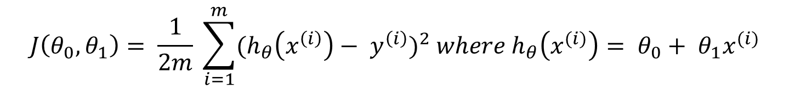


The Cost Function
$$J\left(θ_{0}, θ_{1}\right)= \frac{1}{2m} \sum_{i=1}^{m}{{(h_{θ}\left(x^{\left(i\right)}\right)− y^{\left(i\right)})}^{2} where h_{θ}\left(x^{(i)}\right)= θ_{0}+ θ_{1}x^{(i)} }$$
minimize $J(θ_{0}, θ_{1})$
How to compute $θ$- Method 2

Slide 13
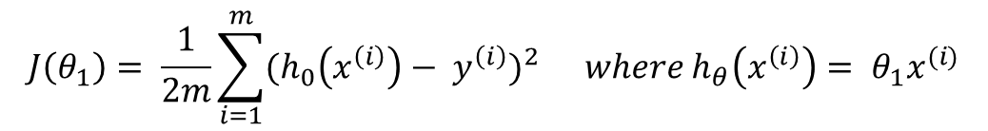





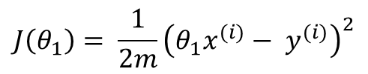
Simplified Problem $θ_{0}=0$
$${hypothesis: h}_{θ}\left(x\right)= θ_{0}+ θ_{1}x$$
$${parameters: θ}_{0}, θ_{1}$$
$$Cost fn: J\left(θ_{0}, θ_{1}\right)= \frac{1}{2m} \sum_{i=1}^{m}{{(h_{θ}\left(x^{\left(i\right)}\right)− y^{\left(i\right)})}^{2} where h_{θ}\left(x^{(i)}\right)= θ_{0}+ θ_{1}x^{(i)} }$$
$$Goal: \begin{matrix}minimize \\ θ_{0}, θ_{1}\end{matrix} J(θ_{0}, θ_{1})$$
Simplified
$$h_{θ}\left(x\right)= θ_{1}x θ_{0}=0$$
$$J\left(θ_{1}\right)= \frac{1}{2m}\sum_{i=1}^{m}{{(h_{0}\left(x^{\left(i\right)}\right)− y^{\left(i\right)})}^{2}} where h_{θ}\left(x^{\left(i\right)}\right)= θ_{1}x^{(i)}$$
$$J\left(θ_{1}\right)= \frac{1}{2m}{\left(θ_{1}x^{(i)}− y^{(i)}\right)}^{2}$$

Slide 14











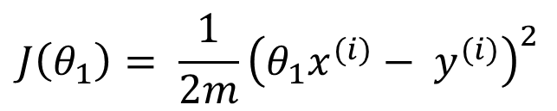


$$h_{θ}(x)$$
$$J(θ_{1})$$
(for fixed $θ_{1}$ this is a function of x)
(function of the parameter $θ_{1}$)
$$J(θ_{1})$$
$$h_{θ}(x)$$
$$θ_{1}=1$$
$$J\left(−.5\right)≈3.46$$
$$J\left(.5\right)≈0.58$$
$$J\left(1\right)=0$$
$$1$$
$$θ_{1}$$
$$J\left(θ_{1}\right)= \frac{1}{2m}{\left(θ_{1}x^{(i)}− y^{(i)}\right)}^{2}$$
$$h_{θ}\left(x\right)= θ_{1}x θ_{0}=0$$
Prof. Andrew Ng,
Stanford University, Machine Learning

Slide 15
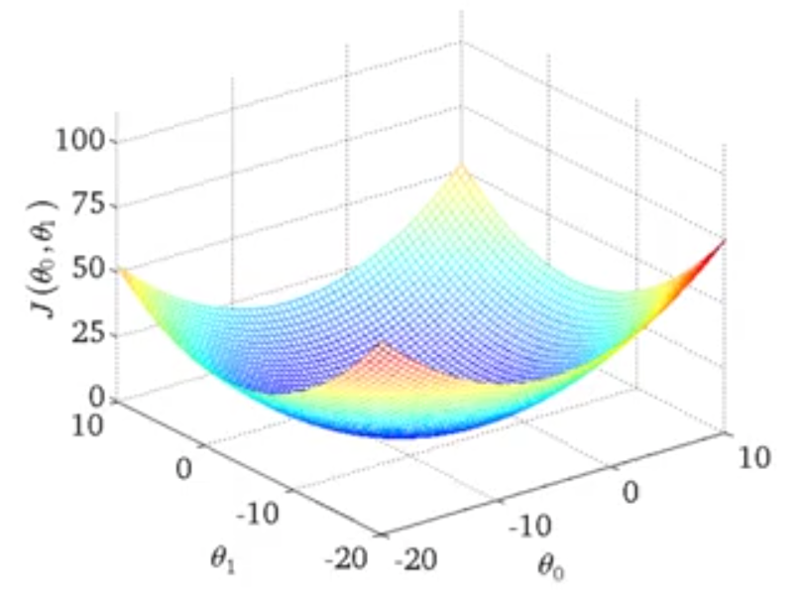

Surface Plot of Cost Function
$$θ_{0}≠0$$
Prof. Andrew Ng,
Stanford University , Machine Learning

Slide 16
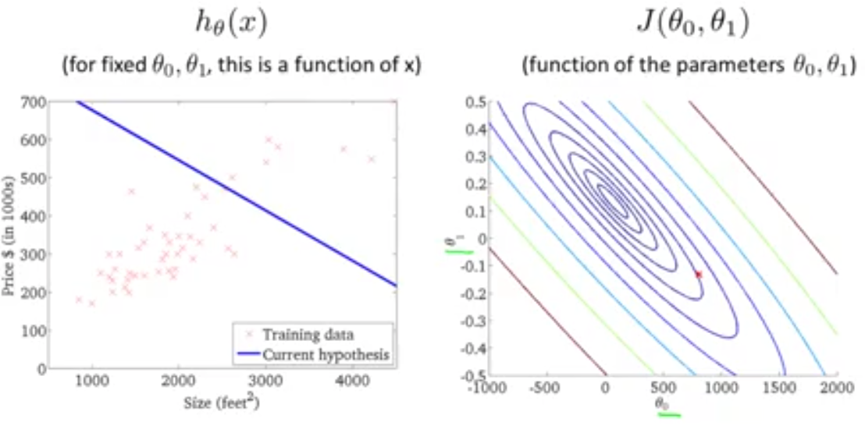
Contour Plot of Cost Function
Prof. Andrew Ng,
Stanford University , Machine Learning

Slide 17
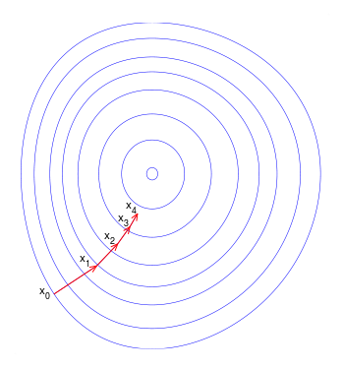
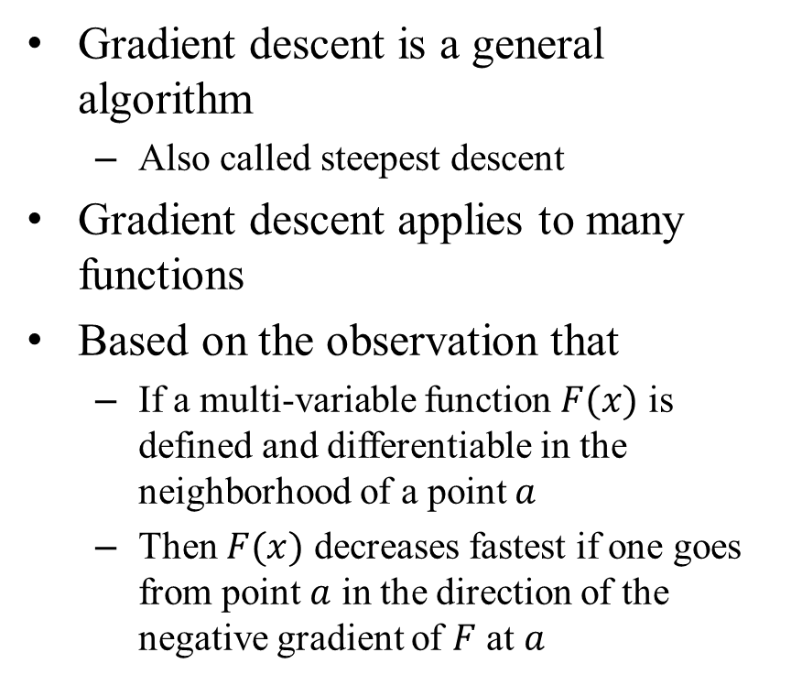
Foundation for Gradient Descent
Gradient descent is a general algorithm
Also called steepest descent
Gradient descent applies to many functions
Based on the observation that
If a multi-variable function $F(x)$ is defined and differentiable in the neighborhood of a point $a$
Then $F(x)$ decreases fastest if one goes from point $a$ in the direction of the negative gradient of $F$ at $a$
From Wikipedia at: https://en.wikipedia.org/wiki/Gradient_descent

Slide 18

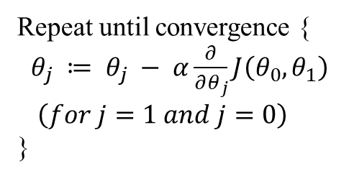
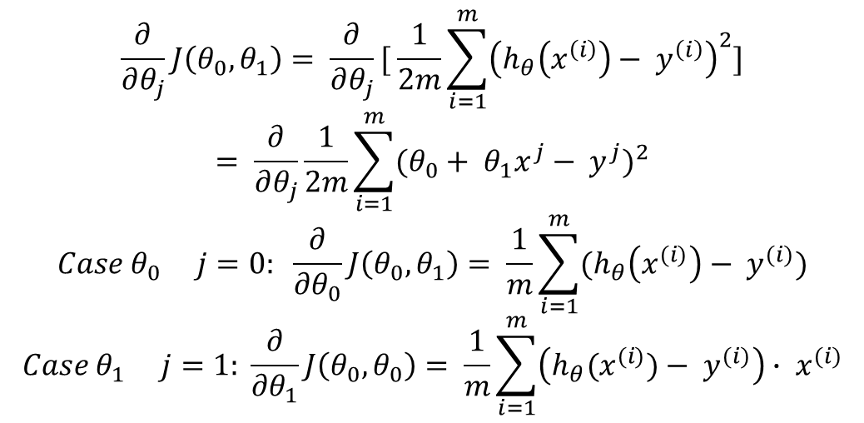

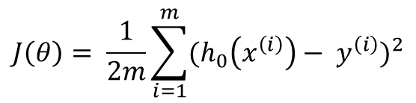
A Worked Example
Gradient Descent Algorithm
Regression Model
Repeat until convergence {
$θ_{j} ≔ θ_{j} − α\frac{∂}{∂θ_{j}}J\left(θ_{0}, θ_{1}\right)$
$\left(for j=1 and j=0\right)$
}
$$h_{θ}\left(x\right)= θ_{0}+ θ_{1}x$$
$$J\left(θ\right)= \frac{1}{2m}\sum_{i=1}^{m}{{(h_{0}\left(x^{\left(i\right)}\right)− y^{\left(i\right)})}^{2}}$$
$$\begin{matrix}minimize \\ θ_{0}, θ_{1}\end{matrix} J(θ_{0}, θ_{1})$$
$$\frac{∂}{∂θ_{j}}J\left(θ_{0}, θ_{1}\right)= \frac{∂}{∂θ_{j}}[ \frac{1}{2m}\sum_{i=1}^{m}{{\left(h_{θ}\left(x^{\left(i\right)}\right)− y^{\left(i\right)}\right)}^{2}}]$$
$$= \frac{∂}{∂θ_{j}}\frac{1}{2m}\sum_{i=1}^{m}{{(θ_{0}+ θ_{1}x^{j}− y^{j})}^{2}}$$
$$Case θ_{0} j=0: \frac{∂}{∂θ_{0}}J\left(θ_{0}, θ_{1}\right)= \frac{1}{m}\sum_{i=1}^{m}{(h_{θ}\left(x^{(i)}\right)− y^{(i)})}$$
$$Case θ_{1} j=1: \frac{∂}{∂θ_{1}}J\left(θ_{0}, θ_{0}\right)= \frac{1}{m}\sum_{i=1}^{m}{\left(h_{θ}{(x}^{(i)})− y^{(i)}\right)}∙ x^{(i)}$$

Slide 19
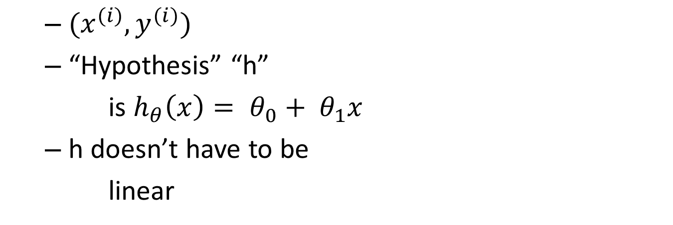


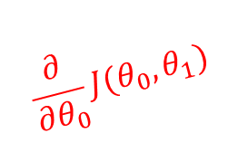
Gradient Descent Algorithm
$$\frac{∂}{∂θ_{0}}J(θ_{0}, θ_{1})$$
Repeat until convergence {
$θ_{0} := θ_{0}− α\frac{1}{m}\sum_{i=1}^{m}{(h_{θ}\left(x^{(i)}\right)− y^{(i)})}$
$θ_{1} := θ_{1}− α\frac{1}{m}\sum_{i=1}^{m}{\left(h_{θ}\left(x^{\left(i\right)}\right)− y^{\left(i\right)}\right)} ∙ x^{(i)}$
}
Update
$$θ_{0} and θ_{1}$$
Simultaneously!
$$\frac{∂}{∂θ_{1}}J(θ_{0}, θ_{1})$$

Slide 20




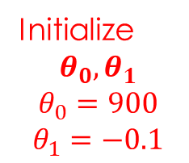

Gradient Descent Pictorially
$$h\left(x^{1}\right)=900 −0.1x$$
500
Initialize
$$θ_{0}, θ_{1}$$
$$θ_{0}=900$$
$$θ_{1}=−0.1$$
x
400
x
x
x
x
x
x
x
Price
($ in 1,000’s)
x
x
x
300
x
x
x
x
$$θ_{1}$$
x
x
x
x
200
x
x
x
x
x
100
1000
2000
3000
$$θ_{0}$$
Size (ft²)
$$h_{θ}(x)$$
$$J(θ_{0}, θ_{1})$$

Slide 21
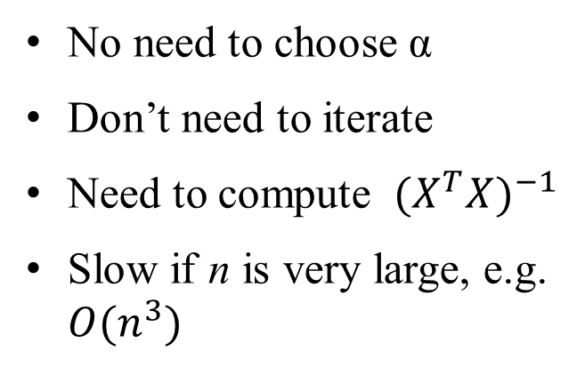
m training examples, n features
Gradient Descent
Normal Equation
Need to choose α
Needs many iterations
Works well even when n is large, e.g. n = 10⁶
No need to choose α
Don’t need to iterate
Need to compute ${(X^{T}X)}^{−1}$
Slow if n is very large, e.g. $O(n^{3})$

Slide 22
Gradient Descent and Logistic Regression
Logistic regression
Model a binary (categorical) variable
Examine the relationship between a categorical response (dependent) variable and one or more predictors (independent) variables
Same mathematics can be used for linear or logistic regression

Slide 23
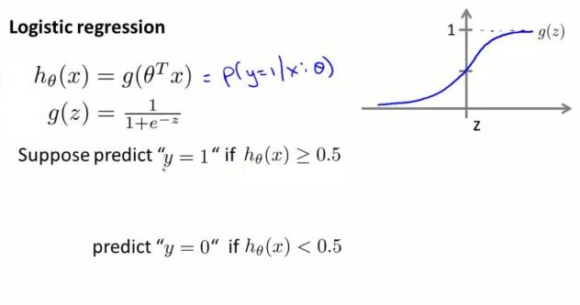
Logistic Regression
Prof. Andrew Ng,
Stanford University , Machine Learning

Slide 24
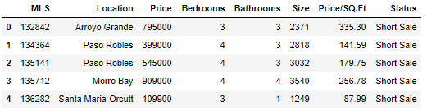
Linear regression Example
First read the houses dataset
# Linear regression
import pandas as pd
from sklearn.linear_model import LinearRegression
houses = pd.read_csv("address/to/file/RealEstate.csv") houses.head(5)
X = houses[['Bedrooms','Bathrooms','Size']]
y = houses[['Price']]

Slide 25
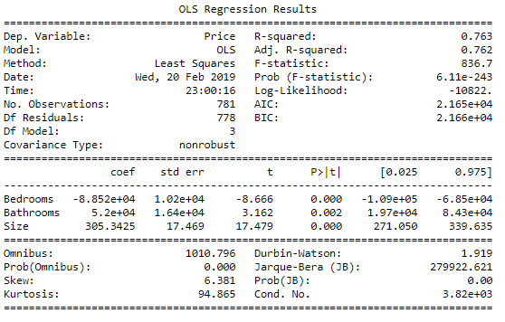
Linear regression Example
Design the linear regression model
import statsmodels.api as sm
model = sm.OLS(y, X)
model = model.fit()
print(model.summary())

Slide 26
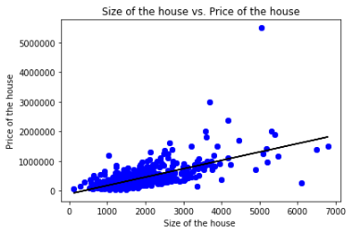
Linear regression Example
Visualize the model
x = houses["Size"]
y = houses["Price"]
fit = np.polyfit(x, y,1)
fit_fn = np.poly1d(fit)
import matplotlib.pyplot as plt
plt.plot(x, y, 'bo', x, fit_fn(x), '-k')
plt.xlabel("Size of the house ")
plt.ylabel("Price of the house")
plt.title("Size of the house vs. Price of the house")
plt.show()

Slide 27

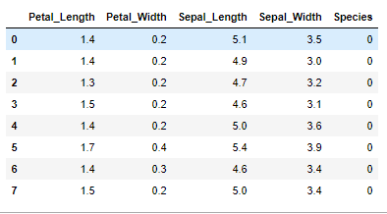
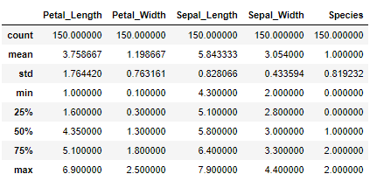
Iris Example
For this part, let’s load the Iris dataset
from sklearn import datasets
import numpy as np
iris = datasets.load_iris()
X = iris.data
# Sepal and pedal negth and width
y = iris.target
IRIS = pd.DataFrame({'Sepal_Length':X[:,0], 'Sepal_Width':X[:,1], 'Petal_Length':X[:,2], 'Petal_Width':X[:,3], 'Species':y})

Slide 28
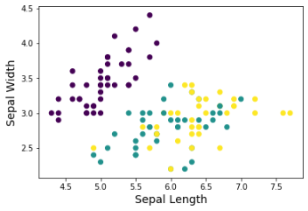
Split data to train and test
Use same methodology as before to split data to train and test
Now we have 70% of data for training and the rest for testing
from sklearn.model_selection import train_test_split
X_train, X_test, y_train, y_test = train_test_split(X, y, test_size=0.30, random_state=52)

Slide 29

Train and evaluate
Train the model
Evaluation
from sklearn.linear_model import LogisticRegression
model = LogisticRegression(solver='lbfgs', multi_class='multinomial')
model.fit(X_train, y_train)
from sklearn.metrics import confusion_matrix
y_predict = model.predict(X_test)
confusion_matrix(y_test, y_predict)
from sklearn.metrics import accuracy_score
accuracy_score(y_test, y_predict)*100

Slide 30


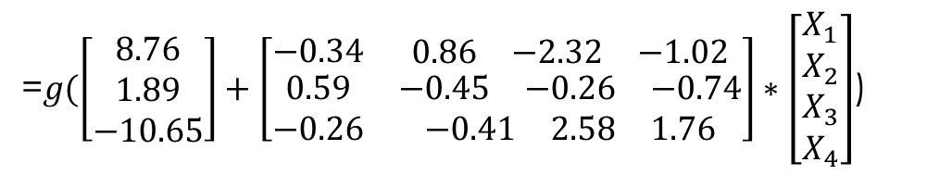
More about the model
What are the coefficients of the model?
What is the final model
$h_{θ}\left(X\right)={g(θ}_{0}+θ_{1}∗\left[\begin{matrix}\begin{matrix}X_{1} \\ X_{2}\end{matrix} \\ X_{3} \\ X_{4}\end{matrix}\right])$
model.intercept_, model.coef_
=$g(\left[\begin{matrix}8.76 \\ 1.89 \\ −10.65\end{matrix}\right]+\left[\begin{matrix}−0.34 & \begin{matrix}0.86 & −2.32 & −1.02\end{matrix} \\ \begin{matrix}0.59 \\ −0.26\end{matrix} & \begin{matrix}\begin{matrix}−0.45 & −0.26 & −0.74\end{matrix} \\ \begin{matrix}−0.41 & 2.58 & 1.76\end{matrix}\end{matrix}\end{matrix}\right]∗\left[\begin{matrix}\begin{matrix}X_{1} \\ X_{2}\end{matrix} \\ X_{3} \\ X_{4}\end{matrix}\right]$)

Slide 31
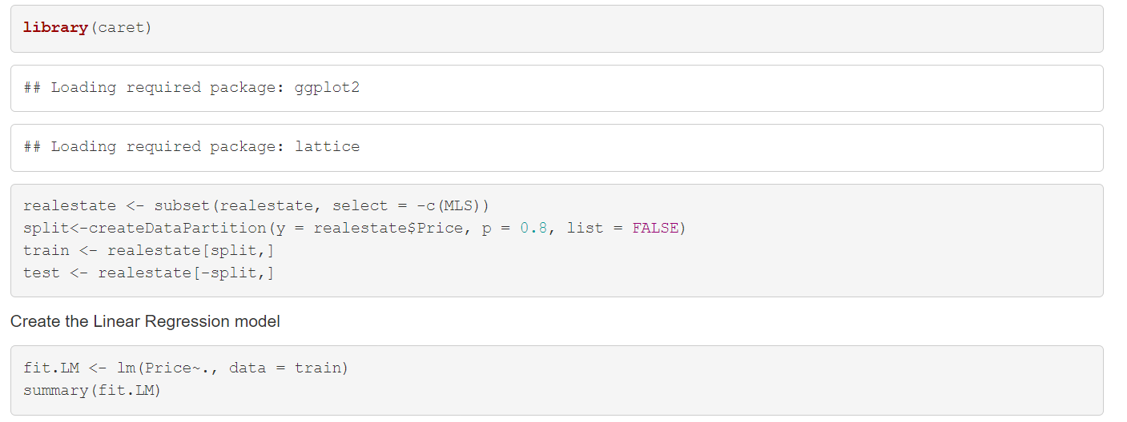
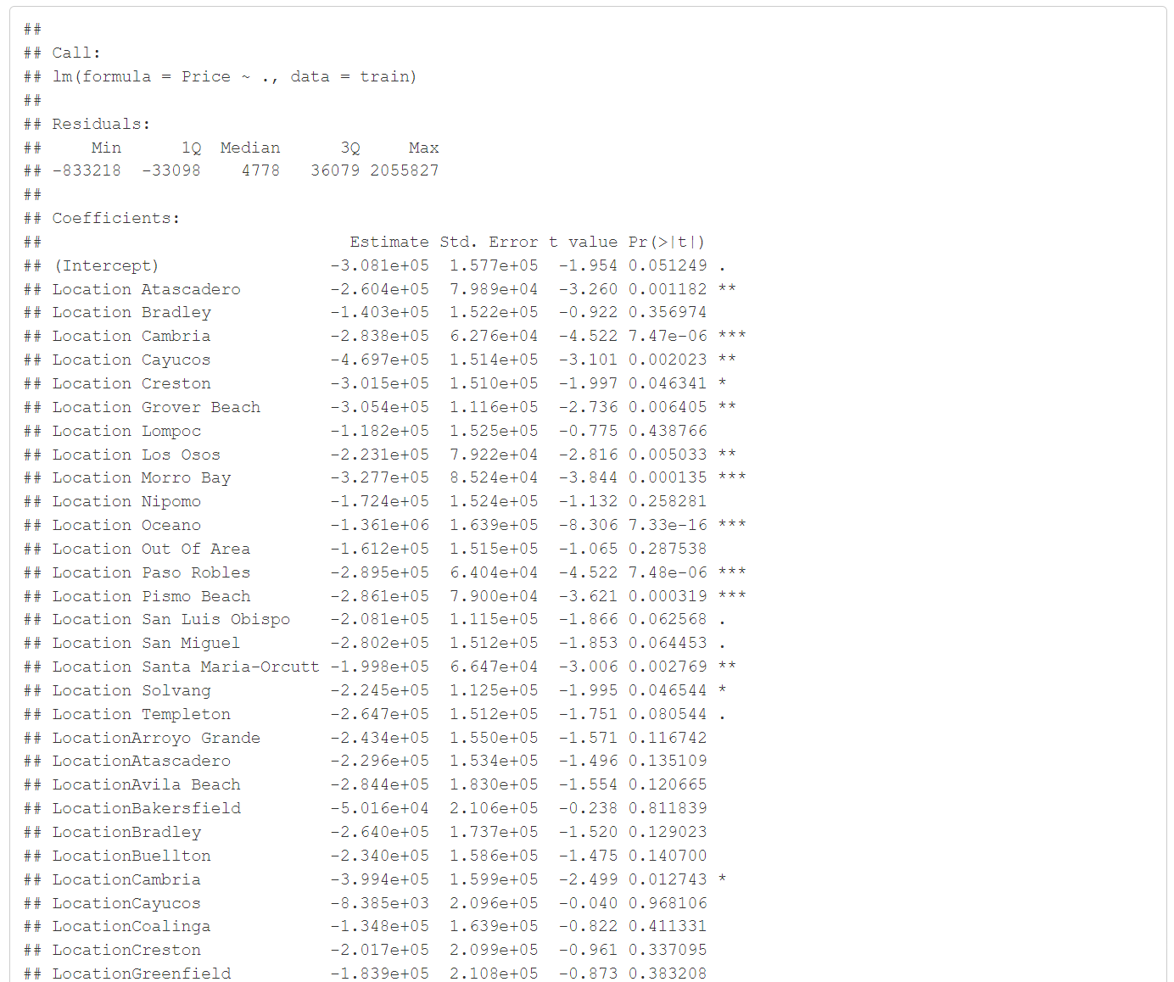
Regression in R

Slide 32
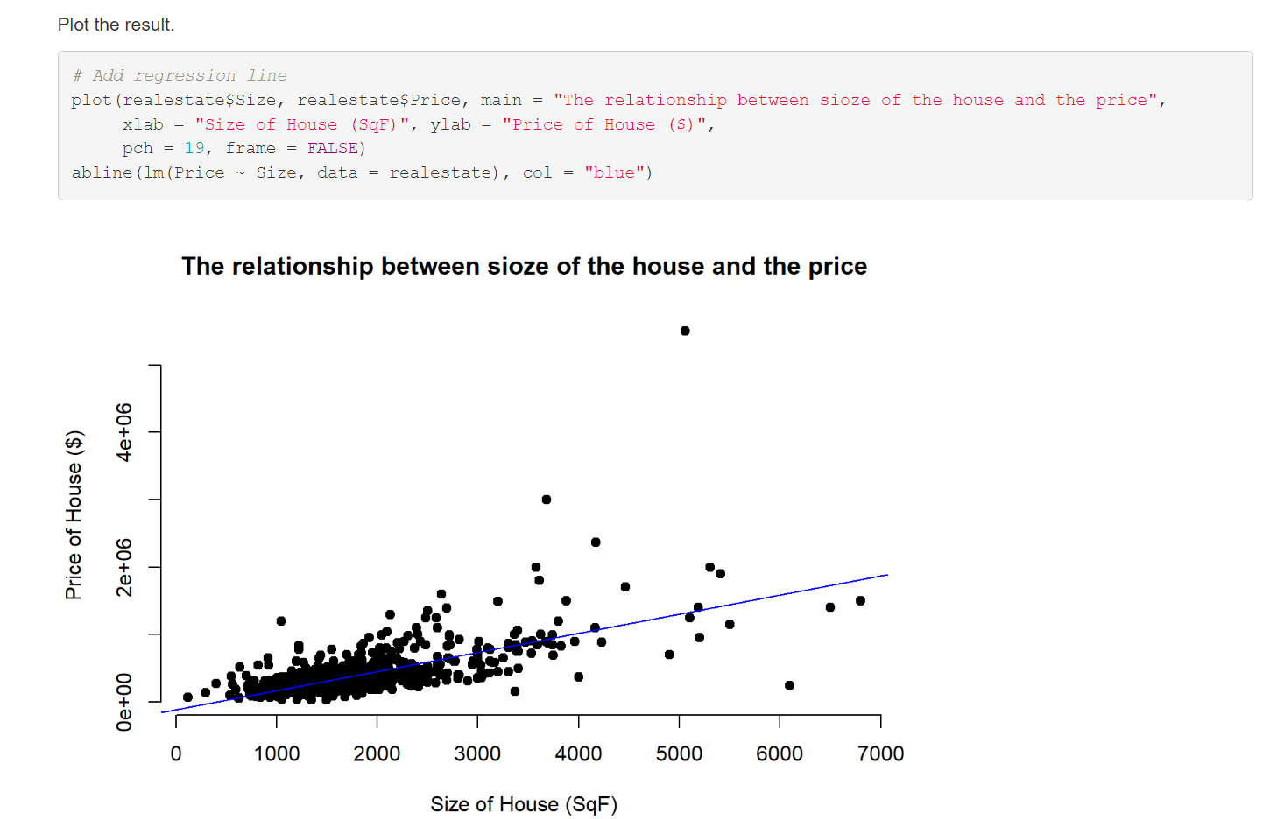
Plot two variables

Slide 33
Iris in R
Specifications of dataset
Split data to train and test
Train the model
str(iris)
'data.frame': 150 obs. of 5 variables:
$ Sepal.Length: num 5.1 4.9 4.7 4.6 5 5.4 4.6 5 4.4 4.9 ...
$ Sepal.Width : num 3.5 3 3.2 3.1 3.6 3.9 3.4 3.4 2.9 3.1 ...
$ Petal.Length: num 1.4 1.4 1.3 1.5 1.4 1.7 1.4 1.5 1.4 1.5 ...
$ Petal.Width : num 0.2 0.2 0.2 0.2 0.2 0.4 0.3 0.2 0.2 0.1 ...
$ Species : Factor w/ 3 levels "setosa","versicolor",..: 1 1 1 1 1 1 1 1 1 1 ...
require(caTools)
iris$spl <- sample.split(iris,SplitRatio = 0.7)
train <- subset(iris, iris$spl==TRUE)
test <- subset(iris, iris$spl==FALSE)
X_train <- train[,-5:-6]
y_train <- train[,5]
# weights: 18 (10 variable)
initial value 109.861229
iter 10 value 10.926698
iter 20 value 2.715576
iter 30 value 1.854315
iter 40 value 1.599614
iter 50 value 1.502383
iter 60 value 0.367176
iter 70 value 0.018492
iter 80 value 0.005202
iter 90 value 0.004831
iter 100 value 0.003935
final value 0.003935
stopped after 100 iterations
library(nnet)
glfit <- multinom(y_train ~ ., data= x_train)

Slide 34
Iris in R
More about model
summary(glfit)
Call:
multinom(formula = y ~ ., data = x)
Coefficients:
(Intercept) Sepal.Length Sepal.Width Petal.Length Petal.Width
versicolor 348.5701 -181.1548 -155.4983 351.2215 133.3534
virginica -529.8564 -261.9545 -288.4206 613.8399 417.7225
Std. Errors:
(Intercept) Sepal.Length Sepal.Width Petal.Length Petal.Width versicolor 715.3786 980.0067 971.6746 1464.856 1428.445
virginica 715.3786 980.0067 971.6746 1464.856 1428.445
Residual Deviance: 0.00787044
AIC: 20.00787

Slide 35
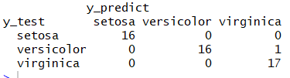

Iris in R
Evaluate model
$Accuracy=\frac{16+16+17}{16+16+17+1}=0.98$ or $98$%
x_test <- test[,-5:-6]
y_test <- test[,5]
y_predict <- predict(glfit,x_test)
table(y_test,y_predict)

