Slide 1
PHONEBOT TECHNICAL CHALLENGE
A Multi-Transcript, Self-Consistent,
Audio-Grounded Pipeline
Caller-info extraction from German phone-call recordings
Prepared by Melih Unsal for JUPUS
2026-05-03
Phonebot Caller-Info Pipeline - Melih Unsal - JUPUS
1 / 21

Slide 2
THE TASK
What I had to extract
• Input: 30 German phone-call recordings (16-bit WAV)
• Output per call: first name, last name, email, phone number
• Phone must be E.164; email lower-cased; names NFC-normalised
Phonebot Caller-Info Pipeline - Melih Unsal - JUPUS
2 / 21

Slide 3
WHY IT IS HARD
The dataset is acoustically and linguistically diverse
• Callers from 11 language traditions: German, French, Italian, Spanish, Brazilian, Swedish, Japanese, Polish, English, Arabic, Irish
• Diacritics are mandatory (Garcia -> Garcia, Lefevre -> Lefevre)
• Spelled-out emails: Punkt, Bindestrich, Unterstrich, at
• Long digit sequences with stutters (e.g. ...12313)
• German STT systems have no incentive to reproduce non-German orthography
Phonebot Caller-Info Pipeline - Melih Unsal - JUPUS
3 / 21

Slide 4
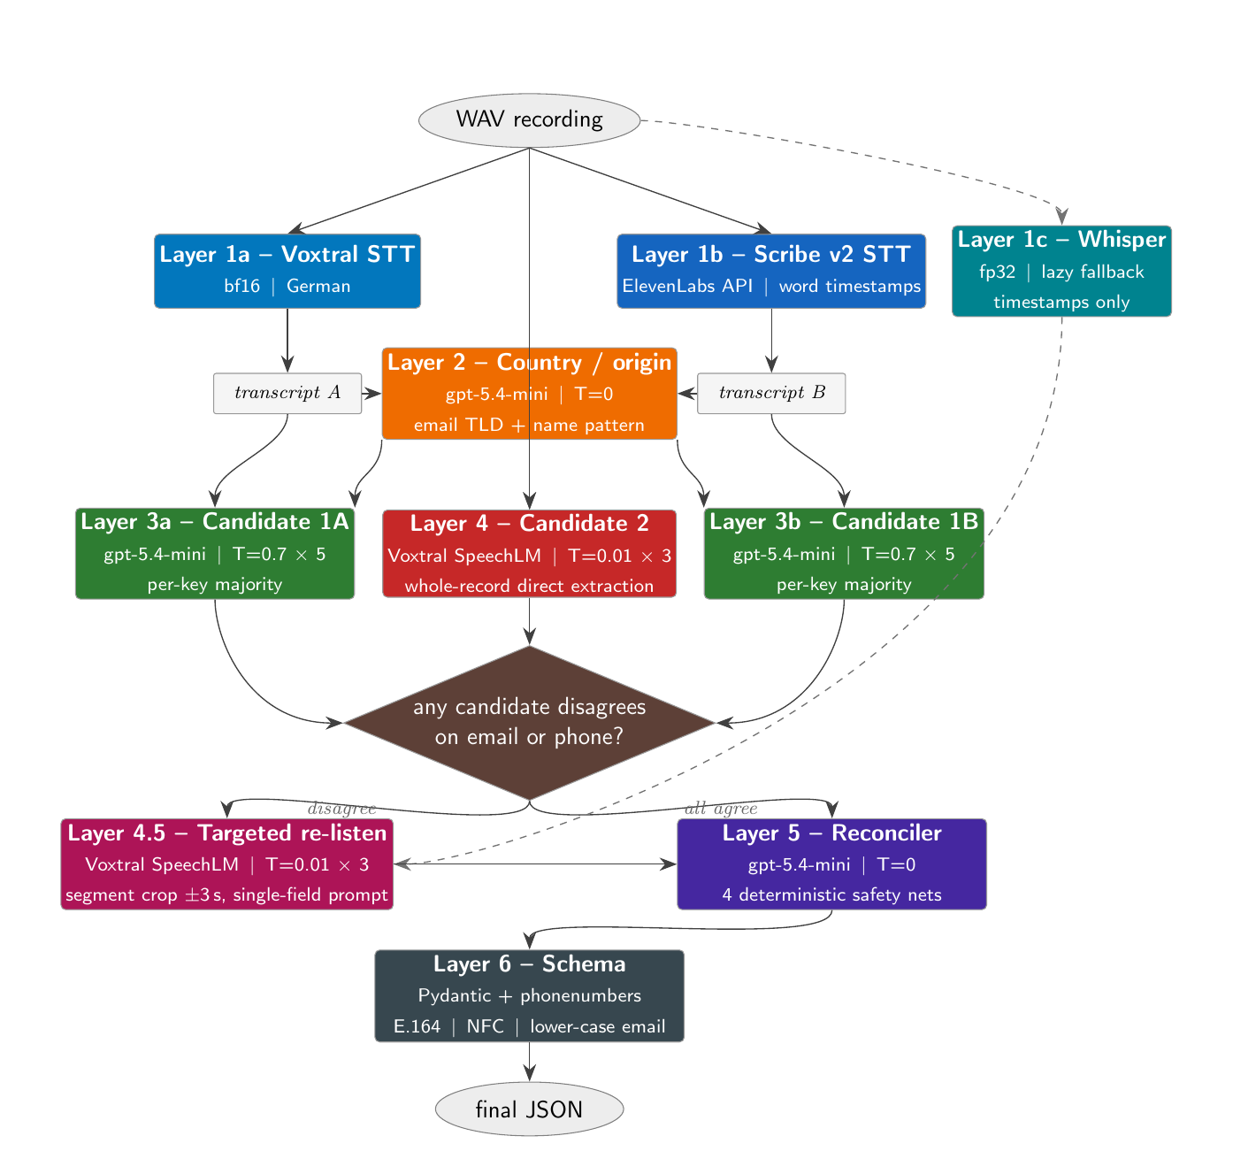
ARCHITECTURE
Full pipeline at a glance
Solid arrows = unconditional flow. Dashed arrows = lazy paths (Whisper, targeted re-listen).
Phonebot Caller-Info Pipeline - Melih Unsal - JUPUS
4 / 21

Slide 5
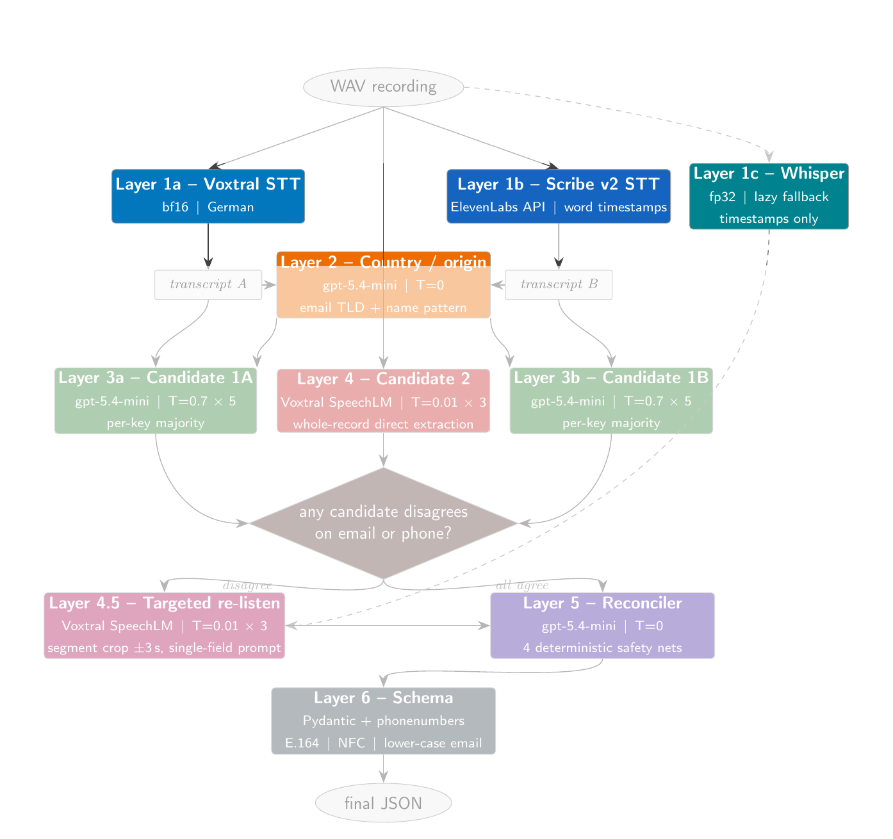
LAYER 1
Dual STT Layer: To eliminate model-biased results
• Voxtral-Mini-3B-2507 (local, bf16): strong on letters, no timestamps
• ElevenLabs Scribe v2 (API): word timestamps + keyterms biasing (Punkt, Bindestrich, gmail.com, ...)
• Errors correlate within one model, uncorrelate across models
• Whisper-large-v3-turbo generates the timestamps lazily (Layer 1c)
Phonebot Caller-Info Pipeline - Melih Unsal - JUPUS
Benchmark Link: https://huggingface.co/spaces/hf-audio/open_asr_leaderboard
5 / 21

Slide 6
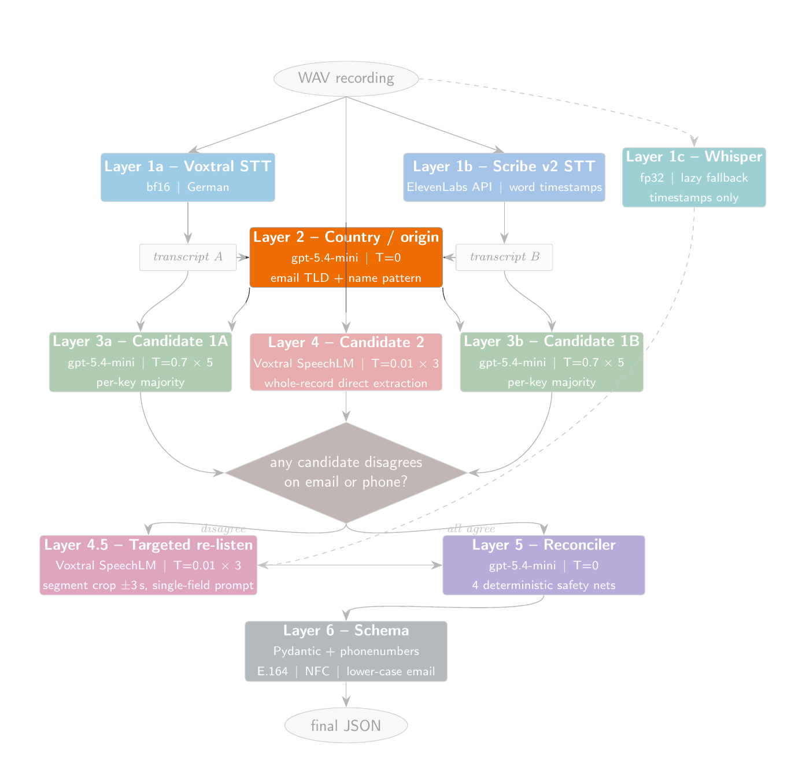
LAYER 2
Country detection: To decrease the orthographic mistakes
• Single LLM call decides the caller's linguistic-origin country once ( UK → Mary , Germany → Marie)
• Signals (priority order): email domain, name pattern, phone code
• Output is a single country string used by every later layer
Phonebot Caller-Info Pipeline - Melih Unsal - JUPUS
6 / 21

Slide 7
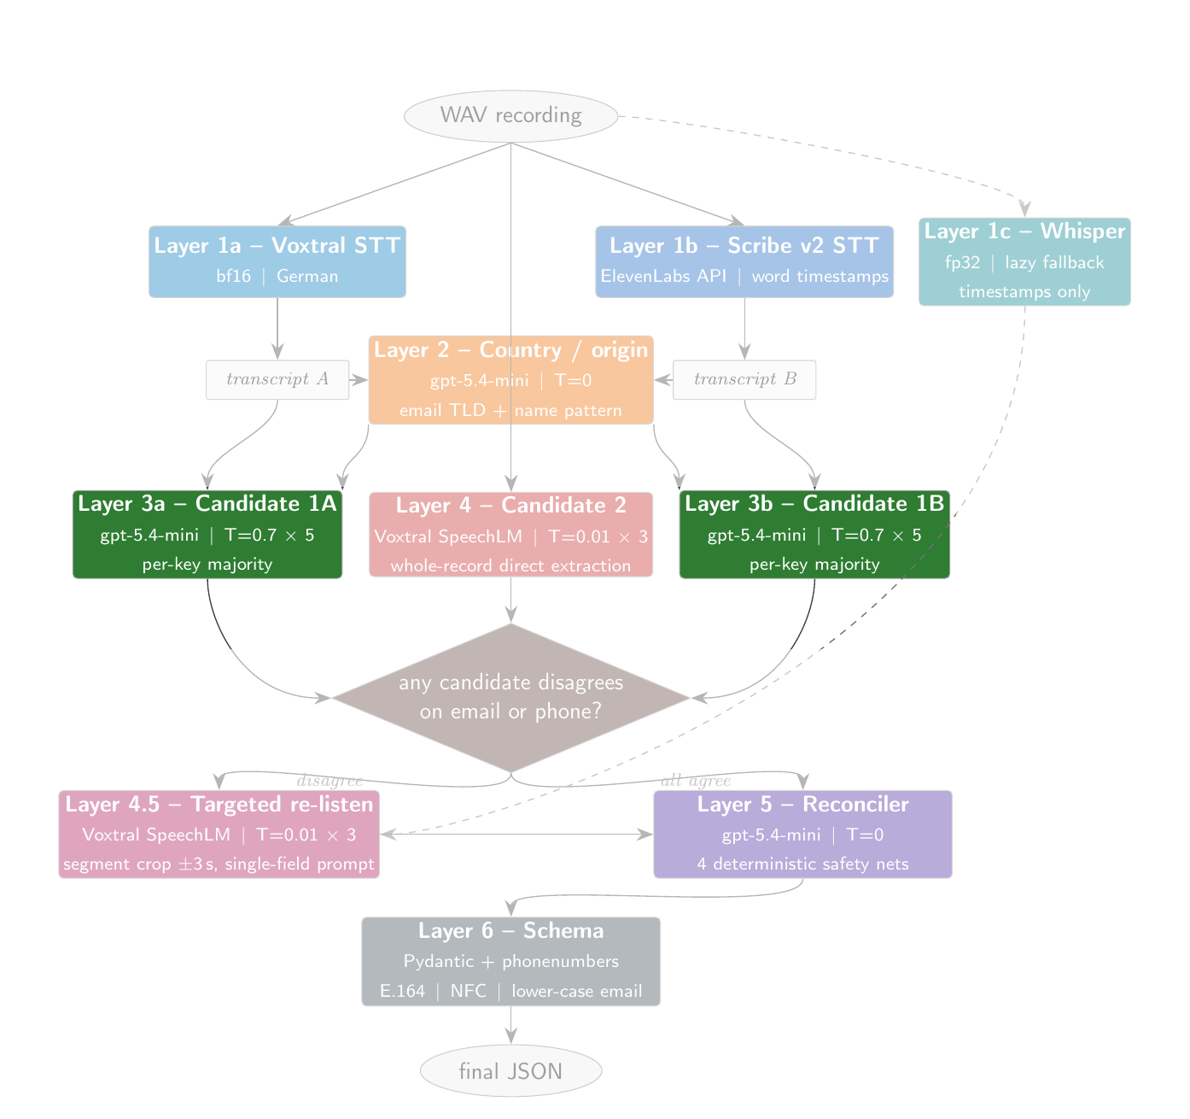
LAYER 3
Candidate-1: Structured output from transcripts
• For each transcript, run gpt-5.4-mini at temperature 0.7, five times
• Per-key majority vote -> one candidate per transcript
• Prompt embeds country-specific orthography, name<->email rules, phone prefix rules
• Self-consistency averages out single-shot LLM noise
• Number of candidate-1s = number of STT models
Phonebot Caller-Info Pipeline - Melih Unsal - JUPUS
7 / 21

Slide 8
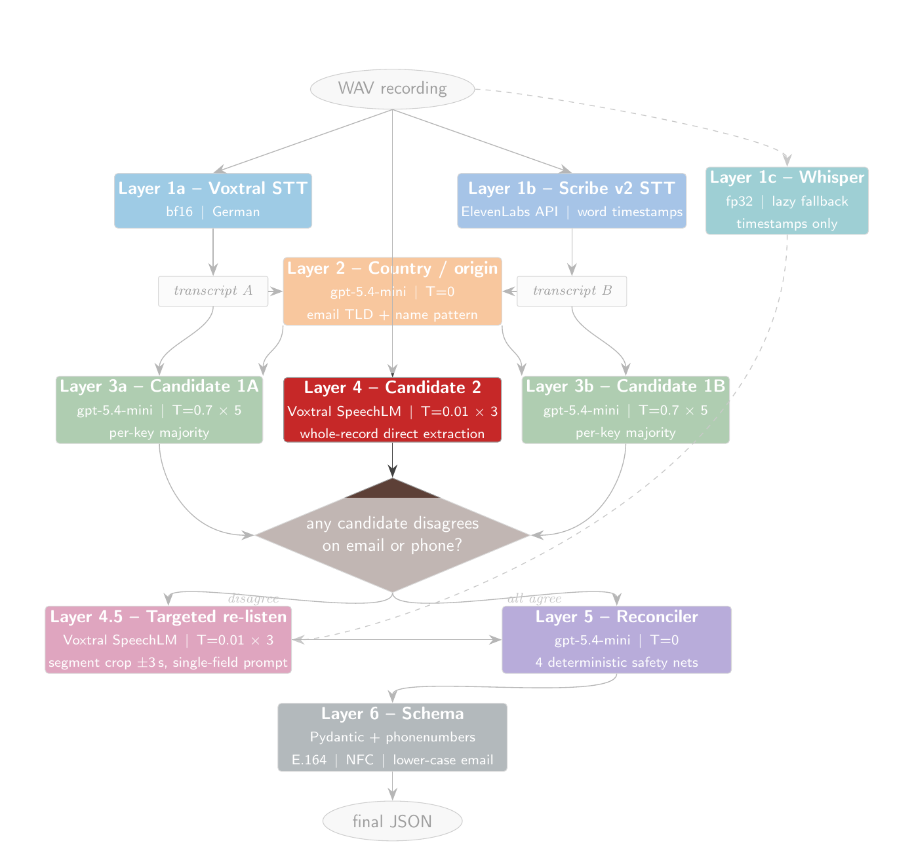
LAYER 4
Candidate-2: SpeechLM directly on the audio to decrease the spelling mistakes
• Voxtral consumes the WAV plus a single text instruction
• Three runs at temperature 0.01 (near-greedy), majority-voted
• Strong on literal letters and digits the caller spoke
• Weak on diacritics and country-aware orthography (audio carries no orthographic signal)
• Different error profile from candidate-1 - this is the point
Phonebot Caller-Info Pipeline - Melih Unsal - JUPUS
8 / 21

Slide 9
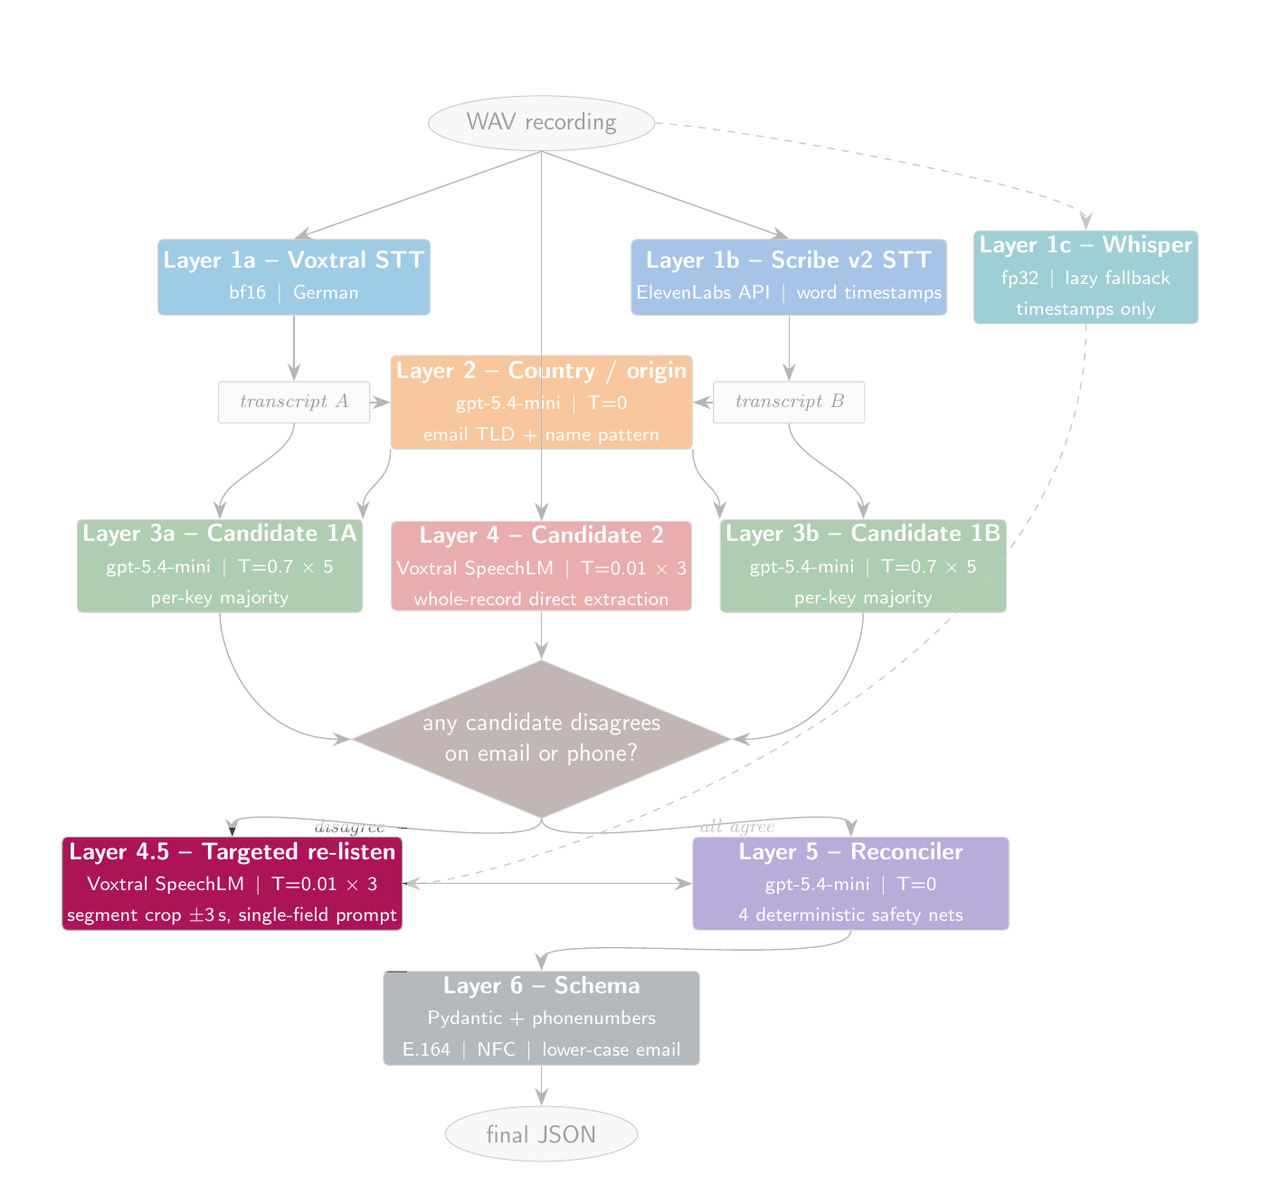
LAYER 4.5
Targeted re-listen: replay the parts you are unsure about
• Gate: opens only if whole-record candidates disagree on email or phone
• Word timestamps come from Scribe or from Whisper (Layer 1c)
• Segment detection looks for Punkt/Bindestrich/at + domain hints, or digit-words and 'plus'
• Crop the audio to the detected window plus 3 seconds context
• Re-prompt the SpeechLM with a single-field prompt, three times, majority-voted
• Most records skip the layer entirely - it is selective by design
Phonebot Caller-Info Pipeline - Melih Unsal - JUPUS
9 / 21

Slide 10
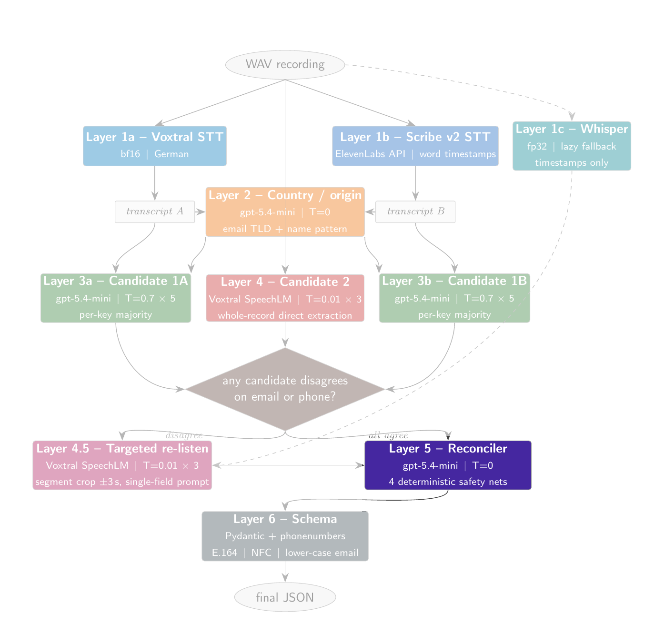
LAYER 5
Reconciler + 4 deterministic safety nets
• LLM reconciler (gpt-5.4-mini, T=0) sees: transcripts, country, every candidate-1, candidate-2, targeted re-listen
• Net 1 - drop targeted email/phone if it is structurally invalid (no @, won't parse)
• Net 2 - if every whole-record candidate agrees, that value wins regardless of the LLM
• Net 3 - strict majority overrides the LLM (e.g. 2 of 3 candidates agree on the right phone)
• Net 4 - email <-> name alignment using ASCII-folded edit distance (fixes Lefevre/Lefebvre/Le Fevre)
• Each net catches a class of obvious cases the LLM might miss
Phonebot Caller-Info Pipeline - Melih Unsal - JUPUS
10 / 21

Slide 11
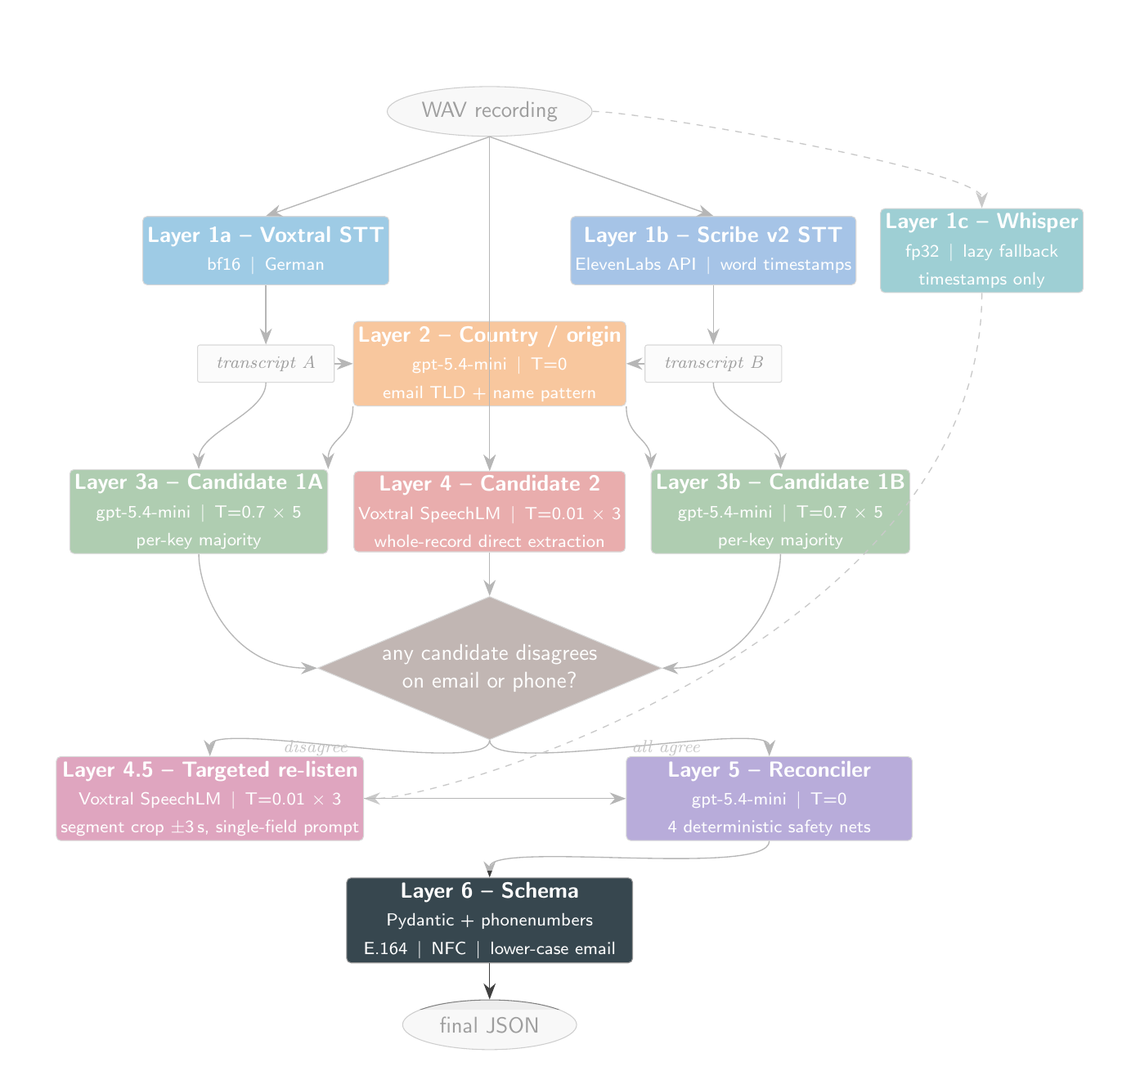
LAYER 6
Schema validation and normalisation
• Pydantic CallerInfo model is the single normalisation point
• Names: NFC normalised
• Emails: lower-cased
• Phone numbers: parsed by phonenumbers, re-emitted in E.164
• Same validators.py used by the evaluator -> formatting can never lose points
Phonebot Caller-Info Pipeline - Melih Unsal - JUPUS
11 / 21

Slide 12
TOOLING
phonebot CLI: one entry point, every config knob
• phonebot run - batch over data/recordings/
• phonebot extract <wav> - one recording -> JSON
• phonebot evaluate <report> - re-evaluate against ground truth
• phonebot ablate <flags> - ablation run, every config knob exposed
• phonebot doctor - GPU / API / Langfuse status
phonebot ablate \
--transcription elevenlabs:scribe_v2 \
--instruct "" --timestamp "" \
--no-targeted --no-auto-resume \
--tag scribe_only_no_audiollm
Phonebot Caller-Info Pipeline - Melih Unsal - JUPUS
12 / 21

Slide 13
RESULTS
Headline accuracy across configurations
Configuration | n runs | Best | Notes
Voxtral + Scribe | full pipeline | 3 | 29 | headline (Voxtral + Scribe + audio LLM + targeted)
Voxtral | +targeted, no Whisper | 1 | 28 | no Whisper Layer 1c
Voxtral | +targeted, +Whisper | 2 | 27 | full single-STT
Voxtral | no targeted (NEW) | 1 | 26 | isolates targeted layer
Scribe | no audio LLM, no targeted (NEW) | 1 | 26 | transcript-only baseline
Scribe | +targeted | 1 | 26 | Scribe full stack
Scribe | no targeted | 2 | 25 | Scribe minus re-listen
Best run = 29 / 30 (dual STT + audio LLM + targeted + Whisper)
Phonebot Caller-Info Pipeline - Melih Unsal - JUPUS
13 / 21

Slide 14
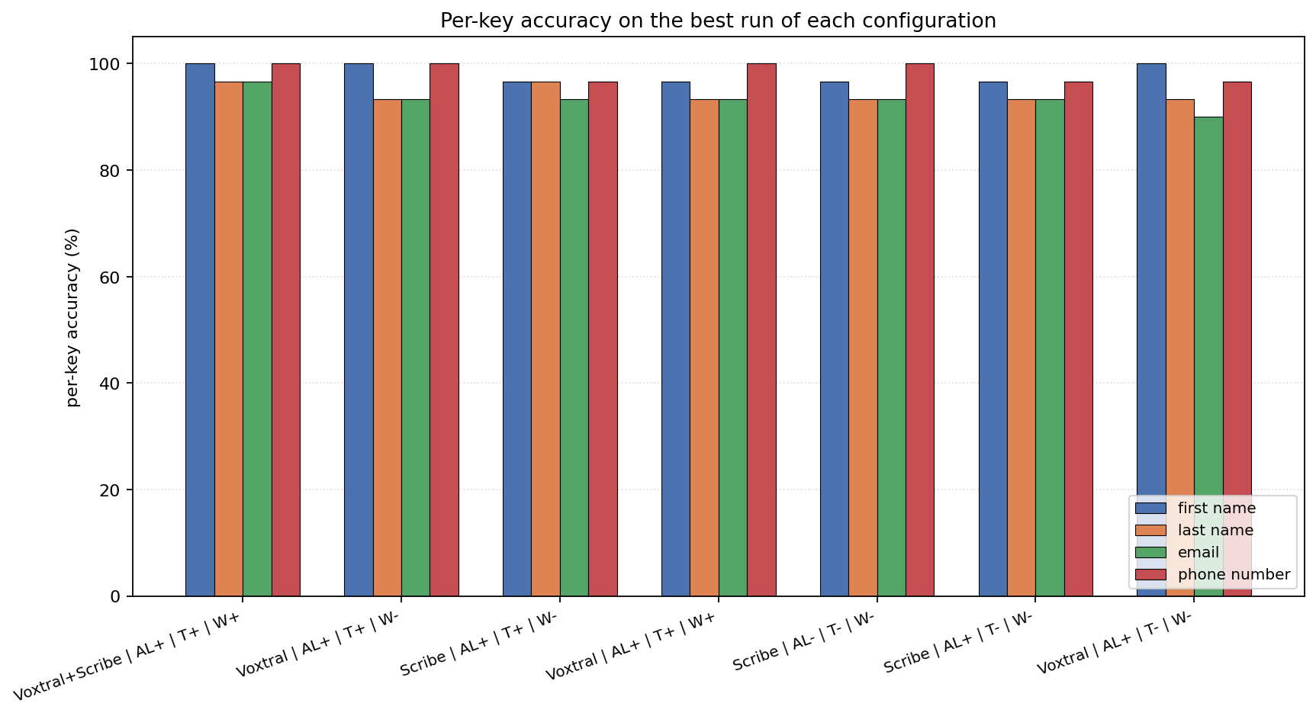
RESULTS
Per-key accuracy: most errors live in last name + email
Phonebot Caller-Info Pipeline - Melih Unsal - JUPUS
14 / 21

Slide 15
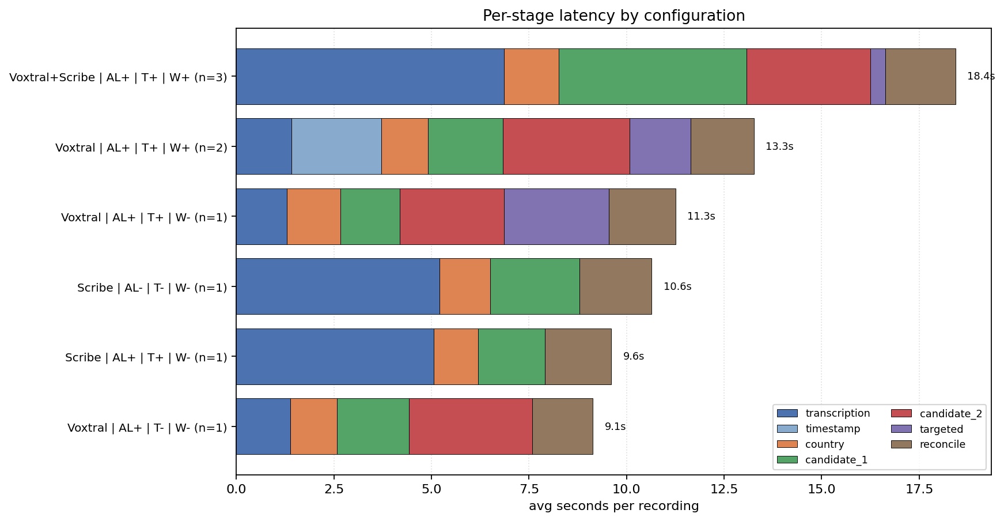
PERFORMANCE
Per-stage wall-clock latency
Targeted re-listen is conditional - on most records the layer returns immediately.
Phonebot Caller-Info Pipeline - Melih Unsal - JUPUS
15 / 21

Slide 16
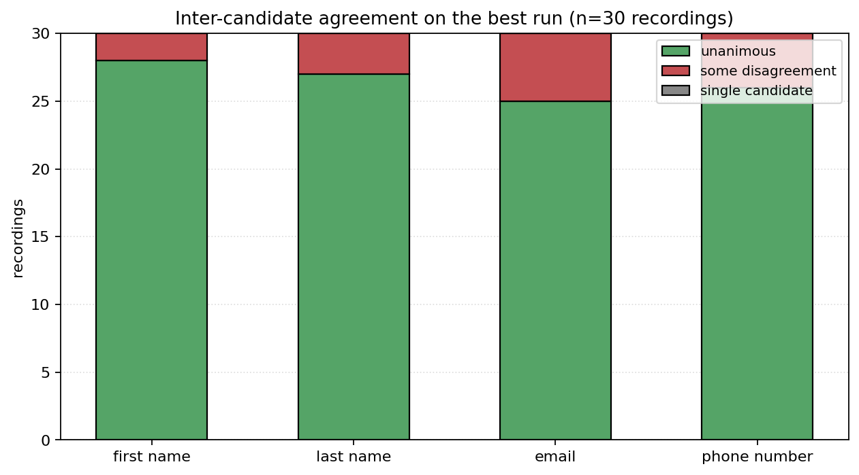
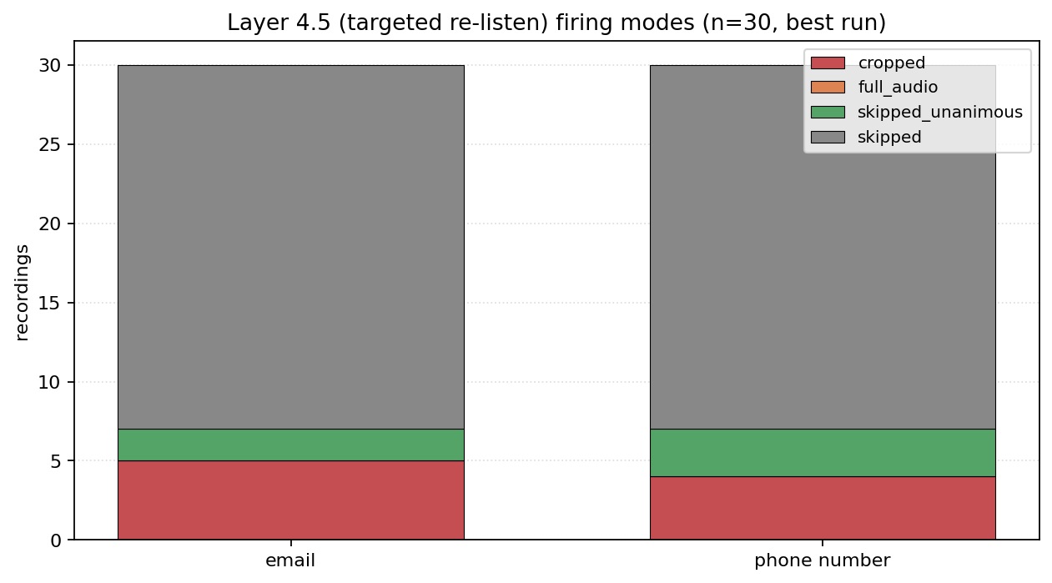
BEHAVIOUR
Agreement drives re-listen activity
Most records are unanimous on email and phone -> the targeted re-listen is skipped on the majority of the dataset.
Phonebot Caller-Info Pipeline - Melih Unsal - JUPUS
16 / 21

Slide 17
ABLATION TAKEAWAYS
What each component is actually buying
• STT choice: dual-STT peaks at 29/30; single-Voxtral peaks at 28; single-Scribe plateaus at 26
• SpeechLM (audio LLM): not strictly additive on its own - only pays off when the targeted re-listen is enabled
• Targeted re-listen: clearest gain on Voxtral-only (26 -> 28); partly redundant once strict-majority kicks in
• Whisper timestamper: needed by Voxtral path; modest cost; small effect once candidates already agree
• Bottom line: the gain over a transcript-only baseline (26 -> 29) comes from THREE things working together, not one component
Phonebot Caller-Info Pipeline - Melih Unsal - JUPUS
17 / 21

Slide 18
EXTENSIBILITY
Adding a new entity is three small changes
Every layer is driven by one list: KEYS = [...] in src/config.py.
To add company_name (or address, appointment_date, case_topic, ...):
• src/config.py: append the key to KEYS and add a <KEY>_RULES string describing how to extract it
• src/prompts.py: splice the new rule into EXTRACT_SYSTEM (and any other prompt that should know about it)
• src/schema.py: add the field to the CallerInfo Pydantic model (with an optional normaliser)
Everything else picks it up automatically:
• Layer 3 majority_vote already iterates KEYS -> self-consistency for free
• Reconciler safety nets (Net 2 unanimous, Net 3 strict-majority) operate on every key in KEYS -> no code change
• Schema validator + evaluator share validators.py -> prediction and ground truth normalised the same way
• Langfuse traces auto-include the new field in every layer's output payload
Phonebot Caller-Info Pipeline - Melih Unsal - JUPUS
18 / 21

Slide 19
FUTURE IMPROVEMENTS
Where this goes next, in production
• Real-time streaming: extract fields incrementally as the caller speaks, not after the call ends
• TTS-driven clarification: when confidence is low, ask the caller ("M-U-E-L-L-E-R or M-U with umlaut?") instead of guessing
• Adaptive memory + dynamic keyterms: confirmed tokens get stored and biased into the next turn's prompts
• Multilingual: swap the language code; localise the spelling-marker word lists (Punkt -> piste / prik / ...)
• Concurrent users (20+): vLLM continuous batching for the SpeechLM, ElevenLabs pool with per-tenant rate limiting
• Long conversations: 30-60s chunked windows + incremental extraction; targeted re-listen already shows the pattern
Phonebot Caller-Info Pipeline - Melih Unsal - JUPUS
19 / 21

Slide 20
ERROR ANALYSIS & CONCLUSION
The one residual error mode
• call_23: emma.andersson@gmail.com - both STTs hear single 'n' (Anderson)
• Country detector couldn’t identify Swedish country, because neither email nor phone number does not reveal it
• Fix: Swedish surname suffix prior, or sub-second re-listen on the ambiguous consonant
Conclusion
• Best run reaches 29/30 full-record matches (96.7%)
• Per-key accuracy: 100% phone, 100% first name, 96.7% email + last name on the best run
• Code, paper, ablation tooling, and reports all reproducible from the study/ folder
Phonebot Caller-Info Pipeline - Melih Unsal - JUPUS
20 / 21

Slide 21
PHONEBOT TECHNICAL CHALLENGE
THANK YOU!
Prepared by Melih Unsal for JUPUS
2026-05-03
Phonebot Caller-Info Pipeline - Melih Unsal - JUPUS
21 / 21

