Slide 1
PHONEBOT TECHNICAL CHALLENGE
A Multi-Transcript, Self-Consistent,
Audio-Grounded Pipeline
Caller-info extraction from German phone-call recordings
Prepared by Melih Unsal for JUPUS
2026-05-03
Phonebot Caller-Info Pipeline - Melih Unsal - JUPUS
1 / 19

Slide 2
THE TASK
What I had to extract
• Input: 30 German phone-call recordings (16-bit WAV)
• Output per call: first name, last name, email, phone number
• Phone must be E.164; email lower-cased; names NFC-normalised
• Ground truth allows multiple acceptable spellings per field
Phonebot Caller-Info Pipeline - Melih Unsal - JUPUS
2 / 19

Slide 3
WHY IT IS HARD
The dataset is acoustically and linguistically diverse
• Callers from 11 language traditions: German, French, Italian, Spanish, Brazilian, Swedish, Japanese, Polish, English, Arabic, Irish
• Diacritics are mandatory (Garcia -> Garcia, Lefevre -> Lefevre)
• Spelled-out emails: Punkt, Bindestrich, Unterstrich, at
• Long digit sequences with stutters (e.g. ...12313)
• German STT systems have no incentive to reproduce non-German orthography
Phonebot Caller-Info Pipeline - Melih Unsal - JUPUS
3 / 19

Slide 4
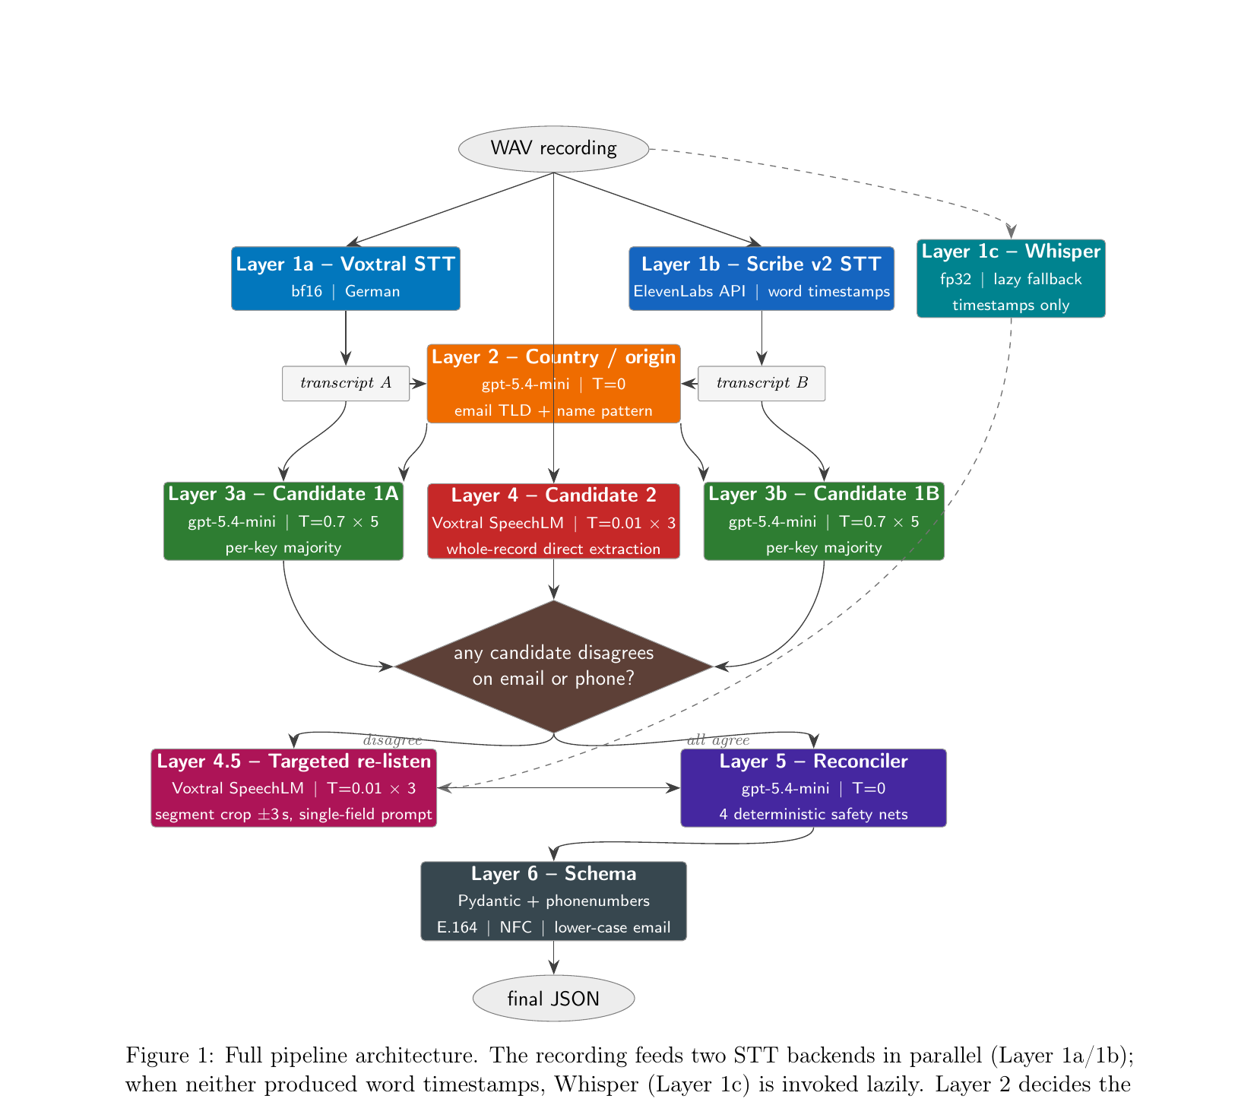
ARCHITECTURE
Full pipeline at a glance
Solid arrows = unconditional flow. Dashed arrows = lazy paths (Whisper, targeted re-listen).
Phonebot Caller-Info Pipeline - Melih Unsal - JUPUS
4 / 19

Slide 5
LAYER 1
Two STT models in parallel = uncorrelated errors
• Voxtral-Mini-3B-2507 (local, bf16): strong on letters, no timestamps
• ElevenLabs Scribe v2 (API): word timestamps + keyterms biasing (Punkt, Bindestrich, gmail.com, ...)
• Errors correlate within one model, uncorrelate across models
• Whisper-large-v3-turbo generates the timestamps lazily (Layer 1c)
Phonebot Caller-Info Pipeline - Melih Unsal - JUPUS
Benchmark Link: https://huggingface.co/spaces/hf-audio/open_asr_leaderboard
5 / 19

Slide 6
LAYER 2
Country detection drives orthography
• Single LLM call decides the caller's linguistic-origin country once
• Signals (priority order): email TLD/domain, name pattern, phone code
• Hard rule: USA is forbidden as a default for ambiguous names
• Output is a single country string used by every later layer
Phonebot Caller-Info Pipeline - Melih Unsal - JUPUS
6 / 19

Slide 7
LAYER 3
Candidate-1: self-consistent transcript-LLM
• For each transcript, run gpt-5.4-mini at temperature 0.7, five times
• Per-key majority vote -> one candidate per transcript
• Prompt embeds country-specific orthography, name<->email rules, phone prefix rules
• Self-consistency averages out single-shot LLM noise
• Number of candidate-1s = number of STT models
Phonebot Caller-Info Pipeline - Melih Unsal - JUPUS
7 / 19

Slide 8
LAYER 4
Candidate-2: SpeechLM directly on the audio
• Voxtral consumes the WAV plus a single text instruction
• Three runs at temperature 0.01 (near-greedy), majority-voted
• Strong on literal letters and digits the caller spoke
• Weak on diacritics and country-aware orthography (audio carries no orthographic signal)
• Different error profile from candidate-1 - this is the point
Phonebot Caller-Info Pipeline - Melih Unsal - JUPUS
8 / 19

Slide 9
LAYER 4.5
Targeted re-listen: rewind the parts you are unsure about
• Gate: opens only if whole-record candidates disagree on email or phone
• Word timestamps come from Scribe or from Whisper (Layer 1c)
• Segment detection looks for Punkt/Bindestrich/at + domain hints, or digit-words and 'plus'
• Crop the audio to the detected window plus 3 seconds context
• Re-prompt the SpeechLM with a single-field prompt, three times, majority-voted
• Most records skip the layer entirely - it is selective by design
Phonebot Caller-Info Pipeline - Melih Unsal - JUPUS
9 / 19

Slide 10
LAYER 5
Reconciler + 4 deterministic safety nets
• LLM reconciler (gpt-5.4-mini, T=0) sees: transcripts, country, every candidate-1, candidate-2, targeted re-listen
• Net 1 - drop targeted email/phone if it is structurally invalid (no @, won't parse)
• Net 2 - if every whole-record candidate agrees, that value wins regardless of the LLM
• Net 3 - strict majority overrides the LLM (e.g. 2 of 3 candidates agree on the right phone)
• Net 4 - email <-> name alignment using ASCII-folded edit distance (fixes Lefevre/Lefebvre/Le Fevre)
• Each net catches a class of obvious cases the LLM might miss
Phonebot Caller-Info Pipeline - Melih Unsal - JUPUS
10 / 19

Slide 11
LAYER 6
Schema validation and normalisation
• Pydantic CallerInfo model is the single normalisation point
• Names: NFC normalised
• Emails: lower-cased
• Phone numbers: parsed by phonenumbers, re-emitted in E.164
• Same validators.py used by the evaluator -> formatting can never lose points
Phonebot Caller-Info Pipeline - Melih Unsal - JUPUS
11 / 19

Slide 12
ABLATION TOOLING
CLI harness exposing every config knob
• study/cli.py mutates src.config before main.py is imported
• Every relevant constant in src/config.py becomes a flag
• Tagged reports go to study/results/ for aggregation
python -m study.cli \
--transcription elevenlabs:scribe_v2 \
--instruct "" --timestamp "" \
--no-targeted --no-auto-resume \
--tag scribe_only_no_audiollm
Phonebot Caller-Info Pipeline - Melih Unsal - JUPUS
12 / 19

Slide 13
RESULTS
Headline accuracy across configurations
Configuration | n | Mean | Std | Best
Voxtral + Scribe | full pipeline | 2 | 26.5 | 2.5 | 29
Voxtral | +targeted, no Whisper | 1 | 28.0 | - | 28
Voxtral | +targeted, +Whisper | 2 | 26.5 | 0.5 | 27
Voxtral | no targeted (NEW) | 1 | 26.0 | - | 26
Scribe | no audio LLM, no targeted (NEW) | 1 | 26.0 | - | 26
Scribe | +targeted | 1 | 26.0 | - | 26
Scribe | no targeted | 2 | 25.0 | 0.0 | 25
Best run = 29 / 30 (dual STT + audio LLM + targeted + Whisper)
Phonebot Caller-Info Pipeline - Melih Unsal - JUPUS
13 / 19

Slide 14
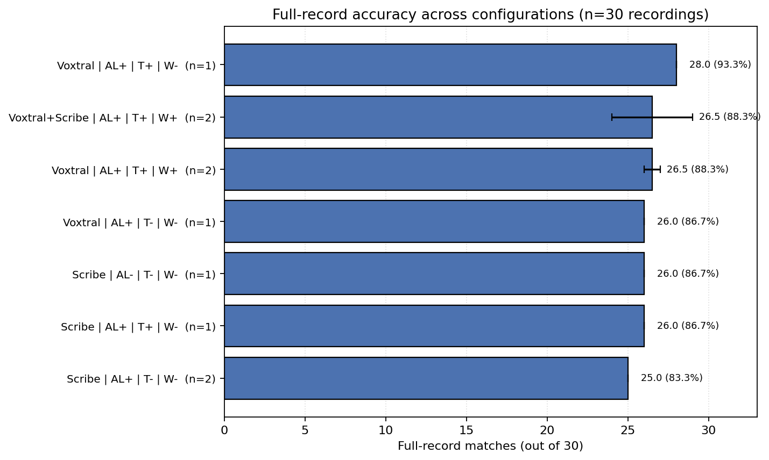
RESULTS
Full-record matches per configuration
Phonebot Caller-Info Pipeline - Melih Unsal - JUPUS
14 / 19

Slide 15
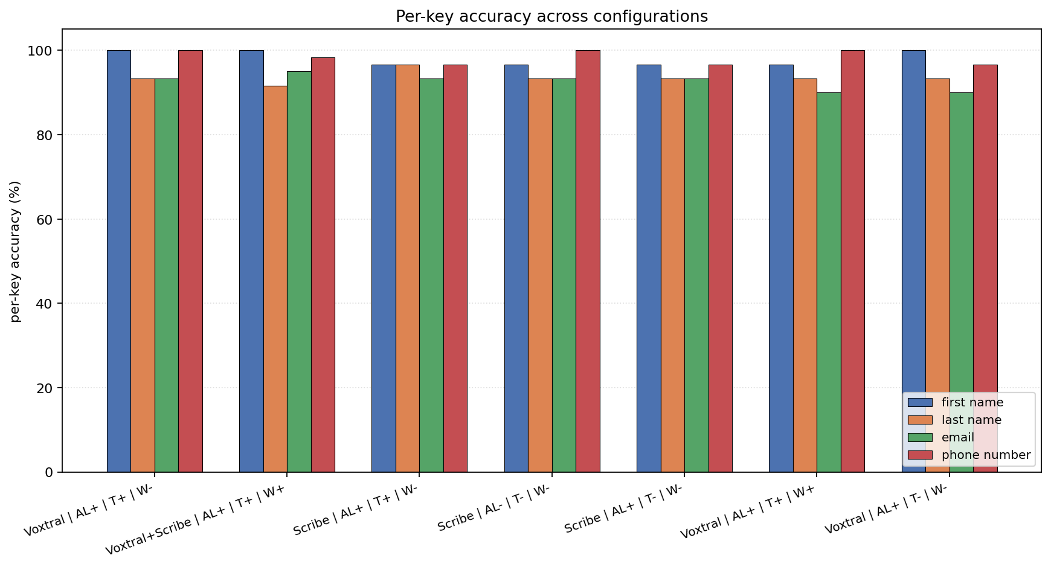
RESULTS
Per-key accuracy: most errors live in last name + email
Phonebot Caller-Info Pipeline - Melih Unsal - JUPUS
15 / 19

Slide 16
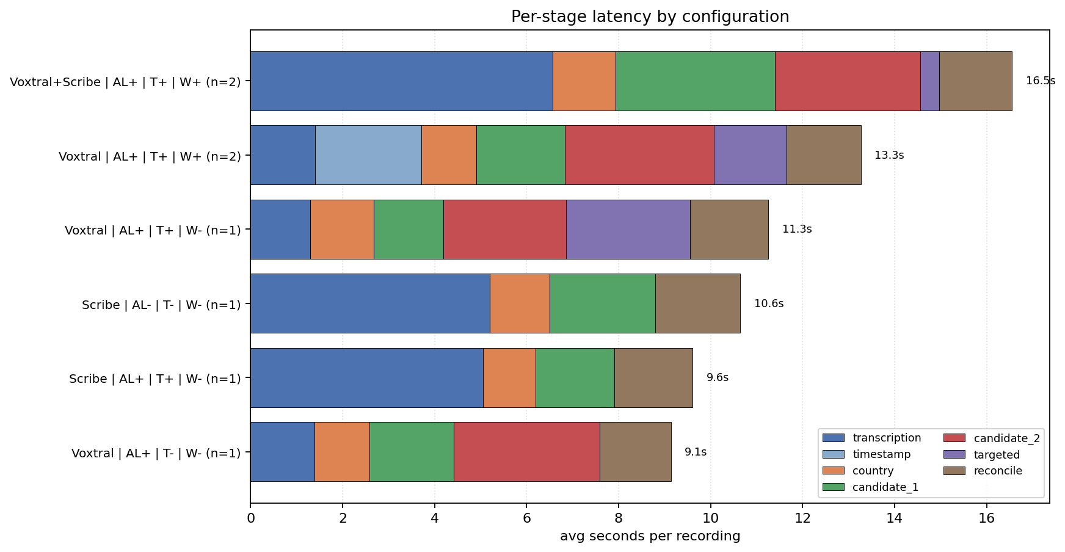
PERFORMANCE
Per-stage wall-clock latency
Targeted re-listen is conditional - on most records the layer returns immediately.
Phonebot Caller-Info Pipeline - Melih Unsal - JUPUS
16 / 19

Slide 17
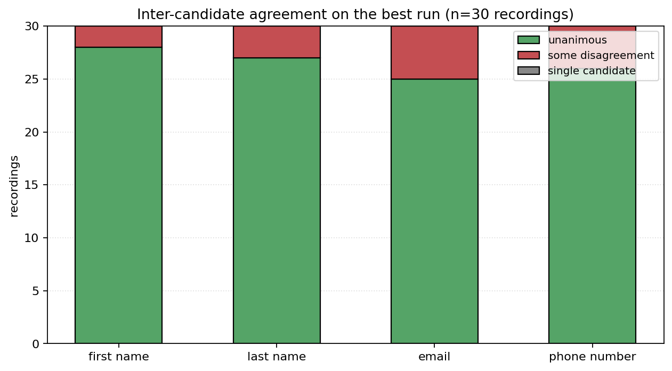
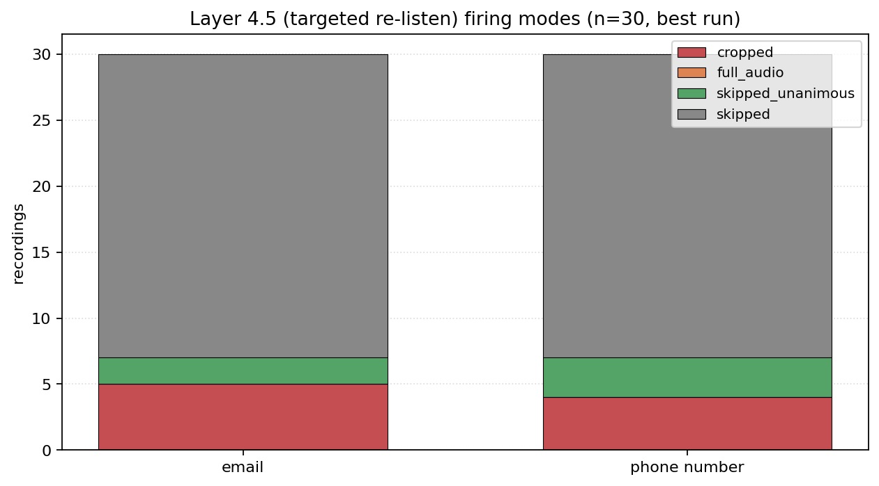
BEHAVIOUR
Agreement drives re-listen activity
Most records are unanimous on email and phone -> the targeted re-listen is skipped on the majority of the dataset.
Phonebot Caller-Info Pipeline - Melih Unsal - JUPUS
17 / 19

Slide 18
ABLATION TAKEAWAYS
What each component is actually buying
• STT choice: dual-STT peaks at 29/30; single-Voxtral peaks at 28; single-Scribe plateaus at 26
• SpeechLM (audio LLM): not strictly additive on its own - only pays off when the targeted re-listen is enabled
• Targeted re-listen: clearest gain on Voxtral-only (26 -> 28); partly redundant once strict-majority kicks in
• Whisper timestamper: needed by Voxtral path; modest cost; small effect once candidates already agree
• Bottom line: the gain over a transcript-only baseline (26 -> 29) comes from THREE things working together, not one component
Phonebot Caller-Info Pipeline - Melih Unsal - JUPUS
18 / 19

Slide 19
ERROR ANALYSIS & CONCLUSION
The one residual error mode
• call_23: emma.andersson@gmail.com - both STTs hear single 'n' (Anderson)
• Country detector identifies Swedish, but email piece is also 'anderson' so Net 4 cannot help
• Fix: Swedish surname suffix prior, or sub-second re-listen on the ambiguous consonant
Conclusion
• Best run reaches 29/30 full-record matches (96.7%)
• Per-key accuracy: 100% phone, 100% first name, 96.7% email + last name on the best run
• Code, paper, ablation tooling, and reports all reproducible from the study/ folder
Phonebot Caller-Info Pipeline - Melih Unsal - JUPUS
19 / 19

