Slide 1

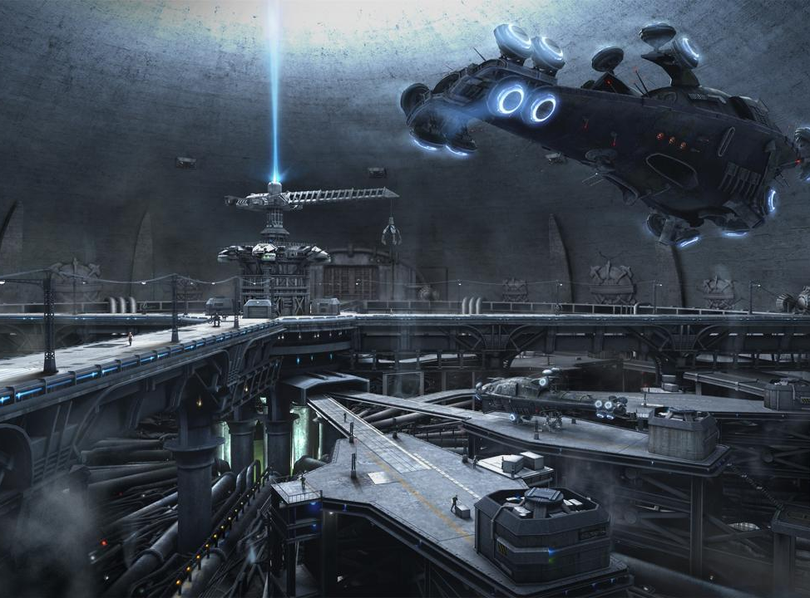
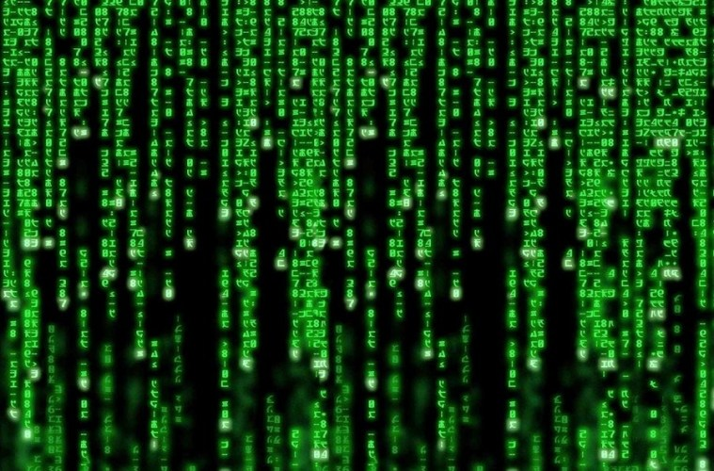
NEBUCHADNEZZAR
Canberk Akbay
Meliha Özdemir
Pınar Büşra Özkan

Slide 2
THIS PROJECT IS ABOUT…

Slide 3
COLLECTING DATA
Data Sources
Tools
Size And Type
Processing

Slide 4
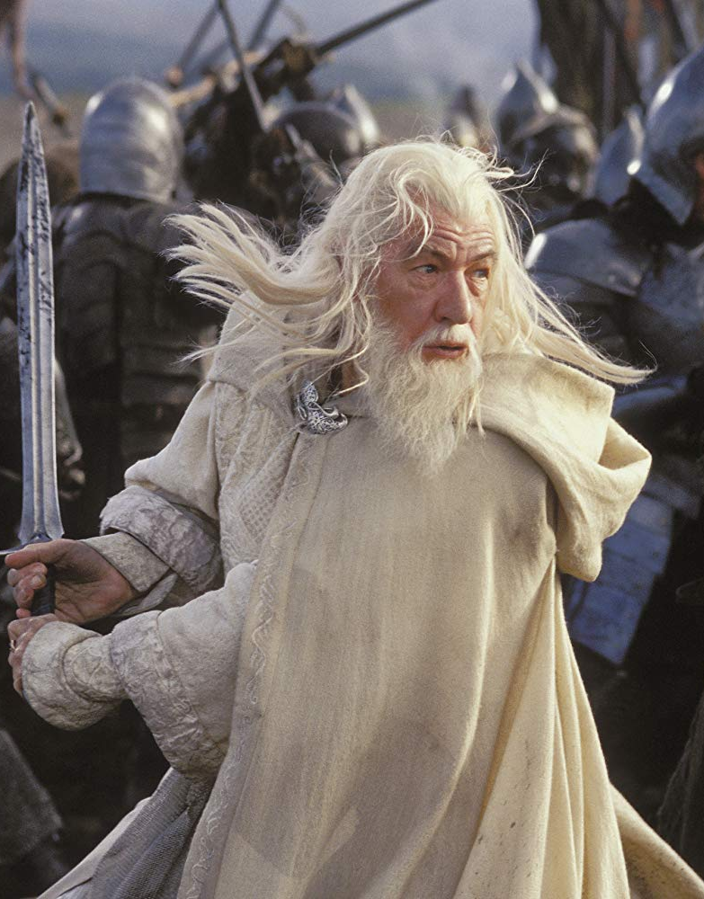
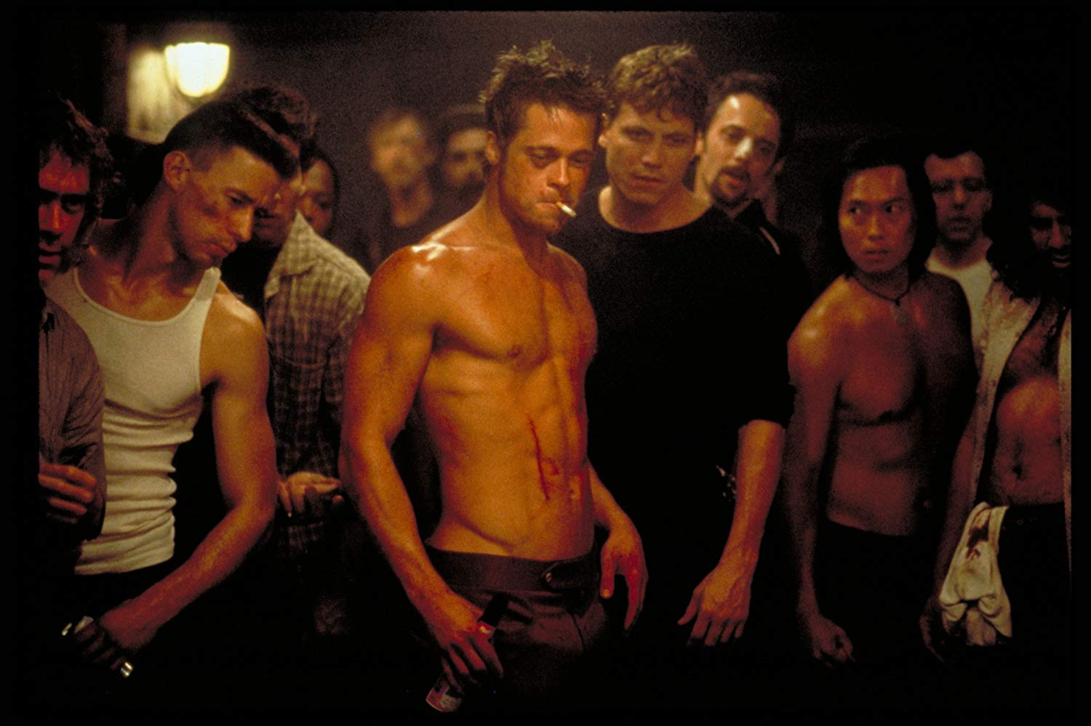
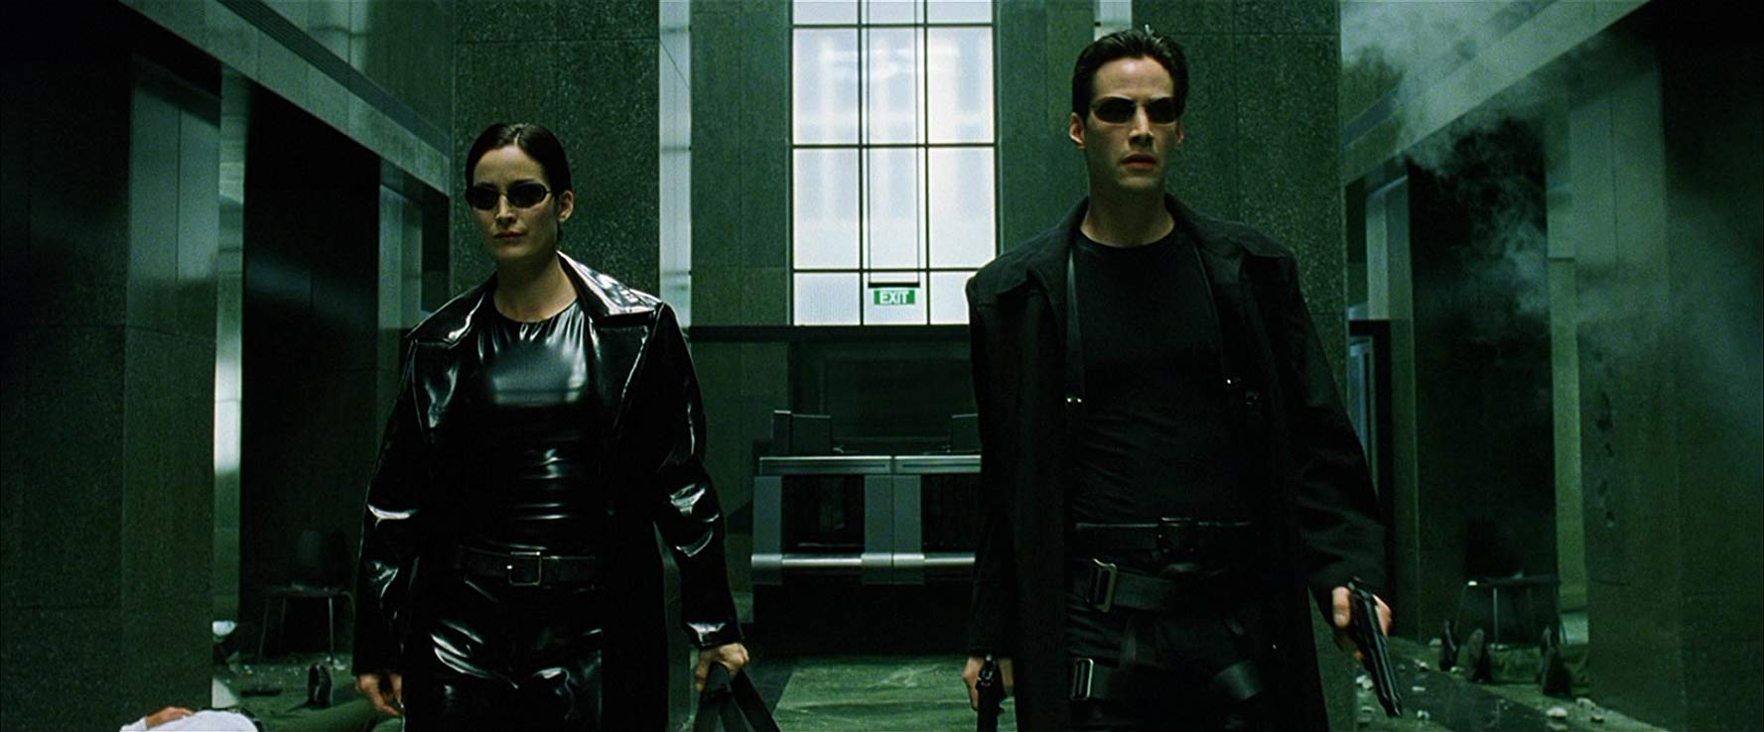
LEGEND SCENES OF ALL TIME

Slide 5
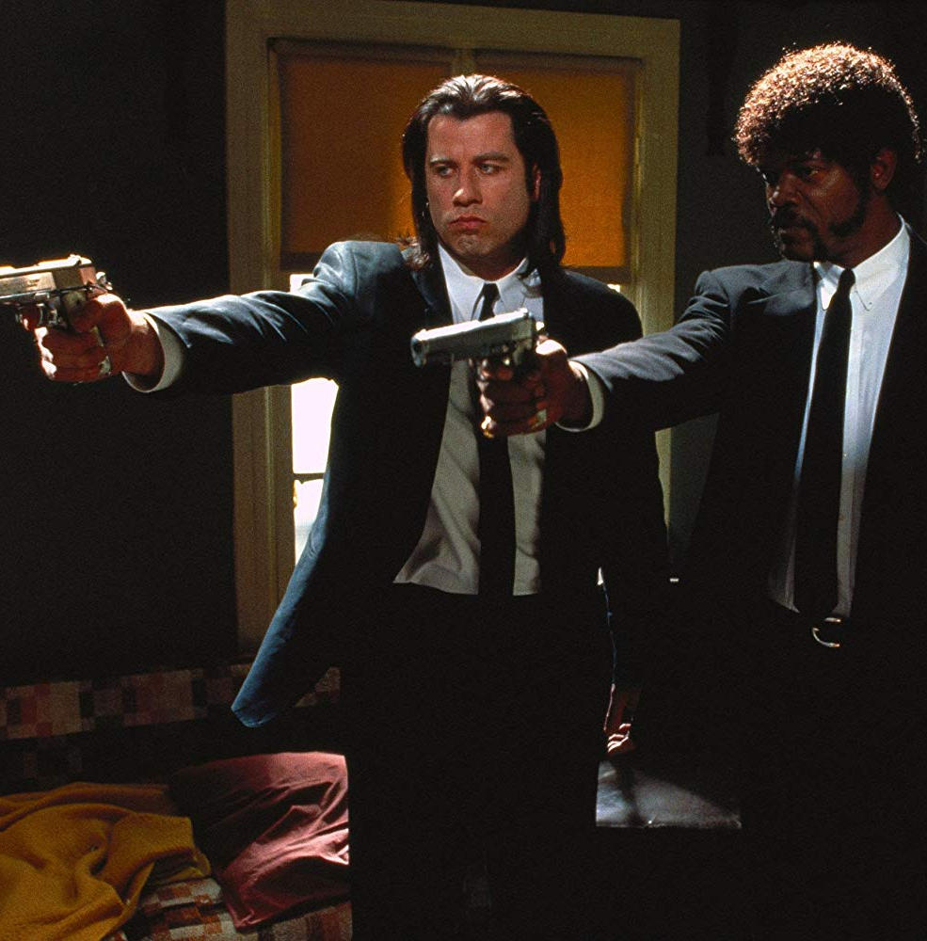
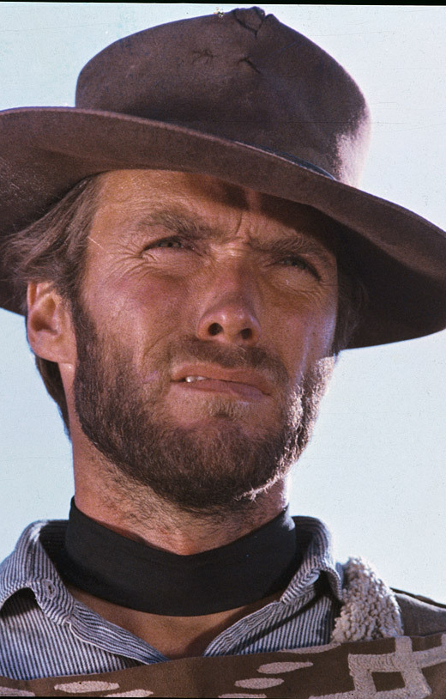
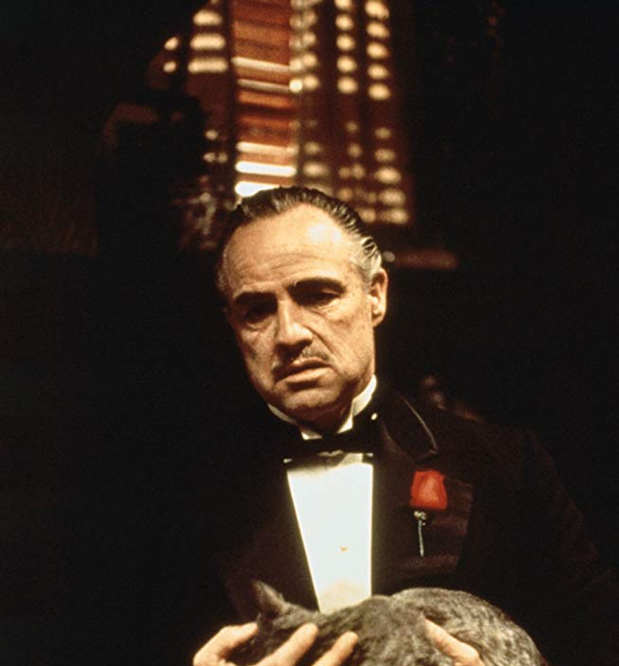

LEGEND SCENES OF ALL TIME

Slide 6
BUILDING MODEL
What is CNN?
How does CNN work?
How does our model look like?

Slide 7
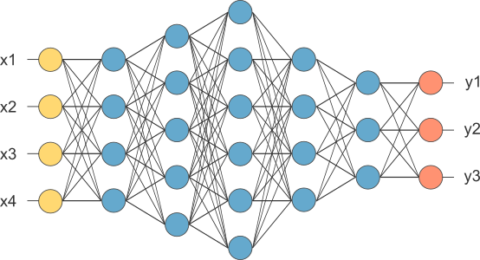
CONVOLUTION
NEURAL NETWORKS

Slide 8
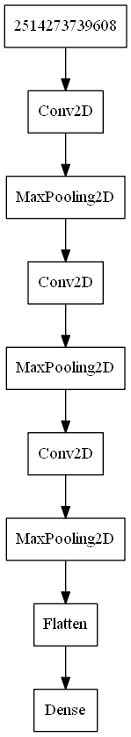
CNN MODEL

Slide 9
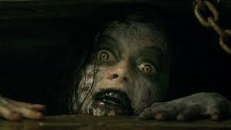
RESULTS
Evil Dead - horror
Predicted as a horror with 0.35 probability

Slide 10
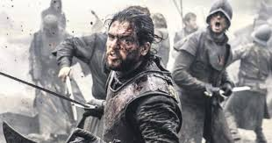
RESULTS
Game of Thrones - fantasy(scify), war, drama
Predicted as a war with 0.85 probability

Slide 11
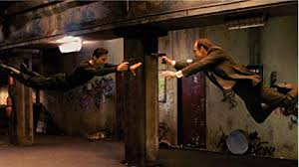
RESULTS
The Matrix - fantasy(scify)
Predicted as a western with 0.85 probability

Slide 12
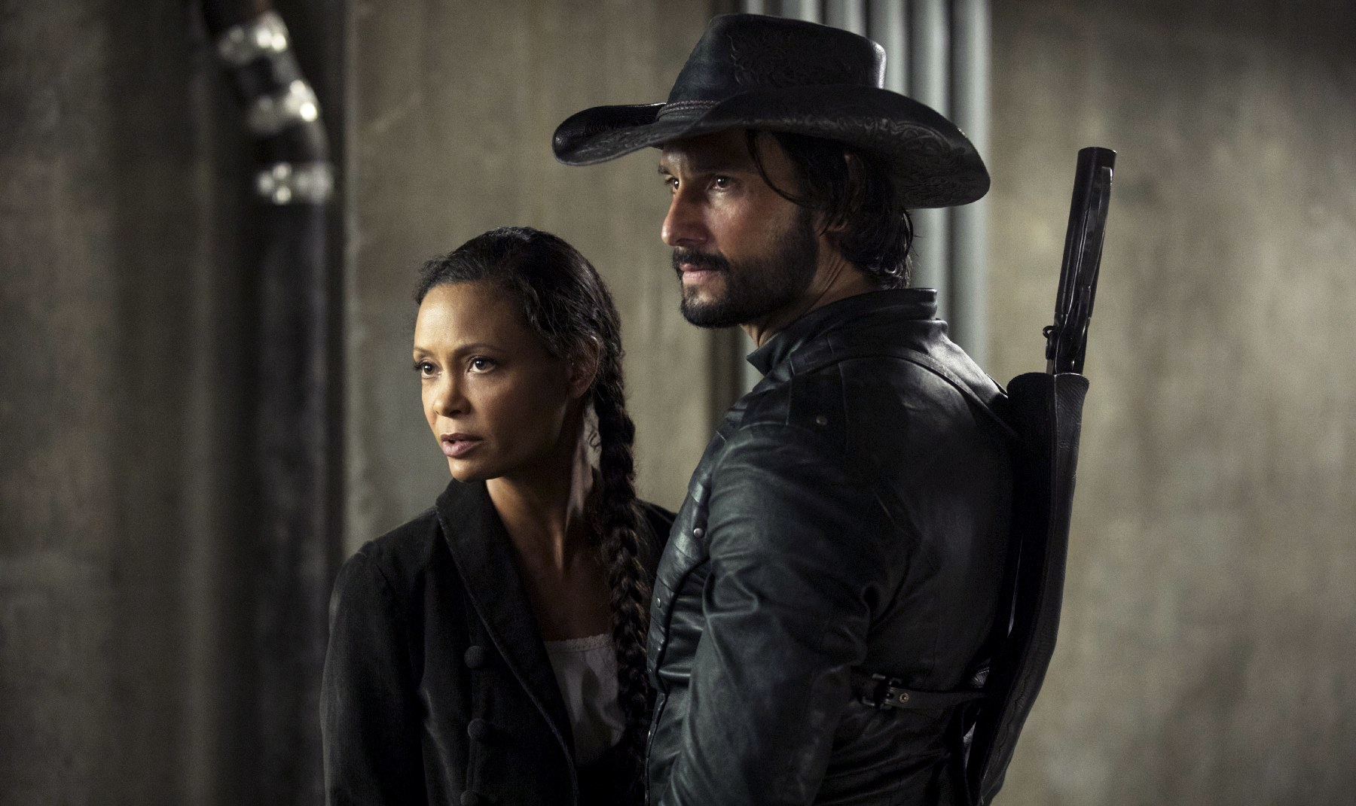
RESULTS
WestWorld - fantasy(scify), western
Predicted as a western with 0.68 probability

Slide 13
HOW CAN WE IMPROVE THE MODEL?
Labels based on scene
More data
More CHARACTESISTIC data
More preprocessing
Model can be improved vai more computational power ☹

Slide 14
THANKS TO…
Our trainer Şükrü Bezen
Kodluyoruz Crew
METU
And you all of course…

Slide 15
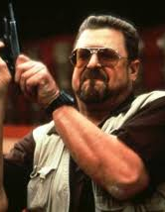


QUESTIONS???
Feel free to contact us…
Canberk Akbay:
/akbayc /akbayc
Meliha Özdemir:
/melihaozd /melihaozd
Pınar Büşra Özkan:
/pinarbusra /pinarbusraozkan

