Slide 1

Water Access & Mortality Prediction
Yasemin Elizabeth Jones – 22069915 Zaki Ghali -- 21069936 Fahrettin Erkin Avcı

Slide 2

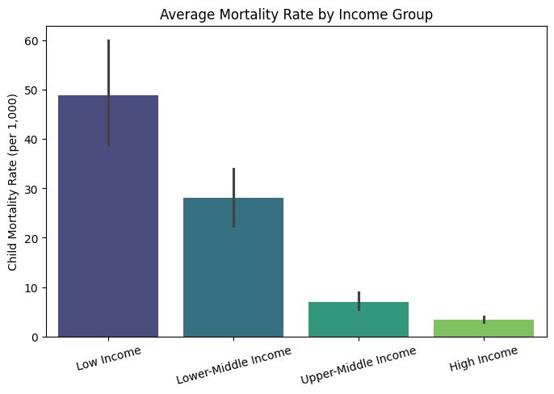

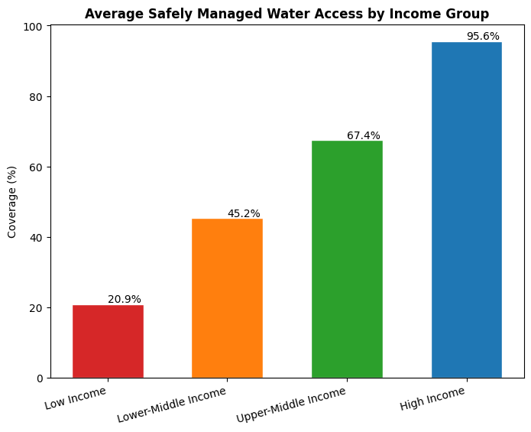
Background
This project investigates the relationship between water access quality and mortality rates across countries
3 datasets merged: WHO/UNICEF JMP water tiers, World Bank Mortality rate attributed to unsafe water & GDP per capita
Access to clean and safely managed water is directly connected to public health. By predicting whether a country has high or low mortality risk, the project can help identify countries where water infrastructure improvements may have the greatest impact.
177 countries | 6 water service levels | 1 mortality target

Slide 3
Objectives
How do water service profiles and GDP influence global mortality risk?
1 ) Binary Classification: Predict High vs. Low mortality
2 ) Regression Extension: Predict the exact continuous mortality rate
3 Feature Importance: Identify which water tier drives mortality risk most
Linked to SDG 3 (Health) and SDG 6 (Clean Water)

Slide 4

SDG Relation
SDG 6: Clean Water & Sanitation
Low-income countries average only 20.9% safely managed water coverage vs. 95.6% in high-income countries
SDG 3: Good Health & Well-Being
Low-income countries: around 50 deaths per 1,000 births | High-income countries: around 4 deaths per 1,000 births
.

Slide 5
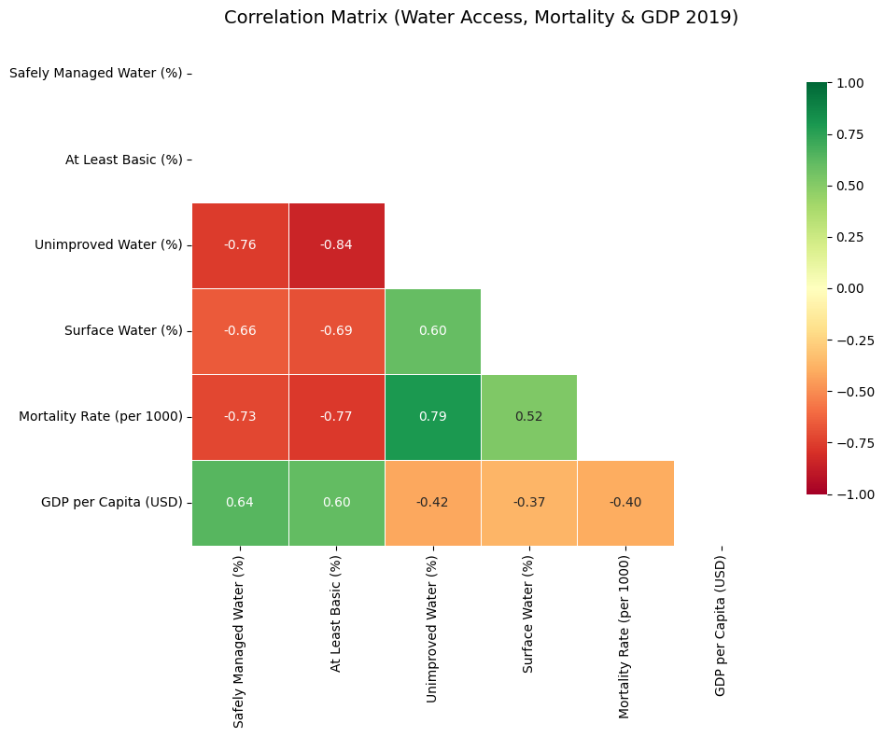
Data
Sources: WHO/UNICEF JMP · World Bank Mortality · World Bank GDP
Income Group: Low / Lower-Middle / Upper-Middle / High
Binary target: High Mortality = 1 if rate > 6.10 (90 low, 87 high)
5 RFE-selected features: Safely Managed, Limited Service, Unimproved, Surface Water, GDP per Capita

Slide 6
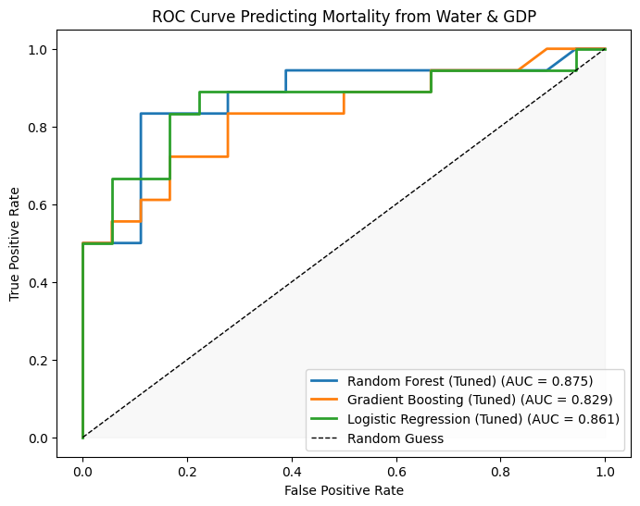
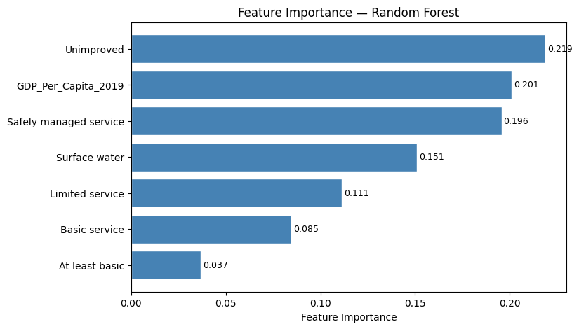
Model Selection and Training/Testing
5 Baseline Classifiers - RFE Feature Selection - GridSearchCV Tuning
Best: Random Forest: 83.3% accuracy, AUC 0.875, CV gap: 0.021 (no overfitting)
Logistic Regression: 77.8% accuracy , AUC 0.861, mild overfit
Gradient Boosting: 75.0% accuracy, AUC 0.829, overfit warning
Regression: RF Regressor R² = 0.64 / RMSE = 12.84 (Linear: R² = 0.59)

Slide 7
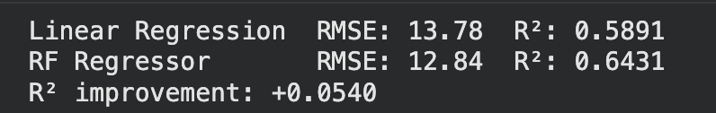
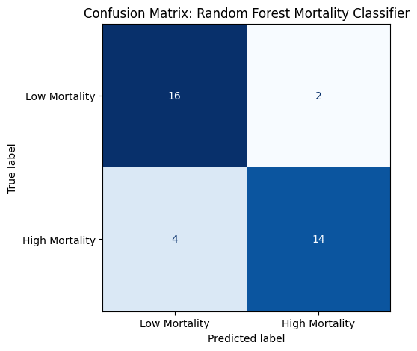
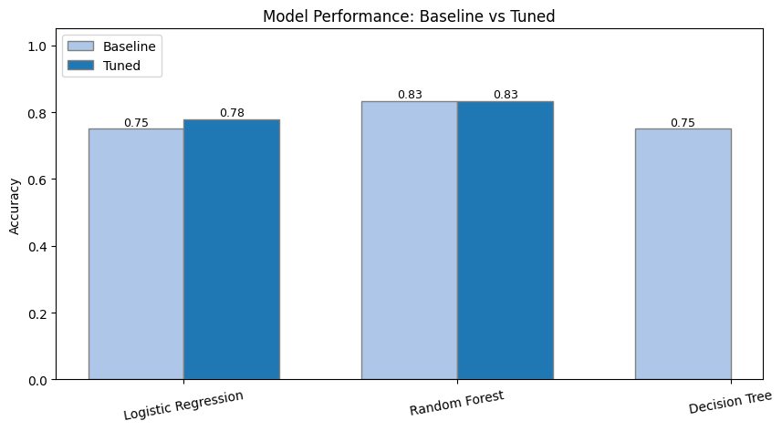
Evaluation Results
Random Forest (Tuned
Accuracy: 83.3% AUC: 0.875 F1: 0.833
Confusion Matrix: 16 TN, 14 TP, 2 FP , 4 FN
4 false negatives = high-mortality countries missed (key public health risk)
Unimproved water access is the strongest single predictor (importance = 0.219)

Slide 8
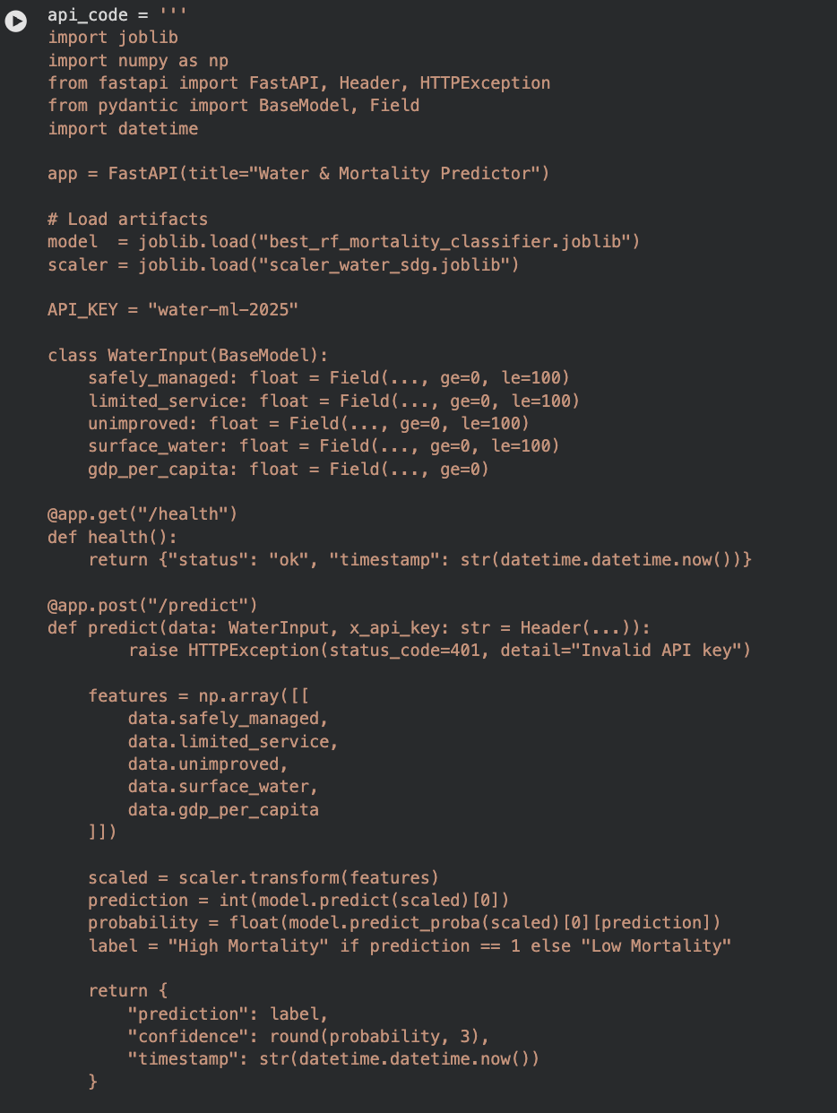
Deployment
FastAPI Endpoint
Two artefacts serialised via joblib: RandomForestClassifier + StandardScaler
Security: API-key authentication (x-api-key) | HTTPS / TLS in production
Validation: All water % inputs range checked 0–100 | HTTP 401 on invalid key
Logging: Prediction count, confidence, auth failures, response time

Slide 9
Thank you!

