Slide 1
Detecting Most Representative Polling Units in Istanbul Local Election
Group 3: City Council
Ahmet Çalışkan 31065
Cem Dereli 30708
Melih Dilbaz 31169

Slide 2
What’s the subject of this project
Since the municipal elections in March 2014, Turkish voters have submitted their votes seven times, including the mayoral election in March 2019. (Esen & Gumuscu, 2019)
There will be local elections in Turkey in March 2024.
Turkish people and politicians are curious about the results of the upcoming elections.
Istanbul is the most populous city in Turkey and it will be the most crucial city in local elections because it is the economic heart of Turkey, generating nearly one third of Turkey’s GDP (Esen & Gumuscu, 2019).

Slide 3
That’s why this project is based on determination of the best neighborhoods
in Istanbul which predict closely the election datas to the overall votes as for
which political party is likely to win in Istanbul.

Slide 4
Purpose

Slide 5
Why ?
Local elections in Turkey occur once every five years and survey companies make guesses of election results before elections.
This project aims to find the most representative polling units in Istanbul elections with previous elections’ data.
It leads survey companies to getting better at predicting results with less effort.
Results of this project is a reference point for people who are curious about the local election results in Istanbul.

Slide 6
Process
Step 1 : 2014 and 2019 local election results for the Istanbul Metropolitan Municipality are extracted from the website of the Supreme Election Council (Yüksek Seçim Kurulu in Turkish) and collected accordingly.
Step 2 : It was decided on what will be pursued during the project. Aftermath, method and the formulas that is to be used to have the neighbourhoods of Istanbul sorted based on a regarding score were discussed.
Step 3 : Having made use of excel and python, related data was manipulated and sorted on a basis that was discussed formerly. Some deficiencies were detected and solutions were found to realize.
Step 4 : The last version of the manipulated data was prepared to utilize through the reporting process.

Slide 7
Method

Slide 8
Use of Excel
Istanbul has 39 districts with more than 900 neighbourhoods. In the website of the Supreme Election Council (YSK), 2014 and 2019 local election results take place separately for each single ballot box that were held in the related district.
It was needed to classify whole data by in which district the data was collected.
It was obtained 39 data files twice for these two years that elections were held.
Excel files for each district have placed the names of the neighbourhoods that the ballot was held.
Files have given the number of registered voter, number of people who voted, whose vote was valid and invalid; additionally the political parties were represented with the number of votes that they were given in the particular ballot.
Some neighbourhood only existed in one particular election year, or has been acknowledged in recent years.
Exceptionally, 2019 local elections were held with alliances that some political parties retreated on behalf of their alliance by suggesting to their supporters to vote for the ally party. These missing parties were put on the file though, and represented with 0 vote in the particular district.

Slide 9
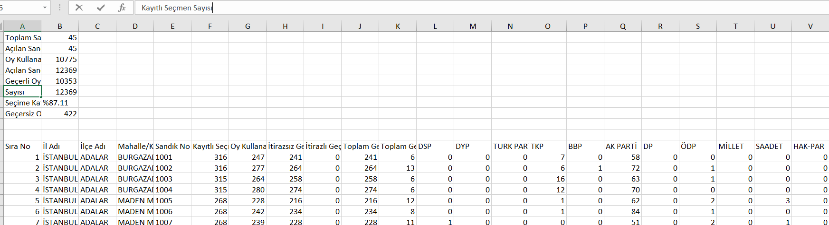
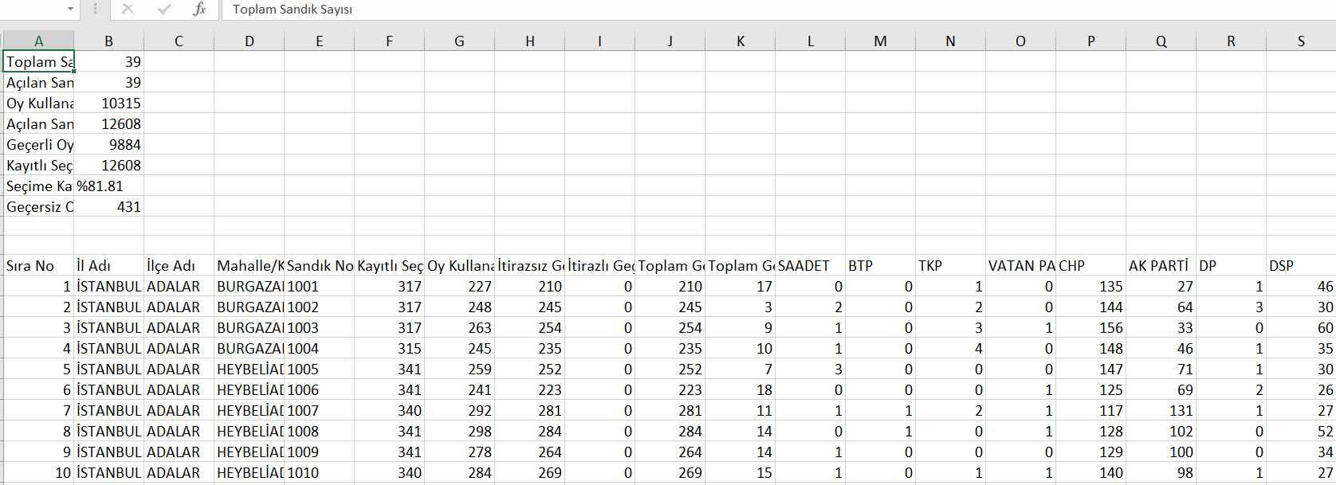
2014
2019

Slide 10
Use of Python
Extracted data was organized with data structure tools and some python libraries like pandas.
The research and data manipulation took place by the automatic run of the program that was coded on purpose.
Neighborhood names were combined with the district name that they located in case a duplicate exists
For 2014 and 2019 local elections, respectively 4 and 5 the most popular political parties were taken into account to formulate the score of their closeness to the general result in Istanbul. It helped to escape from the complexity of the small and ineffective elements to the result and to provide a more robust way to express it by combining all other parties under the title of “OTHERS” (Diğer in Turkish).
Formula was applied onto the whole data set in order to get them sorted as weighted accordingly.

Slide 11
Formulas
We have 2 formulas for this project.
First one based on general percentages of parties,
Second one based on coefficients of parties.

Slide 12
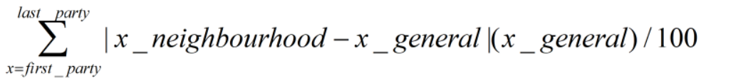
Formula Based on General Percentages

Slide 13
Formula Based on General Percentages
This formula is executed for every political parties in a neighbourhood and summing of the all result is the total score of this neighbourhood.
The formula based on error margin therefore best representative neighbourhood has least score.
x_neighbourhood represents percentage of x party’s votes in the neighbourhood.
x_general represents percentage of x party’s votes in Istanbul.

Slide 14
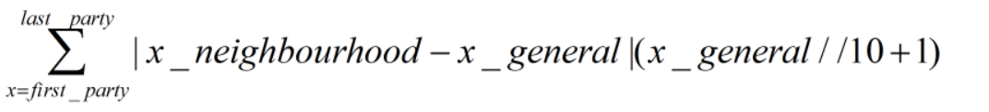
Formula Based on Coefficients

Slide 15
Formula Based on Coefficients
This formula is executed for every political parties in a neighbourhood and summing of the all result is the total score of this neighbourhood.
The formula based on error margin therefore best representative neighbourhood has least score.
x_neighbourhood represents percentage of x party’s votes in the neighbourhood.
x_general represents percentage of x party’s votes in Istanbul.
(x_general // 10 + 1) is coefficient of x party.
For instance, if one party has %47 of all votes in Istanbul, coefficient of that party is 5.

Slide 16
Findings

Slide 17
Sorted Excel Files
For 2014 and 2019 local elections, two separate sorted excel file were obtained as a result of data manipulation.
These two data were combined by summing up their error margin and it is found the most successful neighbourhoods at closely predicting the general election results.
These files were arranged based on the number of votes given to the most popular parties and the score that was gotten from the application of the formula.
Popular parties were represented with the percentage they got over the number of the total valid vote. Along with that, other element that was presented in the file was OTHERS (Diğer in Turkish) which shows the sum of the votes that were given to the political parties that only gained relatively small percentage of the total votes.
In 2014 local elections of Istanbul, the most preferred political parties were AK PARTI, CHP, HDP and MHP.
In 2019 local elections of Istanbul, the most preferred political parties were AK PARTI, CHP, HDP, IYI PARTI and MHP.

Slide 18
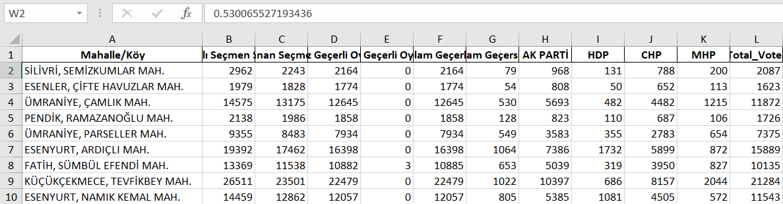
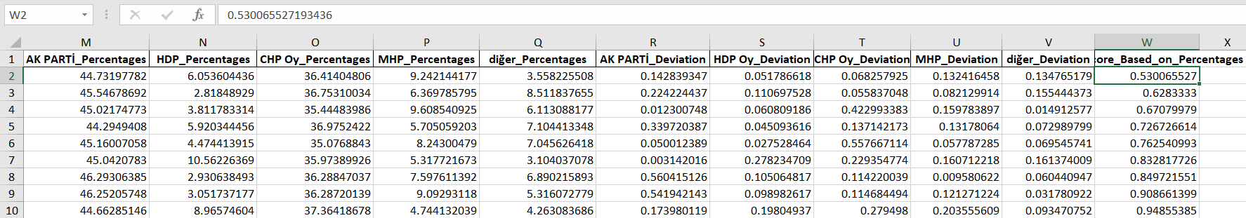
2014

Slide 19
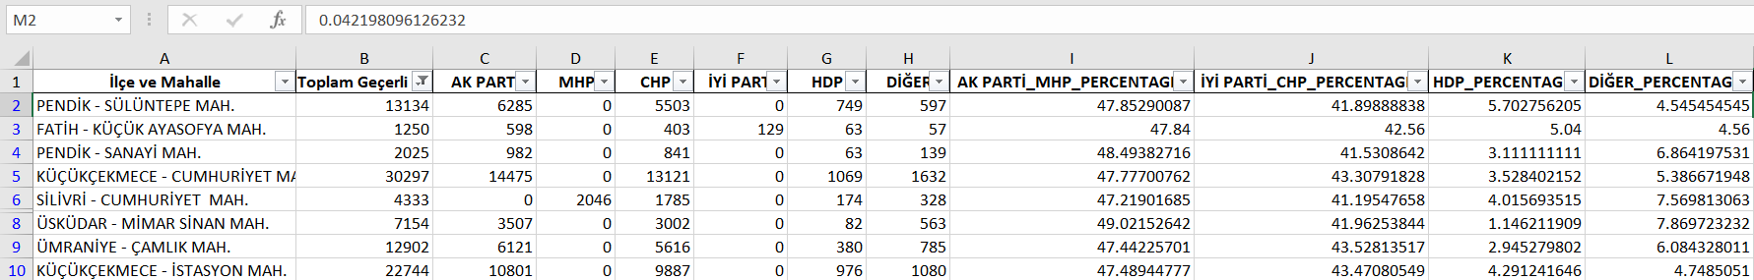
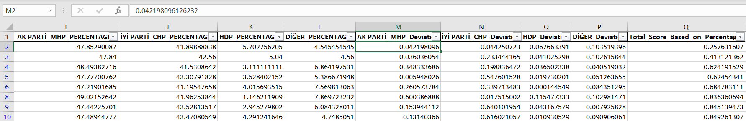
2019

Slide 20
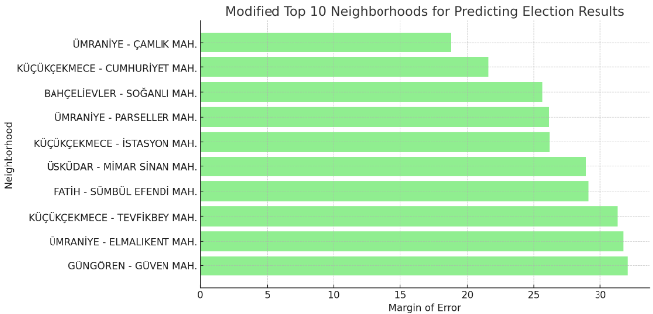
Top 10 Most Successful Neighborhoods
Modified* - only considers the neighborhoods that participated in both elections.

Slide 21
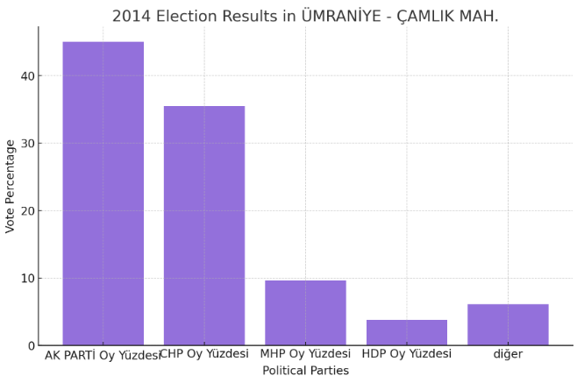
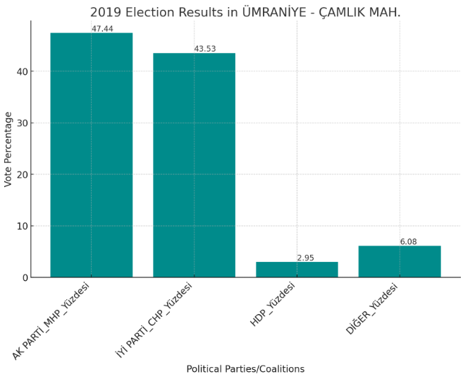
Ümraniye - Çamlık Mah.

Slide 22
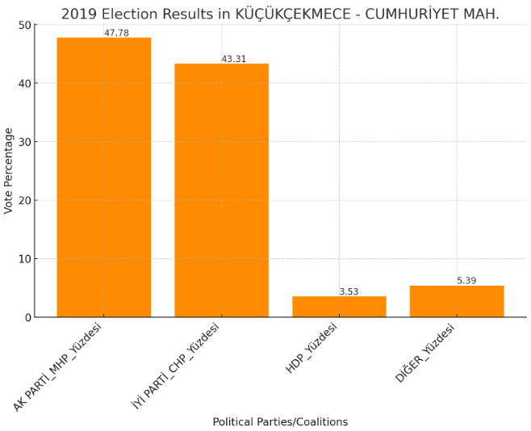
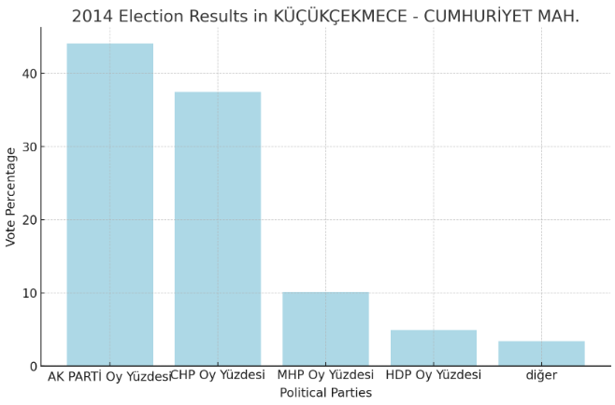
Küçükçekmece - Cumhuriyet Mah.

Slide 23
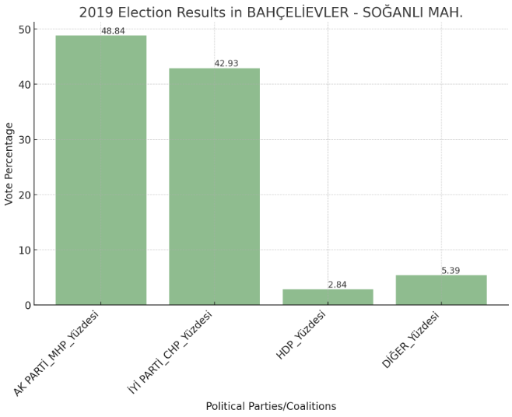
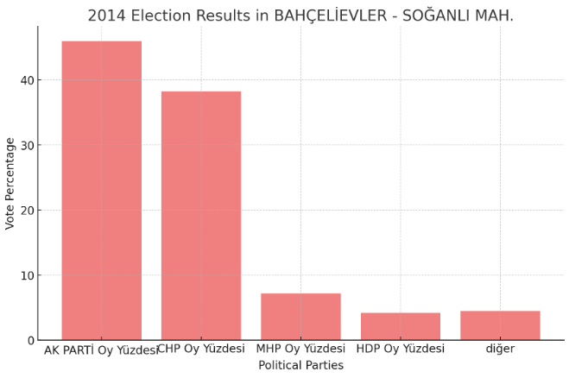
Bahçelievler - Soğanlı Mah.

Slide 24
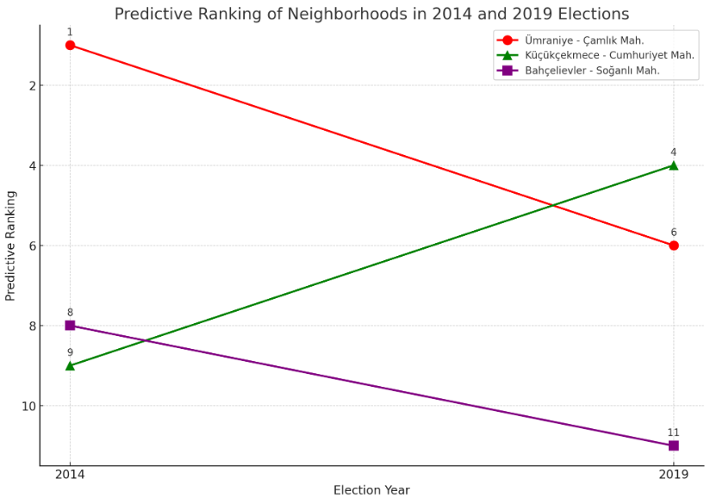

Slide 25
Discussion
The parallel reading of the neighbourhood-based election results in 2014 and 2019 show that the top 10 predicting polling units in this particular year suggest a highly consistent ranking with multiple overlaps. To put it clearly, the best three neighbourhoods of the combined list of these two years take their places also in the regarding years’ sorted lists. It leads one to think this is more than coincidence. Given this overlap, this research seems to succeed the initial motivation.
This analysis highlights the dynamic nature of electoral politics at the neighborhood level. Factors such as demographic changes, local issues, and changes in political views can significantly impact the predictive accuracy of a neighborhood over time. Uptrend in Küçükçekmece – Cumhuriyet Mah. can be an indicator to that this neighborhood should be monitored as an important area in predictive insights for future elections.
In the following periods, it is important to keep track of these neighborhoods to determine if trends are continuing or if new patterns are emerging. Expanding the analysis to include other variables such as socioeconomic status can further explain the driving factors of the forecasting trends.
Notes:
10 top ngh in two years -> overlapping highly -> top three of combined list also in these particular lists
a change occurs during the period between elections -> demographic changes, political views as in the case of küçükçekmece
keep track of these ngh trends continue or if there is a change -> political atmosphere can be fed by this

Slide 26
Some neighbourhoods between the period of these two elections, were either renamed or involved in another place, so that these ones were not included in the last version of the sorted list. Consequently, the combination of the electoral datas from these years has some mismatches with the particular years’ election results.
In order to get a reader-friendly perspective out of the research, some political parties were discarded when they were of mere amount of votes which were not impactful on the general election result. However, it implies that the rate of success that is found by the determined formulas still do not promise such %100 accuracy.
As a further interpretation, it is clear that some districts in Istanbul such as Ümraniye, Küçükçekmece and Pendik have their neighbourhoods taking place more on around the head of the sorted lists. It proves that some districts are likely better options to draw a conclusion at general scale for Istanbul.
This analysis not only helps in understanding past election dynamics but also serves as a valuable tool in predicting future election outcomes, making it one of the vital elements for political analysis and strategy.
Notes:
mismatch -> renamed or involved in smw else
some political parties discarded -> under diğer -> still not a %100 democratic representation
have ngh more on the head of the list -> more suitable to draw a conclusion for ist gnrl
given the overlaps in data of diff years, consistent success of districts having ngh more on the head and the our ability to read change in plt atmsp can leas to forecast the results of election, give a chance to polt parties to come up with more accurate strategy and make new analysis

Slide 27
References
Esen, B., & Gumuscu, S. (2019, July 3). Killing Competitive Authoritarianism Softly: The 2019 Local Elections in Turkey. South European Society and Politics, 24(3), 317–342. https://doi.org/10.1080/13608746.2019.1691318
Sandık Sonuçları ve Tutanaklar. (n.d.). https://sonuc.ysk.gov.tr/sorgu
https://drive.google.com/drive/folders/1ch2gqqcEnHBaRyvAN1gsjsv8Bc_gQ6nJ?usp=drive_link

