Slide 1
Land Mines
Melih Gülbay 20202905013 ACM476.1

Slide 2
Dataset Info
Voltage (V) :Output voltage value of FLC sensor due to magnetic distortion.
High (H): The height of the sensor from the ground.
Soil Type (S):6 different soil types depending on the moisture condition.
Mine Type (M): Mine types commonly encountered on land. 5 different mine classes.
Voltage is between [0V, 10.6V]
High(H) is between [0 cm, 20cm]
Soil Types: 0- Dry and Sandy 0,2- Dry and humus 0,4- Dry and Limy 0,6- Humid and Sandy 0,8- Humid and Humus 1- Humid and Limy
Mine Type (M): 1- Null 2- Anti-Tank 3- Anti-Personnel 4- Booby Trapped Anti-personnel 5- M14 Anti-personnel

Slide 3
Example Dataset(From 338 Instance)
V H S M
0,256284 | 0,818182 | 0,6 | 1
0,235649 | 1 | 0,6 | 1
0,315347 | 0 | 0,2 | 1
0,283988 | 0,181818 | 0,2 | 1
0,303262 | 0,272727 | 0,2 | 1

Slide 4
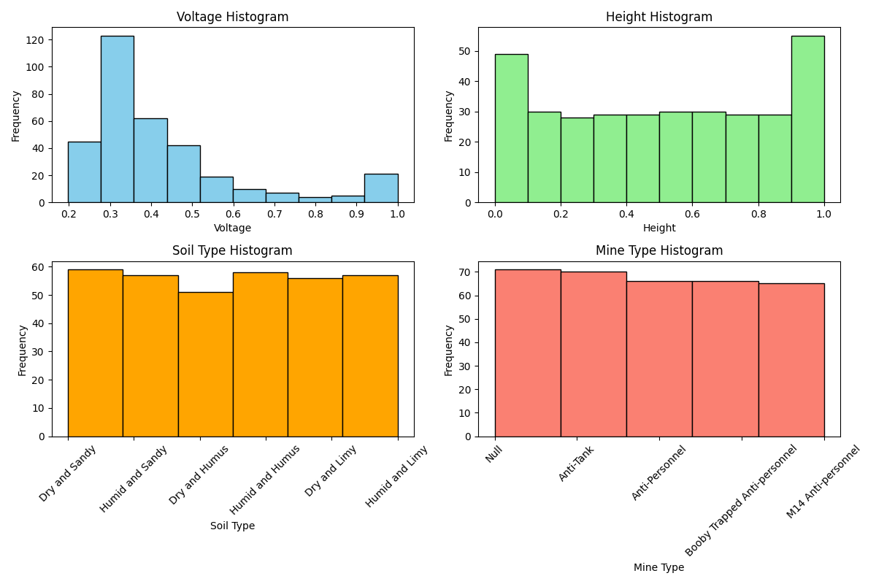
Histogram of Dataset

Slide 5
Descriptive Statistics for Features
V H S
count 338.000000 338.000000 338.000000
mean 0.430634 0.508876 0.503550
std 0.195819 0.306043 0.344244
min 0.197734 0.000000 0.000000
25% 0.309737 0.272727 0.200000
50% 0.359516 0.545455 0.600000
75% 0.482628 0.727273 0.800000
max 0.999999 1.000000 1.000000

Slide 6
Descriptive Statistics for Features
The standard deviation for the 'S' column (approximately 0.34) is larger compared to the 'V' and 'H' columns (0.20 and 0.31, respectively). This suggests that the values in the 'S' column are more spread out compared to the 'V' and 'H' columns.
In the 'S' column, the median value is approximately 0.6. This means that 50% of the data points in this column are less than or equal to 0.6.
In the 'V' column, if the maximum value is much larger than the 75th percentile, it suggests the presence of outliers at the upper end of the distribution.

Slide 7
Descriptive Statistics for Target Variable
M
count 338.000000
mean 2.952663
std 1.419703
min 1.000000
25% 2.000000
50% 3.000000
75% 4.000000
max 5.000000

Slide 8
Descriptive Statistics for Target Variable
The mean mine type is approximately 2.953. Since mine types are discrete values (1 to 5), this mean might not have direct interpretive significance like continuous variables. However, it gives a central tendency measure, suggesting that, on average, the observed mine types tend to be around 3.

Slide 9
What Dataset Offers ?
The paper proposes a solution to the limitations of passive mine detectors by introducing a new approach based on artificial intelligence and utilizing magnetic anomaly, measurement height, and soil type data. The experimental setup validates this approach, achieving a high success rate of 98.2% in detecting mines.
Notably, the developed model not only detects mines effectively but also classifies five different types of mines with an 85.8% success rate, marking a significant contribution to the literature.
This innovative method demonstrates the viability and success of passive mine detection, offering a promising alternative to active detectors while mitigating the risk of triggering mine explosions.

Slide 10
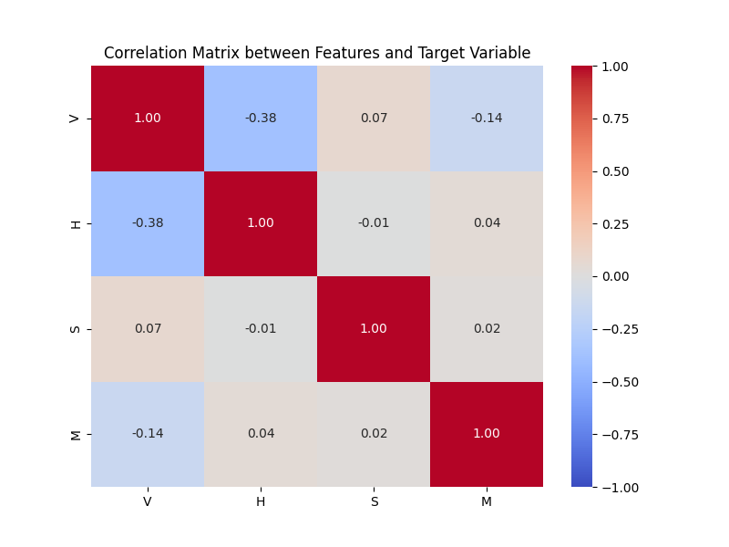
Correlation Matrix

Slide 11
Correlation Matrix
In summary, based on the correlation analysis:
Voltage (V) shows a weak negative correlation with Mine Type (M).
High (H) and Soil Type (S) have very weak correlations with Mine Type (M), indicating almost no linear relationship.
Voltage seems to have the most notable association with Mine Type, though it's still relatively weak.

Slide 12
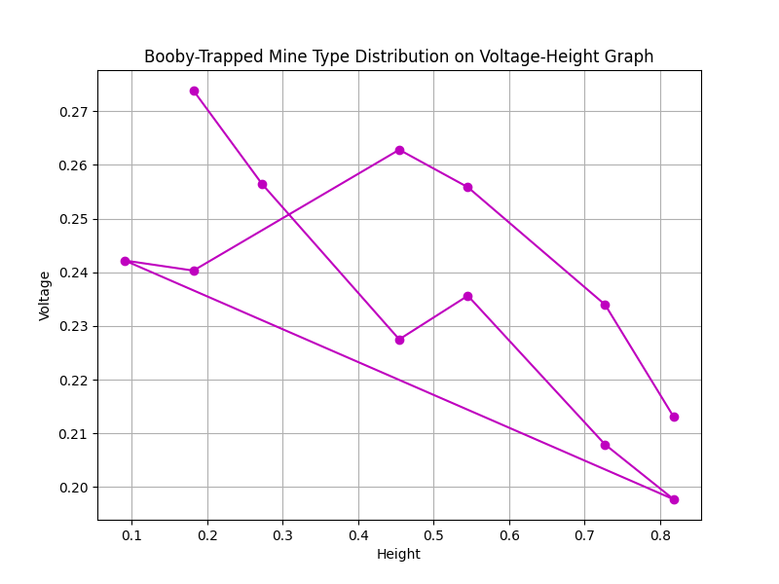
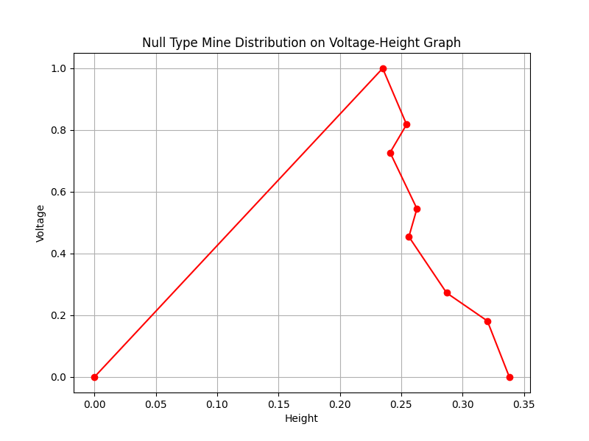
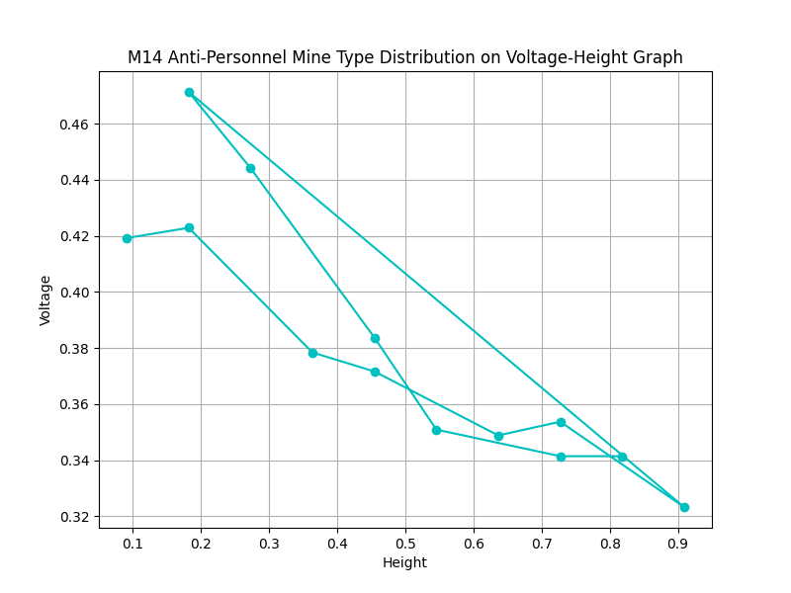
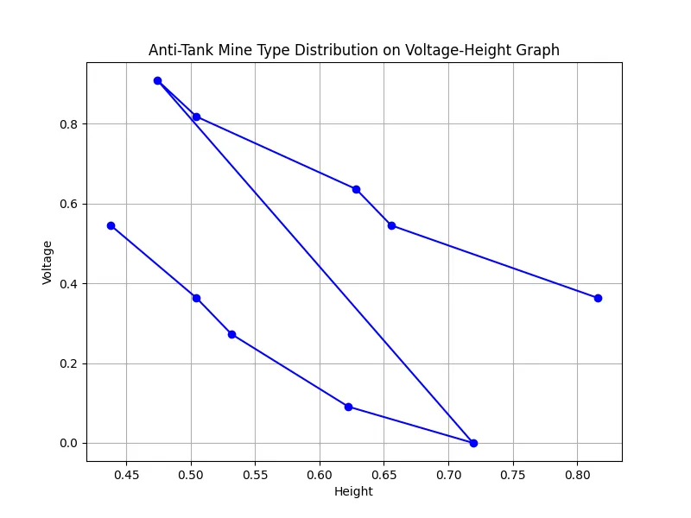
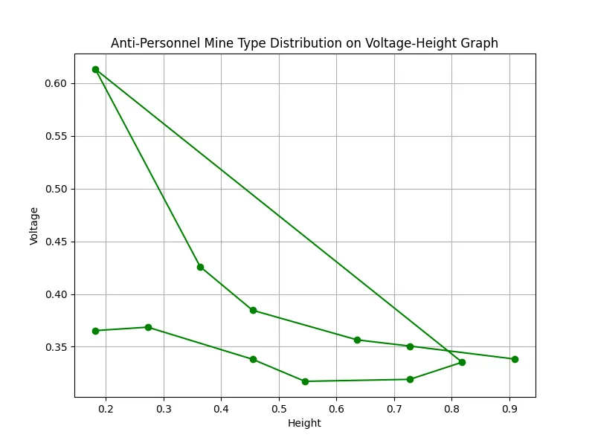
Mines Distributed on V-H Graph

Slide 13
Mines Distributed on V-H Graph
As shown in the graphs the height of the mine sensor from ground has also effected the voltage(the magnetic anomaly detected by mine detectors).
It also shows its not possible to spot which type of mine is under the ground since voltage is also affected by height.

Slide 14
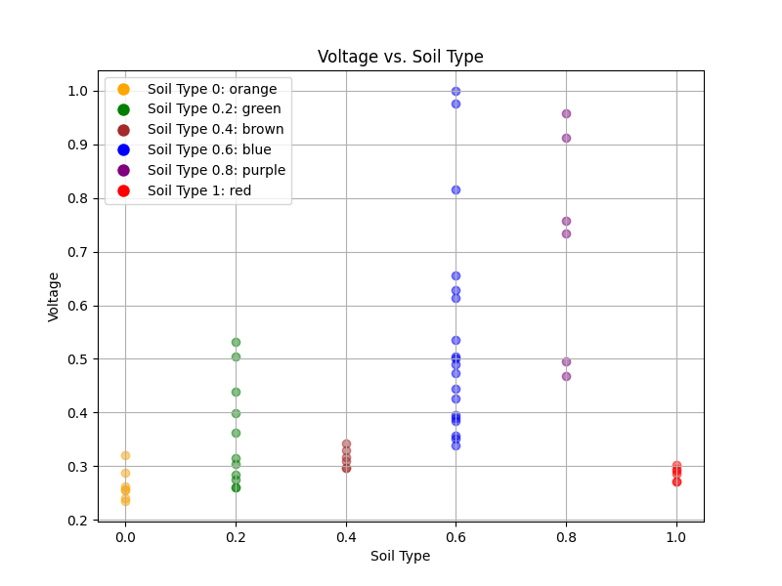
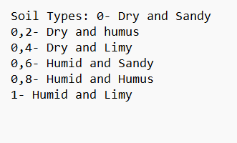
Effect of soil type (S) on magnetic anomalies(V)

Slide 15
Effect of soil type (S) on magnetic anomalies(V)
As seen in the graphs magnetic anomaly is also effected by soil type.
Therefore only using soil type and voltage graphic is not enough to calculate which type of mine is buried underground.

Slide 16
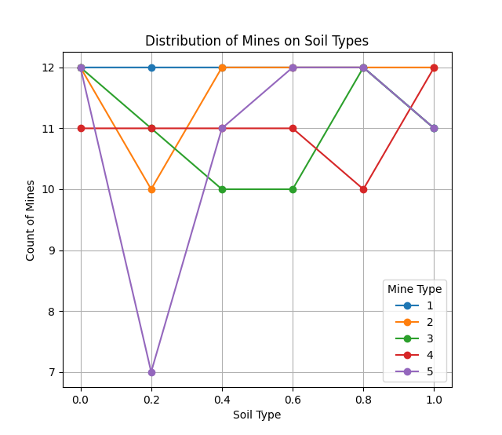
Soil Type and Mine Type Correlation

Slide 17
Soil Type and Mine Type Correlation
According to given dataset which type of mine planted on soil types dont have any meaning since mines are not affected by soil types.
However we can understand M14 Anti-personnel are less common in Dry and humus soil types.

Slide 18
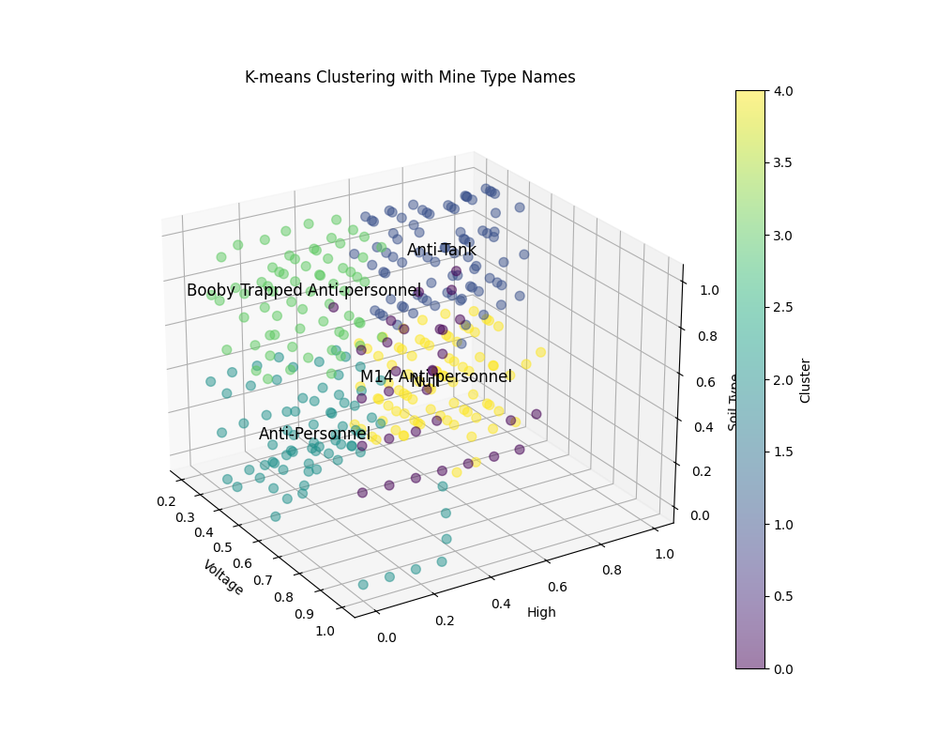
Clustering Mines on V-H-S Graph(3D)

Slide 19
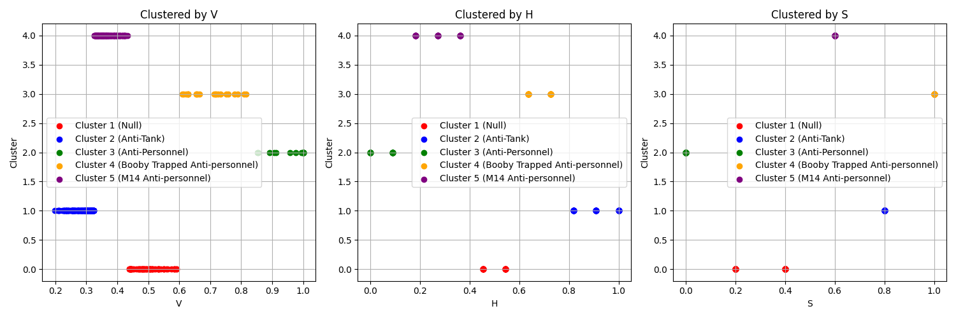
Clustering Mines by V-H-S

Slide 20
Clustering Mines by V
Cluster 1 (Null): Appears at a lower voltage range.
Cluster 2 (Anti-Tank): Distinct lower voltage values.
Cluster 3 (Anti-Personnel): Higher than Cluster 1 but lower than others.
Cluster 4 (Booby Trapped Anti-personnel): Intermediate voltage values.
Cluster 5 (M14 Anti-personnel): Highest voltage range.

Slide 21
Clustering Mines by H
Cluster 1 (Null): Lower height values.
Cluster 2 (Anti-Tank): Intermediate height values.
Cluster 3 (Anti-Personnel): Higher height values.
Cluster 4 (Booby Trapped Anti-personnel): Intermediate height values.
Cluster 5 (M14 Anti-personnel): Higher height values

Slide 22
Clustering Mines by S
Cluster 1 (Null): Lower soil type values.
Cluster 2 (Anti-Tank): Higher soil type values.
Cluster 3 (Anti-Personnel): Intermediate soil type values.
Cluster 4 (Booby Trapped Anti-personnel): Higher soil type values.
Cluster 5 (M14 Anti-personnel): Highest soil type values.

Slide 23
Conclusion Of V-S-H on Detecting Mines
Upon analysis, it becomes evident that magnetic anomalies vary based on the mine type, measurement altitude, and soil composition. Thus, relying solely on magnetic anomaly data for the development of a passive mine detector may prove inadequate or even flawed.
To date, attributing the shortcomings of passive mine detectors solely to this factor may not accurately address the underlying issue.

Slide 24
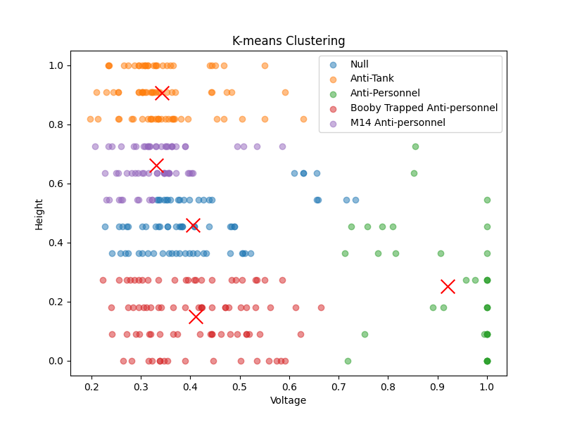
Clustering Mines on V-H Graph

Slide 25
Using V-H Cluster to Spot Mine Types
As seen in the graph detecting mine types according to Voltage-Height is mostly possible.
For example Anti-Tank mines are giving higher magnetic anomaly since they are planted closer to surface. While booby-trapped anti-personnel mines are harder to detect since they are more deep underground.

Slide 26
Logistic Regression For Mine Types(V-H-S)
Accuracy: 0.36764705882352944
Classification Report:
precision recall f1-score support
1 0.26 0.91 0.41 11
2 0.71 1.00 0.83 12
3 0.50 0.12 0.20 16
4 0.00 0.00 0.00 11
5 0.25 0.06 0.09 18
accuracy 0.37 68
macro avg 0.34 0.42 0.31 68
weighted avg 0.35 0.37 0.28 68

Slide 27
Logistic Regression For Mine Types(V-H)
Accuracy: 0.36764705882352944
Classification Report:
precision recall f1-score support
1 0.28 1.00 0.44 11
2 0.80 1.00 0.89 12
3 0.17 0.06 0.09 16
4 0.12 0.09 0.11 11
5 0.00 0.00 0.00 18
accuracy 0.37 68
macro avg 0.27 0.43 0.31 68
weighted avg 0.25 0.37 0.27 68

Slide 28
Logistic Regression For Mine Types(V)
V
Accuracy: 0.38235294117647056
Classification Report:
precision recall f1-score support
1 0.28 1.00 0.43 11
2 0.55 1.00 0.71 12
3 0.33 0.06 0.11 16
4 0.67 0.18 0.29 11
5 0.00 0.00 0.00 18
accuracy 0.38 68
macro avg 0.36 0.45 0.31 68
weighted avg 0.33 0.38 0.27 68

Slide 29
Conclusion of Logistic Regression Analysis
V-H-S (Voltage - Height - Soil Types):
This model achieved relatively low accuracy and precision, especially for mine types 1, 4, and 5. It struggled to correctly identify mine type 4 and had limited success with mine types 1 and 5.
V-H (Voltage - Height):
Insights: This model performed better in terms of precision for mine types 1 and 2 compared to the V-H-S model, but it still struggled with mine types 3, 4, and 5.
V (Voltage):
The model performed similarly to the V-H model but achieved slightly higher precision for mine type 4. However, it still struggled with mine types 1 and 5.

Slide 30
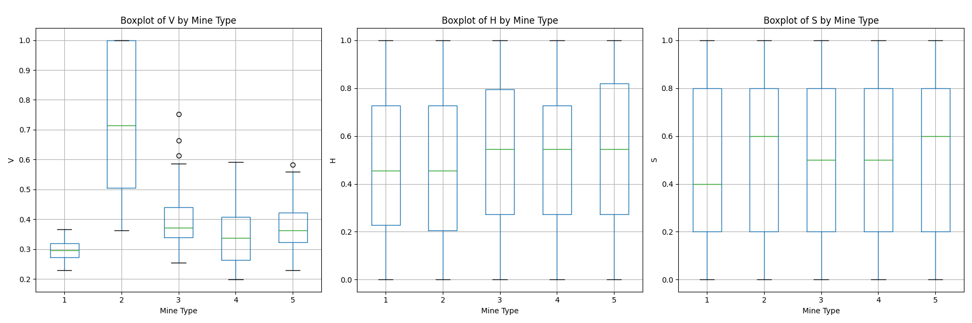
Boxplot Analysis

Slide 31
Boxplot of V by Mine Type
Mine Type 1: The voltage (V) has a relatively small range, with values centered around 0.3.
Mine Type 2: Voltage has a wide range, with values spanning from about 0.3 to 1.0. This indicates significant variability in voltage for this mine type.
Mine Type 3: Voltage is generally lower, with the middle 50% (interquartile range) around 0.4. There are a few outliers around 0.7.
Mine Type 4: Voltage shows a moderate range, with values generally around 0.4.
Mine Type 5: Voltage is also moderate, with values mostly between 0.4 and 0.7, and some outliers near 0.6.

Slide 32
Boxplot of H by Mine Type
All Mine Types: The high (H) feature has a large range for all mine types, spanning from 0 to 1. The interquartile ranges are similar across all mine types, centered around 0.5.
Mine Type 1, 2, 3, 4, 5: The distributions of the high (H) feature are very similar, with no significant differences between mine types. Each has a similar range and median value.

Slide 33
Boxplot of S by Mine Type
All Mine Types: The soil type (S) feature also has a large range from 0 to 1 for all mine types. The interquartile ranges are similar, centered around 0.5.
Mine Type 1, 2, 3, 4, 5: Similar to the H feature, the distributions of the soil type (S) feature are very consistent across all mine types. Each mine type has similar ranges and median values.

Slide 34
Conclusion of Boxplot Analysis
The voltage (V) might be a more critical feature for distinguishing between mine types, given its variability.
The high (H) and soil type (S) features show consistent distributions across all mine types, suggesting they may be less informative for classification purposes.

Slide 35
Confusion Matrixes
Used for mine classification models:
(60% training, 20% validation, 20% testing)
V-H-S
V-H
V-S
V

Slide 36
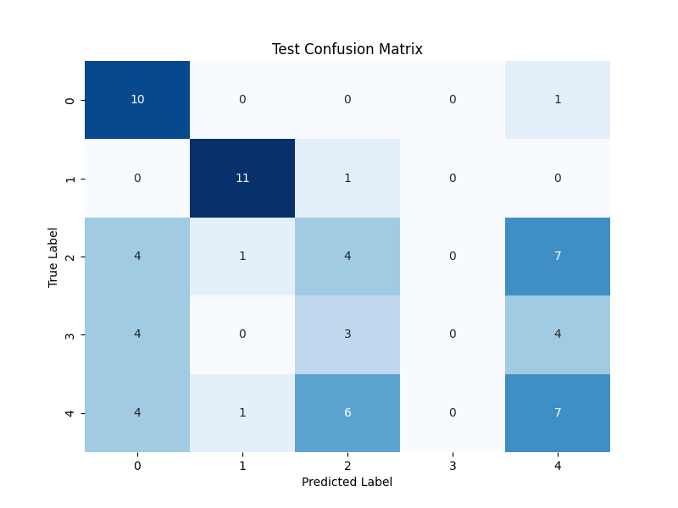
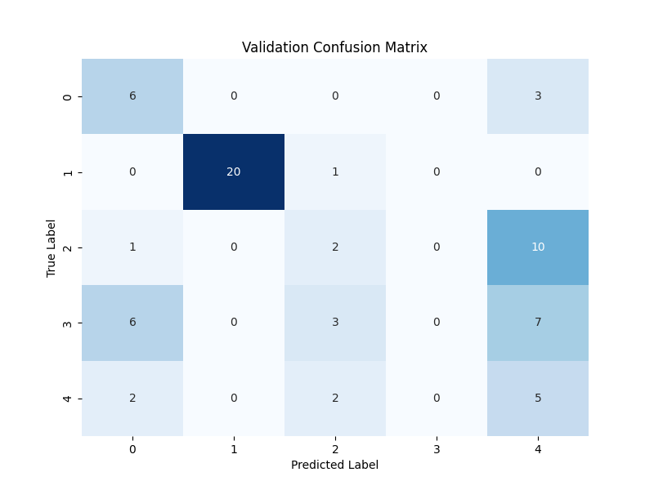
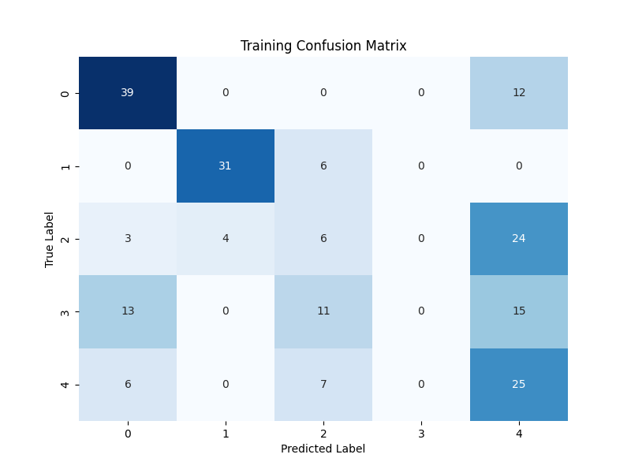
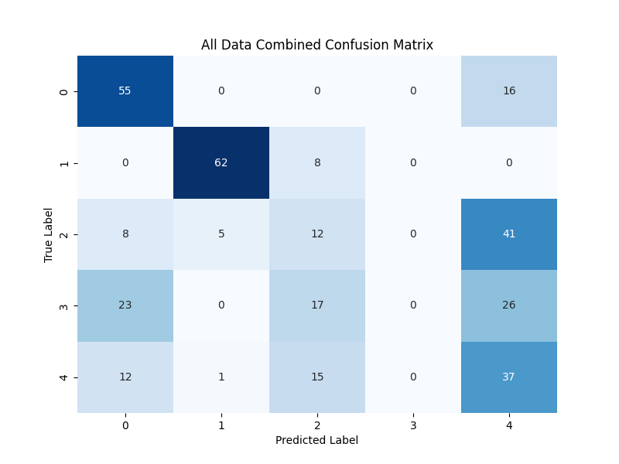
V-H-S

Slide 37
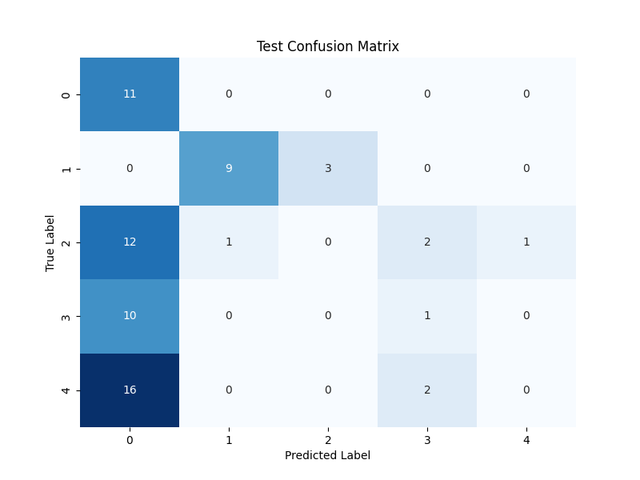
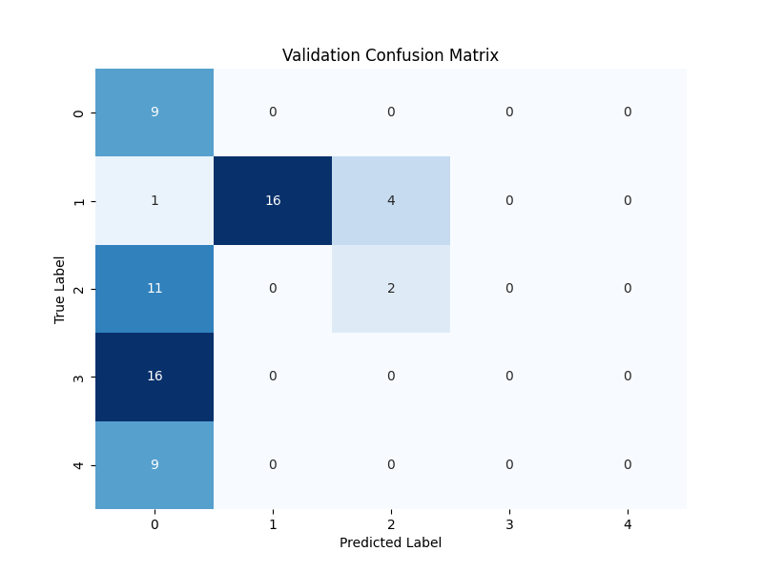
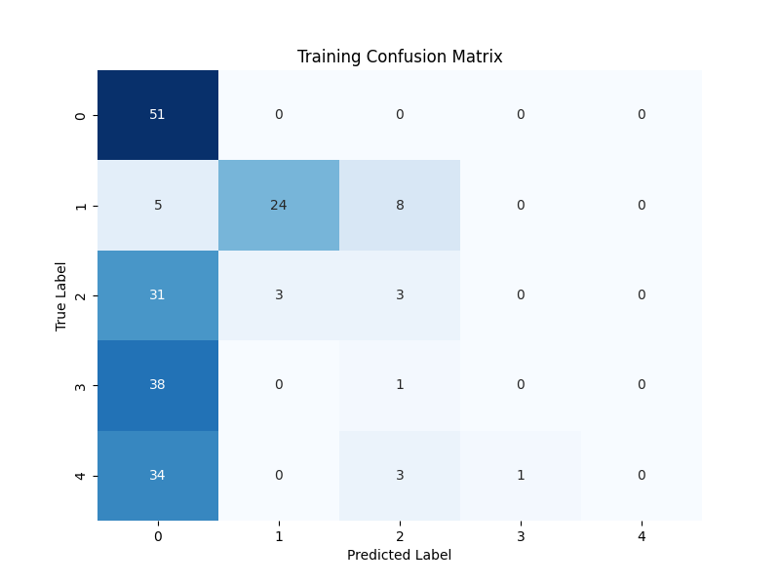
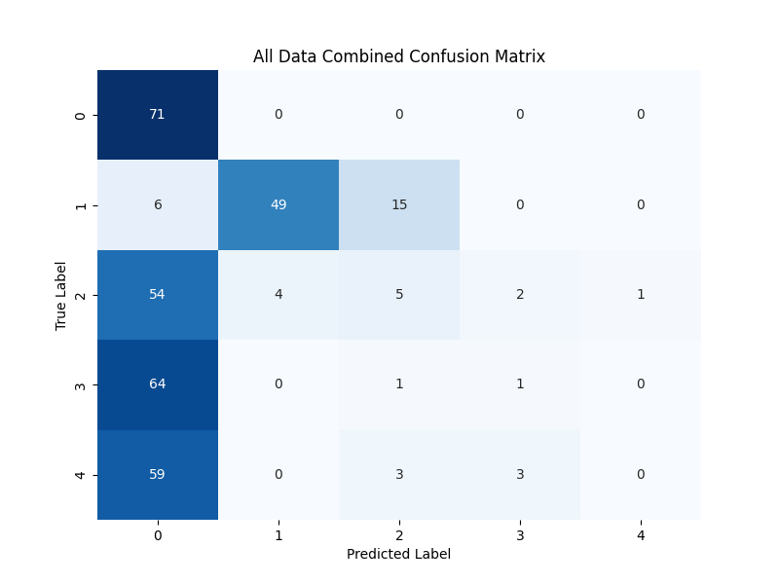
V-H

Slide 38
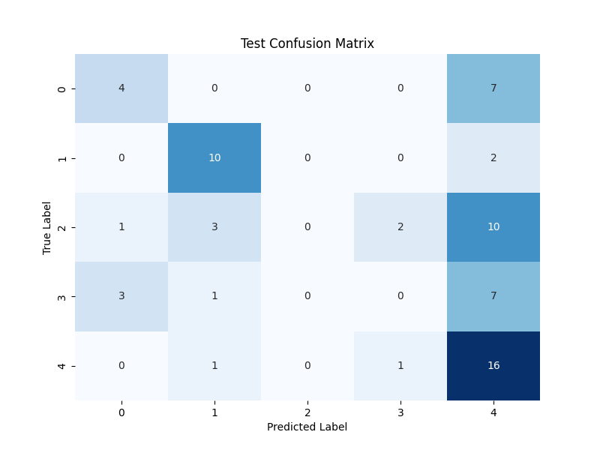
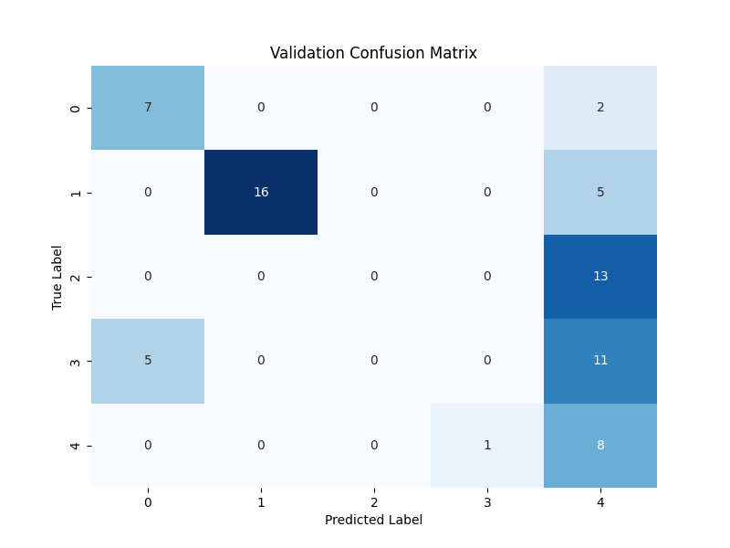
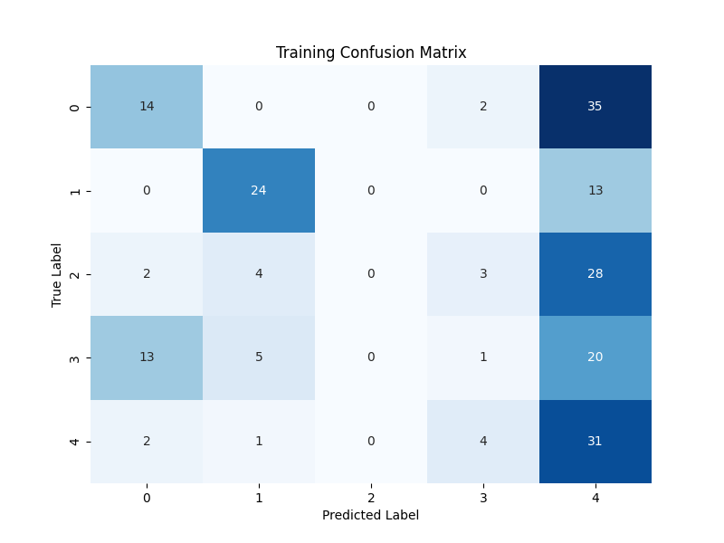
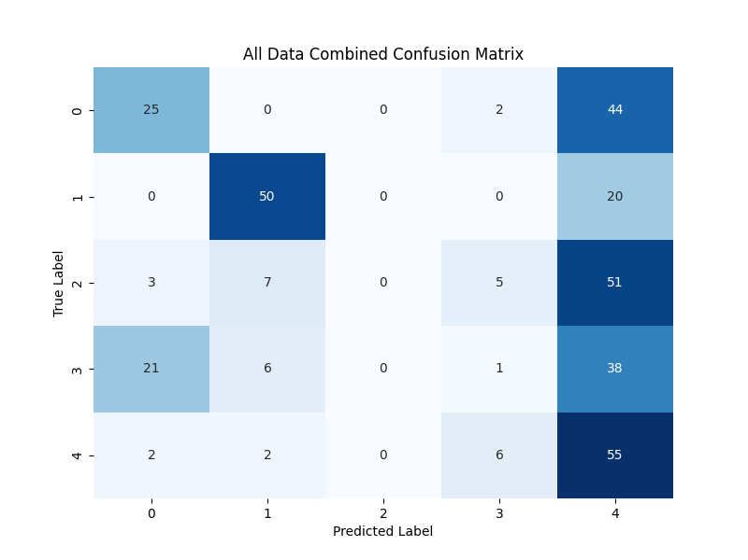
V-S

Slide 39
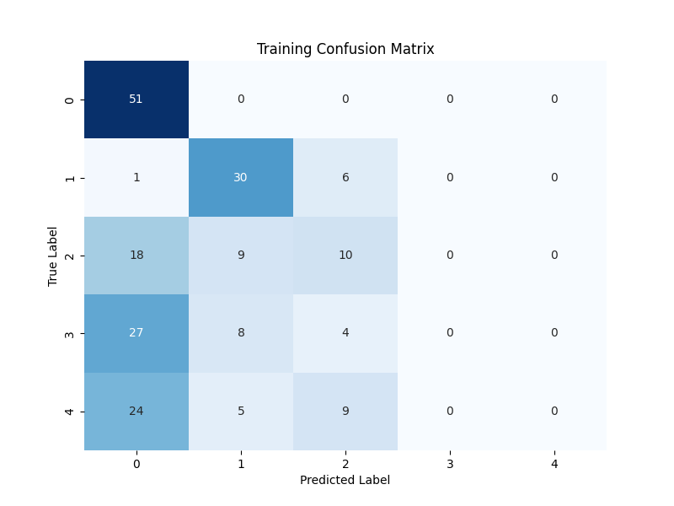
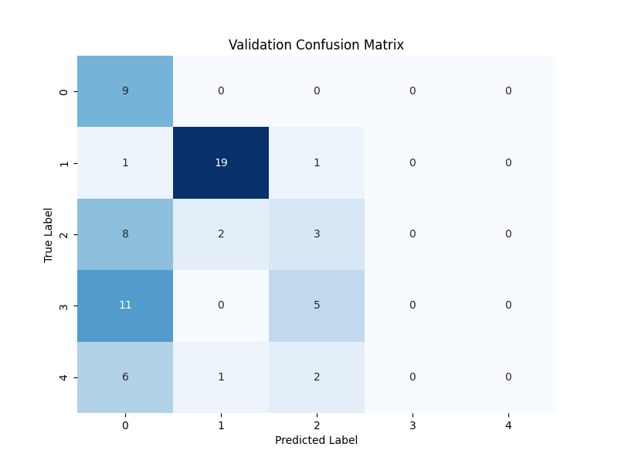
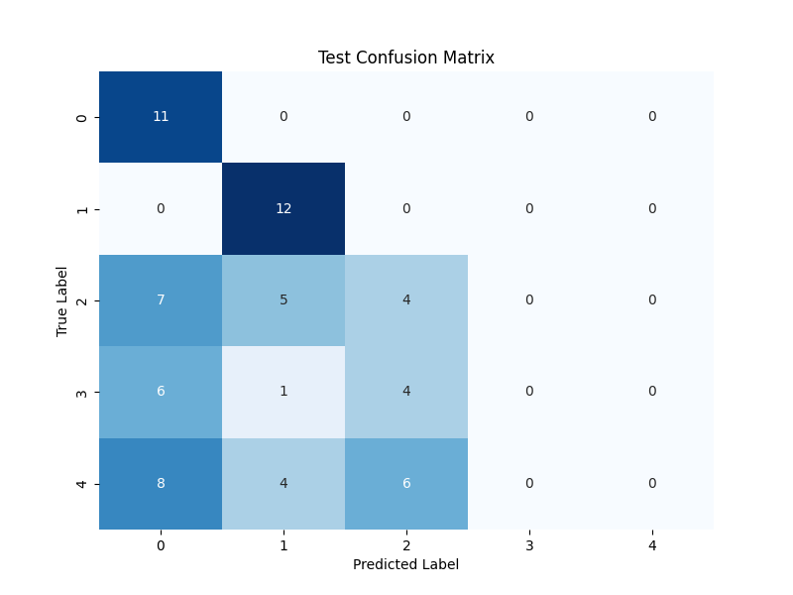
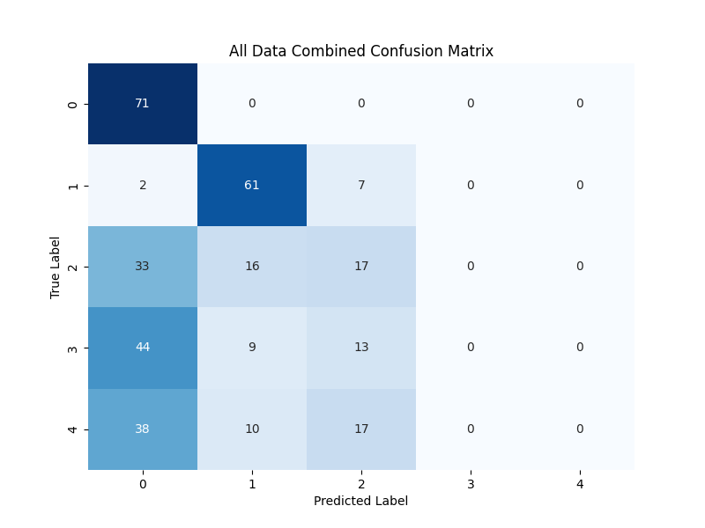
V

Slide 40
Confusion Matrixes
V-H-S:
Training Confusion Matrix:
Strongly predicts class 1 and class 5.
Has some confusion between class 2 and class 3.
Validation Confusion Matrix:
Predictions are less certain, with more confusion across all classes compared to training.
Test Confusion Matrix:
Similar confusion pattern to validation, indicating generalization.
All Data Combined Confusion Matrix:
Similar trends to training, validation, and test, suggesting consistency across datasets.

Slide 41
Confusion Matrixes
V-H:
Training Confusion Matrix:
Predicts class 1 with high accuracy but struggles with class 2 and class 3.
Validation Confusion Matrix:
High accuracy for class 1 but significant confusion in other classes.
Test Confusion Matrix:
Similar trends as validation, indicating consistent performance.
All Data Combined Confusion Matrix:
Similar patterns as seen in training and validation, indicating consistency.

Slide 42
Confusion Matrixes
V-S:
Training Confusion Matrix:
Struggles with class 1 and class 5, more uncertainty compared to other subsets.
Validation Confusion Matrix:
Predictions are less certain, with more confusion across all classes compared to training.
Test Confusion Matrix:
Similar confusion pattern to validation, indicating generalization.
All Data Combined Confusion Matrix:
Similar trends to training, validation, and test, suggesting consistency across datasets.

Slide 43
Confusion Matrixes
V:
Training Confusion Matrix:
High accuracy for class 1, but significant confusion in other classes.
Validation Confusion Matrix:
Similar trends as training, with high accuracy for class 1 but confusion in other classes.
Test Confusion Matrix:
Similar patterns as validation, indicating consistent performance.
All Data Combined Confusion Matrix:
Similar patterns as seen in training and validation, indicating consistency.

Slide 44
Feature Selection 1
Spearman Correlation:
V 0.057714
H 0.040802
S 0.017362
The Spearman correlation coefficient measures the strength and direction of association between two ranked variables.
The highest correlation is with the 'V' (Voltage) feature, but the correlation coefficients are quite low overall.

Slide 45
Feature Selection 2
Mutual Information:
V H S
[0.48759971 0. 0. ]
Mutual information measures the amount of information obtained about one variable through the other variable.
'V' (Voltage) has the highest mutual information.

Slide 46
Feature Selection 3
ANOVA F-values:
V H S
[1.30388619e+02, 2.60859955e-01, 5.05428644e-02]
ANOVA (Analysis of Variance) F-values are used to test if there are significant differences between the means of multiple groups.
Higher F-values indicate that the means of the groups (in this case, different mine types) are significantly different for that feature.
'V' (Voltage) has the highest ANOVA F-value.

Slide 47
Feature Selection 4
Chi-Square Test:
V H S
[18.31432907, 0.19375308, 0.04812058]
The chi-square test is used to determine if there is a significant association between two categorical variables.
Higher chi-square values indicate a stronger association between the feature and the target variable.
Here, 'V' (Voltage) again has the highest chi-square value.

Slide 48
Principal Component Analysis (PCA)
pc1 and pc2: These are the first and second principal components, capturing the most variance in the data.
M: This is the original target variable, representing mine types (values from 1 to 5).
pc1 pc2 M
0 0.613841 1.737952 1
1 0.136260 1.627007 1
2 -0.190161 1.569437 1
3 -0.713983 1.457385 1
4 -0.896770 1.403252 1
[0.4617988 0.33249468]

Slide 49
Principal Component Analysis (PCA)
0.4617988: The first principal component (pc1) accounts for about 46.18% of the total variance.
0.33249468: The second principal component (pc2) accounts for about 33.25% of the total variance.
Combined Variance: Together, pc1 and pc2 account for about 79.43% of the total variance in the dataset.
The transformed data (pc1 and pc2) captures most of the variance from the original features (V, H, S).

Slide 50
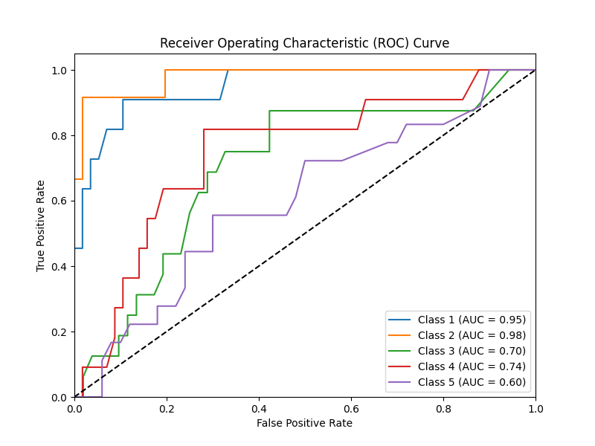
AUC-ROC Curve

Slide 51
AUC-ROC Curve
Class 1 (Null): AUC = 0.95High AUC indicates strong classifier performance.Effective in distinguishing "Null" class from others.
Class 2 (Anti-Tank): AUC = 0.98Very high AUC suggests excellent classifier performance.Strong ability to differentiate "Anti-Tank" class.
Class 3 (Anti-Personnel): AUC = 0.70Lower AUC compared to previous classes.Classifier's performance in distinguishing "Anti-Personnel" is moderate.
Class 4 (Booby Trapped Anti-personnel): AUC = 0.74AUC indicates relatively good classifier performance.Fair ability to identify "Booby Trapped Anti-personnel".
Class 5 (M14 Anti-personnel): AUC = 0.60Lowest AUC among all classes.Classifier's performance in distinguishing "M14 Anti-personnel" is weaker compared to others.

Slide 52
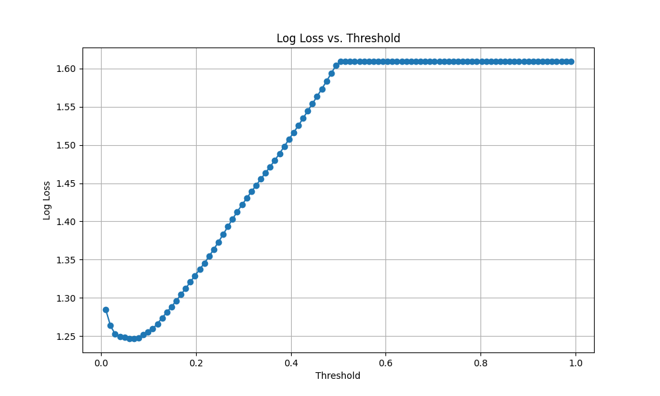
Log Loss

Slide 53
Log Loss
Optimal Threshold: The plot helps in identifying the threshold that minimizes the log loss. In this plot, it seems that the log loss is minimized at a threshold near 0.05.
Threshold Sensitivity: The log loss increases sharply as the threshold increases beyond a certain point (around 0.15 in this case). This indicates that the classifier's performance (in terms of log loss) is very sensitive to the choice of threshold.
Log Loss Behavior: Initially, the log loss decreases as the threshold increases from 0.01 to around 0.05, then increases gradually until about 0.15, after which it rises steeply. This behavior suggests that a lower threshold is more effective in reducing the log loss for this classifier.
(The threshold in this context is a parameter used to adjust the predicted probabilities from the classifier to find the optimal point that minimizes the log loss.)

Slide 54
Anomalies (Autoencoders)
V H S M
47 0.999999 0.000000 0.0 2
48 0.999999 0.090909 0.0 2
49 0.999999 0.272727 0.0 2
50 0.906343 0.363636 0.0 2
55 0.999999 0.000000 0.6 2 These instances have been flagged as outliers because their reconstruction errors exceeded the defined threshold.
56 0.999999 0.090909 0.6 2
70 0.999999 0.000000 0.8 2
78 0.999999 0.000000 0.4 2
79 0.999999 0.181818 0.4 2
80 0.999999 0.272727 0.4 2
86 0.999999 0.000000 1.0 2
88 0.999999 0.272727 1.0 2
249 0.999999 0.181818 0.0 2
253 0.999999 0.181818 0.6 2
260 0.999999 0.090909 0.8 2
264 0.999999 0.090909 0.4 2
268 0.993956 0.090909 1.0 2

Slide 55
Anomalies (Isolation Forest)
Outliers:
V H S M
47 0.999999 0.000000 0.0 2
48 0.999999 0.090909 0.0 2
49 0.999999 0.272727 0.0 2
50 0.906343 0.363636 0.0 2
63 0.719032 0.000000 0.2 2
70 0.999999 0.000000 0.8 2
82 0.999999 0.545455 0.4 2
83 0.854984 0.727273 0.4 2
86 0.999999 0.000000 1.0 2
87 0.891238 0.181818 1.0 2
88 0.999999 0.272727 1.0 2
89 0.809667 0.454545 1.0 2
249 0.999999 0.181818 0.0 2
250 0.788519 0.454545 0.0 2
266 0.851963 0.636364 0.4 2
268 0.993956 0.090909 1.0 2
290 0.752265 0.090909 1.0 3

Slide 56
Anomalies
Rows 47, 48, 49, 50: These instances have high values of V and relatively low values of H, S, and M.
Row 63: This instance has a relatively low value of V and H but a moderate value of S.
Rows 70, 86, 88, 249: These instances have high values of V and relatively low values of H and M.
Rows 82, 83, 87, 89, 250, 266, 268, 290: These instances have a combination of high or moderate values of V, H, S, and M.

Slide 57
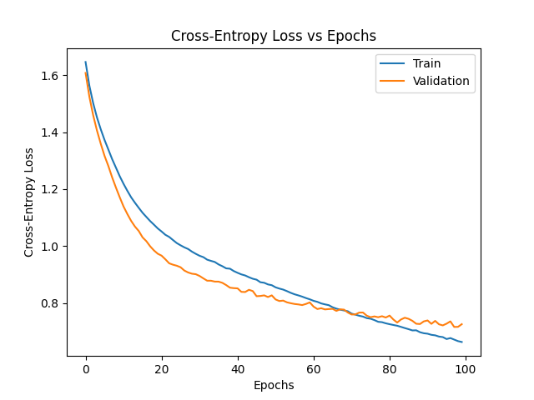
Cross-entropy - Epoch

Slide 58
Cross-entropy - Epoch
Convergence:Both training and validation losses are decreasing, indicating that the model is learning effectively.The training loss continues to decrease steadily, which is a good sign of model improvement.
Validation Performance:The validation loss decreases similarly to the training loss, indicating that the model is not overfitting. If the validation loss were to increase while the training loss continued to decrease, it would suggest overfitting.
Training Stability:The validation loss curve is relatively smooth and does not exhibit significant fluctuations, suggesting that the model is training stably without sudden changes in performance.

Slide 59
Cross-entropy - Epoch
Test Loss: 0.9565897583961487
Test Accuracy: 0.6617646813392639
Interpretation of the Test Metrics:
Test Loss (0.9566):This is the cross-entropy loss on the test set. A lower loss generally indicates a better fit to the data, but in this context, a loss close to 1 suggests that the model might still have room for improvement in terms of its predictions.
Test Accuracy (66.18%):This is the proportion of correctly predicted samples out of the total samples in the test set. An accuracy of 66.18% indicates that the model correctly predicts the target class approximately two-thirds of the time.

Slide 60
Conclusion
To build a robust mine classifier, it's essential to take into account a combination of VHS parameters.
But the strongest feature to detect mines are Voltage info we have from dataset.
Through experimentation, it has been demonstrated that the optimal method for designing a passive mine detector involves considering the V, H, and S parameters.

