Slide 1
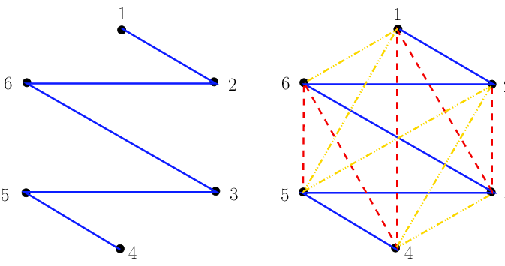
CS 301 Hamiltonian Path Problem
Edin Guso
Güneş Başak Özgün
Begüm Arslanhan
Erkut Gürol
Melih Kurtaran

Slide 2
Overview
Problem Description
01
Algorithm Desription
02
Algorithm Analysis
03
Experimental Analysis
04
Testing
05
Discussion
06

Slide 3
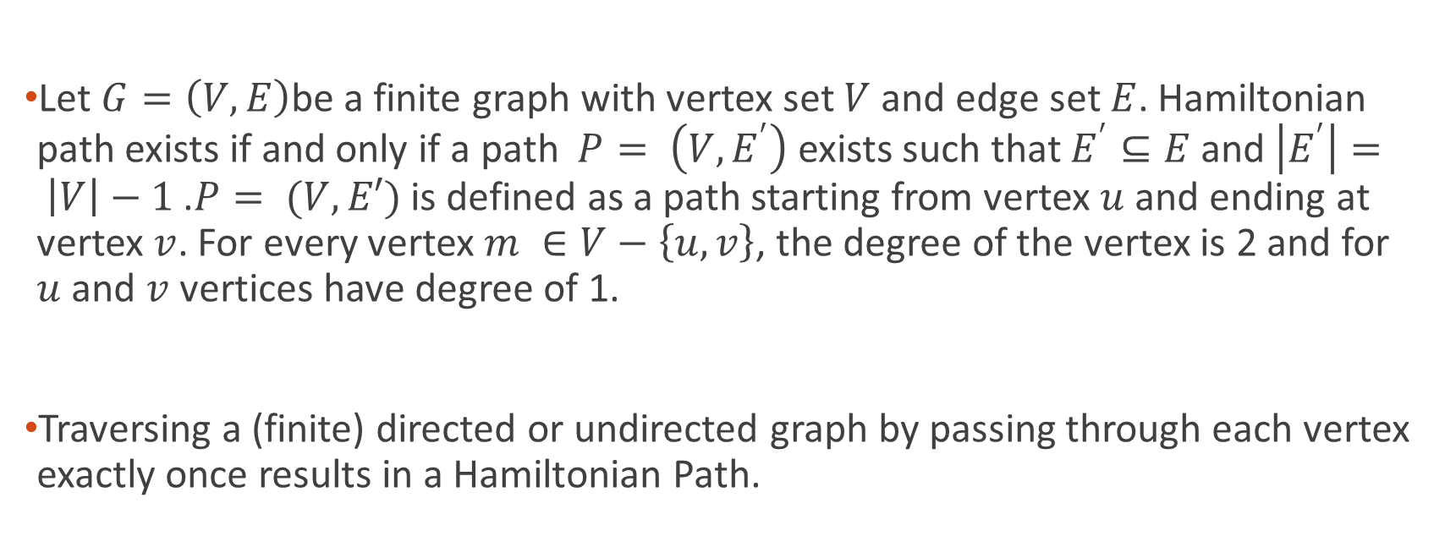
Hamiltonian Path
Let $G=\left(V,E\right)$be a finite graph with vertex set $V$ and edge set $E$. Hamiltonian path exists if and only if a path $P= \left(V,E^{′}\right)$ exists such that $E^{′}⊆E$ and$\left|E^{′}\right|= \left|V\right|−1$ .$P= (V,E′)$ is defined as a path starting from vertex $u$ and ending at vertex $v$. For every vertex $m ∈V−\left\{u,v\right\}$, the degree of the vertex is 2 and for $u$ and $v$ vertices have degree of 1.
Traversing a (finite) directed or undirected graph by passing through each vertex exactly once results in a Hamiltonian Path.

Slide 4
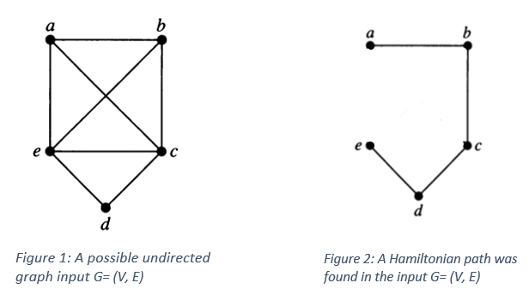
Problem Description
The problem we are considering in this project is
«Given an n-node undirected graph G=(V,E), is there a simple path of edges in G that contains every node in V, and thus contains exactly n−1 edges?»

Slide 5
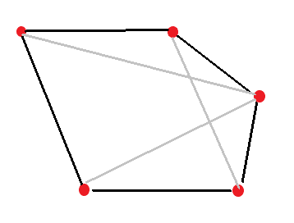
Hamiltonian Path is an NP-Complete Problem
To prove that Hamiltonian Path problem is an NP – Complete problem, following problems should be proven
Hamiltonian Path problem belongs in NP.
Hamiltonian Path problem can be reduced to an NP – Hard problem, with the additional note that the viability of reducing a known NP – Hard problem to the Hamiltonian Path problem itself.
For this purpose, the Hamiltonian Cycle problem could be chosen, which is an NP hard problem and can be deterministically reduced to Hamiltonian Path problem. A detailed explaination can be found in the report in section NP - Complete Proof.
Figure 3: A Hamiltonian Cycle (edges are indicated with black)

Slide 6
Algorithm Description
There is not an exact algorithm that solves Hamiltonian path problem in polynomial time.
For instance, for a graph having N vertices, it visits all the permutations of the vertices (N! iterations). In each of those iterations, it traverses the permutation to see if adjacent vertices are connected or not, so the overall complexity is O(N * N!).
But there are some algorithms that finds if the Hamiltonian path exists or not in polynomial time. They will be an approximation to the exact solution.
In this project, we will cover and analyze the performance of a modified version of Kruskal algorithm.

Slide 7
How does the algorithm work?
Initially, it takes an edge array and the vertex numbers (n) as inputs and creates an array for parent vertices.
Then, it chooses a random edge and checks its vertices to check the condition that the selected vertices have not been visited before and belong to a different set (have different parents).
If those conditions are met, then the selected vertices are marked as visited and their sets are joined until n/2 edges are selected. We mark the nodes visited as True in order not visit them again.

Slide 8
How does the algorithm work?
Then, all the edges that haven’t been used yet are considered. In addition, we change all the vertices as unvisited to find the new edges to join to the edges found in third step. So, for all vertices we mark the visited list as False. Then, add the two vertices with the same condition explained in second step.
If those conditions are met, then the selected vertices are marked as visited and their sets are joined until n-1 edges are reached.
If these are all passed, we say that a Hamiltonian path exists, else it doesn’t exist.

Slide 9
Algorithm Analysis
The algorithm we have suggested does not guarantee that it will find the Hamiltonian Path if there exists one. Because, the algorithm does not consider every possible permutation of edges. Instead, an edge is randomly selected for examination. If the selected edge fits the criteria, it is added to the candidate Hamiltonian Path.
Every edge is considered at most two times (once in the first loop and once in the second loop) and in random orders. This means that only a tiny subset of all possible permutations is considered.
Also, it is possible to get different decision results for the same input in two different runs since the edge selection is random.

Slide 10
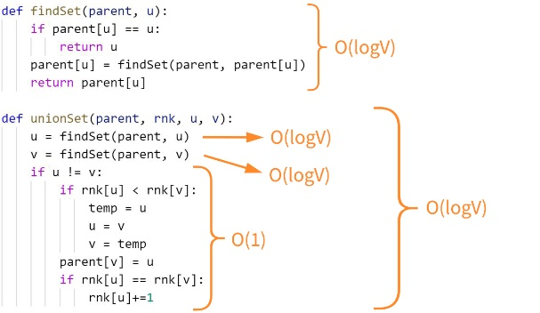
Running Time of the Algorithm

Slide 11
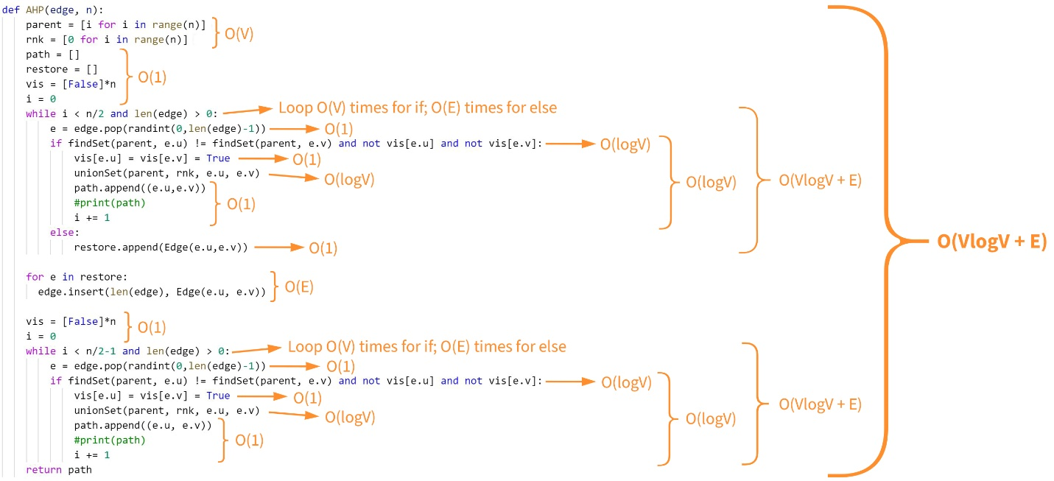

Slide 12
Experimental Analysis
Number of Vertices | 100 Graphs | 1000 Graphs | 3000 Graphs | 5000 Graphs | 10000 Graphs
5 | 74.65 | 71.98 | 73.42 | 73.80 | 72.36
6 | 60.00 | 62.42 | 62.14 | 61.64 | 62.45
7 | 83.33 | 74.36 | 76.08 | 76.77 | 77.74
8 | 69.84 | 61.79 | 62.05 | 60.57 | 63.09
9 | 67.21 | 77.90 | 76.77 | 75.62 | 76.36
10 | 60.71 | 59.11 | 61.33 | 61.20 | 61.28
15 | 75.76 | 71.58 | 75.61 | 73.74 | 75.00
20 | 61.11 | 54.72 | 57.29 | 59.12 | 57.28
Success Rate
If the algorithm outputs a path of length less than |V|-1, that means that it has failed to find a Hamiltonian Path. Otherwise the algorithm finds the path.
We defined the success as explained above and analyzed our algorithm accordingly.
Figure 4: Success rate of graphs with given vertice numbers for different runs

Slide 13
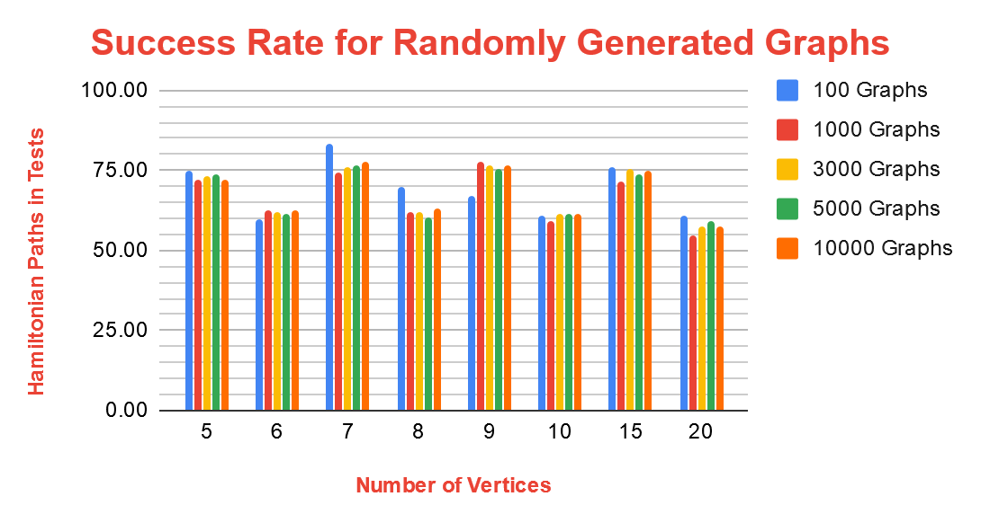
Figure 5: Success rate for randomly generated graphs

Slide 14
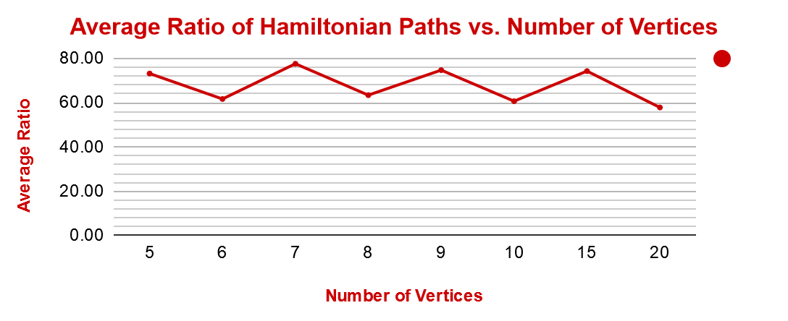
Figure 6: Average ratio of Hamiltonian paths compared to number of vertices

Slide 15
Success Rate for Different Number of Vertices
Number of Vertices | Success Rate
5 | 73.24
6 | 61.73
7 | 77.66
8 | 63.47
9 | 74.77
10 | 60.73
15 | 74.34
20 | 57.91
As the number of vertices increase, there will be more connections to necessary to get the path.
Since our algorithm considers an edge at most two times in random orders, a small subset of possible permuatations are realized.
With the increase in number of vertices, probability of finding the correct combination decreases.
Figure 7: Number of vertices and success rate

Slide 16
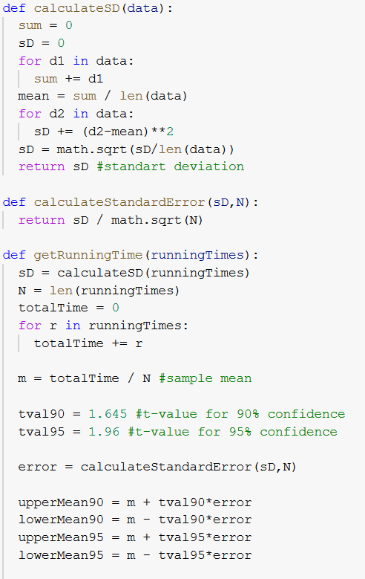
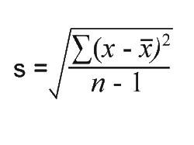
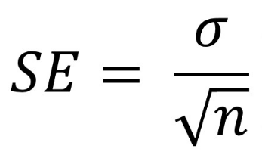
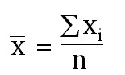

Experimental Running Time of the Algorithm
Statistics was used to get a better understanding of the experimental running time of the algorithm.
We created some functions to find the standard deviation, standard error, mean time and confidence levels of 90% and 95%.
$$\overline{x}±t∗SE$$

Slide 17
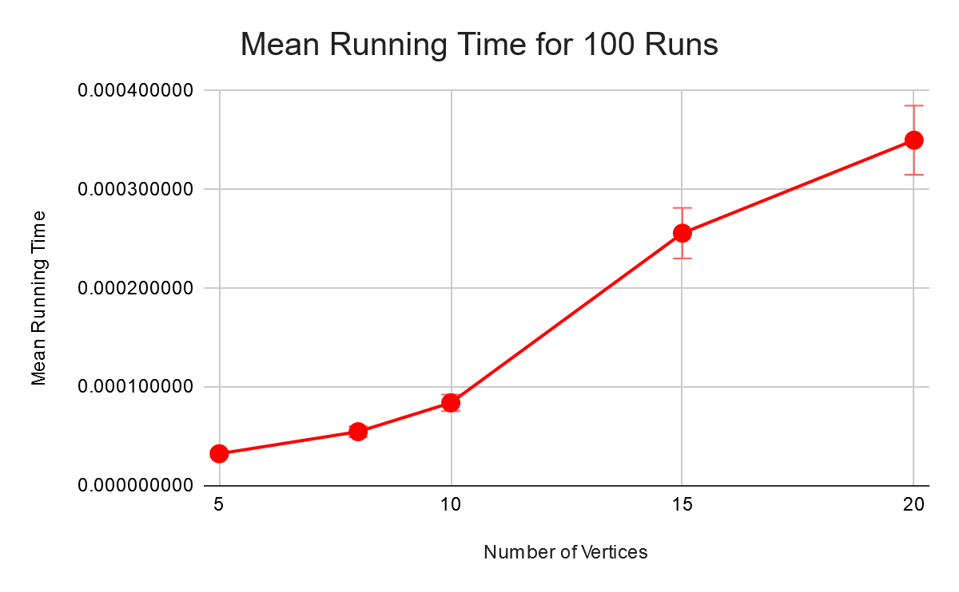
Analysis of 100 Runs
Size | Mean Time(s) | Standard Deviation | Standard Error | 90% - CL | 95% - CL
5 | 0.000032496 | 0.000017267 | 0.000001727 | 3.53368e-05 - 2.96560e-05 | 3.58807e-05 - 2.91121e-05
8 | 0.000054798 | 0.000023685 | 0.000002369 | 5.86943e-05 - 5.09019-05 | 5.94403e-05 - 5.01558e-05
10 | 0.000084031 | 0.000042455 | 0.000004245 | 9.10144e-05 - 7.70468e-05 | 9.23517e-05 - 7.57095e-05
15 | 0.000255847 | 0.000114120 | 0.000011412 | 27.46197e-05 - 23.70742e-05 | 27.82144e-05 - 23.34794e-05
20 | 0.000349996 | 0.000177600 | 0.000017760 | 37.92112e-05 - 32.07809e-05 | 38.48055e-05 - 31.51865e-05
Figure 9: Mean running time for 100 runs
Figure 8: Statistics Table

Slide 18
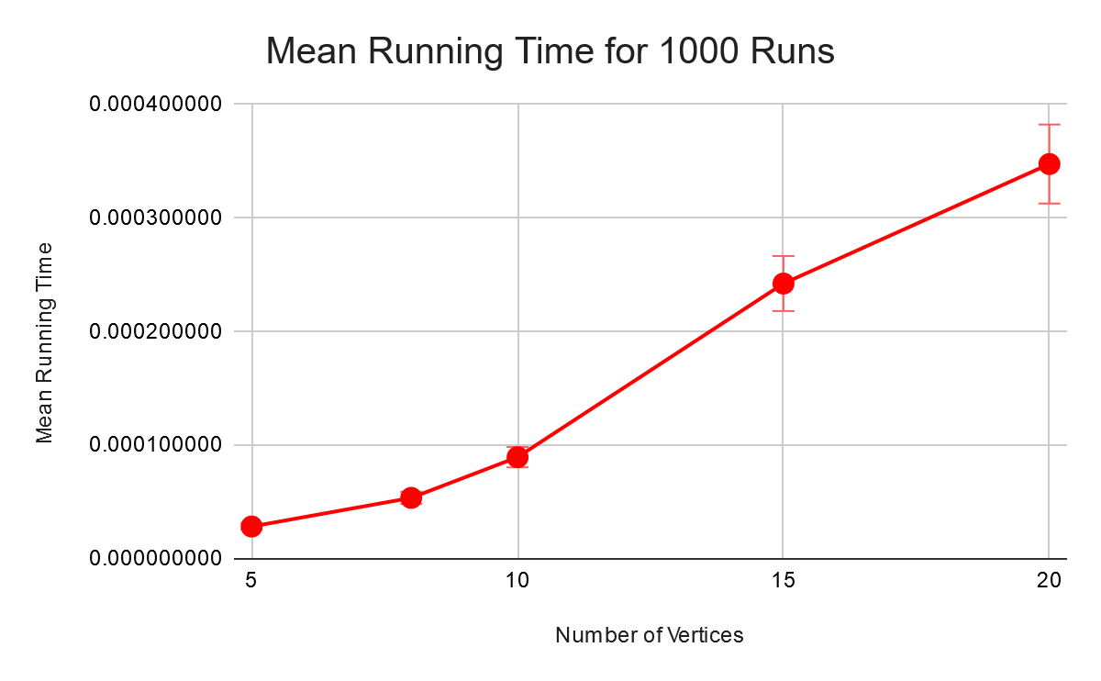
Analysis of 1000 Runs
Size | Mean Time(s) | Standard Deviation | Standard Error | 90% - CL | 95% - CL
5 | 0.000028465 | 0.000015837 | 0.000000501 | 2.9288e-05 - 2.7640e-05 | 2.9446e-05 - 2.7483e-05
8 | 0.000053675 | 0.000024963 | 0.000000789 | 5.4973e-05 - 5.2376e-05 | 5.5221e-05 - 5.2127e-05
10 | 0.000089500 | 0.000042856 | 0.000001355 | 9.1729e-05 - 8.7271e-05 | 9.2156e-05 - 8.6844e-05
15 | 0.000242365 | 0.000133968 | 0.000004236 | 24.9334e-05 - 23.5396e-05 | 25.0668e-05 - 23.4061e-05
20 | 0.000347586 | 0.000166958 | 0.000005280 | 35.6270e-05 - 33.8900e-05 | 35.7934e-05 - 33.7237e-05
Figure 11: Mean running time for 1000 runs
Figure 10: Statistics Table

Slide 19
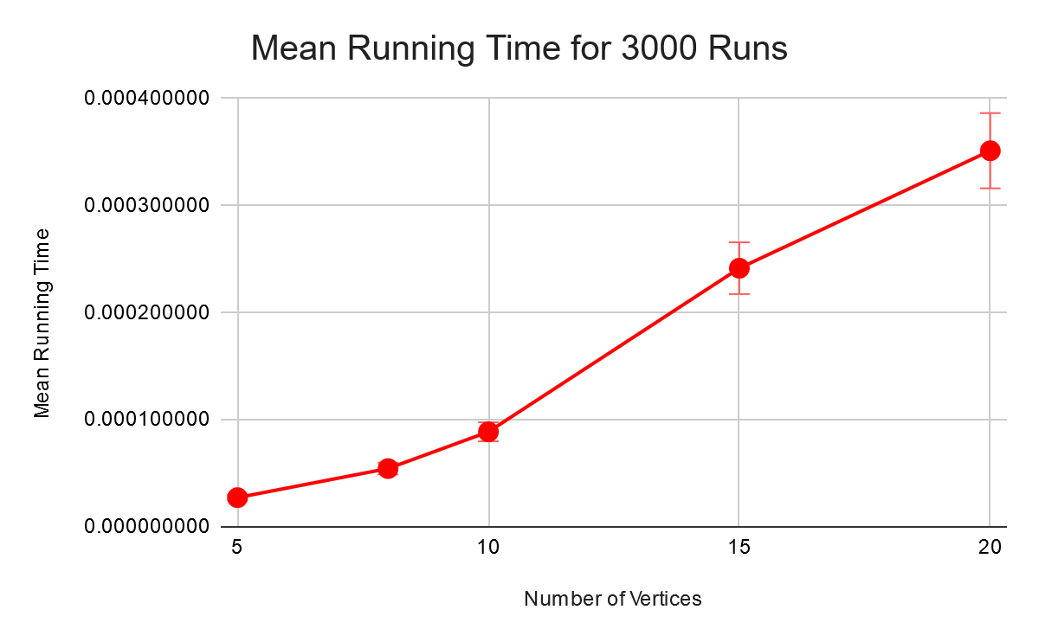
Analysis of 3000 Runs
Size | Mean Time(s) | Standard Deviation | Standard Error | 90% - CL | 95% - CL
5 | 0.000027294 | 0.000013469 | 0.000000246 | 2.7698e-05 - 2.6889e-05 | 2.7776e-05 - 2.6812e-05
8 | 0.000054436 | 0.000026454 | 0.000000483 | 5.5230e-05 - 5.3641e-05 | 5.5382e-05 - 5.3489e-05
10 | 0.000088715 | 0.000049758 | 0.000000908 | 9.0209e-05 - 8.7220e-05 | 9.0495e-05 - 8.6934e-05
15 | 0.000241525 | 0.000130856 | 0.000002389 | 24.5455e-05 - 23.7595e-05 | 24.6208e-05 - 23.6842e-05
20 | 0.000351227 | 0.000175799 | 0.000003210 | 35.6506e-05 - 34.5947e-05 | 35.7518e-05 - 34.4936e-05
Figure 13: Mean running time for 3000 runs
Figure 12: Statistics Table

Slide 20
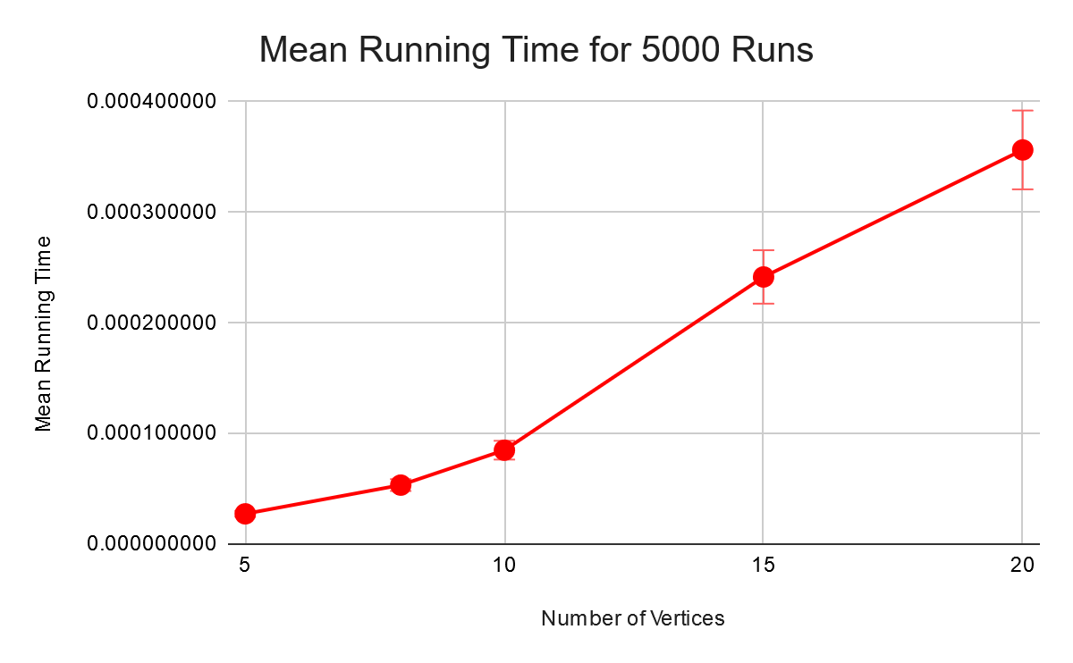
Analysis of 5000 Runs
Size | Mean Time(s) | Standard Deviation | Standard Error | 90% - CL | 95% - CL
5 | 0.000027366 | 0.000016602 | 0.000000235 | 2.7752e-05 - 2.6979e-05 | 2.7826e-05 - 2.6905e-05
8 | 0.000053334 | 0.000026294 | 0.000000372 | 5.3946e-05 - 5.2722e-05 | 5.4063e-05 - 5.2605e-05
10 | 0.000084896 | 0.000041764 | 0.000000591 | 8.5867e-05 - 8.3924e-05 | 8.6053e-05 - 8.3738e-05
15 | 0.000241553 | 0.000127683 | 0.000001806 | 24.452e-05 - 23.858e-05 | 24.509e-05 - 23.801e-05
20 | 0.000356408 | 0.000181924 | 0.000002573 | 36.064e-05 - 35.217e-05 | 36.145e-05 - 35.136e-05
Figure 15: Mean running time for 5000 runs
Figure 14: Statistics Table

Slide 21

Analysis of 10000 Runs
Size | Mean Time(s) | Standard Deviation | Standard Error | 90% - CL | 95% - CL
5 | 0.000027646 | 0.000017236 | 0.000000172 | 2.7929e-05 - 2.7362e-05 | 2.7984e-05 - 2.7308e-05
8 | 0.000055044 | 0.000039898 | 0.000000399 | 5.5700e-05 - 5.4387e-05 | 5.5825e-05 - 5.4261e-05
10 | 0.000085520 | 0.000043361 | 0.000000434 | 8.6233e-05 - 8.4806e-05 | 8.6369e-05 - 8.4670e-05
15 | 0.000240504 | 0.000129679 | 0.000001297 | 24.263e-05 - 23.837e-05 | 24.3045e-05 - 23.7961e-05
20 | 0.000347514 | 0.000173038 | 0.000001730 | 35.036e-05 - 34.466e-05 | 35.090e-05 - 34.412e-05
Figure 17: Mean running time for 10000 runs
Figure 16: Statistics Table

Slide 22
Testing
We generated different graph inputs and tested our algorithm by using the black-box testing technique.
To generate random graphs with given vertices and random edges, we used the function generateGraph(int V, int n, string f) as shown in the following slide.
By using this function, we created a test file:
The edge numbers between 1 and all edges.

Slide 23
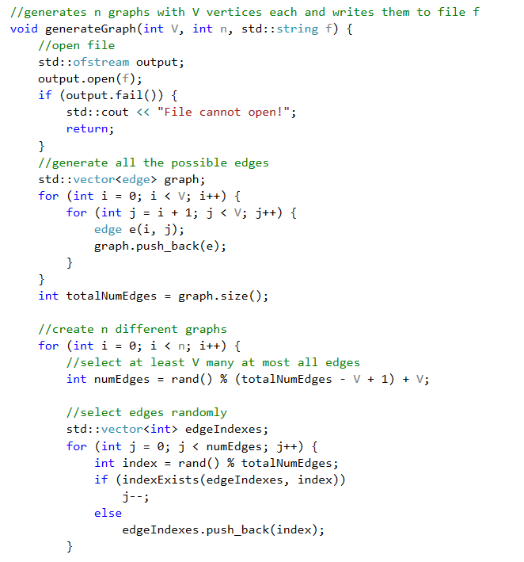
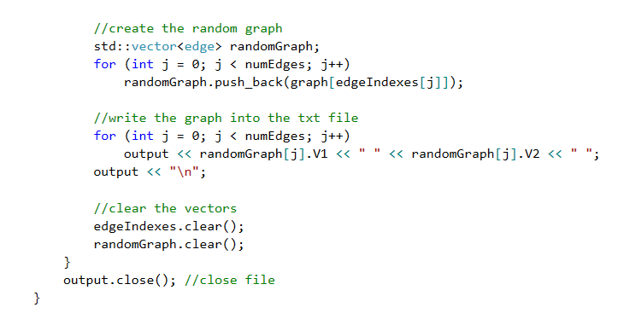

Slide 24
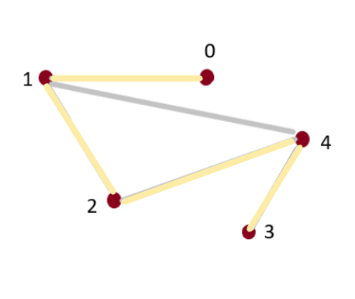
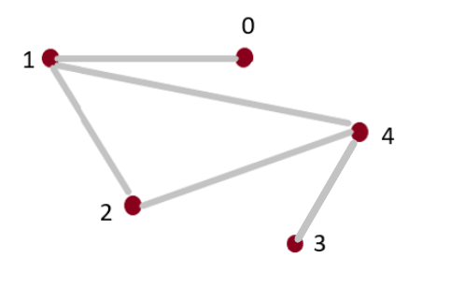
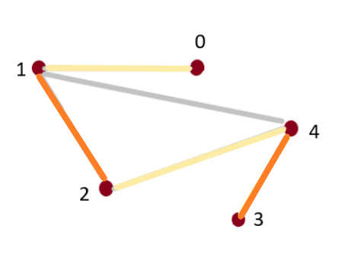
Sample Test Cases
Sample 1: Input graph with 5 vertices and 5 edges
Exact Algortihm: Path Found
Approximation : Path Found
This is a successful case

Slide 25
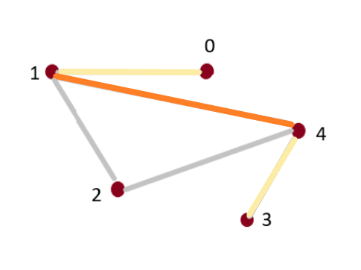
Sample Test Cases
Sample 2: Input graph with 5 vertices and 5 edges
Exact Algortihm: Path Found
Approximation : No Path
This is a failed case

Slide 26
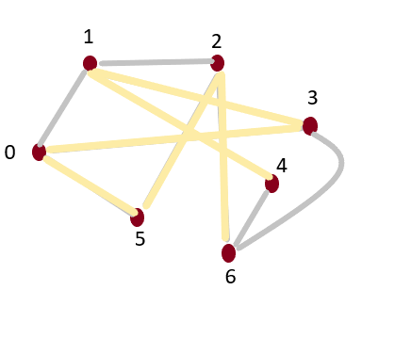
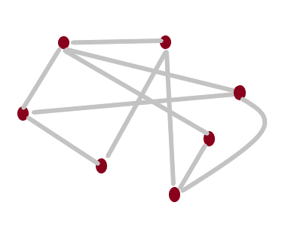
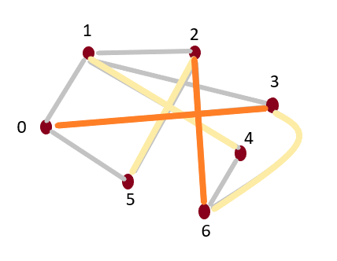
Sample Test Cases
Sample 3: Input graph with 7 vertices and 10 edges
Exact Algortihm: Path Found
Approximation : No Path
This is a failed case
1
2
3
0
4
5
6

Slide 27
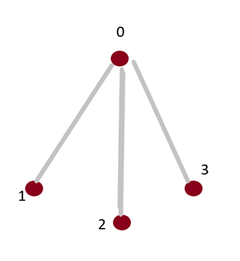
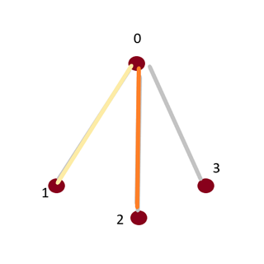
Sample Test Cases
Sample 4: Input graph with 4 vertices and 3 edges
Exact Algortihm: No Path
Approximation : No Path
This is a successful case
1
2
3
0
4
5
6

Slide 28
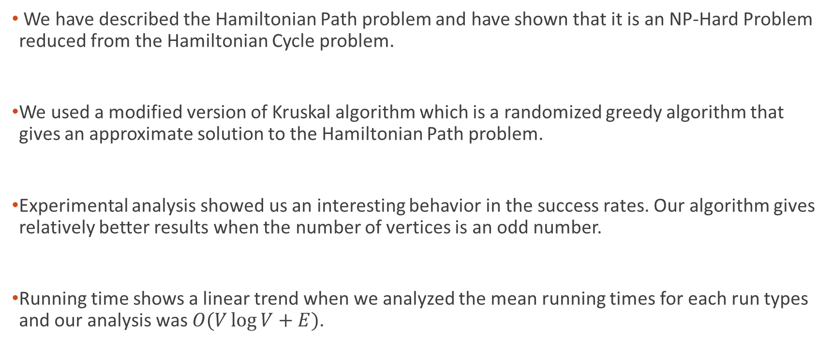
Discussion
We have described the Hamiltonian Path problem and have shown that it is an NP-Hard Problem reduced from the Hamiltonian Cycle problem.
We used a modified version of Kruskal algorithm which is a randomized greedy algorithm that gives an approximate solution to the Hamiltonian Path problem.
Experimental analysis showed us an interesting behavior in the success rates. Our algorithm gives relatively better results when the number of vertices is an odd number.
Running time shows a linear trend when we analyzed the mean running times for each run types and our analysis was $O(V\log{V}+E)$.

Slide 29
References
Cover image:
https://images.app.goo.gl/MS9DRbZnWjVwWoLt6
Approximation Code:
https://github.com/francoMG/Approximation-of-Hamiltonian-Path/blob/master/AHP.py
Exact Code:
https://github.com/samarth-p/Euler-and-Hamiltonian-Path

