Slide 1


SunExpress
Performance Overview

Slide 2

iOS Performance Overview
Date | App Rating | Crash Free User | Download (Weekly) | Active User (Weekly) | Uninstall Count (Weekly)
19 Jan - 25 Jan | - | - | - | - | -
26 Jan - 1 Feb | - | - | - | - | -
2 Feb - 8 Feb | - | - | - | - | -
9 Feb - 15 Feb | - | - | - | - | -
16 Feb - 22 Feb | 1.11 | - | - | - | -
23 Feb - 1 Mar | 1.41 | - | - | - | -
2 Mar - 8 Mar | 1.0 | - | - | - | -

Slide 3
Android Performance Overview
Date | App Rating | Crash Free User | Download (Weekly) | Active User (Weekly) | Uninstall Count (Weekly)
19 Jan - 25 Jan | 2.62 | - | - | - | -
26 Jan - 1 Feb | 3.18 | - | - | - | -
2 Feb - 8 Feb | 2.17 | - | - | - | -
9 Feb - 15 Feb | 2.54 | - | - | - | -
16 Feb - 22 Feb | 1.46 | - | - | - | -
23 Feb - 1 Mar | 2.29 | - | - | - | -
2 Mar - 8 Mar | 2.04 | - | - | - | -

Slide 4
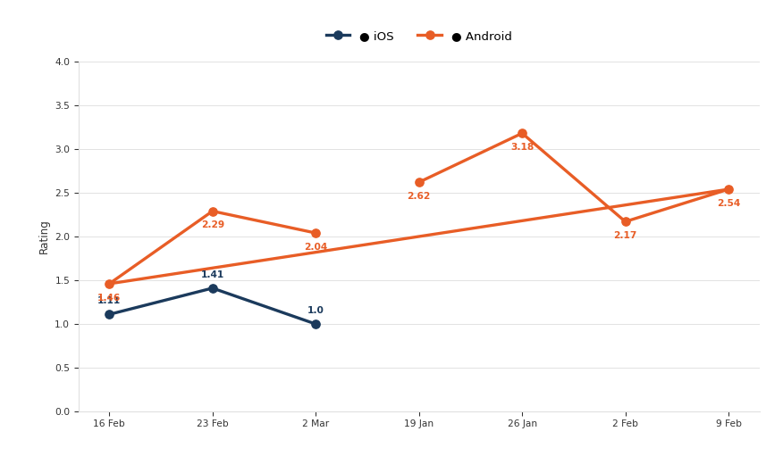
App Rating
Date | iOS | Android
19 Jan - 25 Jan | - | 2,62
26 Jan - 1 Feb | - | 3,18
2 Feb - 8 Feb | - | 2,17
9 Feb - 15 Feb | - | 2,54
16 Feb - 22 Feb | 1,11 | 1,46
23 Feb - 1 Mar | 1,41 | 2,29
2 Mar - 8 Mar | 1,0 | 2,04

Slide 5

Crash Free User
Date | iOS | Android
19 Jan - 25 Jan | - | -
26 Jan - 1 Feb | - | -
2 Feb - 8 Feb | - | -
9 Feb - 15 Feb | - | -
16 Feb - 22 Feb | - | -
23 Feb - 1 Mar | - | -
2 Mar - 8 Mar | - | -

Slide 6
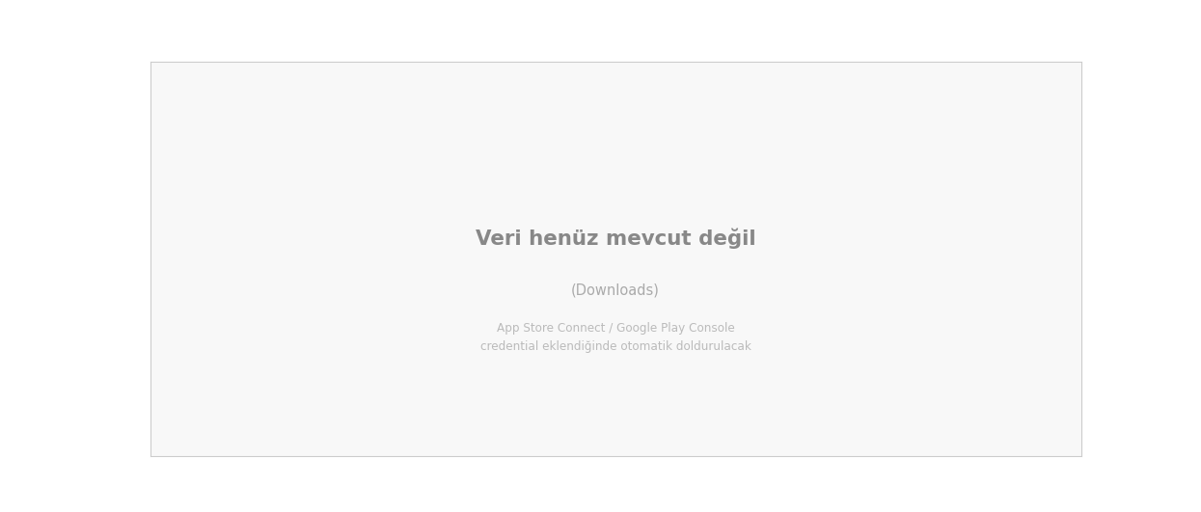
Download (Weekly)
Date | iOS | Android
19 Jan - 25 Jan | - | -
26 Jan - 1 Feb | - | -
2 Feb - 8 Feb | - | -
9 Feb - 15 Feb | - | -
16 Feb - 22 Feb | - | -
23 Feb - 1 Mar | - | -
2 Mar - 8 Mar | - | -

Slide 7
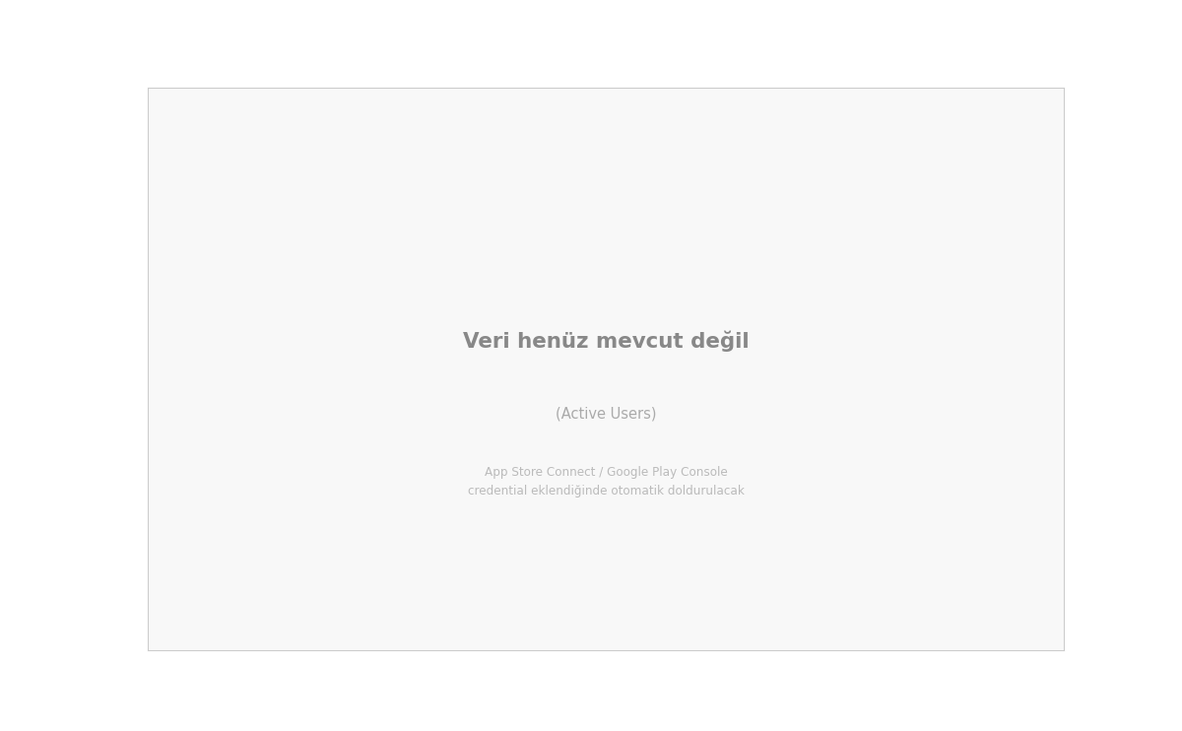
Active User (Weekly)
Date | iOS | Android
19 Jan - 25 Jan | - | -
26 Jan - 1 Feb | - | -
2 Feb - 8 Feb | - | -
9 Feb - 15 Feb | - | -
16 Feb - 22 Feb | - | -
23 Feb - 1 Mar | - | -
2 Mar - 8 Mar | - | -

Slide 8
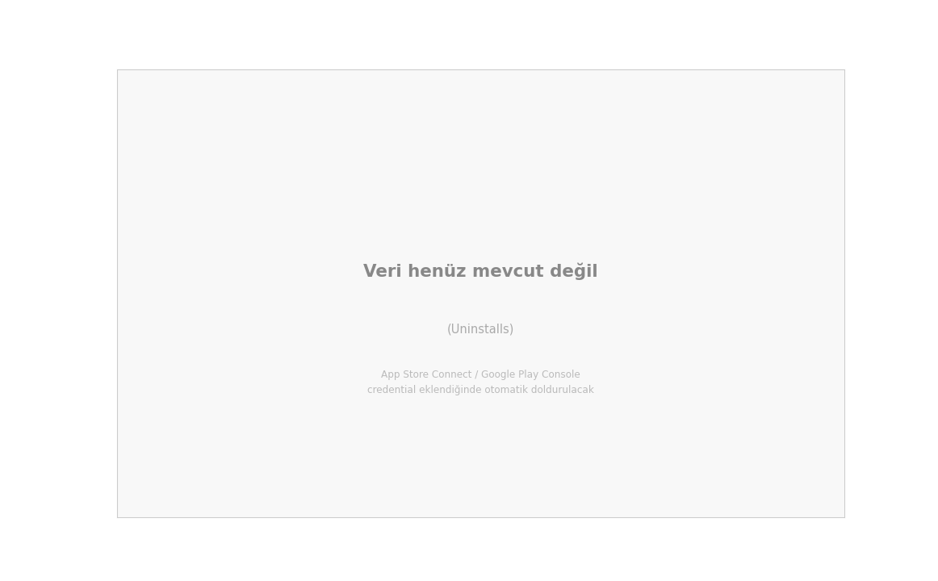
Uninstall Count (Weekly)
Date | iOS | Android
19 Jan - 25 Jan | - | -
26 Jan - 1 Feb | - | -
2 Feb - 8 Feb | - | -
9 Feb - 15 Feb | - | -
16 Feb - 22 Feb | - | -
23 Feb - 1 Mar | - | -
2 Mar - 8 Mar | - | -

