Slide 1


SunExpress
Performance Overview

Slide 2

iOS Performance Overview
Date | App Rating | Crash Free User | Download (Weekly) | Active User (Weekly) | Uninstall Count (Weekly)
19 Jan - 25 Jan | 3.0 | 99.8 | 21.9K | 74K | 1.37K
26 Jan - 01 Feb | 3.0 | 99.85 | 25K | 79K | 2K
02 Feb - 08 Feb | 3.0 | 99.79 | 21K | 77K | 1.8K
09 Feb - 15 Feb | 3.0 | 99.57 | 20.4K | 81K | 1.79K
16 Feb - 22 Feb | 2.8 | 99.6 | 28.8K | 91K | 2.37K
23 Feb - 1 Mar | 2.7 | 99.89 | 30K | 100K | 2.44K
2 Mar - 8 Mar | 2.8 | 99.88 | 27K | 103K | 2.28K

Slide 3
Android Performance Overview
Date | App Rating | Crash Free User | Download (Weekly) | Active User (Weekly) | Uninstall Count (Weekly)
19 Jan - 25 Jan | 3.4 | 99.95 | 12K | 38K | 3K
26 Jan - 01 Feb | 3.6 | 99.94 | 12K | 41K | 5.3K
02 Feb - 08 Feb | 3.63 | 99.94 | 9.7K | 40K | 3.6K
09 Feb - 15 Feb | 3.63 | 99.93 | 9.1K | 41K | 3.4K
16 Feb - 22 Feb | 3.4 | 99.93 | 13K | 45K | 3.8K
23 Feb - 1 March | 3.2 | 99.93 | 15K | 50K | 3.9K
2 Mar - 8 Mar | 3.3 | 99.94 | 13.9K | 51K | 4K

Slide 4
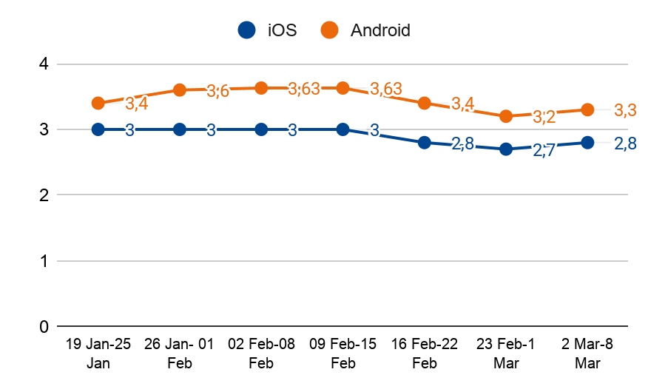
App Rating
Date | iOS | Android
19 Jan - 25 Jan | 3,0 | 3,4
26 Jan - 01 Feb | 3,0 | 3,6
02 Feb - 08 Feb | 3,0 | 3,63
09 Feb - 15 Feb | 3,0 | 3,63
16 Feb - 22 Feb | 2,8 | 3,4
23 Feb - 1 Mar | 2,7 | 3,2
2 Mar - 8 Mar | 2,8 | 3,3

Slide 5
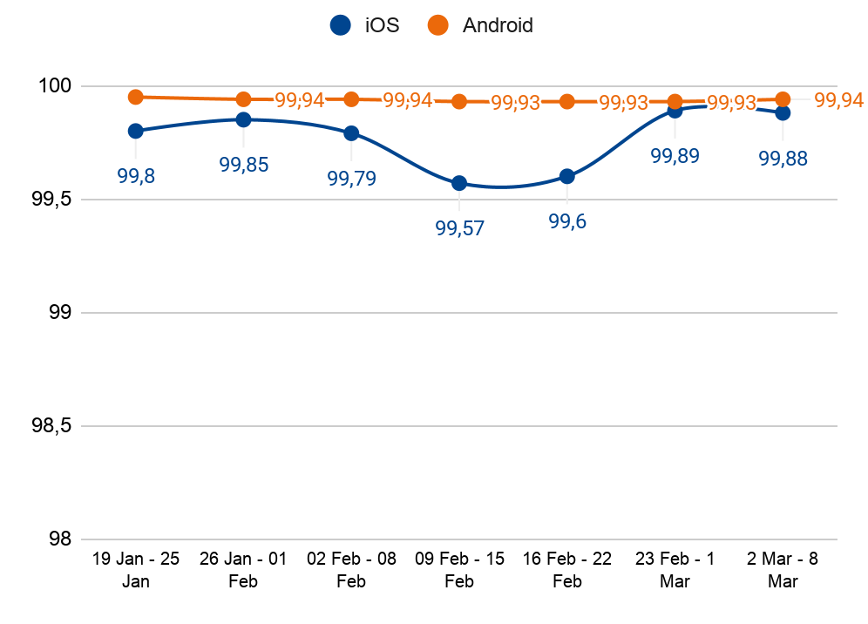
Crash Free User
Date | iOS | Android
19 Jan - 25 Jan | 99.8 | 99.95
26 Jan - 01 Feb | 99.85 | 99.94
02 Feb - 08 Feb | 99.79 | 99.94
09 Feb - 15 Feb | 99.57 | 99.93
16 Feb - 22 Feb | 99.6 | 99.93
23 Feb - 1 Mar | 99.89 | 99.93
2 Mar - 8 Mar | 99.88 | 99.94

Slide 6
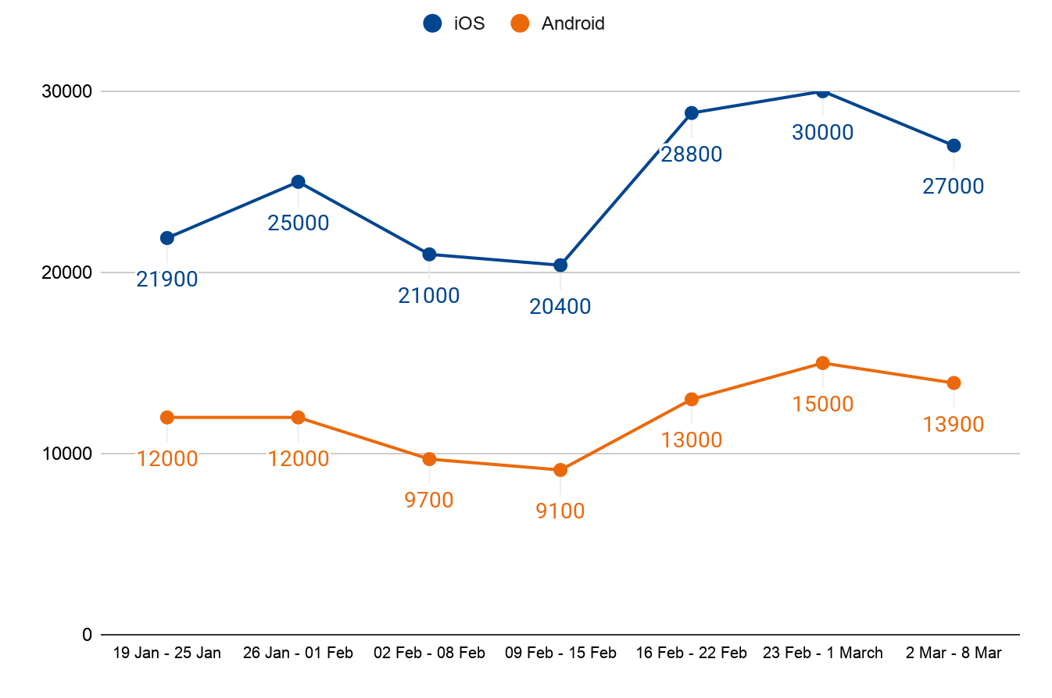
Download (Weekly)
Date | iOS | Android
19 Jan - 25 Jan | 21.9K | 12K
26 Jan - 01 Feb | 25K | 12K
02 Feb - 08 Feb | 21K | 9.7K
09 Feb - 15 Feb | 20.4K | 9.1K
16 Feb - 22 Feb | 28.8K | 13K
23 Feb - 1 March | 30K | 15K
2 Mar - 8 Mar | 27K | 13.9K

Slide 7
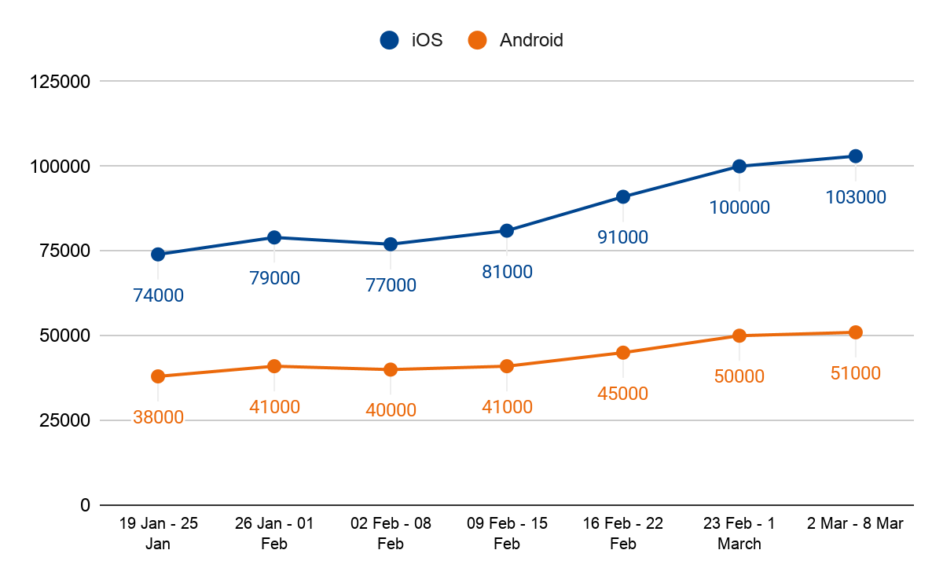
Active User (Weekly)
Date | iOS | Android
19 Jan - 25 Jan | 74K | 38K
26 Jan - 01 Feb | 79K | 41K
02 Feb - 08 Feb | 77K | 40K
09 Feb - 15 Feb | 81K | 41K
16 Feb - 22 Feb | 91K | 45K
23 Feb - 1 March | 100K | 50K
2 Mar - 8 Mar | 103K | 51K

Slide 8
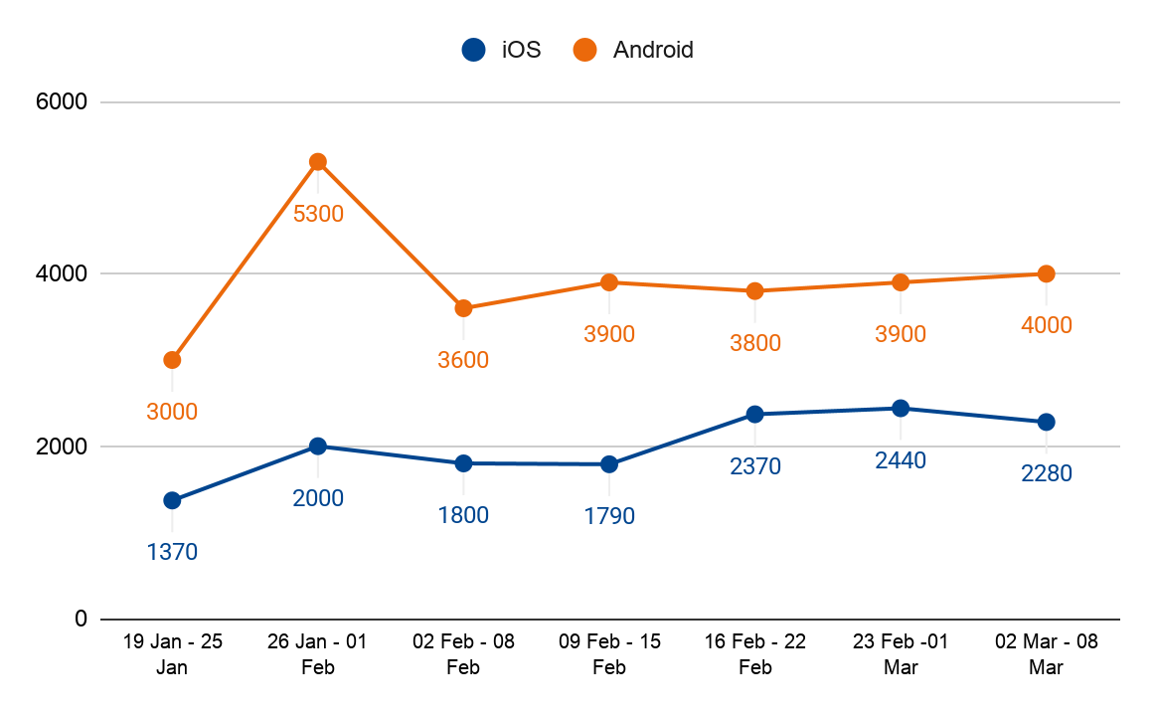
Uninstall Count (Weekly)
Date | iOS | Android
19 Jan - 25 Jan | 1.3K | 3K
26 Jan - 01 Feb | 2K | 5.3K
02 Feb - 08 Feb | 1.8K | 3.6K
09 Feb - 15 Feb | 1.79K | 3.4K
16 Feb - 22 Feb | 2.37K | 3.8K
23 Feb - 1 March | 2.44K | 3.9K
2 Mar - 8 Mar | 2.28K | 4K

