Slide 1

TOPIC MODELING AND SENTIMENT ANALYSIS: ANALYZING CULTURAL DIFFERENCES IN MOVIE REVIEWS
Every nation has its own unique culture.

Slide 2
Table of contents
01
02
03
04
05
Motivation
Research Questions
Methodology
Analysis
Results

Slide 3
Motivation
What is the problem?
There is no existing study that addresses topic and sentiment in the movie domain for both Turkish and English.
Who is this for?
This study offers data-driven insight for the cinema industry, producers, and cross-cultural media researchers.
What is our contribution?
We integrate topic and sentiment modeling on a balanced set of TR-EN reviews from 5 platforms and statistically validate their relationship using a Chi-square test.

Slide 4
Research Questions
1
Topic Focus
Do TR and EN viewers focus on different topics within the same film?
2
Sentiment Distribution
Is there a difference in the sentiment distribution between TR and EN reviews?
3
Topic x Sentiment Relationship
Are topic and sentiment statistically independent from each other?

Slide 5
Methodology
Data Collection
English and Turkish reviews of IMDb Top 250 films were collected from five different platforms.
Preprocessing & Balancing
Reviews were prepared and the two languages were balanced per film
BERTopic
Reviews were clustered into meaningful topics using multilingual embeddings.
Sentiment
Each review was assigned a sentiment label using RoBERTa and Qwen 2.5-7B.
Chi-square
The significance of the topic-sentiment relationship was tested statistically.

Slide 6
Data Collection
A total of 578.991 reviews were collected across 250 films from the relevant platforms using Selenium and BeautifulSoup.
Platforms
English
Turkish
IMDb
Letterboxd
Beyaz Perde
Sinemalar
Ekşi Sözlük

Slide 7
Preprocessing & Balancing
Noise removal, stopword elimination and lemmatization were applied for both languages using NLTK. This produced raw data for the sentiment models and cleaned data for the topic model.
To prevent language imbalance, the number of TR and EN reviews was equalized for each film.
Platform | # of reviews
Letterboxd | 99.251
IMDb | 92.311
Sinemalar | 89.476
Ekşi Sözlük | 82.119
Beyaz Perde | 19.820
As a result, we built a language balanced dataset of 382.977 reviews from 229 films.

Slide 8
BERTopic
In the first step, each review is converted into a vector using the multilingual «paraphrase-multilingual-MiniLM-L12-v2» embedding model. The high dimensional vectors are reduced with UMAP, and the density based HDBSCAN algorithm clusters the reviews into topics. Finally, c-TF-IDF extracts the distinctive keywords of each cluster.
The first clustering produced 239 small and overlapping topics. Instead of discarding the outlier topic and losing data, these were merged into semantically similar clusters based on c-TF-IDF similarity, reducing the total to 80 topics. Each topic was manually naming by examining both its keywords and representative reviews, and the topics were grouped into five categories:
Genre related
Social / Cultural Themes,
Cast / Cinematography / Technical Elemens
Audience Experience
Psychological Themes

Slide 9
BERTopic
Bileşen | Parametre | Değer
Embedding | Model | Paraphrase-multilingual-MiniLM-L12-v2
UMAP | n_neighbors | 30
 | n_components | 5
HDBSCAN | min_cluster_size | 200
c-TF-IDF | ngram_range | (1,2)

Slide 10
Sentiment: Dataset
For Turkish, the TREMO and Winvoker datasets were combined. For English, the GoEmotions dataset was used.
Emotion | English | Turkish
Anger | 1.500 | 2.000
Disgust | 1.500 | 2.000
Fear | 1.500 | 2.000
Happiness | 1.500 | 2.000
Neutral | 1.500 | 2.000
Sadness | 1.500 | 2.000
Total | 9.000 | 12.000

Slide 11
Sentiment: Models - RoBERTa
roberta-base
Transformers based encoder-only (All at once)
Bidirectional (Both left and right words)
Upgraded version of BERT
125 million parameters
Pretrained with Wikipedia + BookCorpus + CC-News + OpenWebText + Stories (160GB total).
Created by Meta AI and researchers from the University of Washington in 2019
roberta-base-turkish
Same structure as roberta-base
Trained with Turkish Wikipedia, Turkish OSCAR, and some news websites (38 GB texts and 329 million sentences)
Created by Burak Aytan at Turkcell in 2022

Slide 12


Sentiment: Models – Qwen 2.5-7B
Large language model (Ability to generate text, billions of parameters, larger datasets)
Transformers based decoder-only (Left to right text generating)
Created by AliBaba Cloud in September 2024
7 billion parameters (7B)
Supports 20 different language including Turkish and English

Slide 13
Sentiment: RoBERTA
For the RoBERTa models, we used roberta-base-turkish-uncased for Turkish and roberta-base for English. Both models were fine-tuned using the AdamW optimizer with a learning rate of 2e-5, a batch size of 16, and 3 epochs.
Model | Accuracy | F1 (macro)
RoBERTa TR | 0.919 | 0.919
RoBERTa EN | 0.780 | 0.774

Slide 14
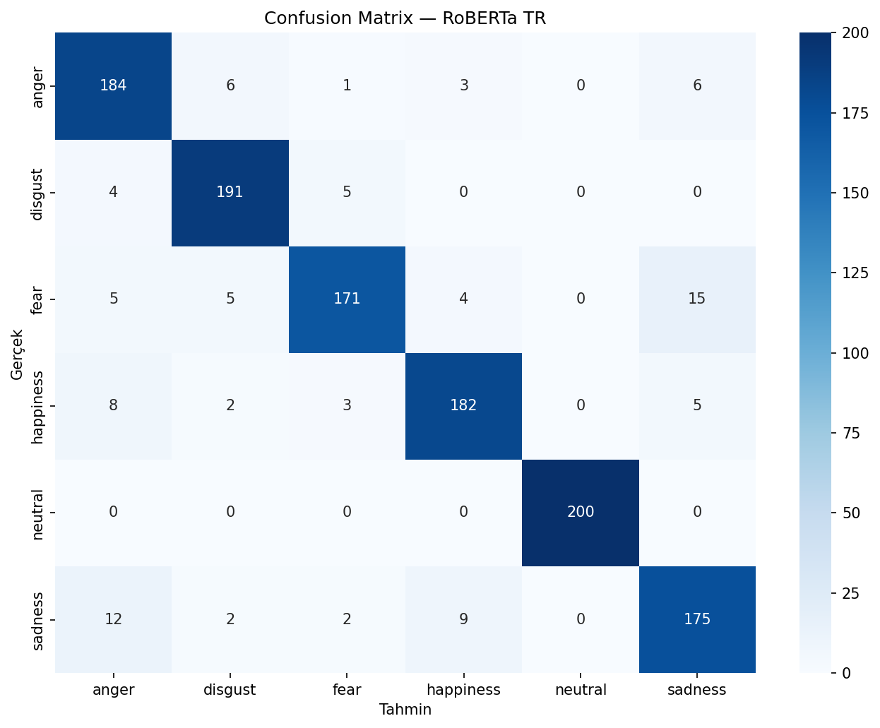
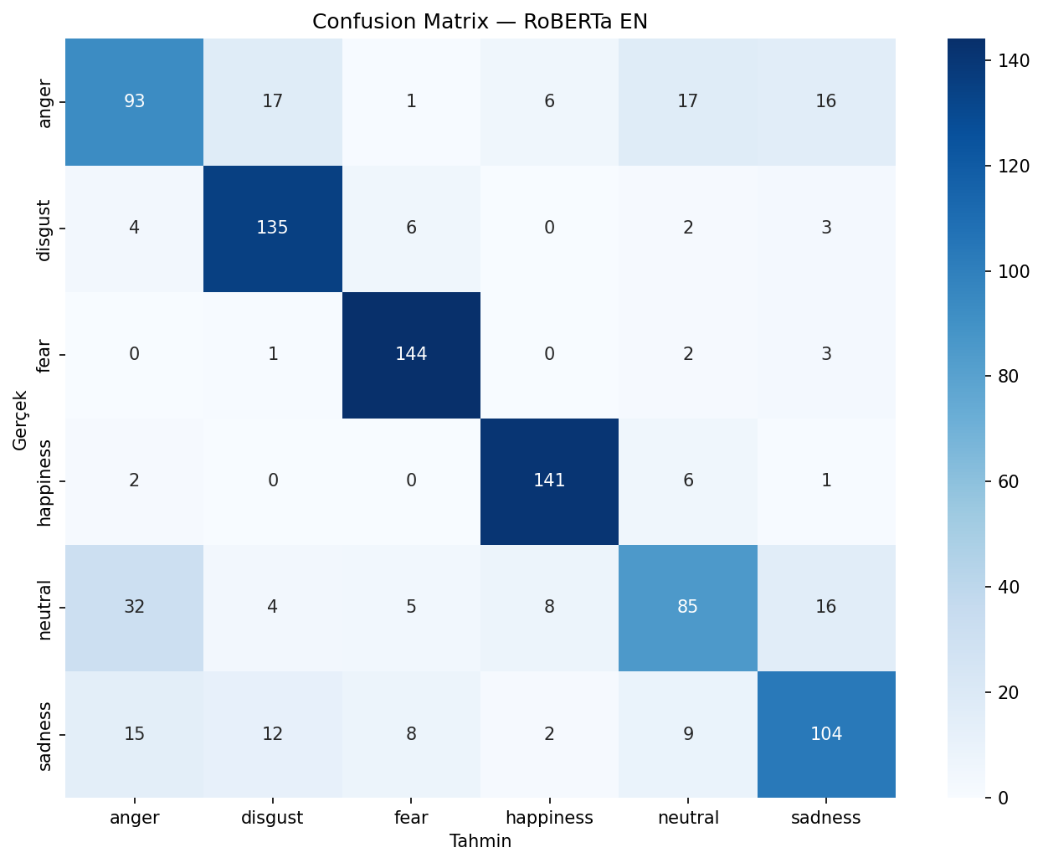
Sentiment: RoBERTA

Slide 15
Sentiment: Qwen 2.5-7B
We adapted the Qwen 2.5-7B-Instruct model to the sentiment classifcation task. Because of memory constraints, we used QLoRA, a parameter efficient method. The parameters are as follows:
Quantization: 4-bit NF4
Compute dtype: bfloat16
LoRA rank: 16
LoRA alpha: 32
Learning rate: 2e-4
Epoch: 3
Model | Accuracy | F1 (macro)
Qwen TR | 0.941 | 0.941
Qwen EN | 0.763 | 0.761

Slide 16

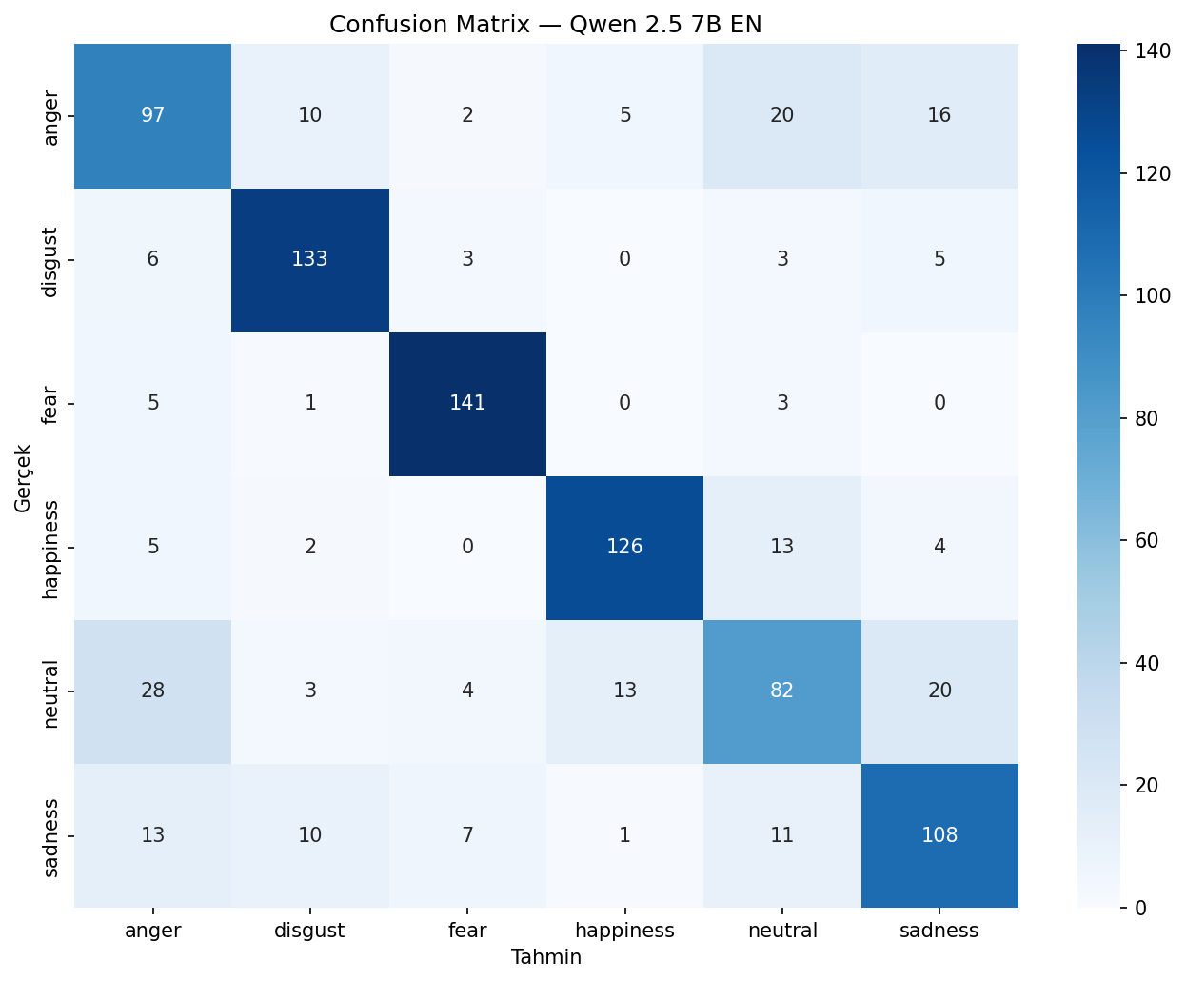
Sentiment: Qwen 2.5-7B

Slide 17
Analysis
1
Overall Sentiment Distribution & Topics
Comparison of the sentiment profiles of TR and EN reviews.
2
Topic x Sentiment Profile
Measuring the sentiment difference between TR and EN within the same topic.
3
Chi-square Result
Statistical validation of the relationship between topic and sentiment.

Slide 18
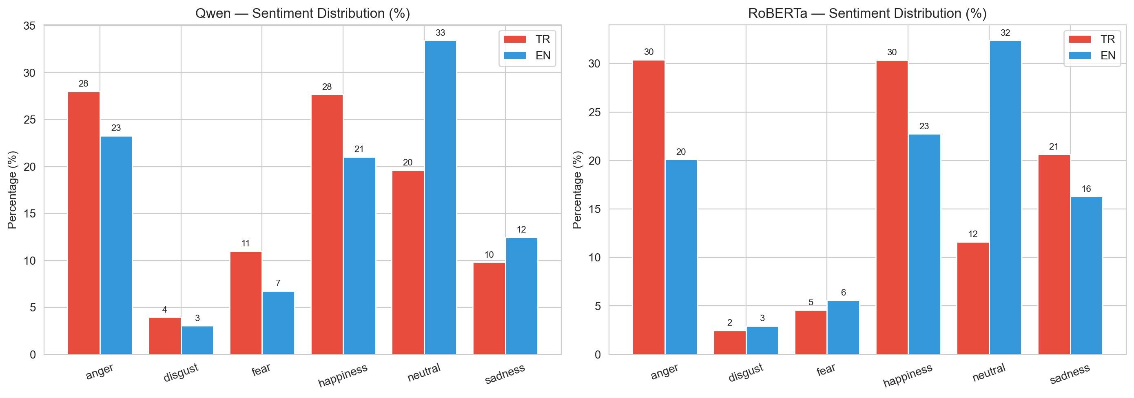
Analysis - 1
In Turkish reviews the anger and happiness classes have a higher share. In English reviews the neutral class is dominant.

Slide 19
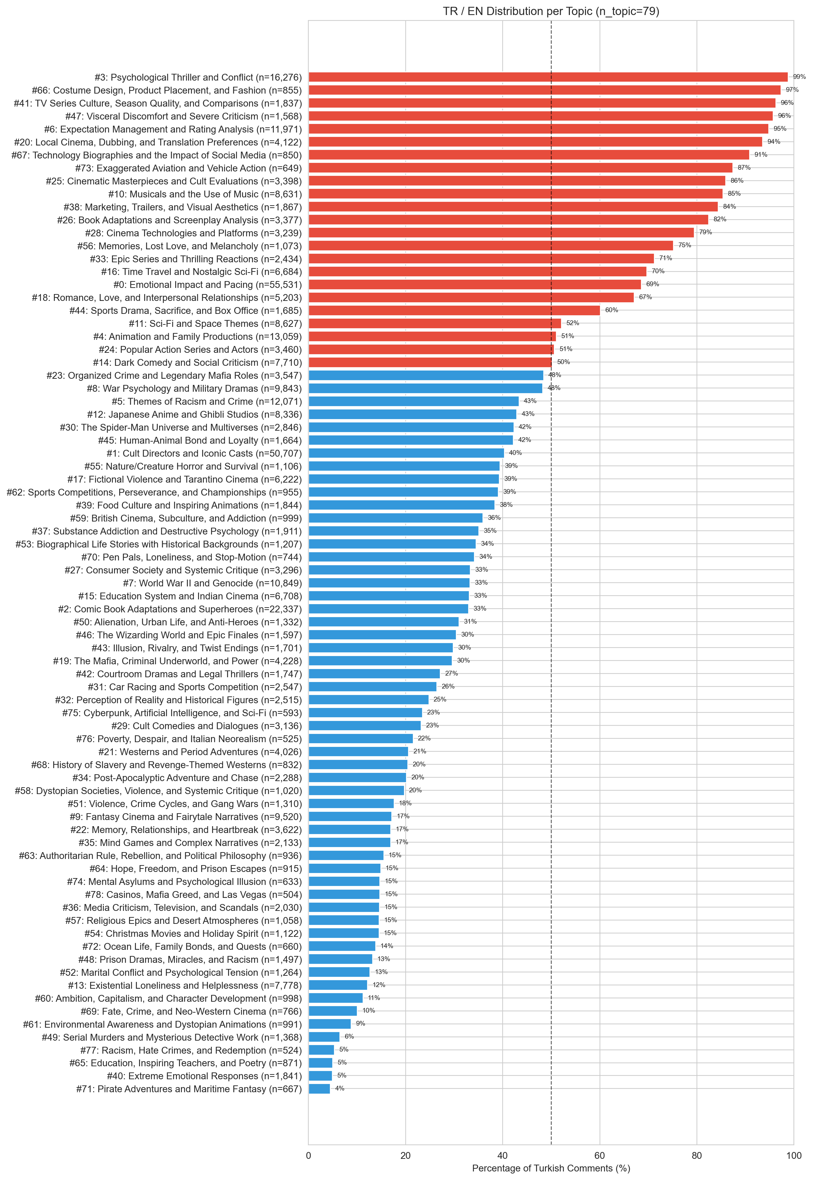
Analysis - 1

Slide 20
Analysis - 1
Category | Topic Count
Genre Related | 41
Social / Cultural Themes | 16
Cast / Cinematography / Technical Elements | 9
Audience Experience | 7
Psychological Themes | 6

Slide 21
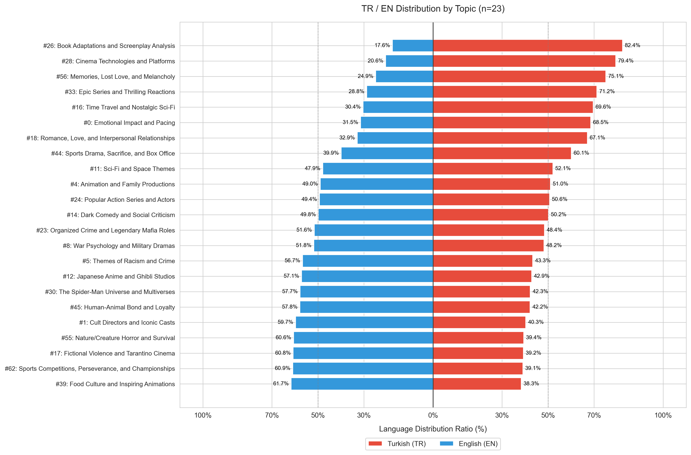
Analysis - 1
Topics were filtered to ensure a balanced TR-EN review distribution within each topic.

Slide 22
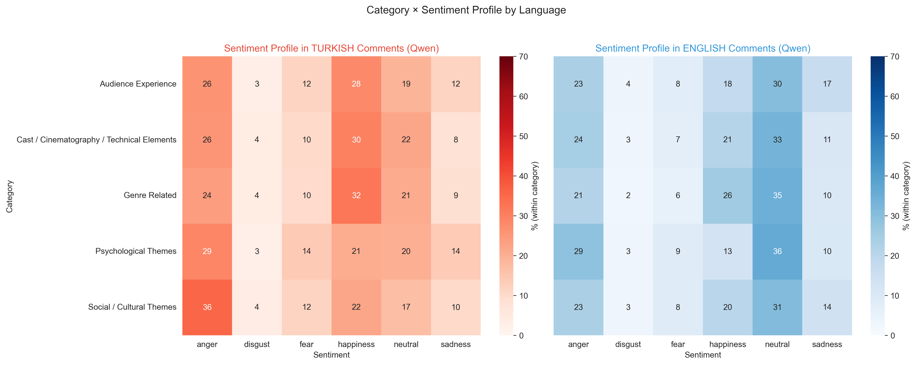
Analysis - 2

Slide 23
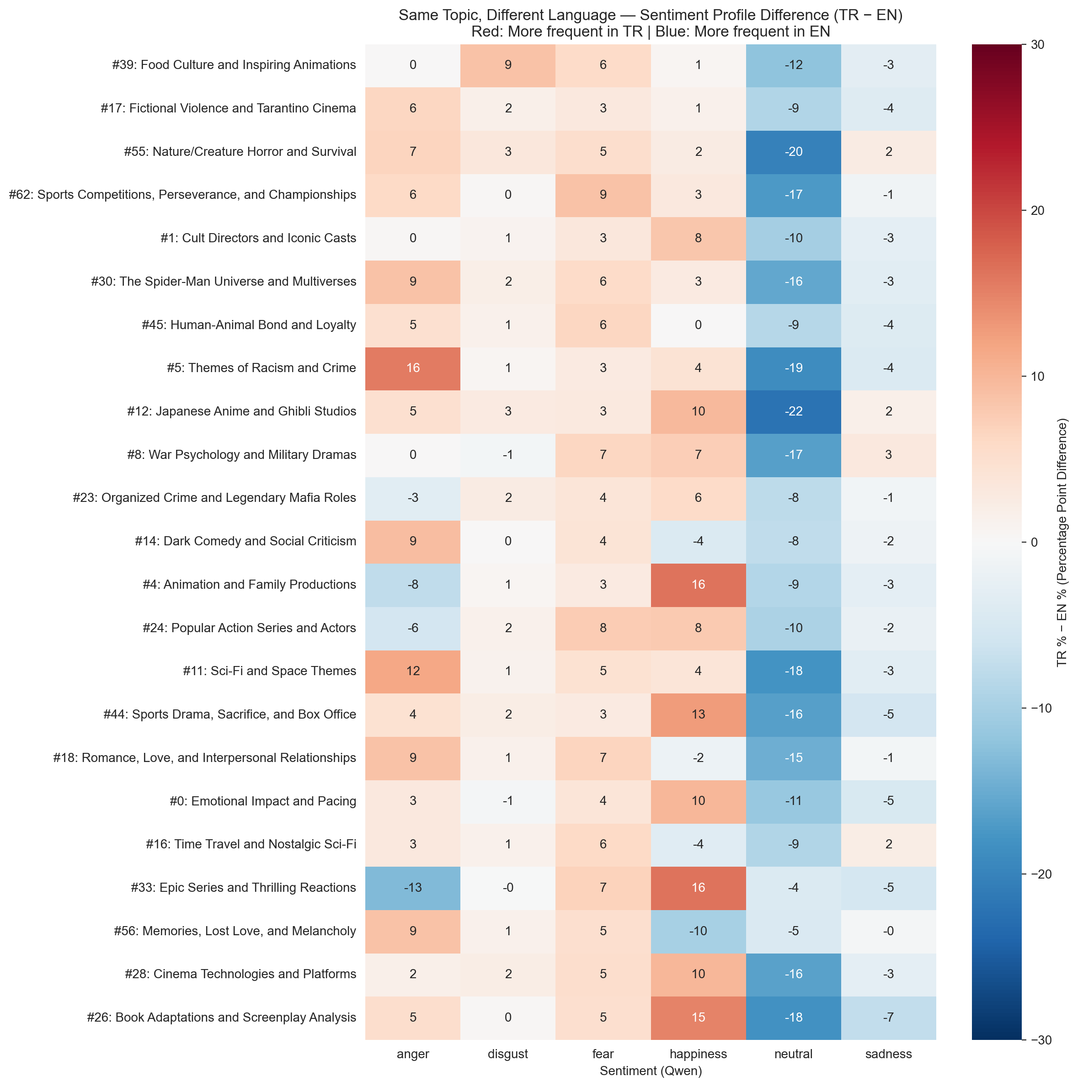
Analysis - 2
The language difference is not constant. It shifts direction according to each topic’s theme

Slide 24
Analysis - 3
Chi square test was performed on 211.223 reviews across 23 topics and 6 emotions. The p- value was below 0,001 so the independence hypothesis was rejected.
Metric | Value
Contingency Table Size | 23 x 6
Total observations | 211.223
X² | 7.648,39
df | 110
p-value | < 0,001
Cramer’s V | ≈0,085
Decision | H₀ rejected

Slide 25
Result
Success: What topics film viewers focus on the emotions related to those topics and the relationship between them were identified and statistically validated with a chi square test.
Limitation: Without a manually labeled movie review dataset, the models true performans could not be fully measured.
Future works: Domain specific fine-tuning with labeled movie reviews and automatic topic naming in BERTopic using an LLM.

Slide 26
Thanks for listening Melih Yelman – 21011702 Faruk Altun – 22011055 Project Advisor: Asst. Prof. Ayşe Öcal

