Slide 1





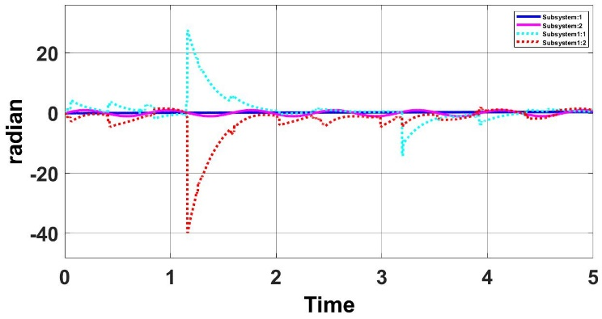
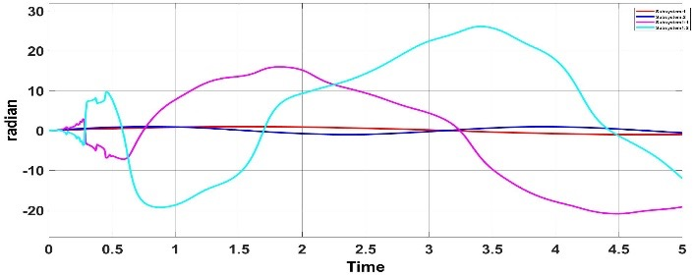
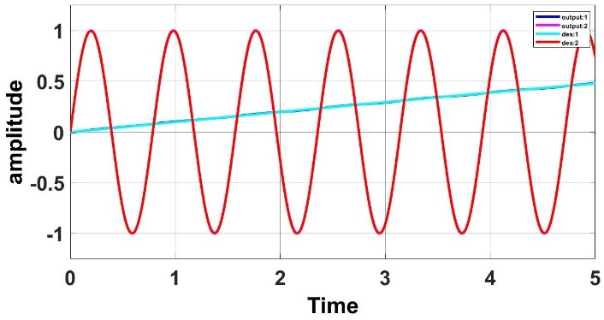
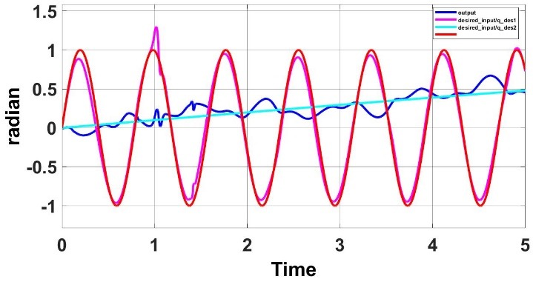
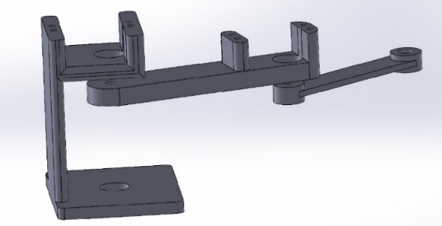
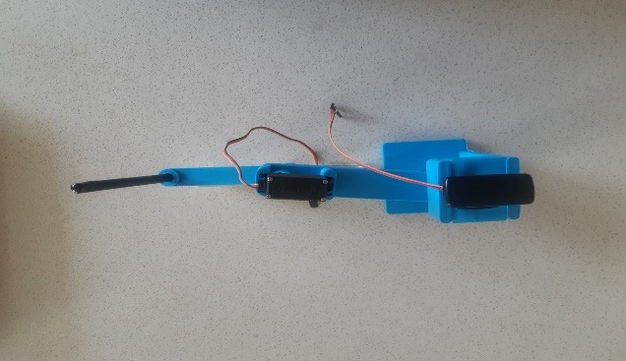
Utilizing Function Approximation Technique and Neural Network Controllers on a 2-DOF Painter Robot Melika Salehian, Mohammad Hosein Hadian, Iman Sharifi, Mohammad Bagher Menhaj Member of Electrical Engineering at Amirkabir University of Technology, Tehran, Iran, Member of Electrical Engineering at Amirkabir University of Technology, Tehran, Iran, Assistant Professor of Electrical Engineering at Amirkabir University of Technology, Tehran, Iran, Professor of Electrical Engineering, Amirkabir University of Technology, Tehran, Iran
2 0 2 2
The 10th RSI International Conference on Robotics and Mechatronics (ICRoM 2022)
15-18 November 2022, K. N. Toosi University of Technology.
Introduction
Nowadays, you cannot find a person who has not heard about robotics and their applications in industry as well as in our daily life. Therefore, it should not be surprising to hear that robots are being used in making arts and masterpieces. One example of its appliance is a painter robot, which is able to draw any desired shape. Hence, our goal was to test it out for ourselves, and see how it works. However, this time with new controllers that have not been used on a painter robot before. Two different controllers were considered for this project: a FAT-based adaptive controller and a neural network controller. Their mathematical equations were first driven then simulated and their results are shown. Later, the project was implemented with 3D printer.
Results
The experiment was a success and the robot was able to track its desired input and make the drawing with minor errors. As they are shown in figure(3) and figure(4), the controllers were tuned to track better in comparison to what they were in [1] and [2].
Conclusions
In spite of other classic controllers, FAT-based adaptive controller, not only does not need any calculation for regressor matrix, but also it does not require acceleration feedback. This is one of the advantages that this controller has over the others since the acceleration sensors are expensive. Furthermore, the neural network controller
In conclusion, both controllers showed incredible performances which were not seen before. The FAT-based adaptive controller, however, had some setbacks while following its trajectory in a wider range of frequencies. On the contrary, the neural network controller was able to pull off without any mistakes even in a large range of frequencies.
Moreover, one of the significant issues that is suggested for future research in this area, is to transfer a real image to the painter robot. Then, by the help of inverse kinematic, the desired joint trajectories would be obtained; so, the picture which would be drawn by the robot will be exactly the same as it was received first.
Materials and Methods
Two degree of freedom (2-DOF) robot is used in designing the system. The end of the second link will be considered as end-effector (EE). For this robot, the links were designed in a way to be identical to each other in the best way possible, so that the utmost usage of work space can be utilized. However, the second link was considered a little bit shorter, in order to prevent weighting problems from happening. Therefore, the robot will not be pulled down by gravity force. The first motor will be located on the top of the base. There will be one bearing drilled in the upper part in order to move the link and Motor simultaneously. The second motor, will be placed on the top of the second link. Motors which were used in this design are MG996R, and their range is ±180 degree.
Fig 3. Comparison between neural network controller’s output
Fig 4. Comparison between FAT controller’s output
Furthermore, it is shown in figure(5) that neural network controller can work more efficiently in a wide range of frequencies, on the other hand, function approximation technique controller would lose its ability to follow accurately as it is shown in figure(6). which is the main reason that we decided to use this controller even though we have to pay the price for it, since its implementation is expensive, but the benefits outweigh its costs
Literature cited
[1] A.C.Huang, S.C.Wu, W.F.Ting “A FAT-based adaptive controller for robot manipulator without regressor matrix: theory and experiments” March 2006, pp205-210
[2] K.Qian ”Neural Network controller for Manipulator”. MMAE540 Robotics- Class Project Paper. Department of Biomedical Engineering, Illinois Institute of Technology, Chicago, IL 60616 USA
[3] Mohammad Bagher Menhaj, “Adaptive Control Systems”
Fig 5. Desired input and output with 0.1, 8 rad/s frequencies for neural network controller
Fig 6. Desired input and output with 0.1, 8 rad/s frequencies for function approximation technique
There are several ways to improve the function approximation technique’s ability to track better, and one of them is to increase the number of Fourier estimation series sample in basis vector. However, there is trade-off , and by increasing , they system will lose its pace . The same thing can be applied for neural network controller. By increasing its hidden layer nodes, you would be able to achieve even more accurate system, nonetheless, the system would be more expensive and would not work properly in real time.
Fig 1. Solidwork structure design
Fig 2. The implementation of the Solidwork structure design with 3D printer
Submission ID: 57054X
Corresponding Author’s email: mh7mbb1130@aut.ac.ir , electing@aut.ac.ir , menhaj@aut.ac.ir , imansharifi@aut.ac.ir

